Slide 1
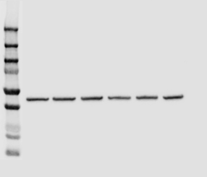
Figure 5A
CD19- 95 kDa
p-ERK- 42,44 kDa
Total ERK- 42,44 kDa
p-BTK- 78 kDa
Trametinib 1.0um
Trametinib 1.0um
Ibrutinib 1.0um
Ibrutinib 1.0um
Ibrutinib 1.0um
Trametinib 1.0um
Trametinib 1.0um
Ibrutinib 1.0um
Control
Control
Control
Control
Trametinib 1.0um
Trametinib 1.0um
Trametinib 1.0um
Trametinib 1.0um
Control
Ibrutinib 1.0um
Ibrutinib 1.0um
Ibrutinib 1.0um
Ibrutinib 1.0um
Control
Control
Control
Raji Control
Raji CD19 KO
Raji Control
Raji CD19 KO
Raji Control
Raji CD19 KO
Raji Control
Raji CD19 KO
Total BTK- 77 kDa
Actin-42 kDa
Trametinib 1.0um
Trametinib 1.0um
Ibrutinib 1.0um
Control
Ibrutinib 1.0um
Control
Trametinib 1.0um
Ibrutinib 1.0um
Ibrutinib 1.0um
Trametinib 1.0um
Control
Control
Raji Control
Raji CD19 KO
Raji Control
Raji CD19 KO

Slide 2
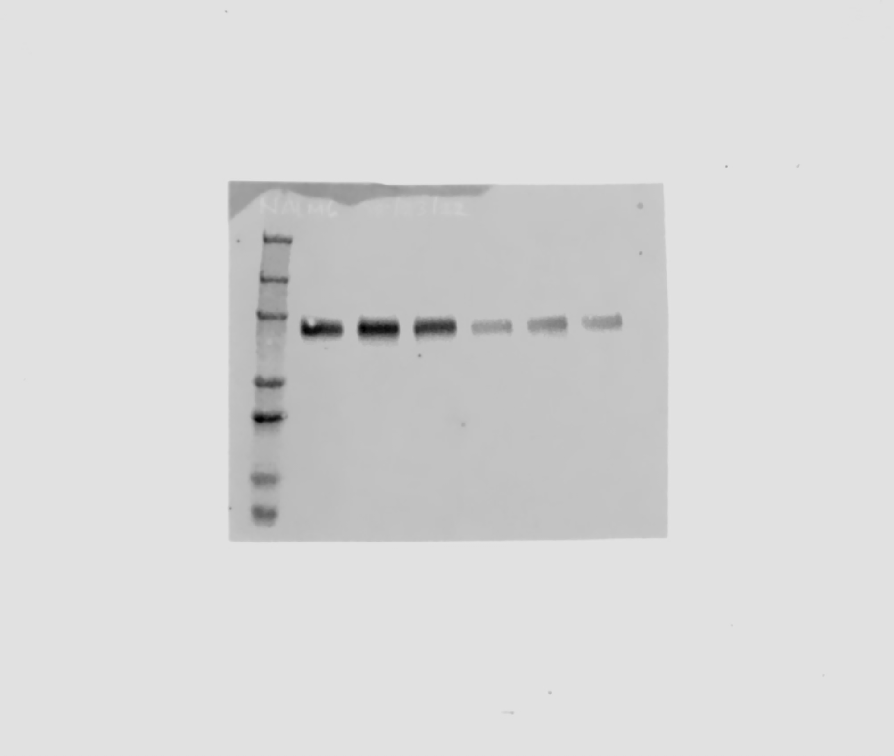
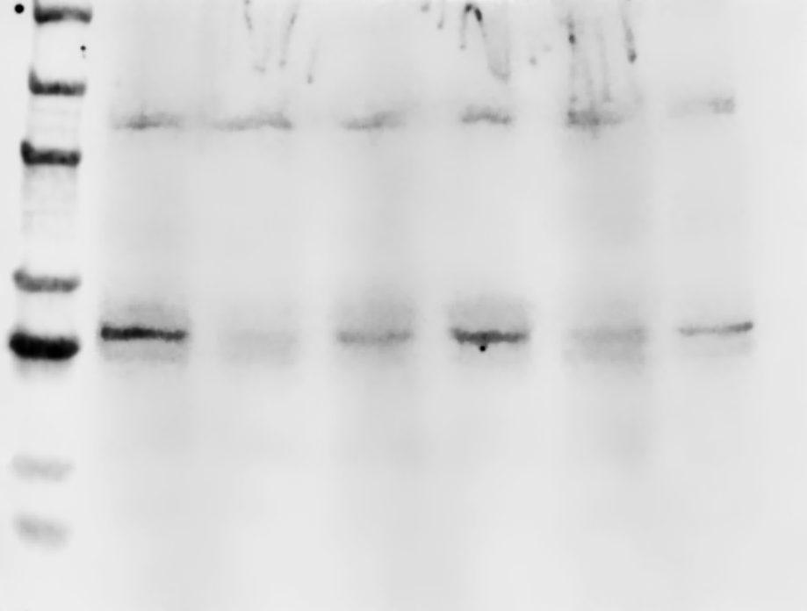
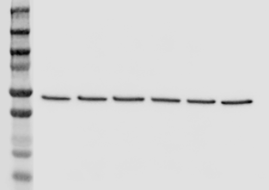
Figure 5B
CD19- 95 kDa
p-ERK- 42,44 kDa
Total ERK- 42,44 kDa
Trametinib 1.0um
Ibrutinib 1.0um
Ibrutinib 1.0um
Trametinib 1.0um
Control
Control
Trametinib 1.0um
Ibrutinib 1.0um
Trametinib 1.0um
Ibrutinib 1.0um
Trametinib 1.0um
Ibrutinib 1.0um
Trametinib 1.0um
Ibrutinib 1.0um
Control
Control
Control
Control
Nalm6-Parental
Nalm6-Resistant
Nalm6-Parental
Nalm6-Resistant
Nalm6-Parental
Nalm6-Resistant
p-BTK- 78 kDa
Total BTK- 77 kDa
Actin-42 kDa
Trametinib 1.0um
Ibrutinib 1.0um
Ibrutinib 1.0um
Trametinib 1.0um
Trametinib 1.0um
Ibrutinib 1.0um
Ibrutinib 1.0um
Trametinib 1.0um
Control
Control
Trametinib 1.0um
Ibrutinib 1.0um
Control
Control
Ibrutinib 1.0um
Trametinib 1.0um
Control
Control
Nalm6-Parental
Nalm6-Resistant
Nalm6-Parental
Nalm6-Resistant
Nalm6-Parental
Nalm6-Resistant

