Slide 1
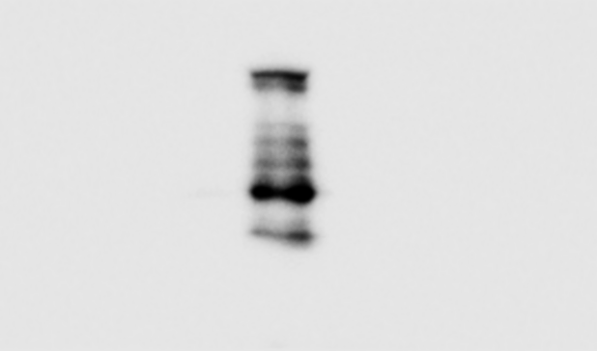
Tiago et al. (Whole Blots, Figures)
Western blot (whole blots):
A
Figure 2A:
1205LuTR-NR2F1-WT
WM793TR-NR2F1-WT
A375TR-
NR2F1-WT
NR2F1
Vinculin
B
Figure 3B:
1205LuTR-NR2F1-WT
NR2F1
Vinculin

Slide 2


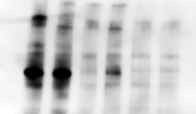
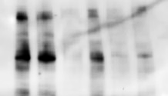
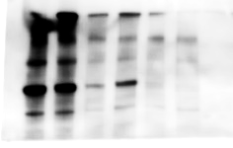
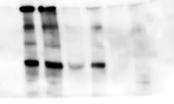
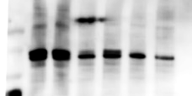
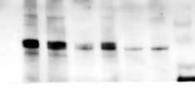
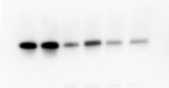
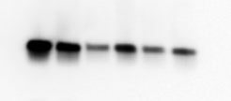
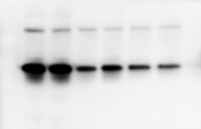
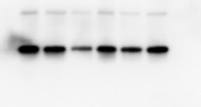
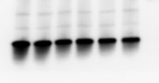
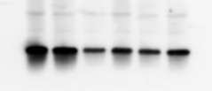
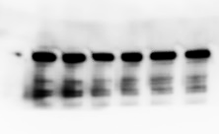
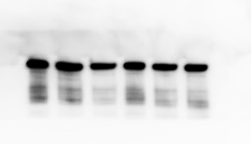
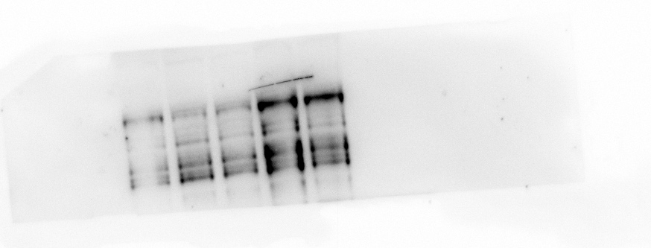


Tiago et al. (Whole Blots, Figures)
C
Figure 4D:
1205LuTR-
NR2F1
WM793TR-
NR2F1
A375R-
NR2F1
NR2F1
FOXM1
RB (pS780)
RB (pS807/811)
RB
S6 (pS235/236)
S6 (pS240/244)
S6
Vinculin
D
E
Figure 6A:
Figure 6C:
Ctrl
Young
Aged
YUMM1.7TR
NR2F1
NR2F1
HSP90
HSP90

Slide 3
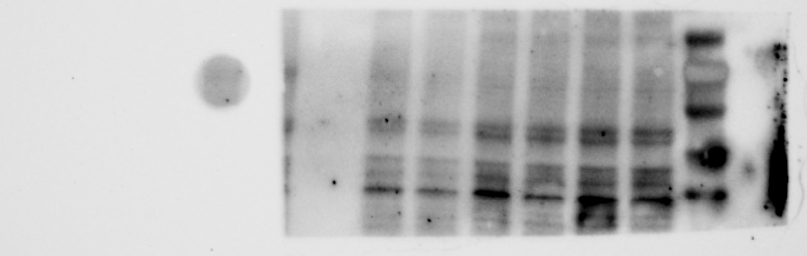
F
Supplemental Figure S1G:
NR2F1
HSP90

Slide 4
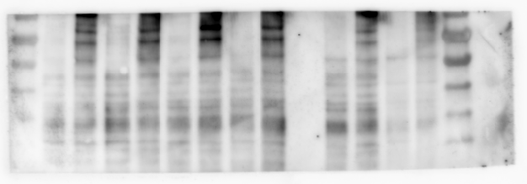
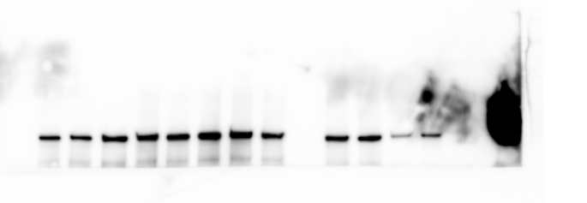







Tiago et al. (Whole Blots, Supplemental Figures)
G
Supplemental Figure S2A:
1205LuTR-LacZ
Beta-galactosidase
Vinculin
NR2F1
Vinculin
H
Supplemental Figure S4A:
1205LuTR-NR2F1
WM793TR-NR2F1
NR2F1
p-ERK1/2
ERK2
p21
Cyclin B1
Cleaved-PARP
Vinculin

Slide 5
Tiago et al. (Whole Blots, Supplemental Figures)
I
Supplemental Figure S4B:
1205LuTR-NR2F1
WM793TR-NR2F1
A375TR-NR2F1
NR2F1
p-RB (S807/811)
RB1
p-RB (S780)
GAPDH
J
Supplemental Figure S4C:
BRAF-mut
NRAS-mut
NR2F1
NR2F1
(long exposure)
HSP90

Slide 6
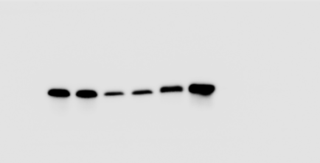
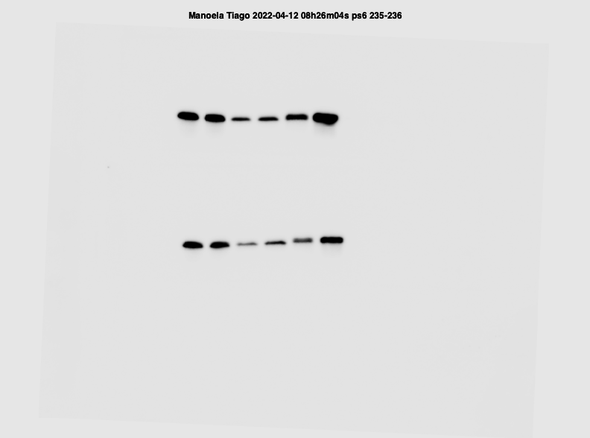
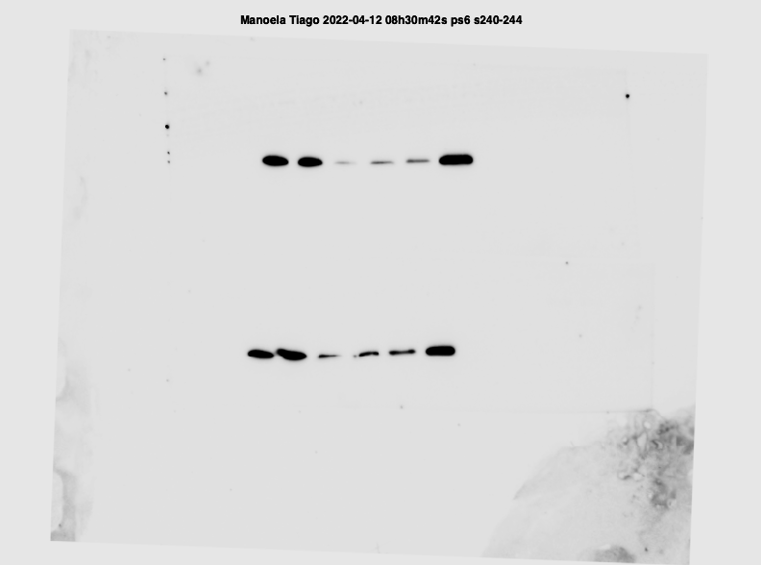
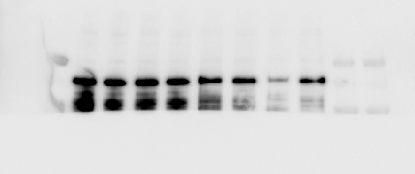
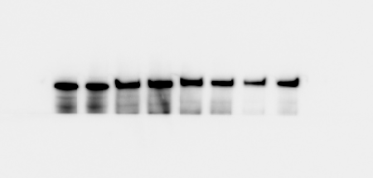
Tiago et al. (Whole Blots, Supplemental Figures)
K
Supplemental Figure S5A:
1205LuTR-NR2F1
WM793TR-NR2F1
p-S6 (S235/236)
p-S6 (240/244)
Vinculin
L
Supplemental Figure S6A:
YUMM1.7 xenografts
NR2F1
HSP90

