Slide 1
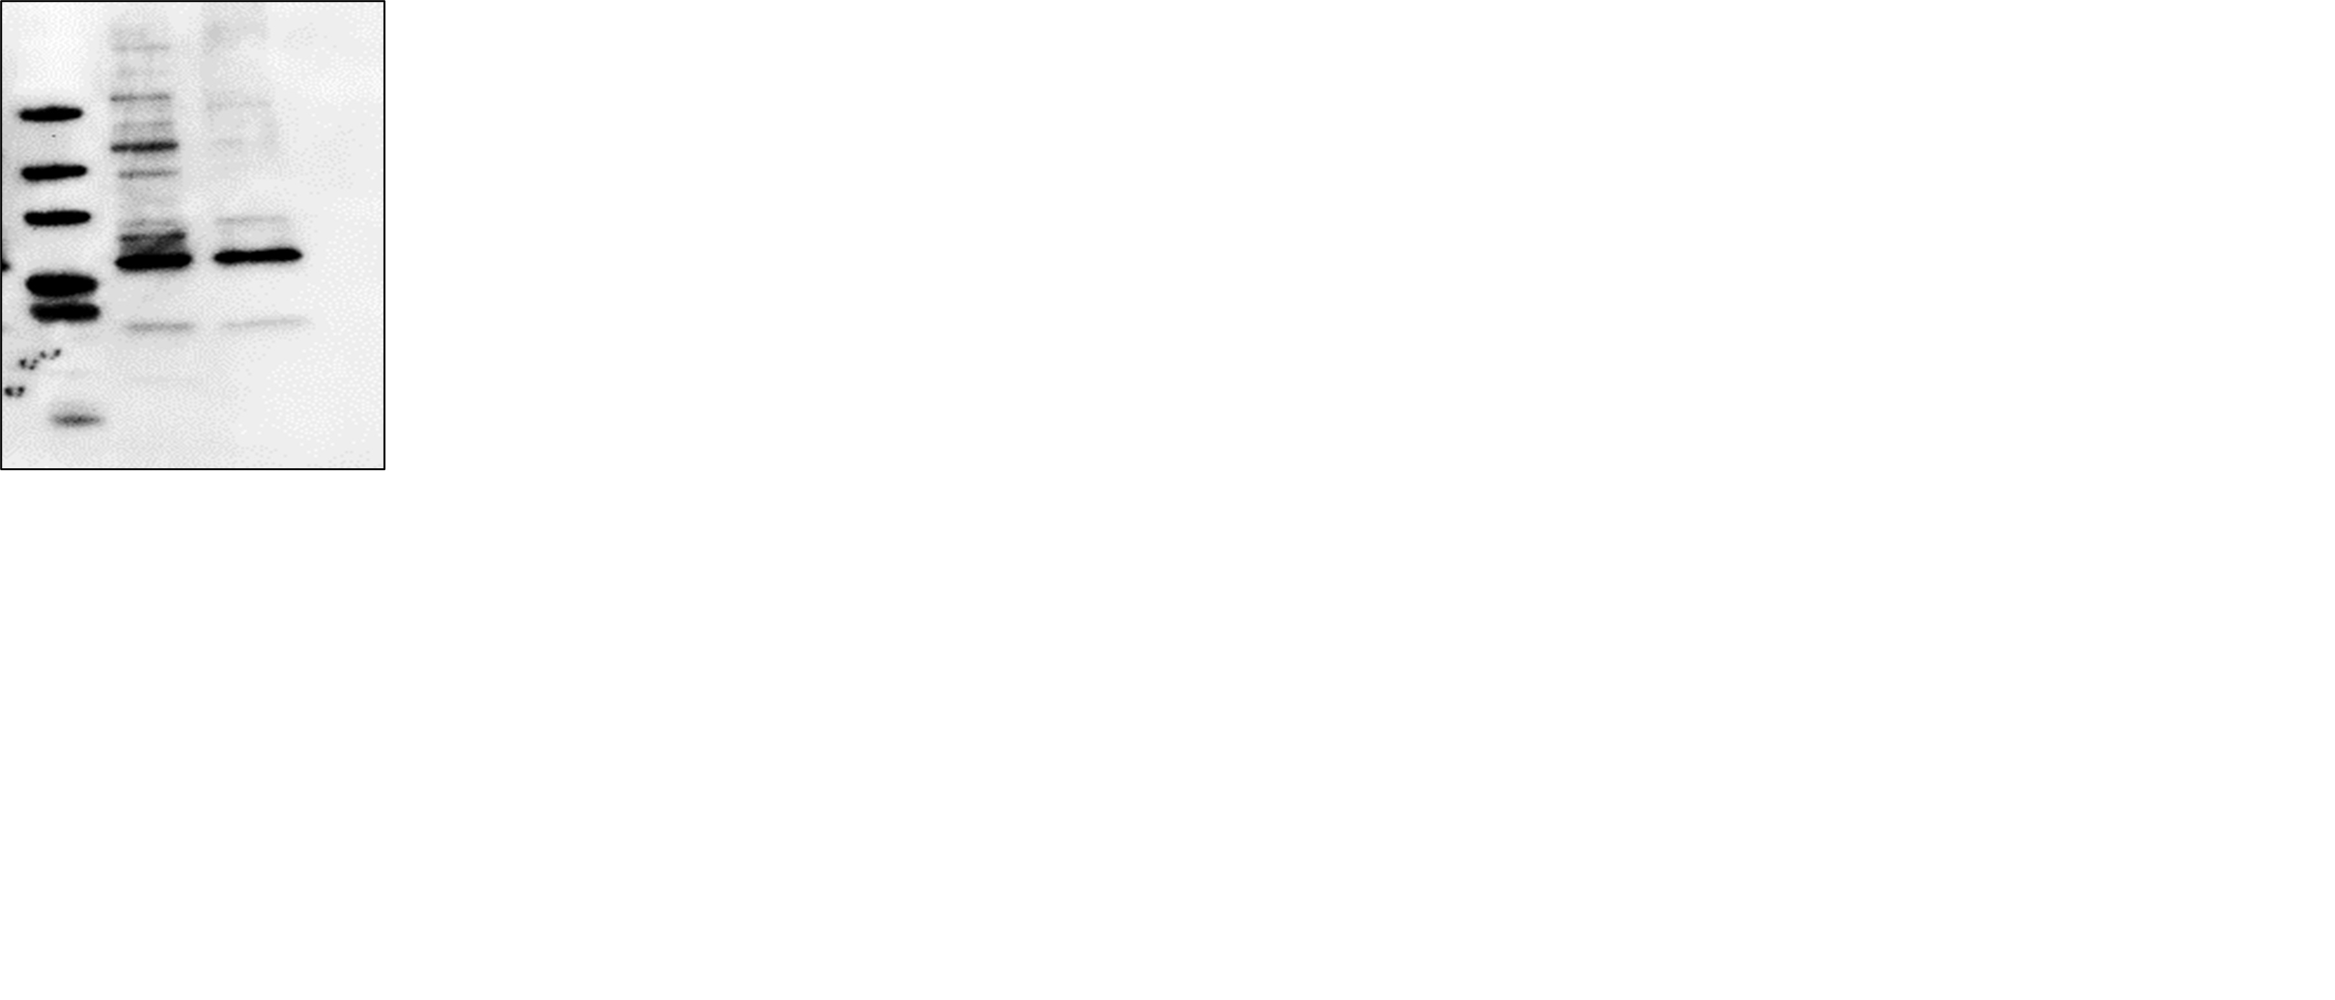
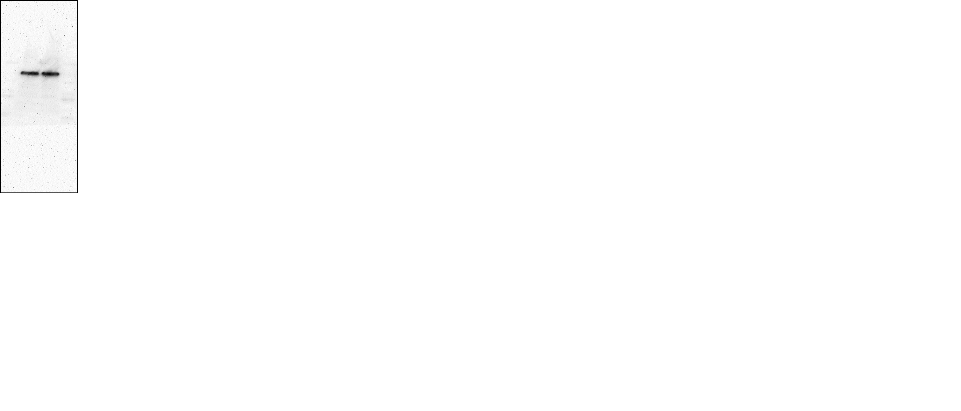
Fig. 6 E
Rabbit
ENT1
ab135756
Mouse Tubulin
ab7291

Slide 2
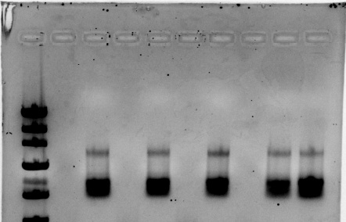
Supplemental Fig. 1B
Semi Quantitative PCR 8-31-2017
Days post confluence
-4
-2
0
3
6
2000 bp
1200 bp
800 bp
ENT1 (722bp)
GAPDH (635bp)

Slide 3
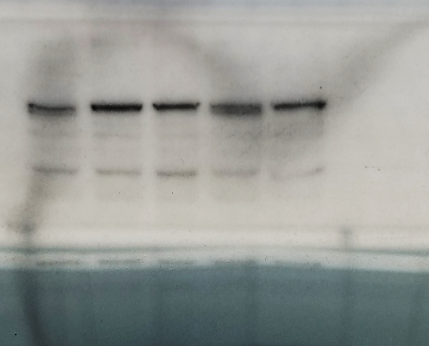


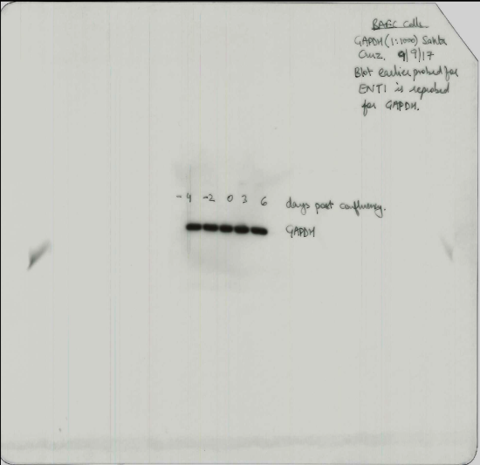
Supplemental Fig. 1B
ENT1 Raw Data 9-08-2017
Days post confluence
-4 -2 0 +3 +6
ENT1 (55Kda)
GAPDH(37Kda)
GAPDH Raw Data 9-9-2017

