Slide 1
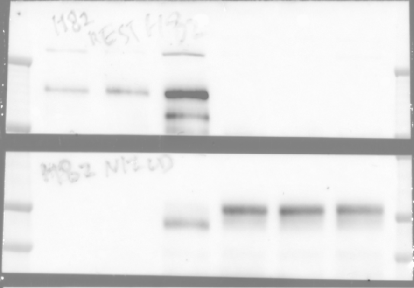
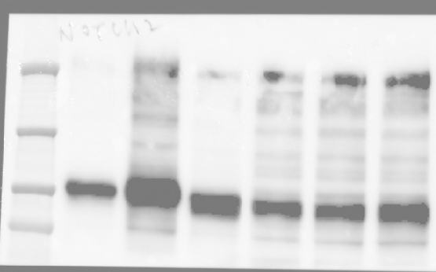
Full unedited image for Figure 4D
REST
N1ICD
NOTCH2
AXL
a-tubulin
a-tubulin
(light exposure)

Slide 2
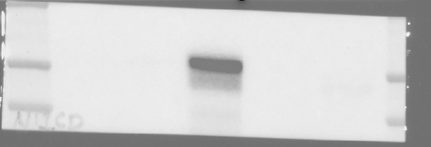
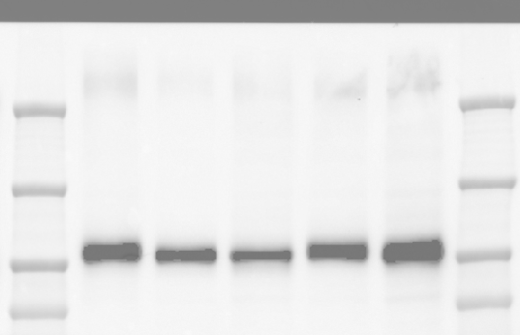
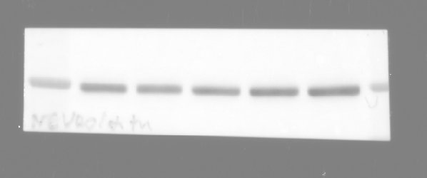
Full unedited image for Figure 4F
N1ICD
REST
NOTCH2
AXL
a-tubulin

Slide 3
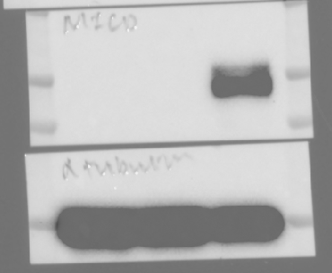
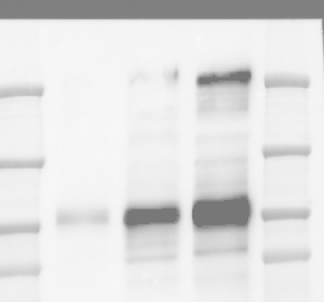
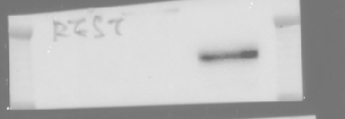
Full unedited image for Figure 4H
N1ICD
a-tubulin
NOTCH2
a-tubulin
(light exposure)
REST
AXL
VIM

Slide 4
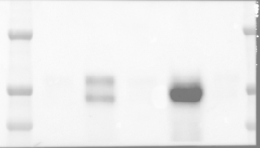
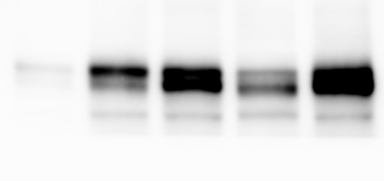
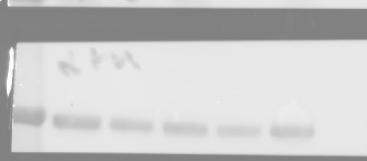
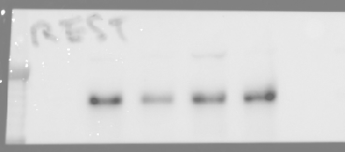
Full unedited image for Figure 4J
N1ICD
NOTCH2
REST
a-tubulin
AXL

Slide 5
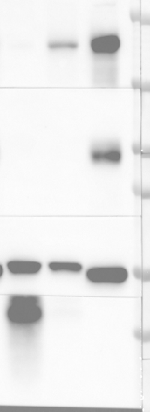
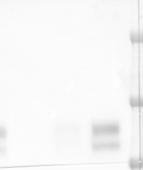
Full unedited image for Figure 4N
REST
NOTCH2
N1ICD
a-tubulin
NEUROD1
SYP
AXL

Slide 6
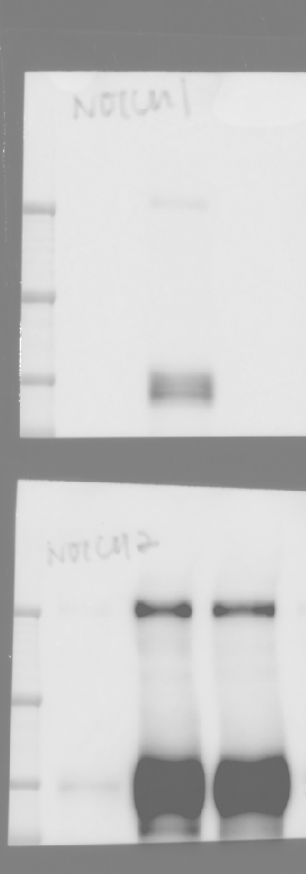
Full unedited image for Figure 6A
Rest
a-tubulin
Ascl1
Notch1
N1icd
Insm1
Notch2
Vim

Slide 7
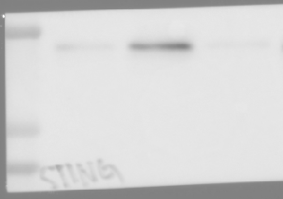
Full unedited image for Figure 7A, C, D, F
STING
STING
STING
a-tubulin
a-tubulin
a-tubulin
Figure 7A
Figure 7C
Figure 7D
STING
a-tubulin
Figure 7F

Slide 8
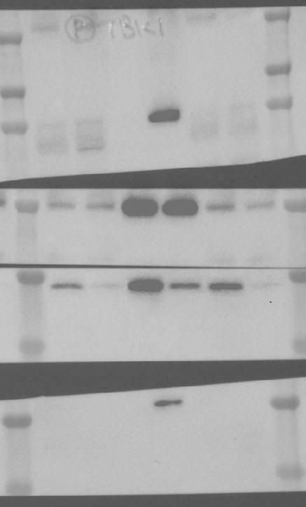
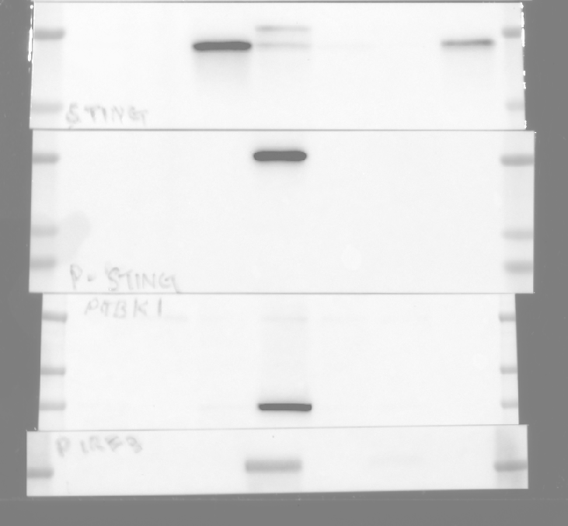
Full unedited image for Figure 7J
STING
p-TBK1
(Ser172)
p-STING
(Ser366)
TBK1
STING
p-TBK1
(Ser172)
p-IRF3
(Ser396)
p-STING
(Ser366)
IRF3
p-IRF3
(Ser396)
TBK1
IRF3
a-tubulin
a-tubulin
COR-L88
KP1

Slide 9
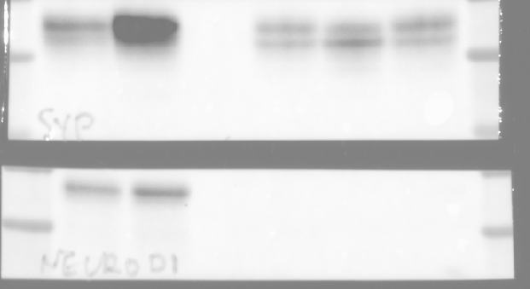
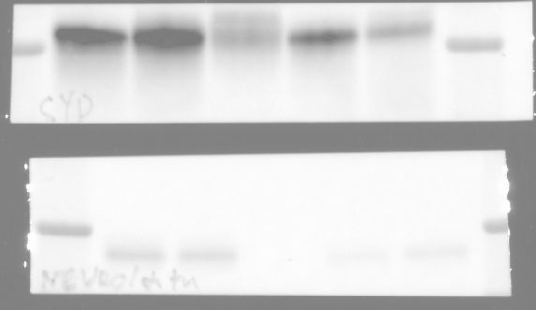
Full unedited image for Supplemental Figure 6B_1
SYP
SYP
NEUROD1
NEUROD1
NEUROD1
(dark exposure)
a-tubulin
a-tubulin
(light exposure)
a-tubulin
H82
H524

Slide 10
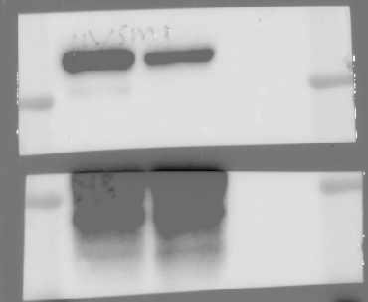
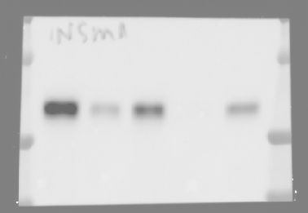
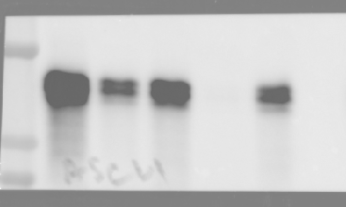
Full unedited image for Supplemental Figure 6B_2
INSM1
INSM1
SYP
ASCL1
a-tubulin
a-tubulin
(light exposure)
a-tubulin
H69
COR-L88

Slide 11
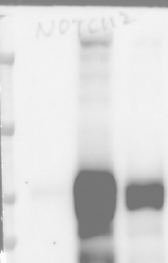
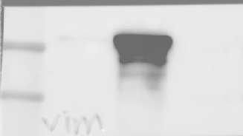
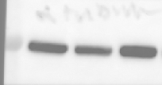
Full unedited image for Supplemental Figure 9A, E
Rest
Notch2
N1icd
Notch2
(light exposure)
Recombined Rb1 (left)
Vim
a-tubulin
Recombined Trp53 (right)
Figure S9A
Figure S9E

Slide 12
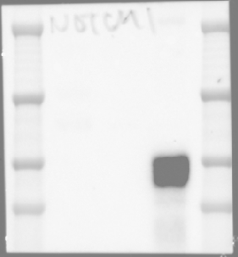
Full unedited image for Supplemental Figure 9G, J
N1ICD
(light exposure)
Notch1
N1ICD
(normal exposure)
a-tubulin
a-tubulin
a-tubulin
(light exposure)
Figure S9G
Figure S9J

Slide 13
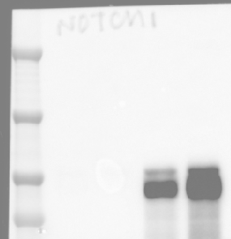
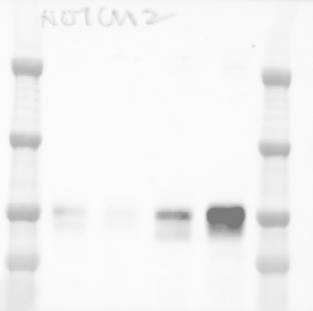
Full unedited image for Supplemental Figure 10E, F
VIM
NOTCH1
NOTCH2
a-tubulin
a-tubulin
a-tubulin
Figure S10E
Figure S10F

Slide 14
Full unedited image for Supplemental Figure 10H
STING
a-tubulin
H82
STING
a-tubulin
COR-L88

Slide 15
Full unedited image for Supplemental Figure 11B
STING
(light exposure)
STING
(dark exposure)
a-tubulin
KP1

Slide 16
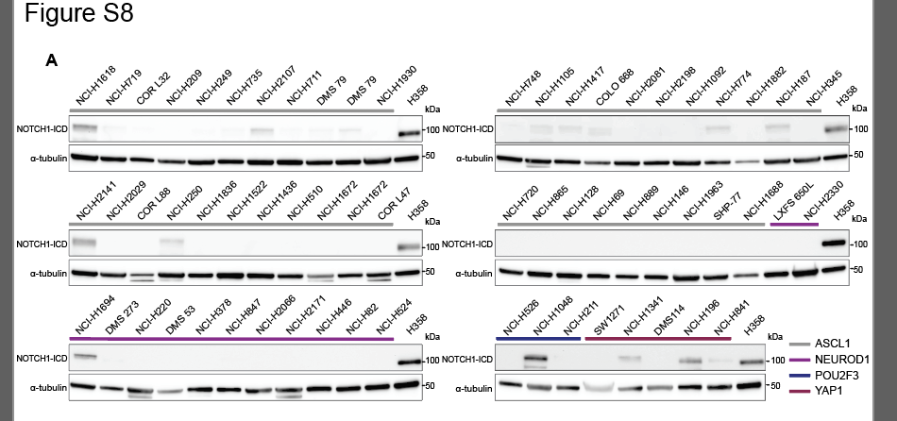
Full unedited image for Supplemental Figure 12
GEL1 NOTCH1-ICD
GEL4 a-tubulin
GEL1 a-tubulin
GEL5 a-tubulin
GEL2 NOTCH1-ICD
GEL6 a-tubulin
GEL2 a-tubulin
GEL3 NOTCH1-ICD
Supplemental Figure 12
GEL3 a-tubulin
GEL1
GEL2
GEL4 NOTCH1-ICD
GEL3
GEL4
GEL5 NOTCH1-ICD
GEL5
GEL6
GEL6 NOTCH1-ICD

