Slide 1
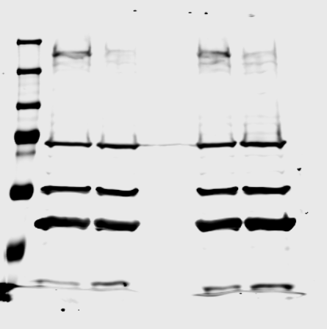
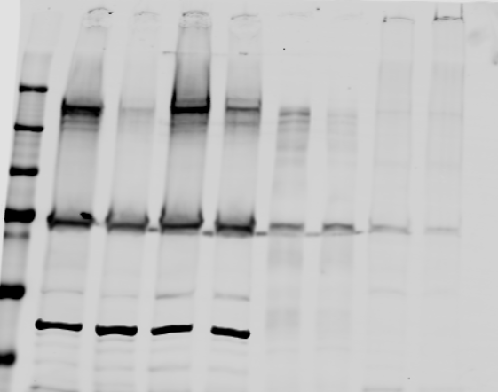
Full unedited blot for Figure 2A
RAW 264.7
shC
shGIV
THP-1 NFkB reporter line
Full unedited blot for Figure 2D
WT
KO
250
150
ABT80
100
75
50
37
Tubulin
Full unedited blot for Figure 2J
THP-1 cells
WT
KO
250
ABT80
150
100
75
50
B-actin
37

Slide 2
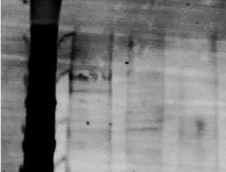
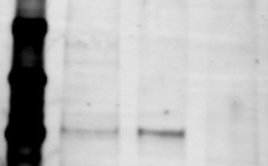
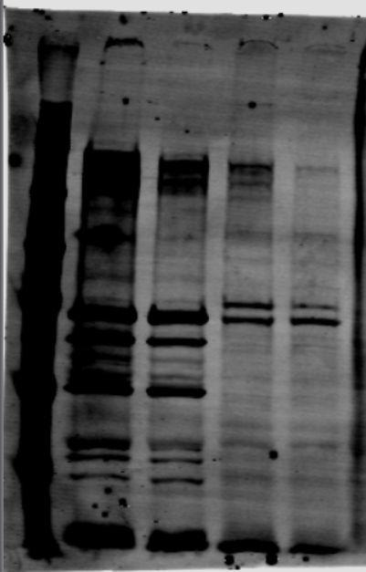
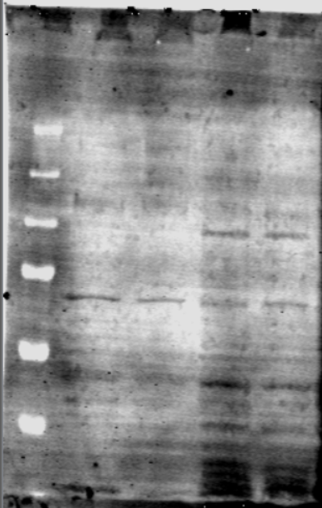
Full unedited blot for Figure 7B
Anti-
NOD2
IgG
control
WT
KO
WT
250
150
GIV
Immunoprecipitates
100
75
Immunoprecipitates
150
100
NOD2
WT
KO
GIV
Lysates
NOD2

Slide 3
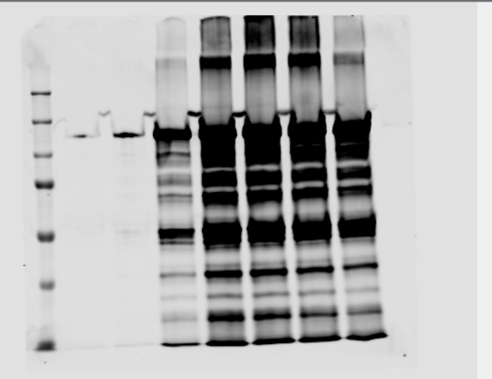
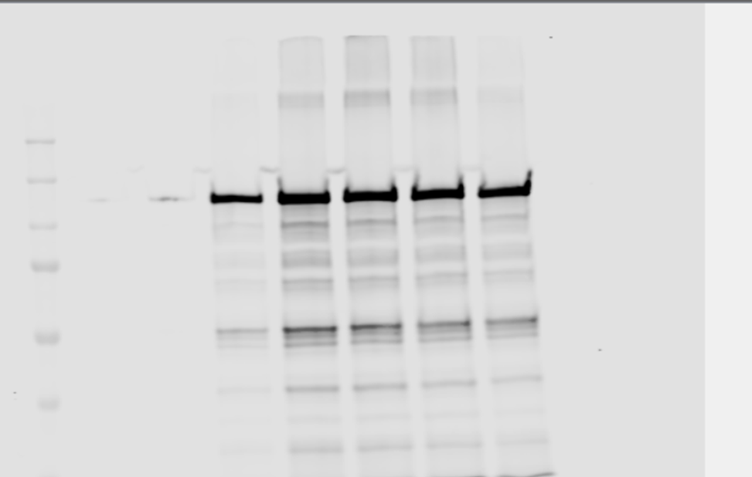
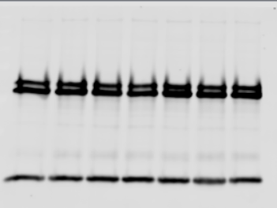
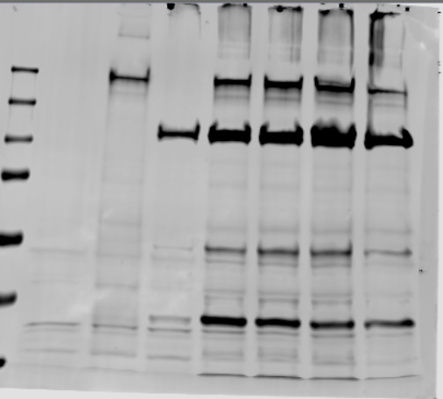
Full unedited blot for
Figure 7G
IP: anti-FLAG (GIV)
250
FLAG(GIV)
150
100
75
Immunoprecipitates
50
37
250
HA(NOD2)
150
100
75
Immunoprecipitates
50
37
75
50
IgG
Immunoprecipitates
37
25
250
FLAG(GIV)
150
100
Inputs
75
HA(NOD2)
50
37
25

Slide 4
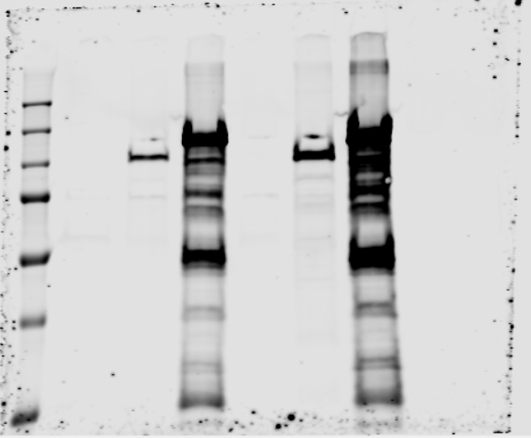
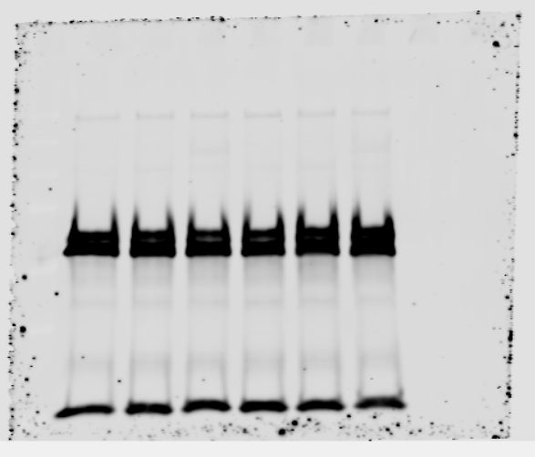
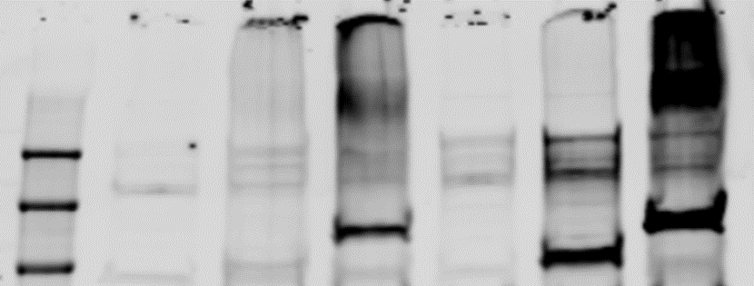
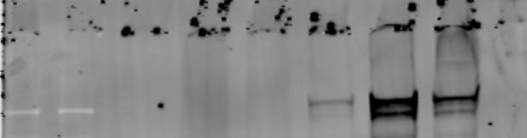
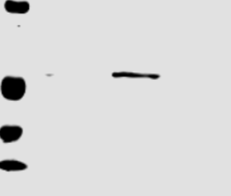
Full unedited blot for Figure 8C
250
GIV(FLAG)
150
100
75
IP: anti-HA
50
37
250
150
100
75
IP: anti-HA
IgG
50
37
250
150
HA (NOD2)
Inputs
100
250
FLAG (GIV)
150
Full unedited blot for Figure 8G
GST-NOD2-LRR
37
25
GIV-CT
(His)
20
15

Slide 5
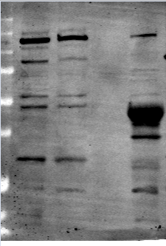
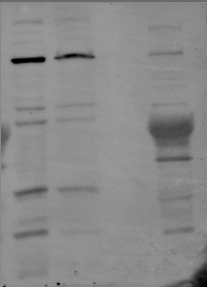
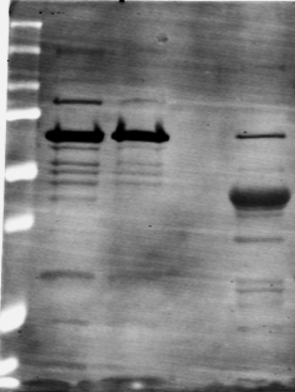
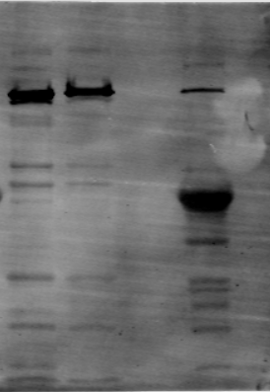
Full unedited blot for Figure 8F
GST-GIV-CT pulldown with myc-bound
recombinant NOD2-domains
Bound
Bound
GST GIV CT
GST GIV CT
Inputs
GST
Inputs
GST
250
100
myc FL
myc △ LRR
50
25
Bound
Bound
250
100
50
myc △ NBD
myc △CARD
25

Slide 6
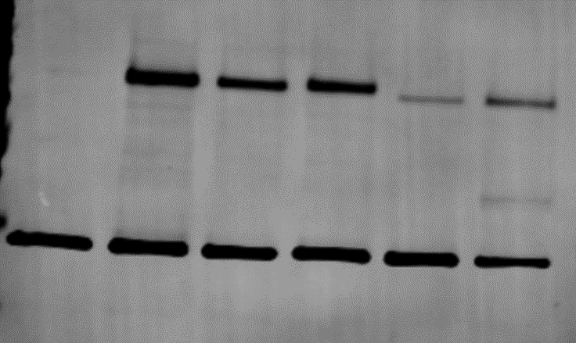
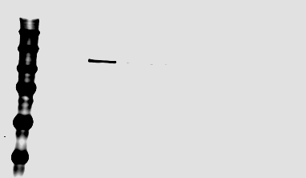
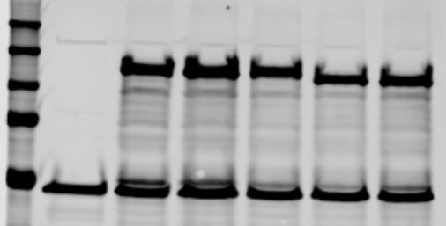
Full unedited blot for Figure 8I
GST-GIV-CT pulldown with lysates of HEK293T
250
150
NOD2
(HA mAb)
100
GST Pulldown
75
50
GIV-CT
(GST pAb)
250
150
NOD2
(HA mAb)
100
GST Pulldown
75
50
250
150
HA mAb
(NOD2)
Inputs
100
75
50
GIV-CT
(GST pAb)

Slide 7
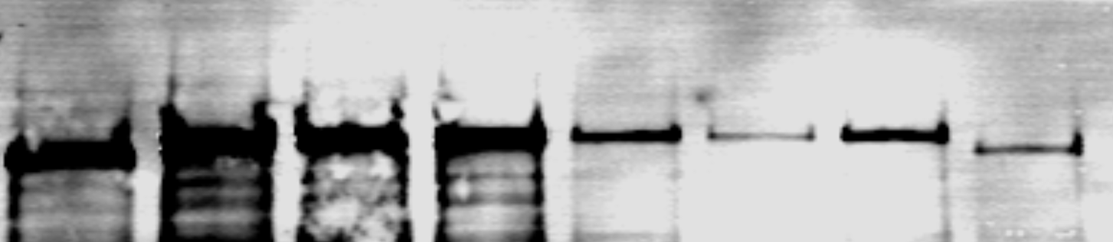
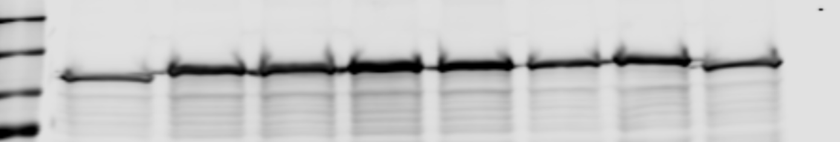
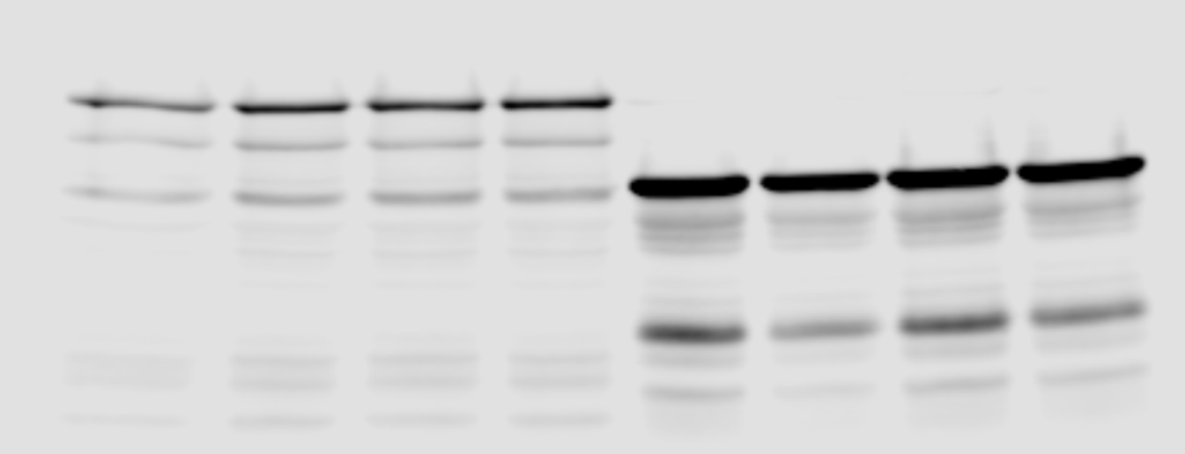
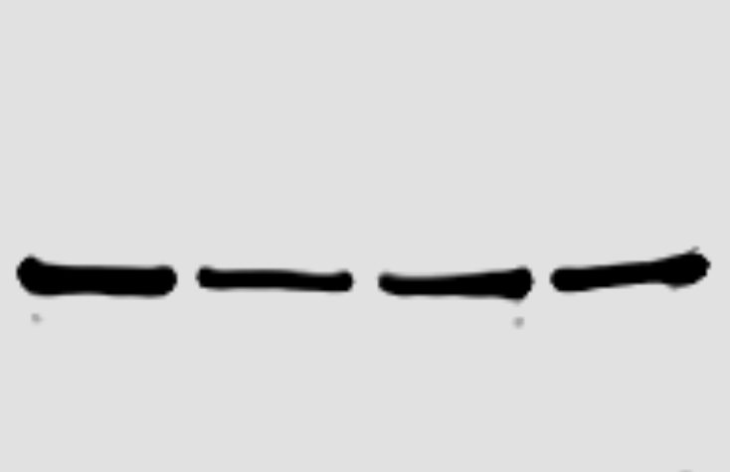
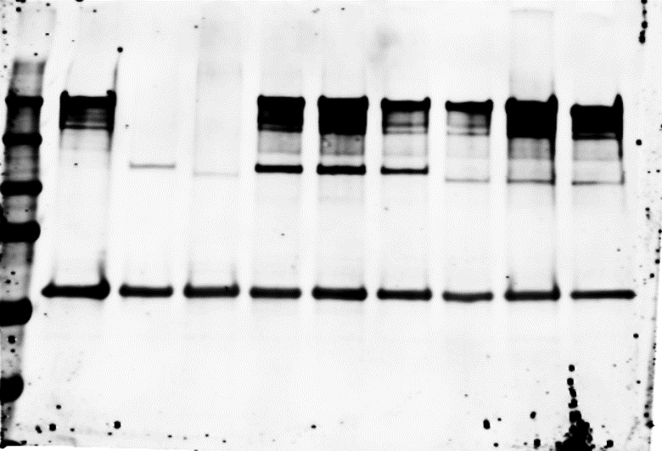
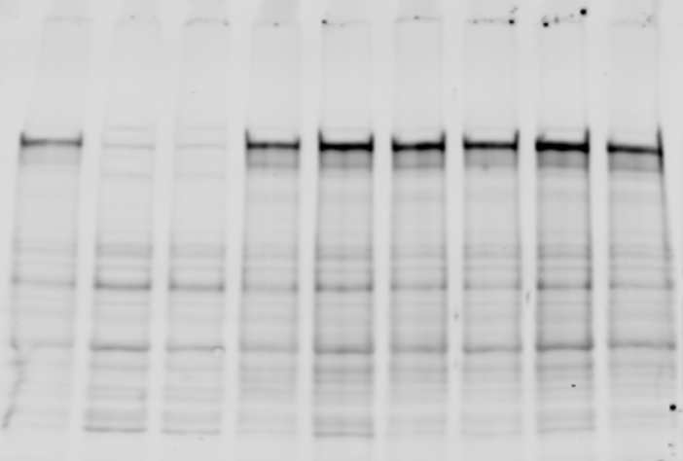
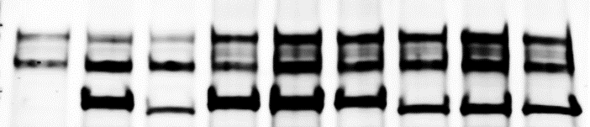
Full unedited blot for Figure 9C
IB:
150
HA(NOD2)
250
100
150
HA(NOD2)
100
GST-Pulldown
Inputs
75
50
GST GIV CT
50
GST GIV CT
37
Full unedited blot for Figure 9D
250
150
100
FLAG (GIV)
Immunoprecipitates
(Anti-FLAG)
250
75
150
50
Inputs
FLAG(GIV)
37
250
150
250
100
HA (NOD2)
75
Inputs
150
Immunoprecipitates
(Anti-FLAG)
50
100
HA(NOD2)
37

Slide 8
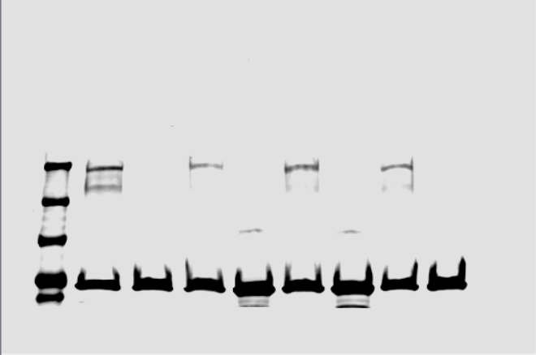
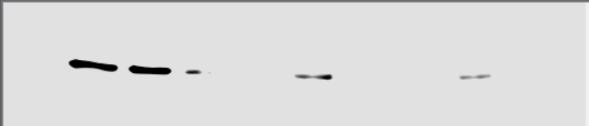
Full unedited blot for Supplementary Figure 1B
250
150
GIV CC
75
37
Tubulin

Slide 9
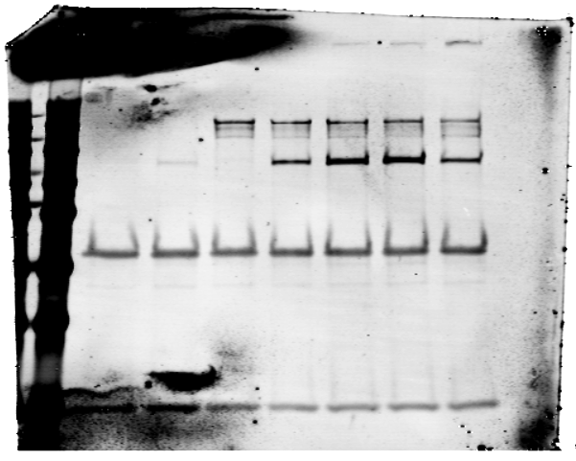
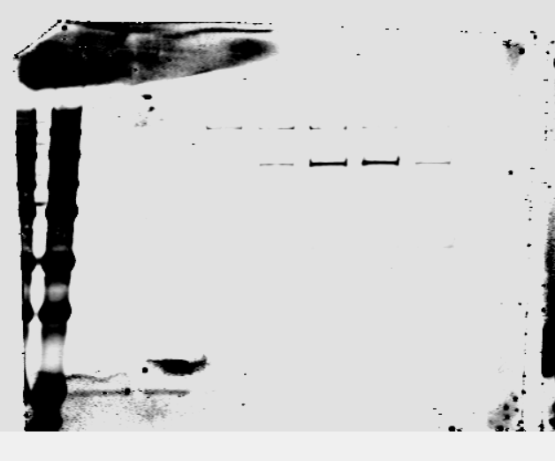
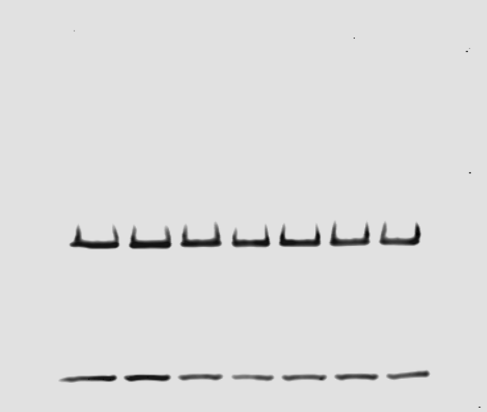
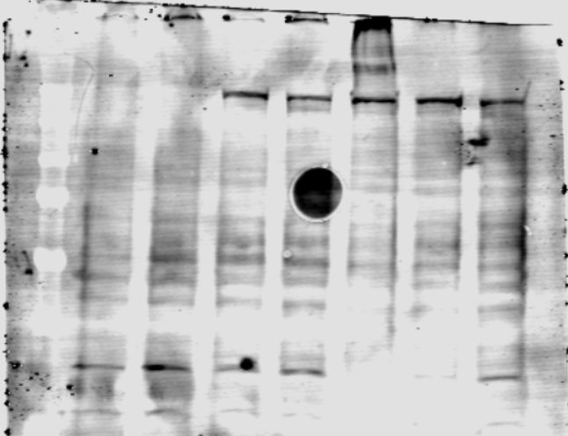
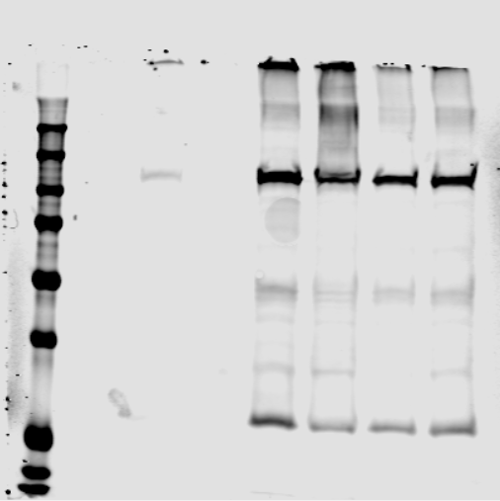
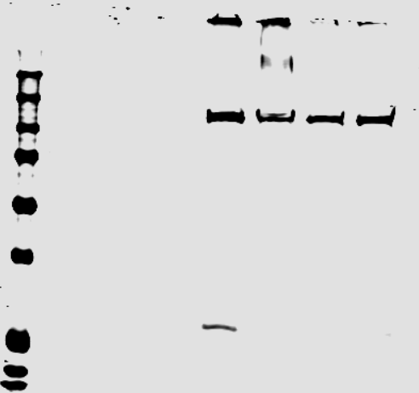
Full unedited blot for
Supplementary Figure 4A
250
FLAG (GIV)
150
HA (NOD2)
High exposure
100
75
Immunoprecipitates
(Anti-FLAG)
50
37
250
HA (NOD2)
Low exposure
150
100
Immunoprecipitates
(Anti-FLAG)
75
50
37
Immunoprecipitates
(Anti-FLAG)
IgG
50
250
FLAG (GIV)
150
100
Inputs
75
50
37
250
HA (NOD2)
(Exposure-1)
HA (NOD2)
(Exposure-2)
150
100
Inputs
75
50
37
25

Slide 10
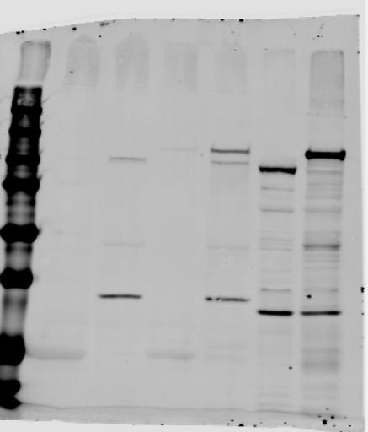
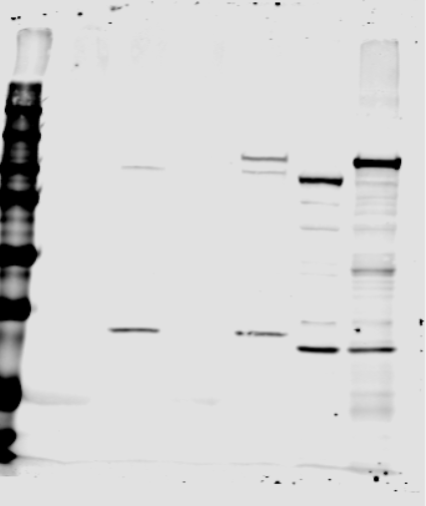
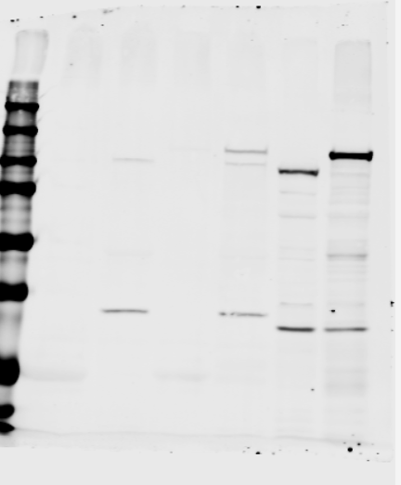
Full unedited blot for Supplementary figure 4B
IB: HA
(NOD1)
IB: HA
(NOD2)
HA-NOD1
GIV-CT
GIV-CT
HA-NOD2
250
GST
GST
150
100
75
50
37
Lower exposure-1
Lower exposure-2

Slide 11
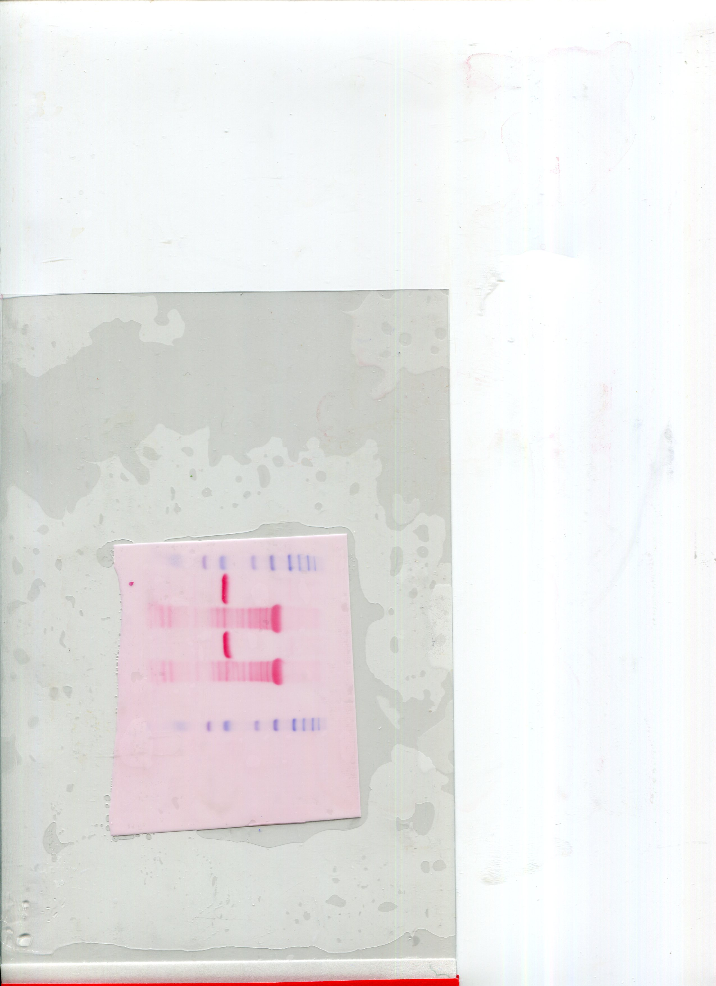
Full unedited blot for Supplementary figure 4C
GST-NOD2
LRR
GST
IB:
His(GIV)
Low
exposure
GST Pulldown
High
exposure
Inputs

Slide 12
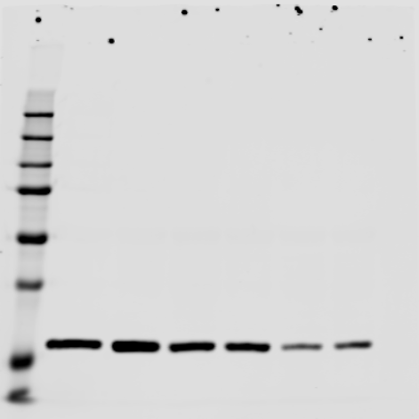
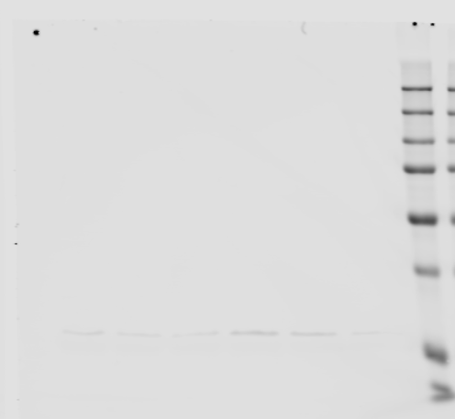
Supplementary figure 4D
250
150
100
75
50
GST Pulldown
37
25
IB: His GIV CT
250
150
100
75
GST Pulldown
50
37
25
IB: His GIV CT

Slide 13
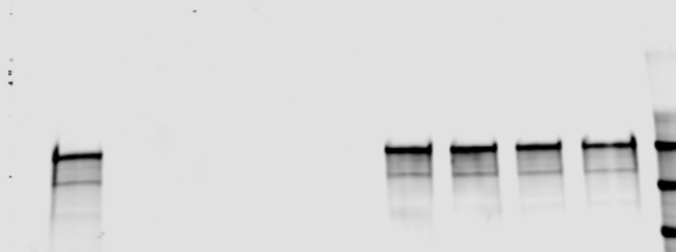
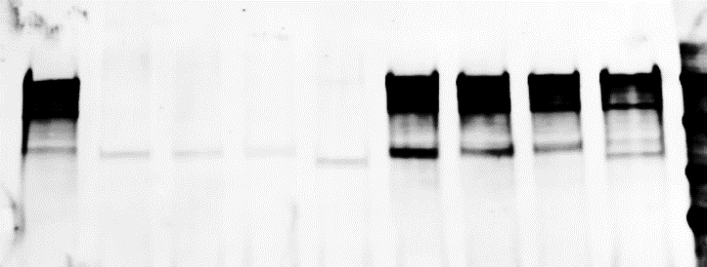
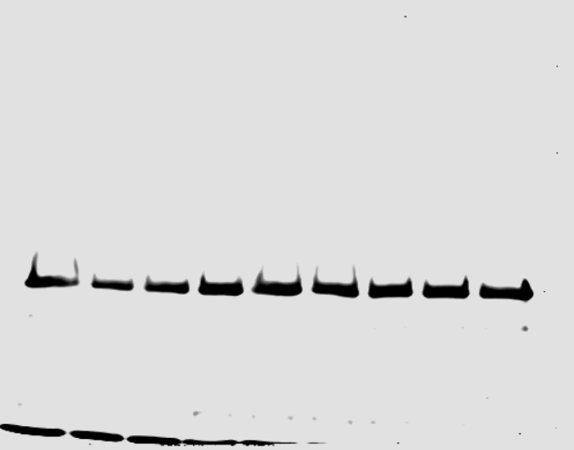
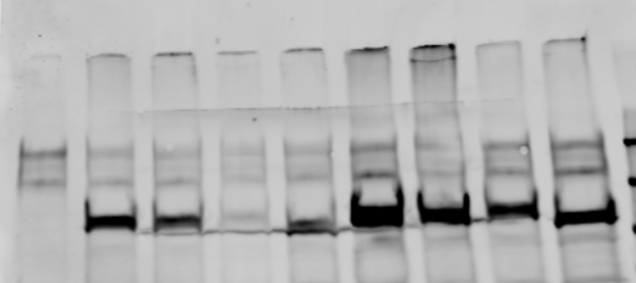
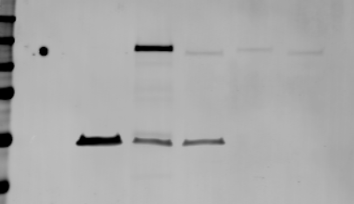
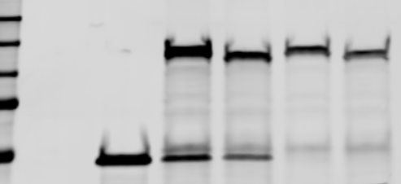
Full unedited blot for Supplementary figure 4E
250
FLAG (GIV)
150
100
250
Immunoprecipitates
(Anti-FLAG)
150
100
HA(NOD2)
75
50
IgG
Inputs
250
150
100
HA(NOD2)
Supplementary figure 4F
250
<HA mAb(NOD2)
150
100
GST Pulldown
75
50
<GST pAb(GIV-CT)
37
250
150
<HA mAb(NOD2)
Inputs
100
75
50
<GST pAb(GIV-CT)

