Slide 2
1E
ATR
Actin

Slide 3
Figure 1h
ATR
usp21
Actin

Slide 4
Figure 2D
ATR
USP21

Slide 5
2E
ATR
FLAG
ATR
ACTIN

Slide 6

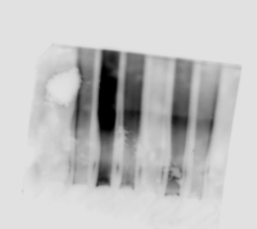


2G
ATR
UB
ATR
GAPDH
USP21

Slide 7

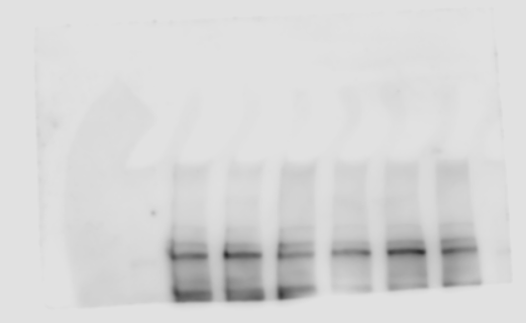
2H
ATR
UB
GAPDH
FLAG
ATR

Slide 8
4A
ATR
N-Cadherin
E-Cadherin
Actin

Slide 9
4C
ATR
N-Cadherin
E-Cadherin
ACTIN

Slide 10
Figure 4E
E Cadherin
N Cadherin
ACTIN

Slide 11
Figure 4G
N Cadherin
E Cadherin
ACTIN

Slide 12
Figure 5A
FLAG
FLAG
ACTIN
SQ/TQ

Slide 13
Figure 5C
SQ/TQ
FLAG
FLAG

Slide 14
Figure 5E
FLAG
SQ/TQ
FLAG
ACTIN

Slide 15
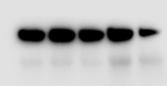
Figure 5G
SQ/TQ
SUN2
SUN2
ACTIN
ATR

Slide 16
Figure 5K
SUN2
E-cadherin
N-cadherin
ACTIN

Slide 17
Figure 5M
SUN2
N-cadherin
E-cadherin
GAPDH
FLAG

Slide 18
Figure 6A-B
KASH1
KASH1
SQ/TQ
FLAG
KASH2
FLAG
KASH2
ACTIN

Slide 19
Figure 6D
N-Cadherin
ATR
E-Cadherin
USP21
ACTIN

Slide 20
7A
ATR
β-Catenin
Lamin B1
GAPDH

Slide 21
Figure 7C
β-Catenin
Lamin B1
GAPDH

Slide 22
7E
Lamin B1
β-Catenin
GAPDH
SUN2

Slide 23
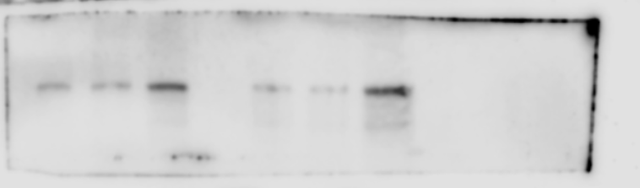

Figure 7G
β-Catenin
GAPDH
KASH2
KASH2
α-Catenin
β-Catenin
SUN2
GAPDH for β-Catenin
α-Catenin

Slide 24
Figure 7I
α-Catenin
β-Catenin
α-Catenin

Slide 25
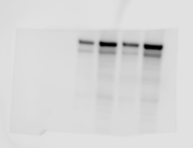
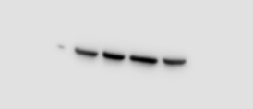
Figure 7P
ATR
SUN2
ACTIN

Slide 26
Figure 8D
N-cadherin
E-cadherin
ATR
GAPDH

Slide 27
S1b
ATR
ACTIN

Slide 28
S1J
usp21
ATR
Actin

Slide 29
S1L
USP21
ATR

Slide 30
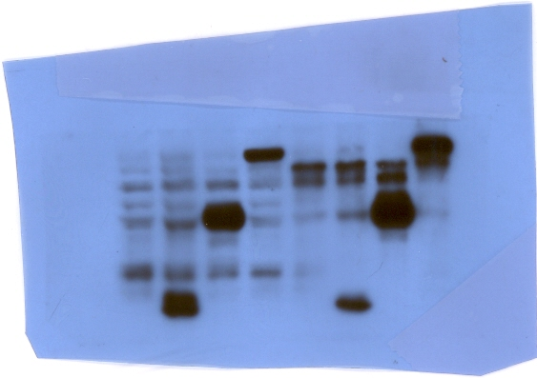
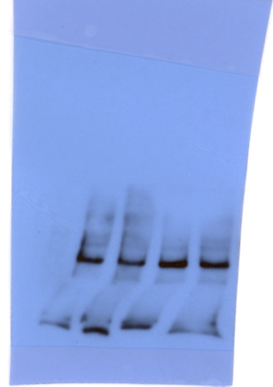
S1M
FLAG
ATR
Actin
ATR

Slide 31
S1O
GAPDH
UB
ATR
ATR
FLAG

Slide 32
Figure S3A
E-cadherin
N-cadherin
Actin

Slide 33
S3C
SQ/TQ
FLAG
ACTIN
FLAG

Slide 34
S3E
FLAG
FLAG
SQ/TQ
ACTIN

Slide 35
S3G
SQ/TQ
FLAG
FLAG
ACTIN

Slide 36
s3i
SQ/TQ
FLAG
FLAG
ACTIN

Slide 37
S3K
E-cadherin
SUN2
ACTIN
N-cadherin

Slide 38
S3M
KASH1
KASH2
KASH1
FLAG
KASH2
SQ/TQ
KASH2

