Slide 1
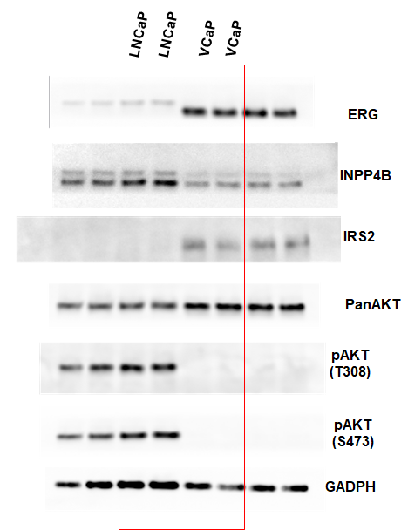
Uncropped gels corresponding to Figure 1F

Slide 2
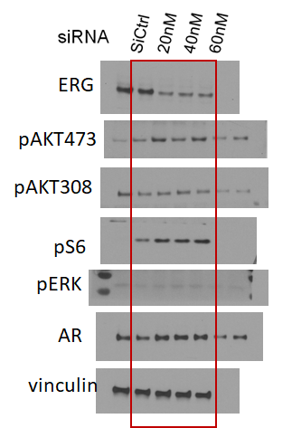
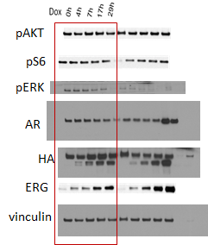
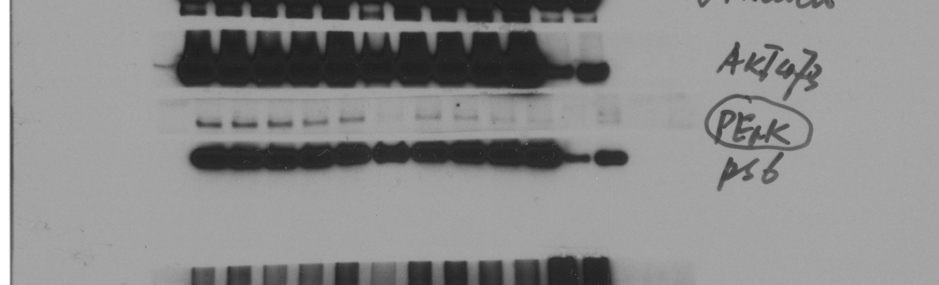
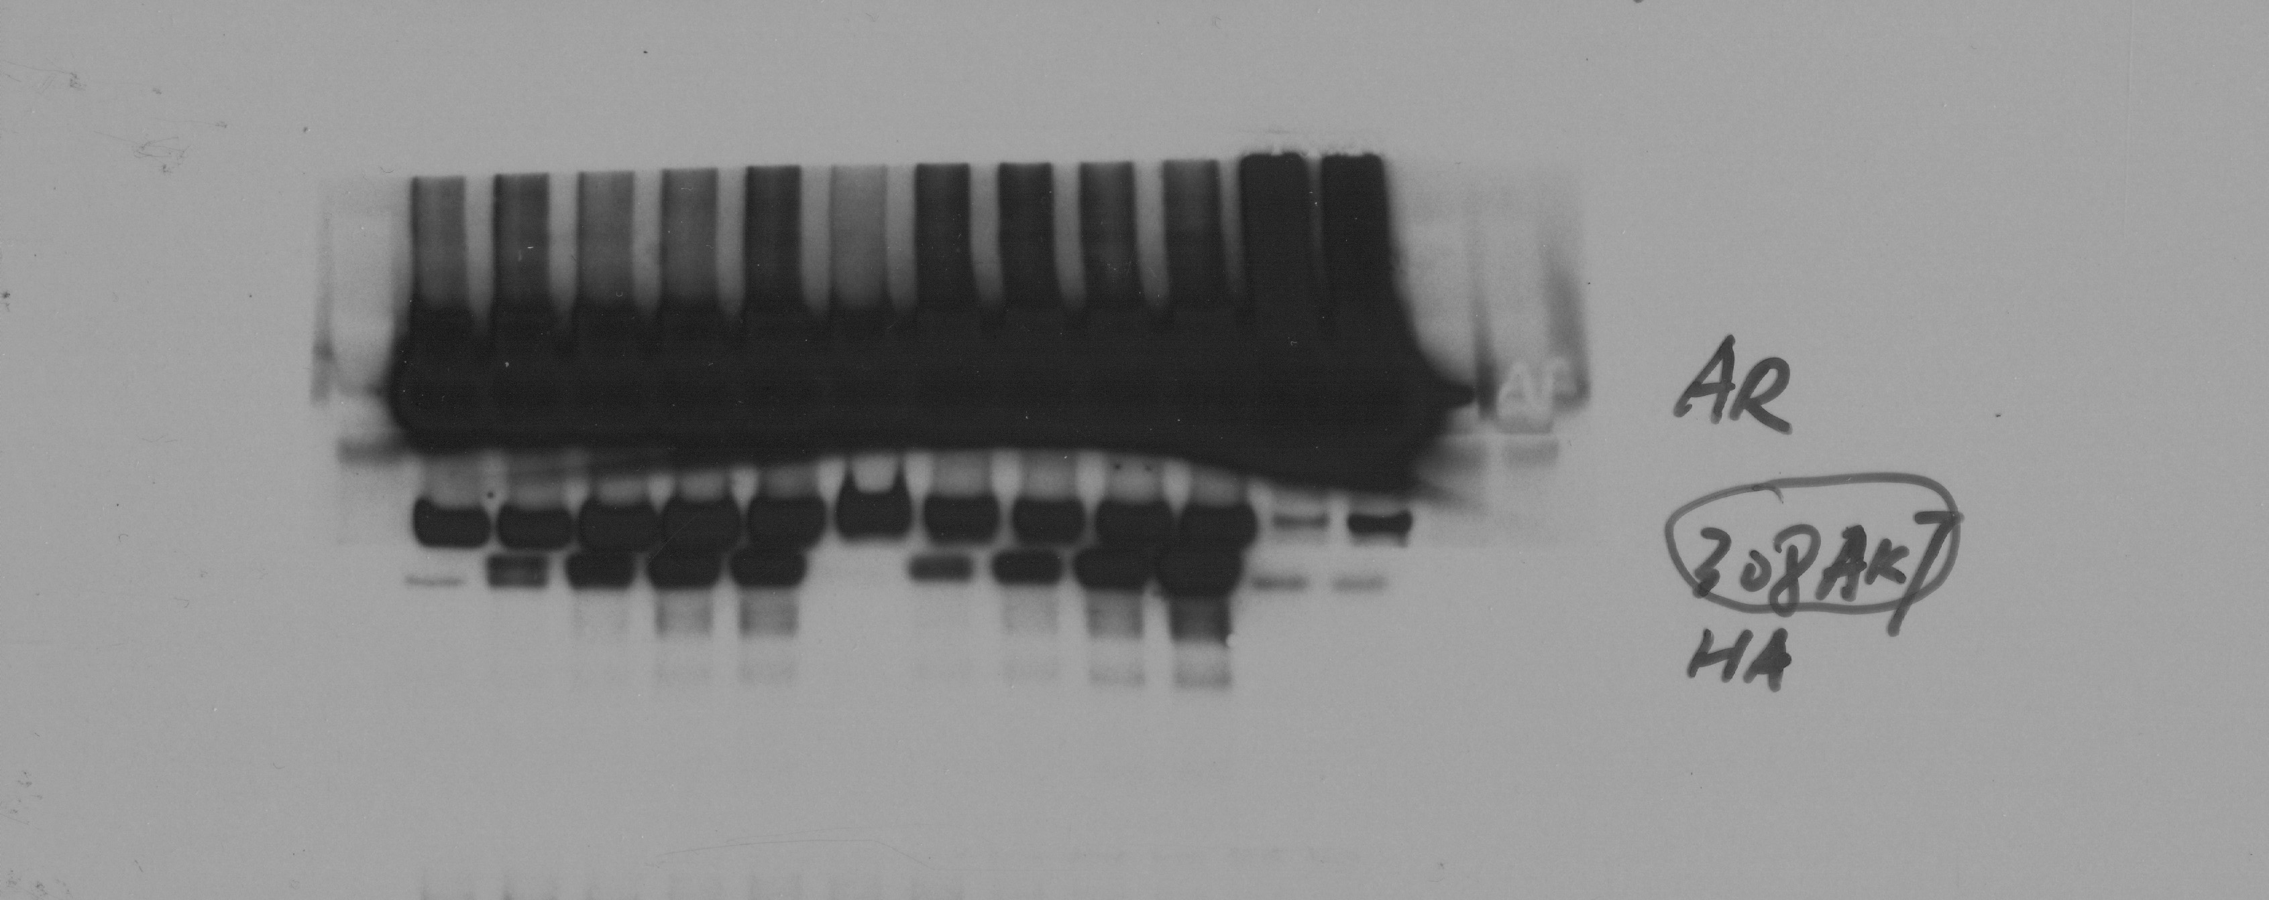
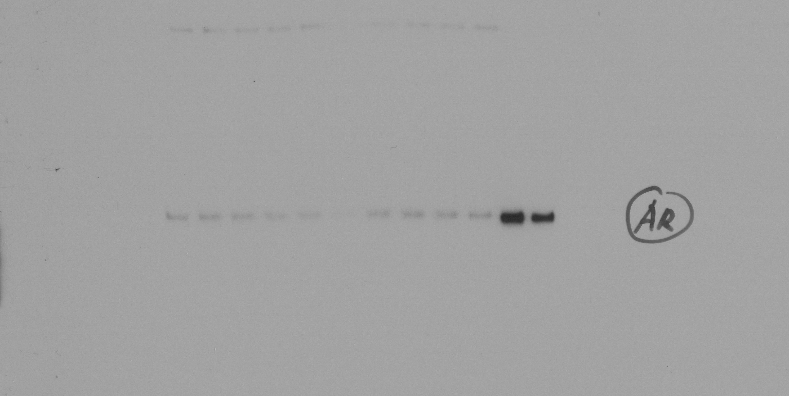
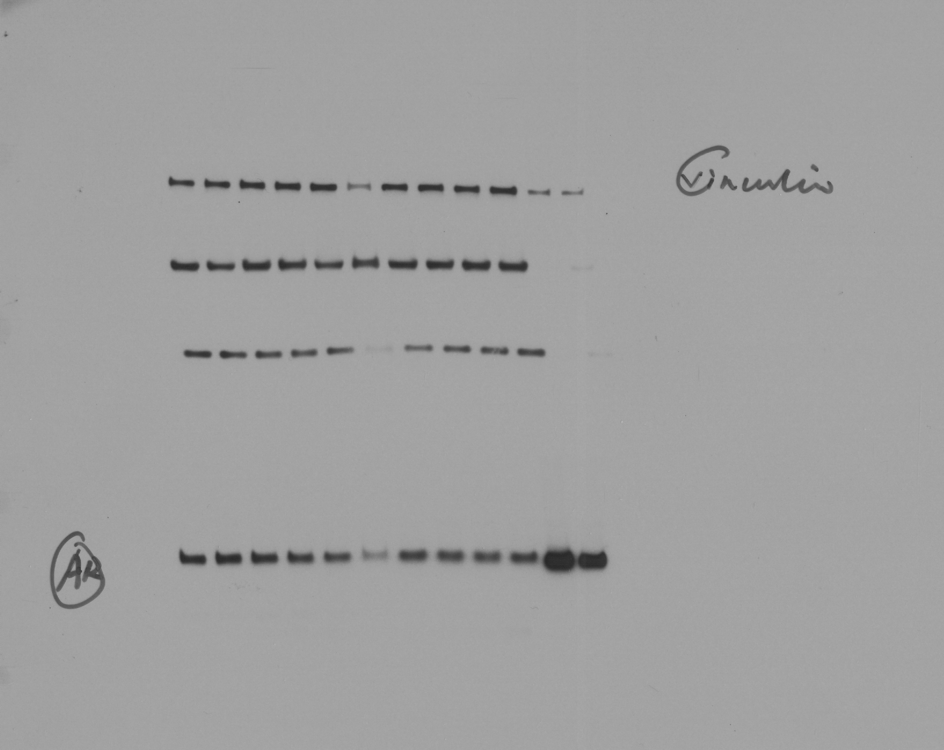
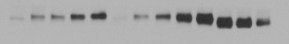

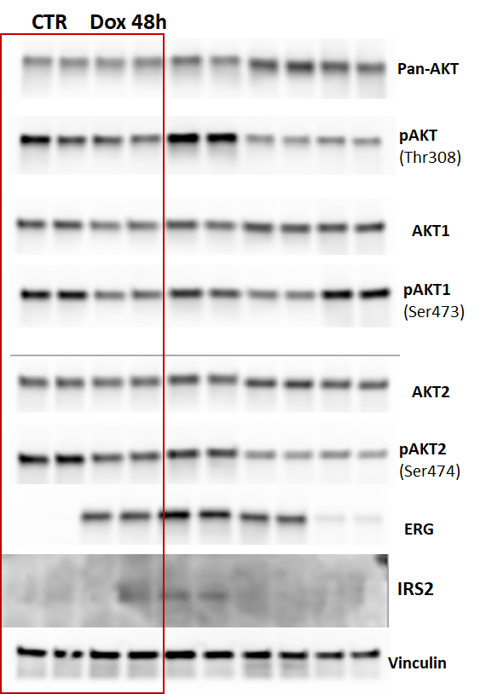
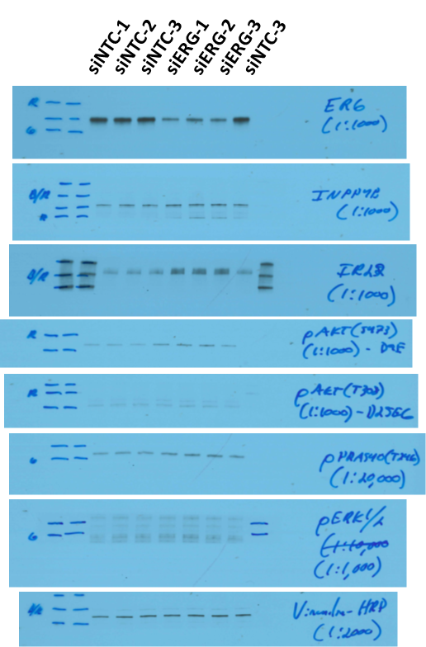
Sh Ctrl
Sh ERG
A
B
C
pAKT473
pAKT308
pS6235,6
pERK
AR
vinculin
ERG
vinculin
D
E
Uncropped gels corresponding to Figure 2. In Figure 2A, blots for the shCtrl and shERG were from the same lysate but ERG was run on a second gel, and the vinculin control for it is shown below the ERG blot.

Slide 3
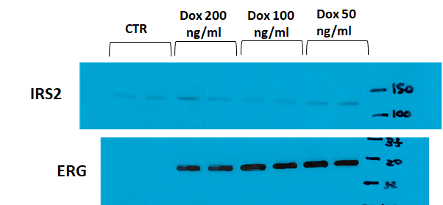
Uncropped gels corresponding to Figure S2C

Slide 4
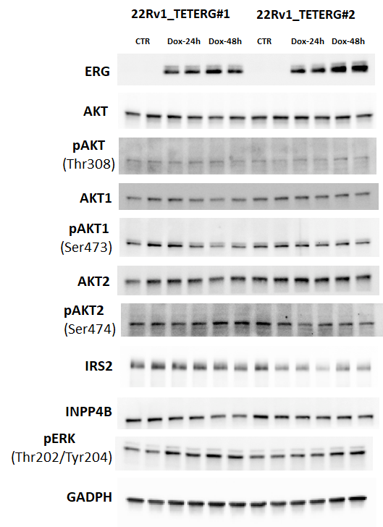
Uncropped gels corresponding to Figure S3

Slide 5
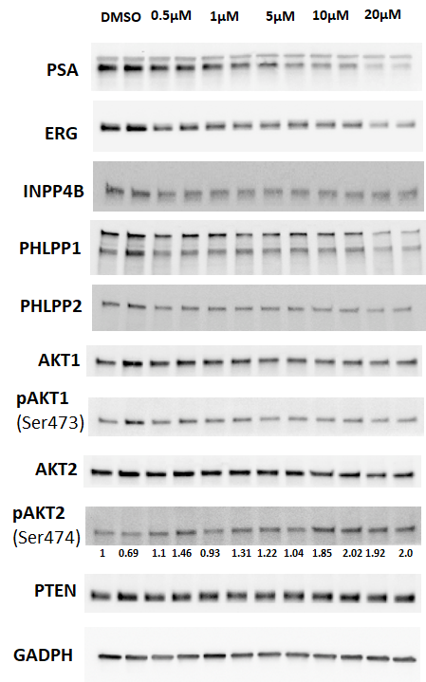
Uncropped gels corresponding to Figure S10

