Slide 1
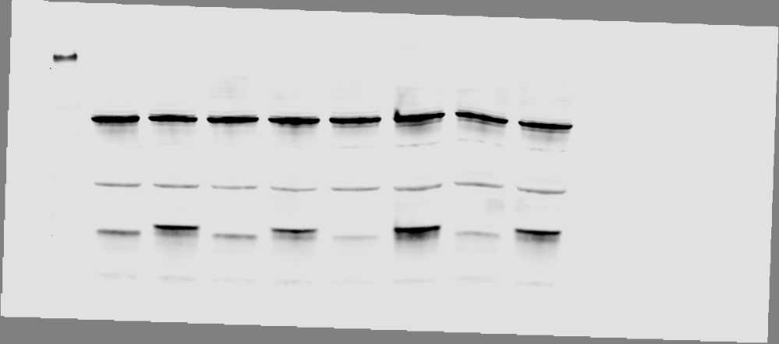
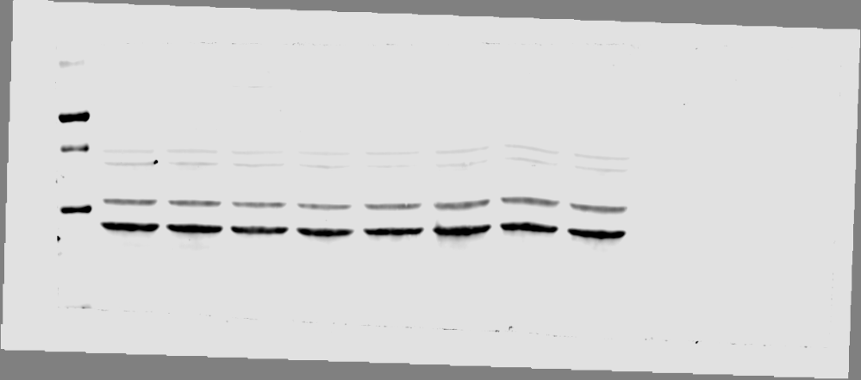
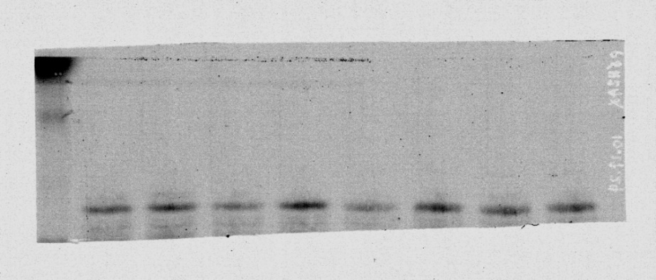
Full unedited blot/gel for Figure 1C
Cyclin D1 U2OS
γ-H2AX
Actin U2OS
70
25
70
50
38
15
EV
CCND1 OE
EV
CCND1 OE
EV
CCND1 OE

Slide 2
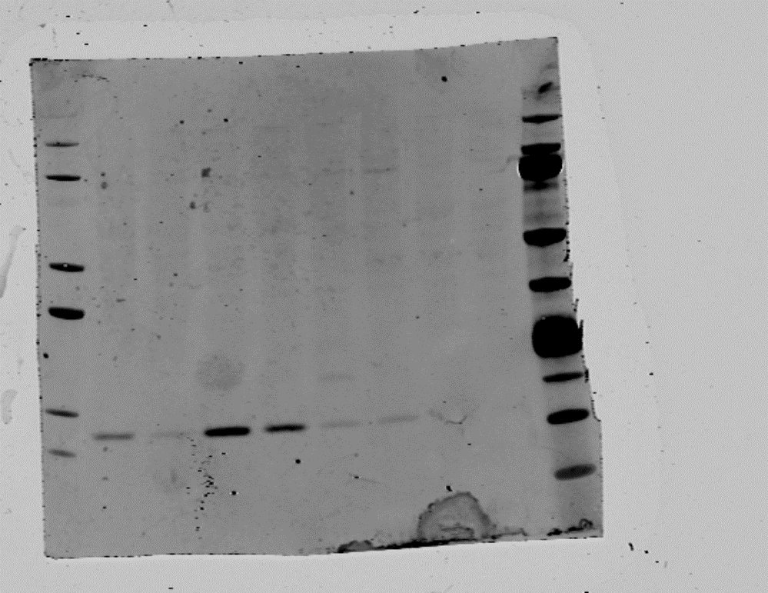
Full unedited blot/gel for Figure 2A
sgNT
sg
POLQ
sgNT
sg
POLQ
sgNT
sg
POLQ
sgNT
sg
POLQ
sgNT
sg
POLQ
sgNT
sg
POLQ
sgNT
sg
POLQ
sgNT
sg
POLQ
GAPDH
g-H2AX

Slide 3
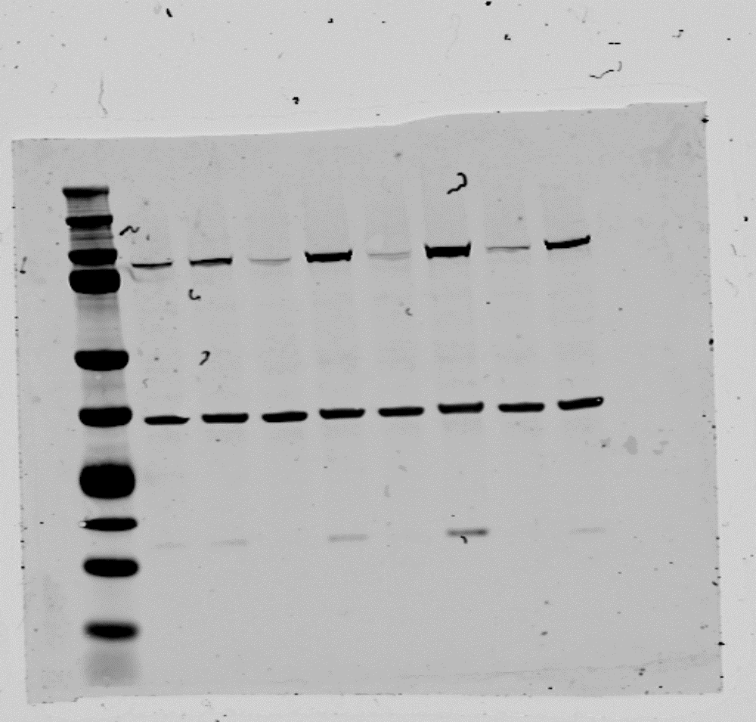
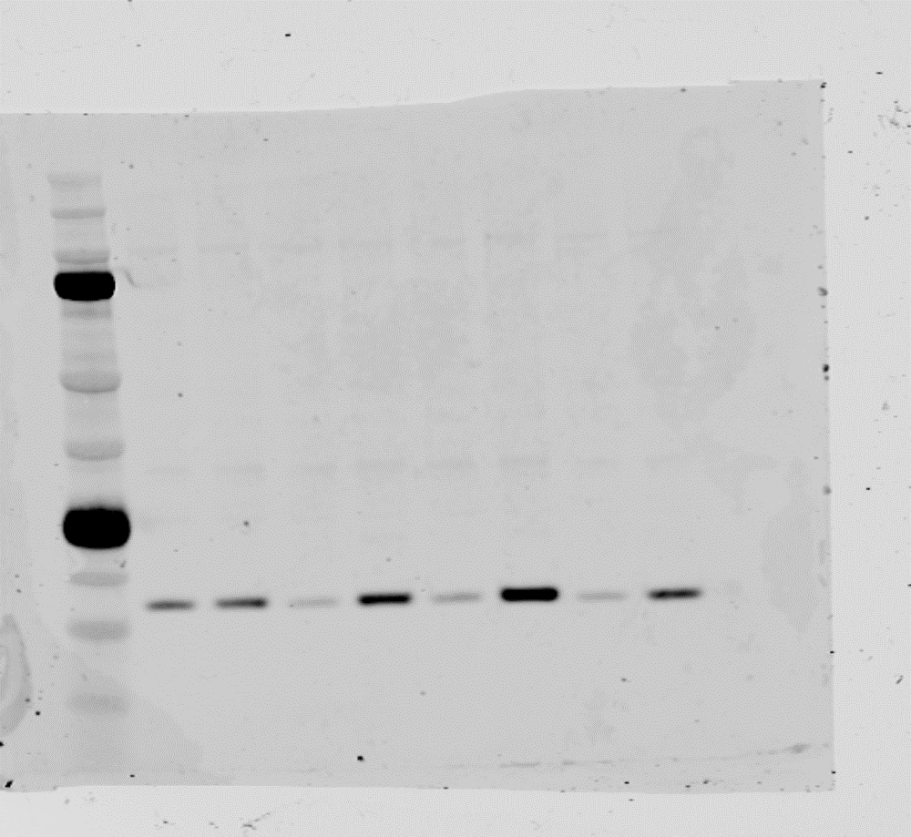
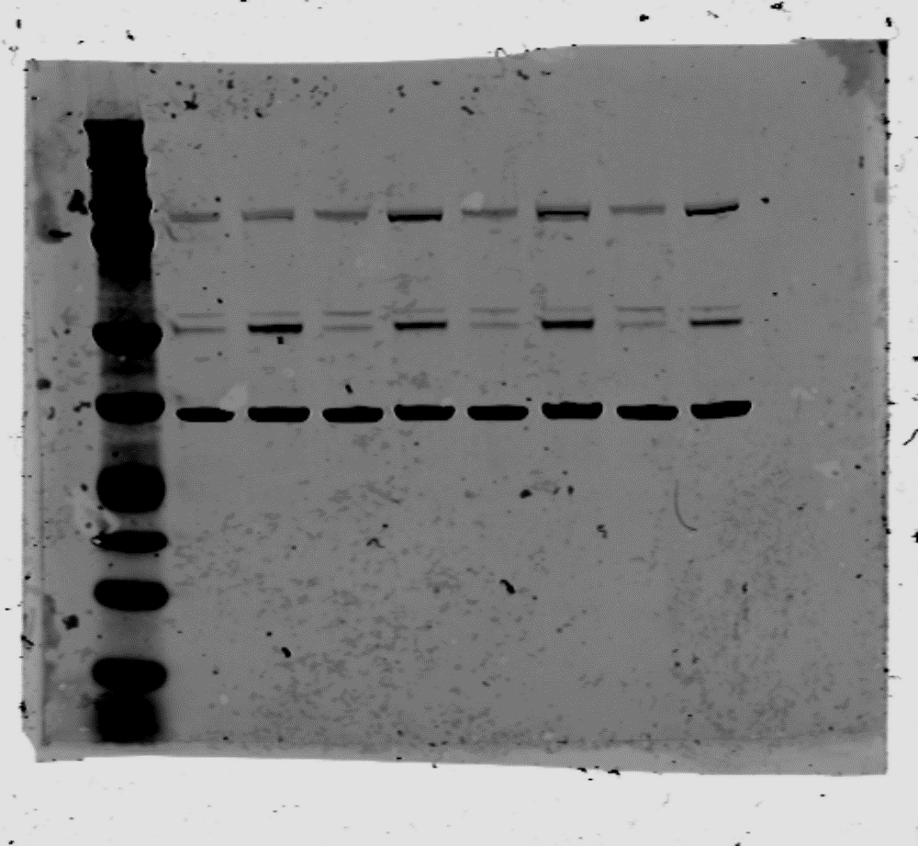
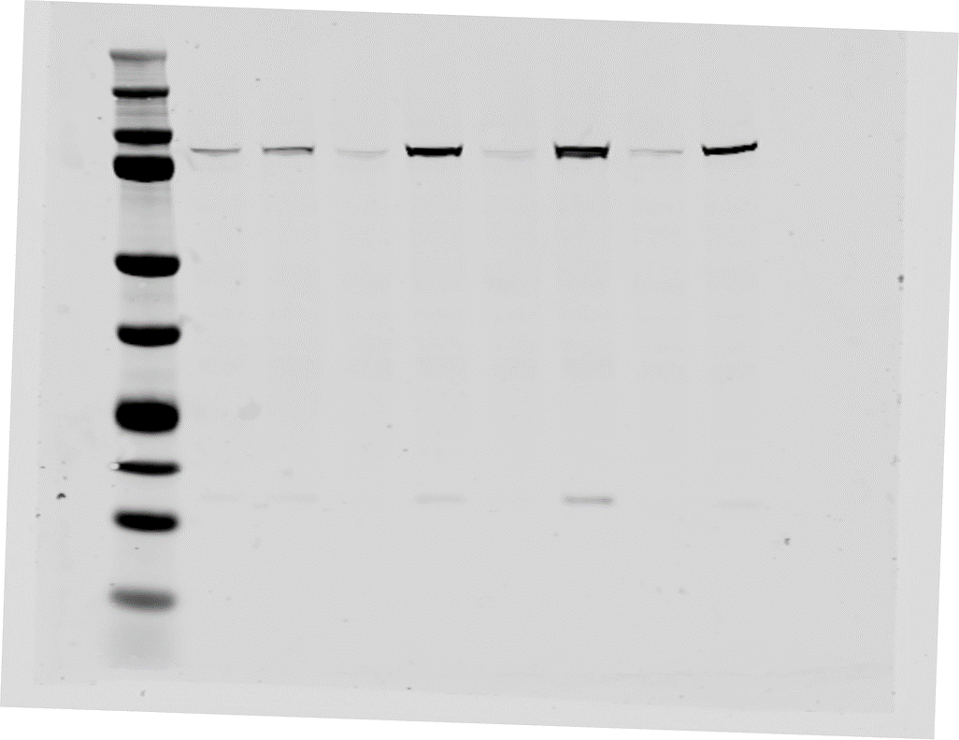
Full unedited blot/gel for Figure 2E
RO3306 - + - + - + - +
Cyclin B1
GAPDH
g-H2AX
RO3306 - + - + - + - +
RO3306 - + - + - + - +
RO3306 - + - + - + - +
Cleaved PARP

Slide 4
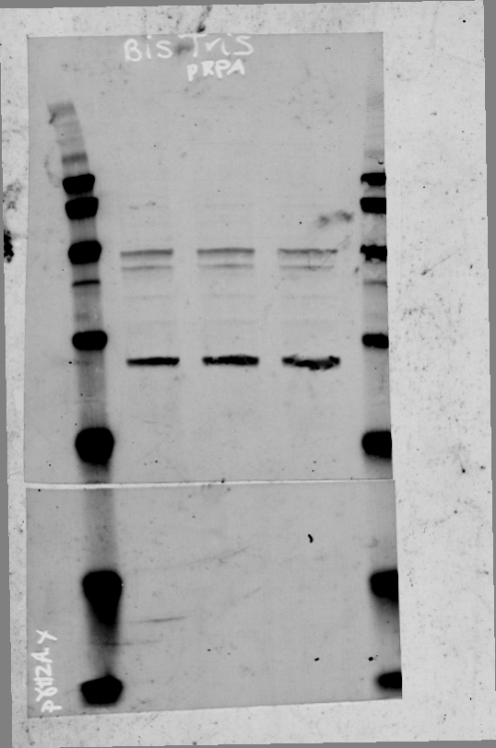
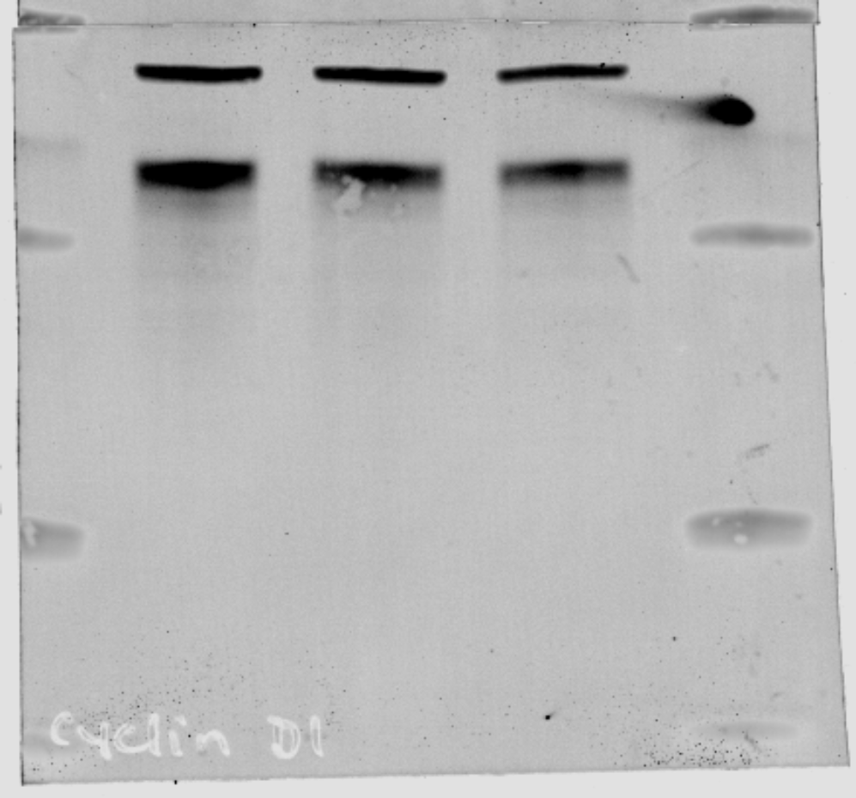
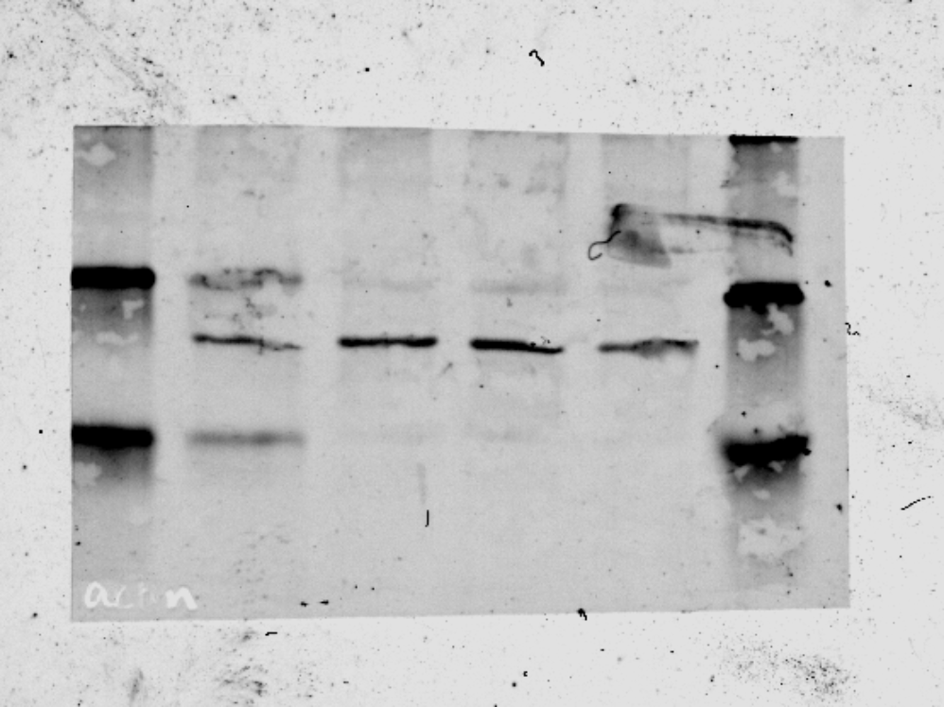
Full unedited blot/gel for Figure 3A
sg
NT
sg
CCND1
sg
NT
sg
CCND1
sg
NT
sg
CCND1
β-actin
38
38
Cyclin D1
sg
NT
sg
CCND1
30
25
38
30
β-actin
25
38
15
g-H2AX
β-actin
38

Slide 5
Full unedited blot/gel for Figure 4D
NT
NT
sg
PQ
sg
PQ
NT
NT
sg
PQ
sg
PQ
NT
NT
sg
PQ
sg
PQ
NT
NT
sg
PQ
sg
PQ
NT
NT
sg
PQ
sg
PQ
NT
NT
sg
PQ
sg
PQ
Unarrested
arrested
Unarrested
arrested
Unarrested
arrested
p-CHK1
CHK1
GAPDH

Slide 6
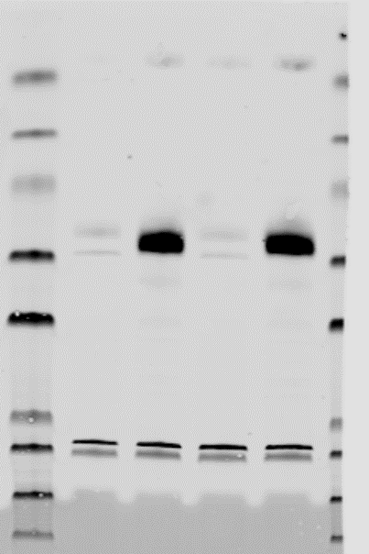
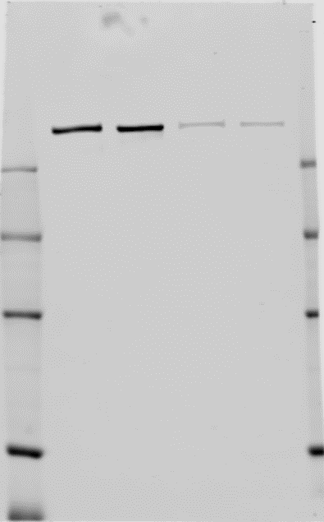
Full unedited blot/gel for Figure 5A
Cyclin D1 OE + ATM KO
Cyclin D1 OE + ATM KO
Cyclin D1 OE + ATM KO
EV
Cyclin d1 OE
ATM
KO
Cyclin D1 OE + ATM KO
EV
Cyclin d1 OE
ATM
KO
EV
Cyclin d1 OE
ATM
KO
EV
Cyclin d1 OE
ATM
KO
V5- endogenous
POLΘ
ATM
Cyclin D1
vinculin

Slide 7
Full unedited blot/gel for Supplemental Figure 1B
Cyclin D1
GAPDH
MMEJ
DR-GFP
EJ5
MMEJ
DR-GFP
EJ5
EV
CCND1 OE
EV
CCND1 OE
EV
CCND1 OE
EV
CCND1 OE
EV
CCND1 OE
EV
CCND1 OE

Slide 8
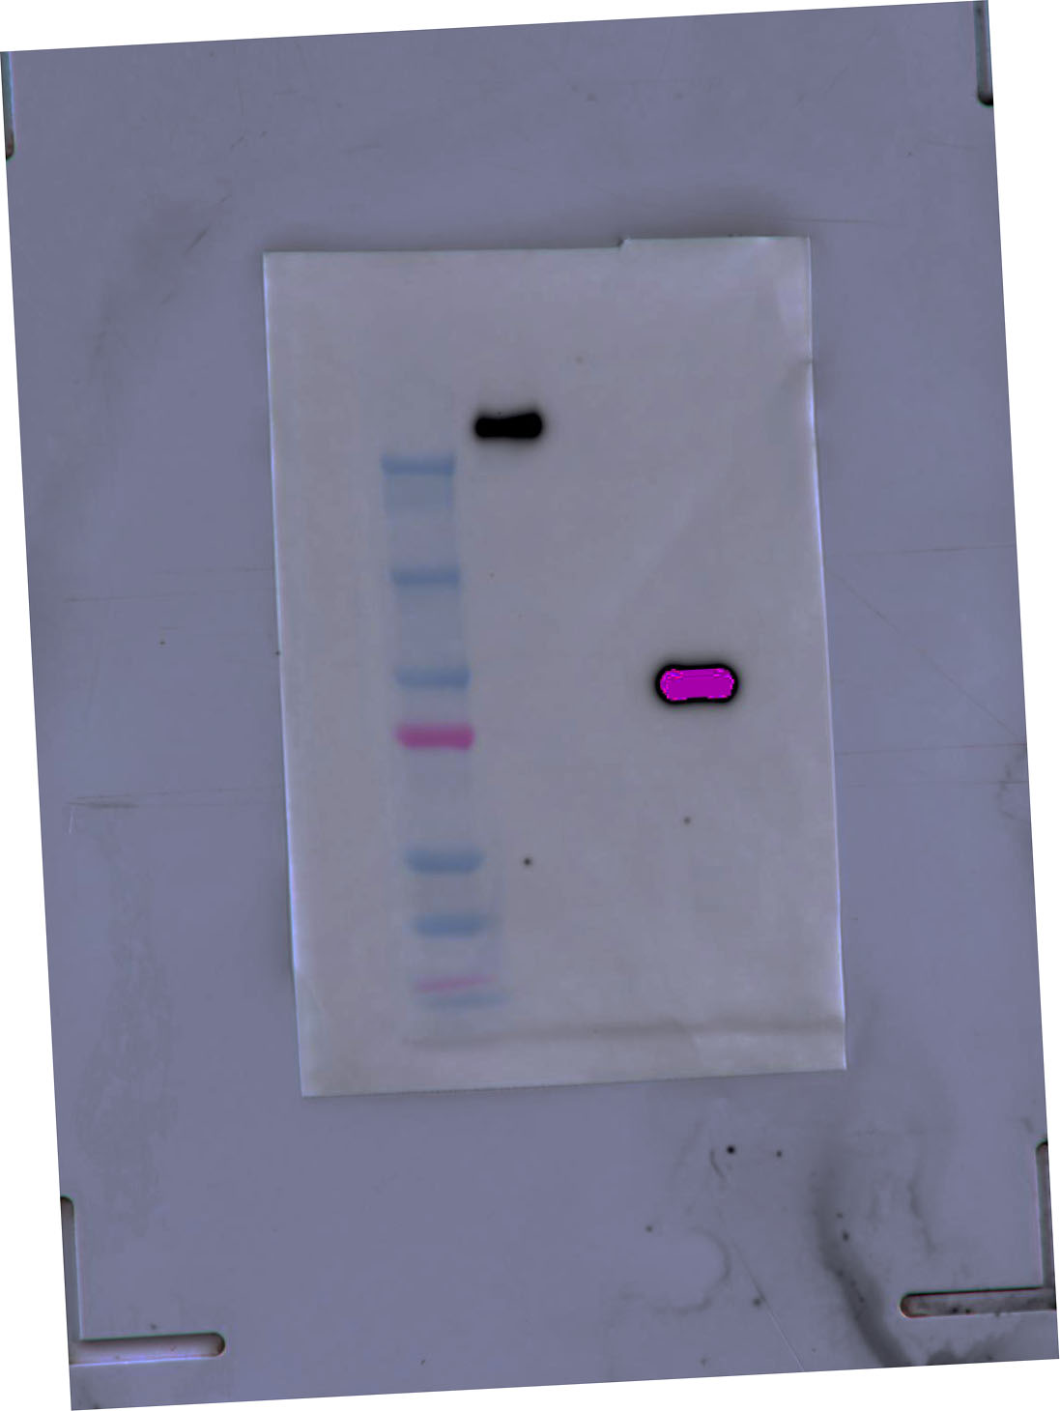
Full unedited blot/gel for Supplemental Figure 1E
sgNT
sg
POLQ
POLΘ
GAPDH
sgNT
sg
POLQ

Slide 9
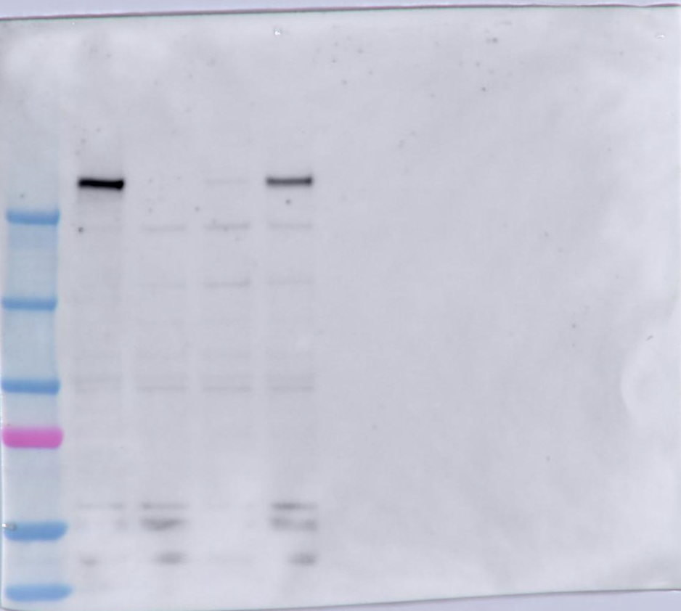
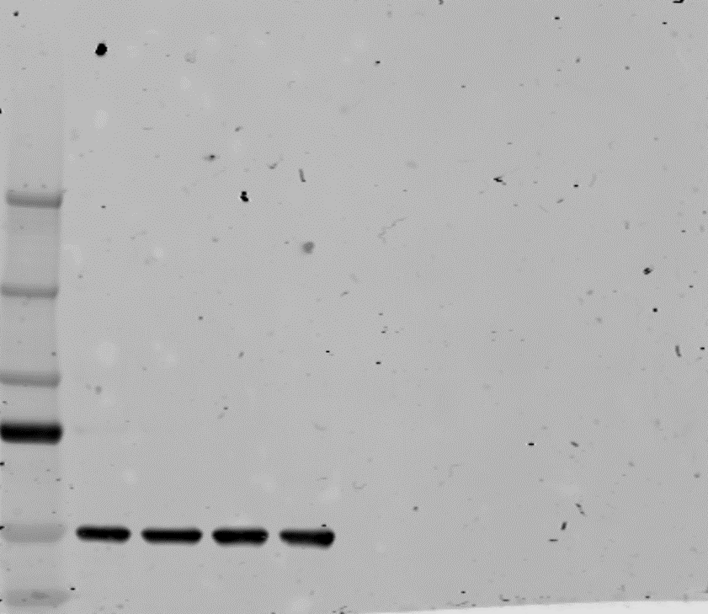
Full unedited blot/gel for Supplemental Figure 2A
NT
PQ sg1
PQ sg2
PQ sg3
3-Flag POLΘ
NT
PQ sg1
PQ sg2
PQ sg3
alpha-tubulin

Slide 10
Full unedited blot/gel for Supplemental Figure 3B
Jeko
sg
NT
Jeko
sg
CCND1
Jeko
sg
CCND1 with Cyclin D1-HA OE
Jeko
sg
NT
Jeko
sg
CCND1
Jeko
sg
CCND1 with Cyclin D1-HA OE
beta-actin
Ectopic CCND1-HA
Endogenous CCND1

Slide 11
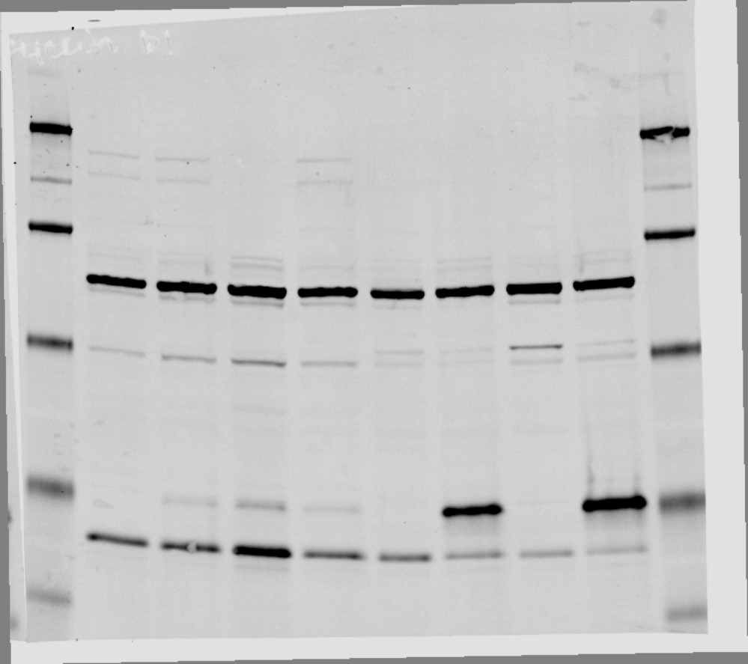
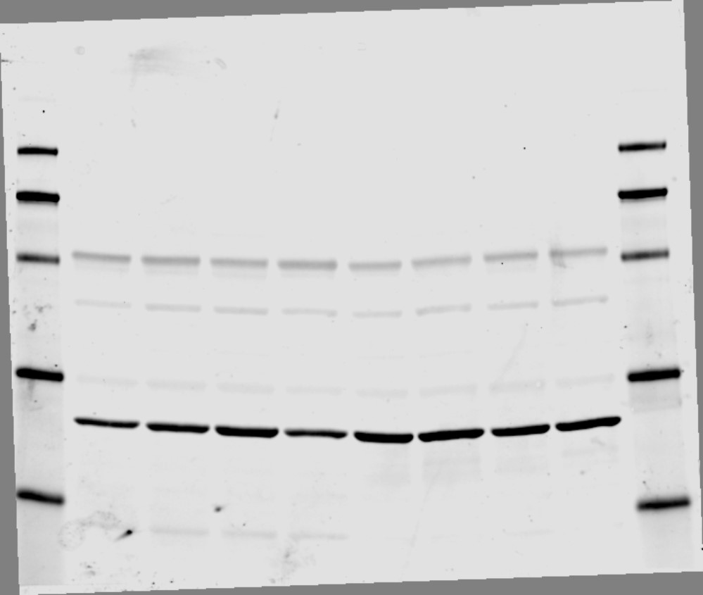
Full unedited blot/gel for Supplemental Figure 3C
U2OS
sg
NT
U2OS Cyclin D1-HA OE
U2OS
sg
NT
U2OS Cyclin D1-HA OE
Ectopic CCND1-HA
beta-actin
Endogenous CCND1

Slide 12
Full unedited blot/gel for Supplemental Figure 4 A-C
DR-GFP
MMEJ
EJ5
ATM
EV
Cyclin d1 OE
ATM
KO
Cyclin D1 OE + ATM KO
EV
Cyclin d1 OE
ATM
KO
Cyclin D1 OE + ATM KO
EV
Cyclin d1 OE
ATM
KO
Cyclin D1 OE + ATM KO
EV
Cyclin d1 OE
ATM
KO
Cyclin D1 OE + ATM KO
ATM
KO
Cyclin D1 OE + ATM KO
EV
Cyclin d1 OE
ATM
KO
Cyclin D1 OE + ATM KO
EV
Cyclin d1 OE
Alpha tubulin
DR-GFP
MMEJ
EJ5
Cyclin D1
EV
Cyclin d1 OE
ATM
KO
Cyclin D1 OE + ATM KO
EV
Cyclin d1 OE
ATM
KO
Cyclin D1 OE + ATM KO
EV
Cyclin d1 OE
ATM
KO
Cyclin D1 OE + ATM KO
DR-GFP
MMEJ
EJ5

Slide 13
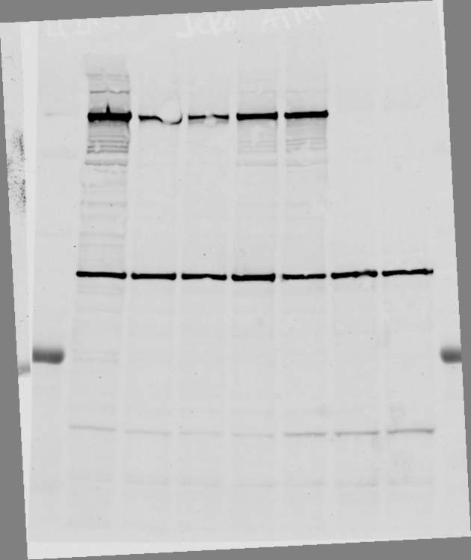
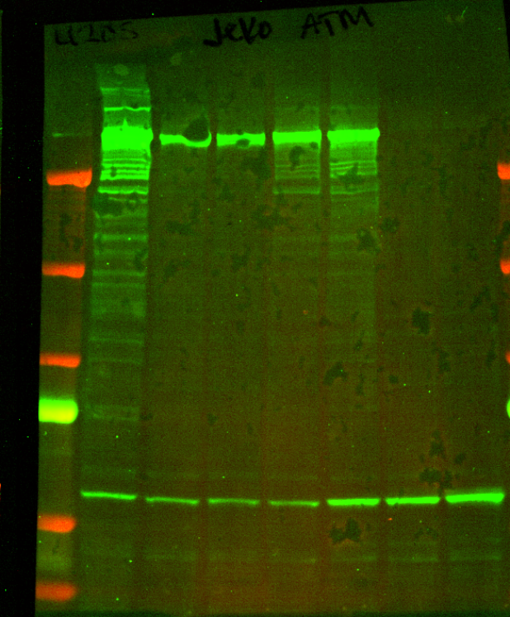
Full unedited blot/gel for Supplemental Figure 4D
WT
ATM^{-/-}
ATM
250
250
150
150
100
vinculin
100
75
50
50

Slide 14
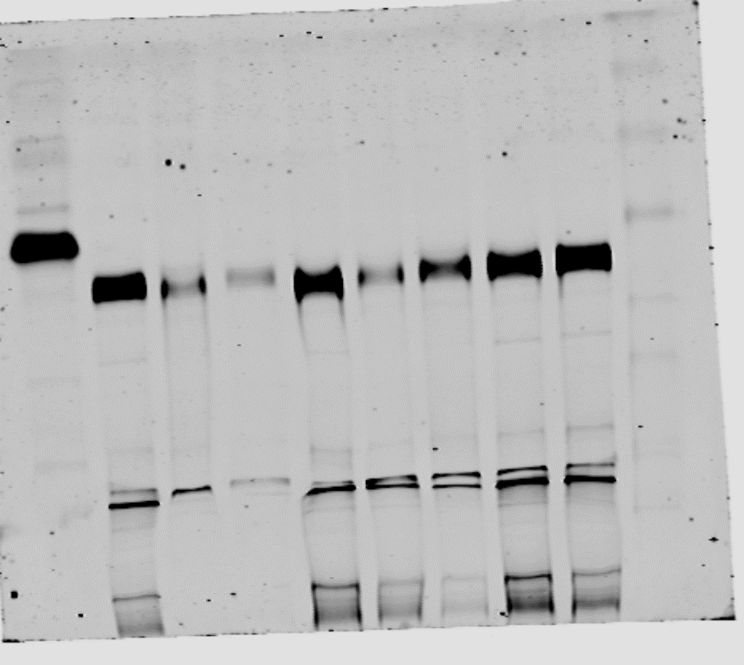
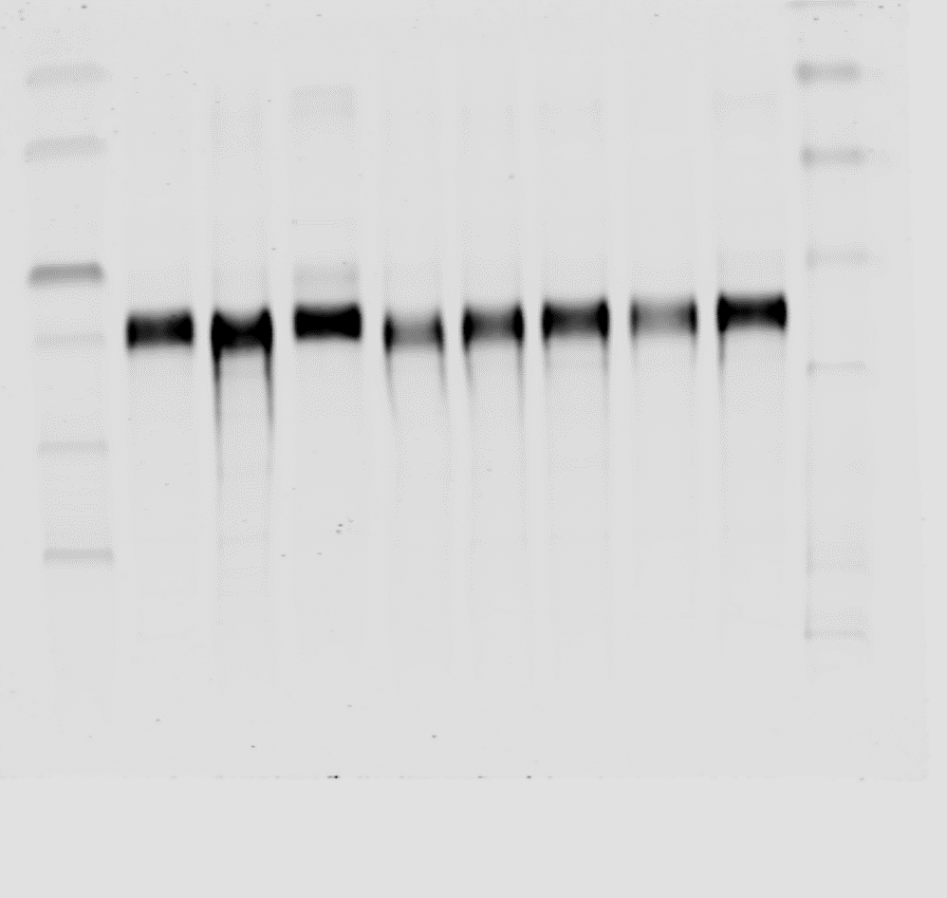
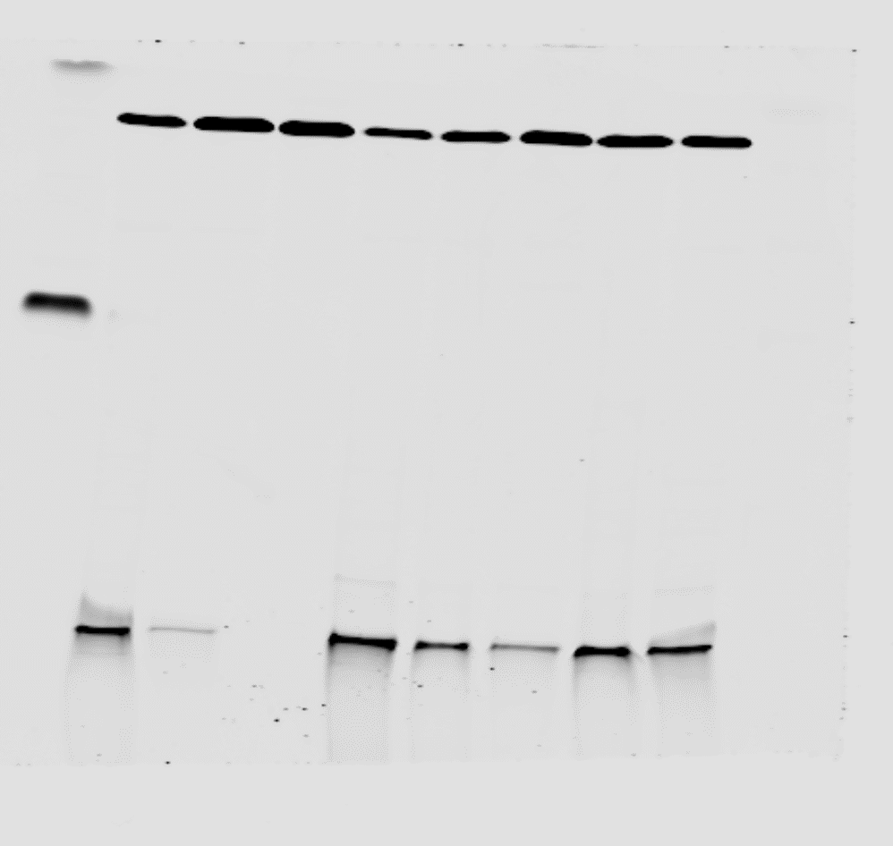
Full unedited blot/gel for Supplemental Figure 5B
Mino
Granta
UPN2
Rec1
MCIR
Z138
Jeko
ATM
Mino
Granta
UPN2
Rec1
MCIR
Z138
Jeko
total
KAP1
p-KAP1
GAPDH
Mino
Granta
UPN2
Rec1
MCIR
Z138
Jeko
Mino
Granta
UPN2
Rec1
MCIR
Z138
Jeko

Slide 15
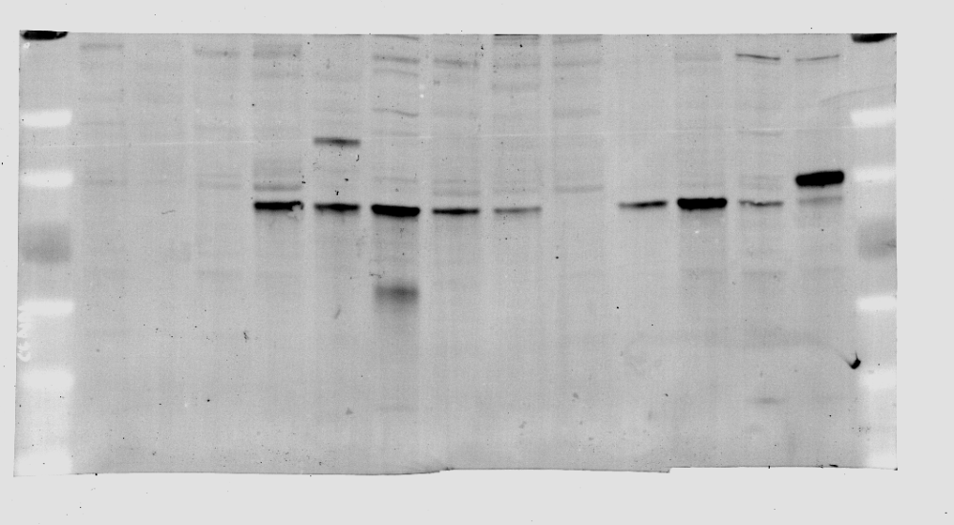
Full unedited blot/gel for Supplemental Figure 7A
Cyclin D1
β-actin

Slide 16
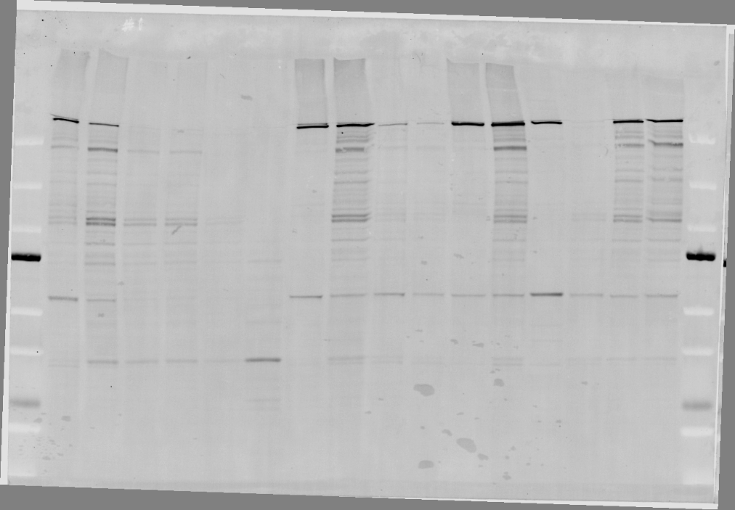
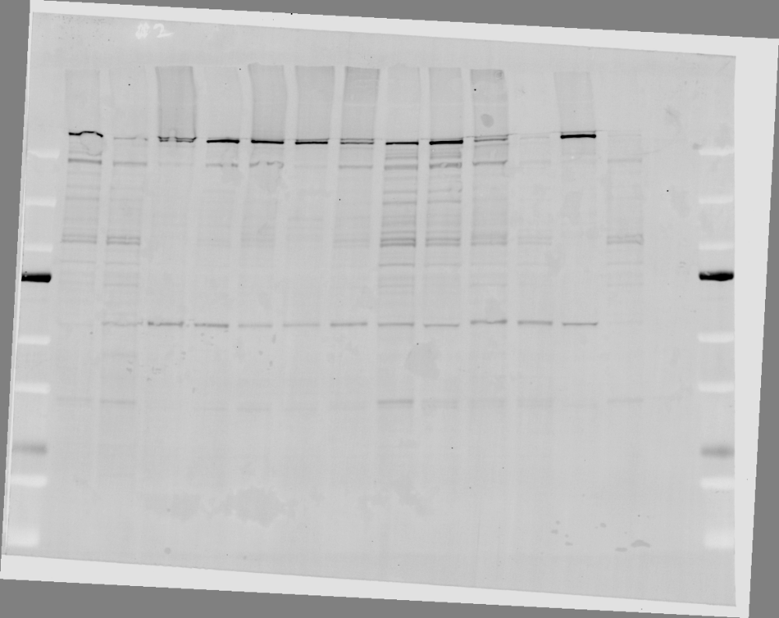
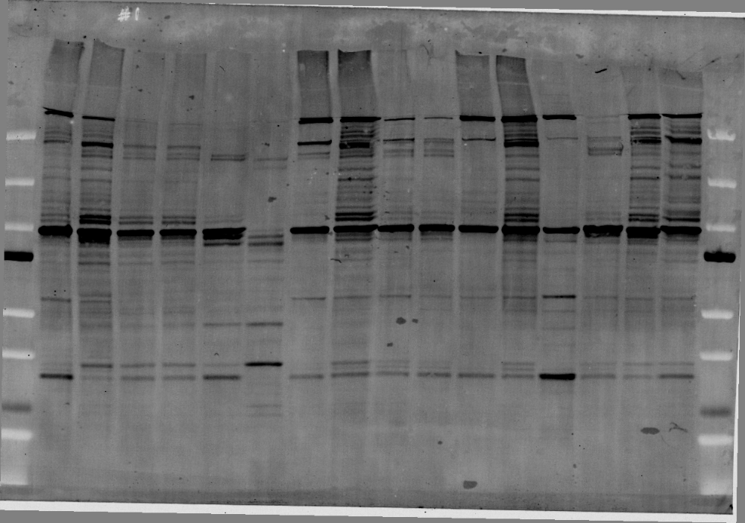
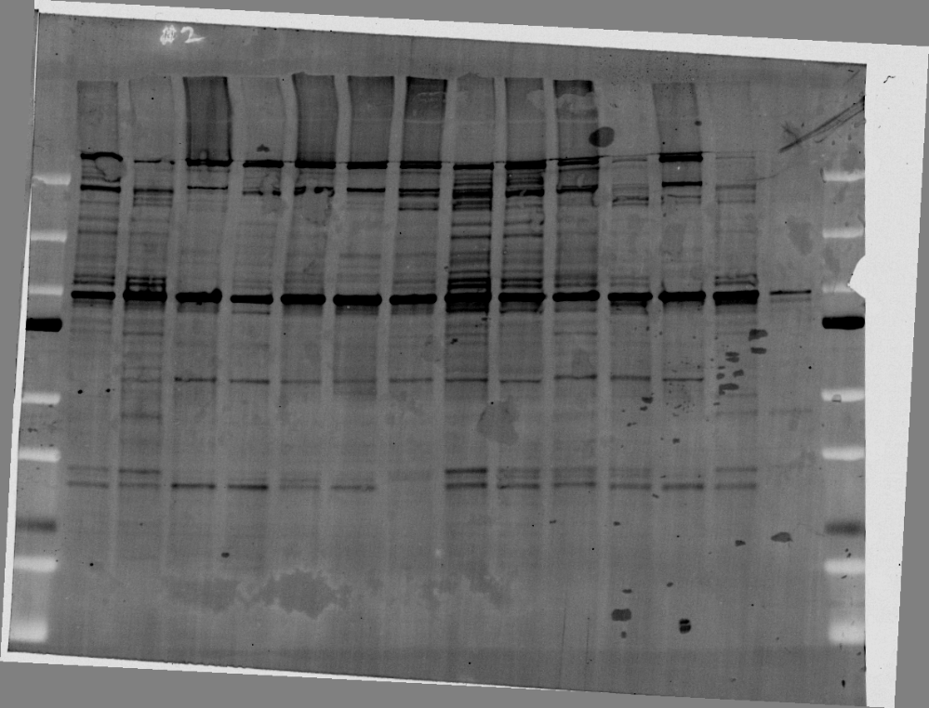
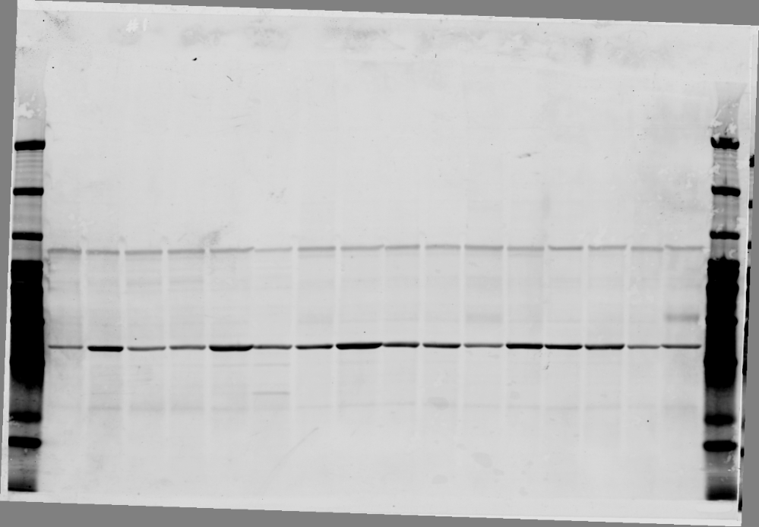
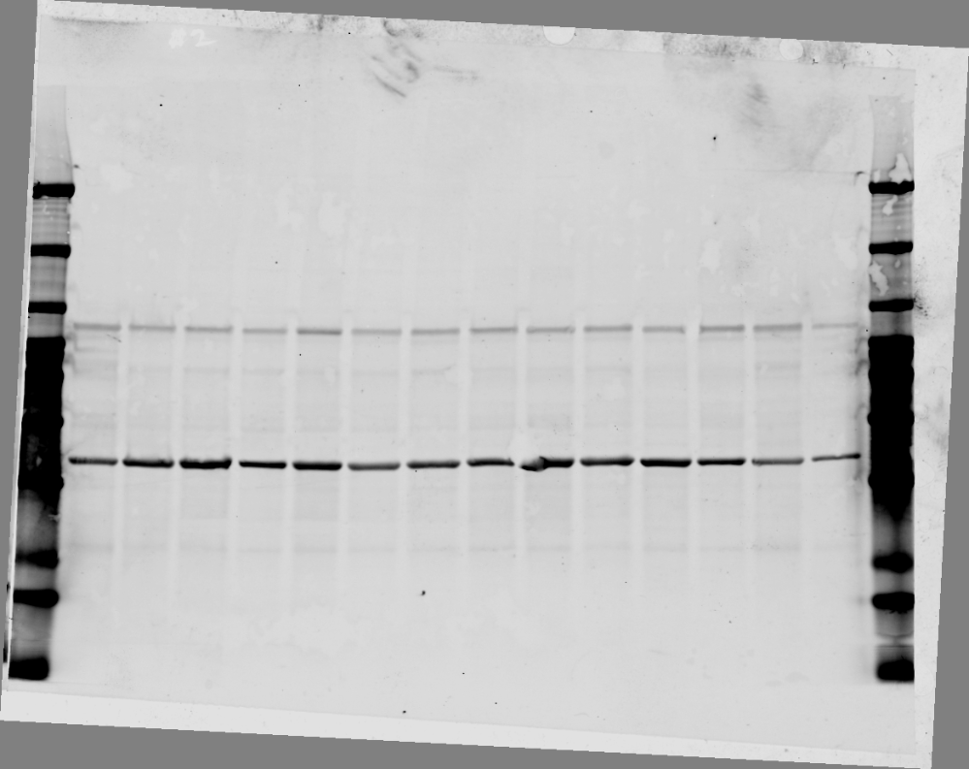
Full unedited blot/gel for Supplemental Figure 7B
ATM
ATM
Cyclin D1
Cyclin D1
Actin
Actin

