Slide 1
Elevated mitochondrial protein import in acute myeloid leukemia increases reliance on mitochondrial protease LONP1
Uncropped images of western blots used in the manuscript

Slide 2
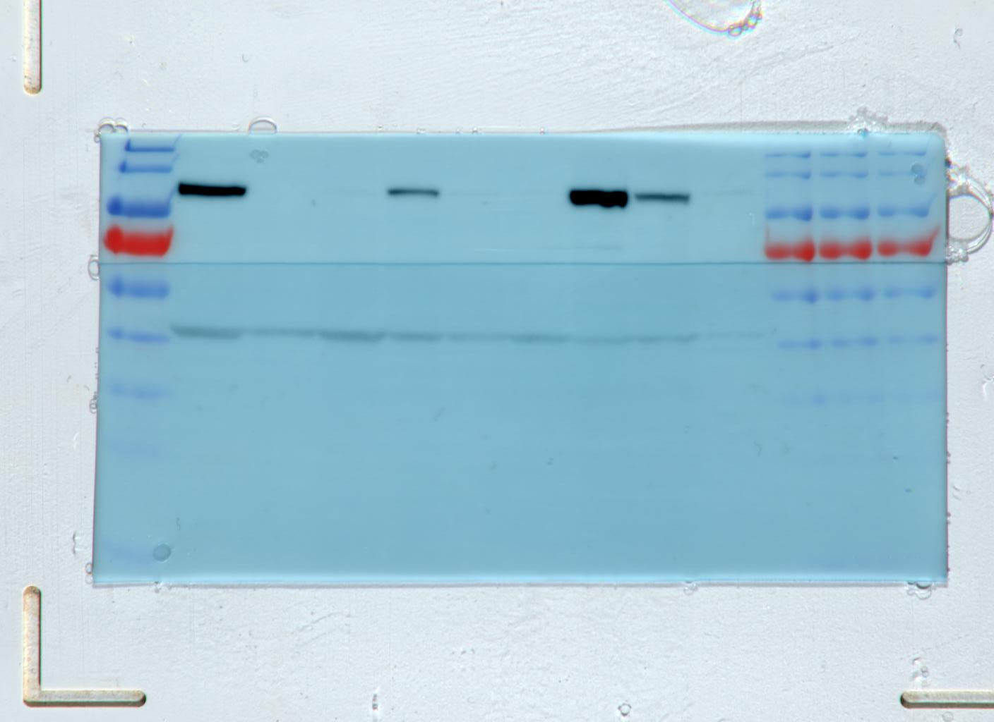
Figure 2A, S9A
OCI-AML2
(Figure 2A)
NB4
(Figure S9A)
OCI-M2
(Figure 2A)
shLONP1 3’UTR
shLONP1 3’UTR
shLONP1 3’UTR
shLONP1 1755
shLONP1 1755
shLONP1 1755
shControl
shControl
shControl
kDa
170
130
95
72
55
43
34
26
17
LONP1
Beta-Actin

Slide 3
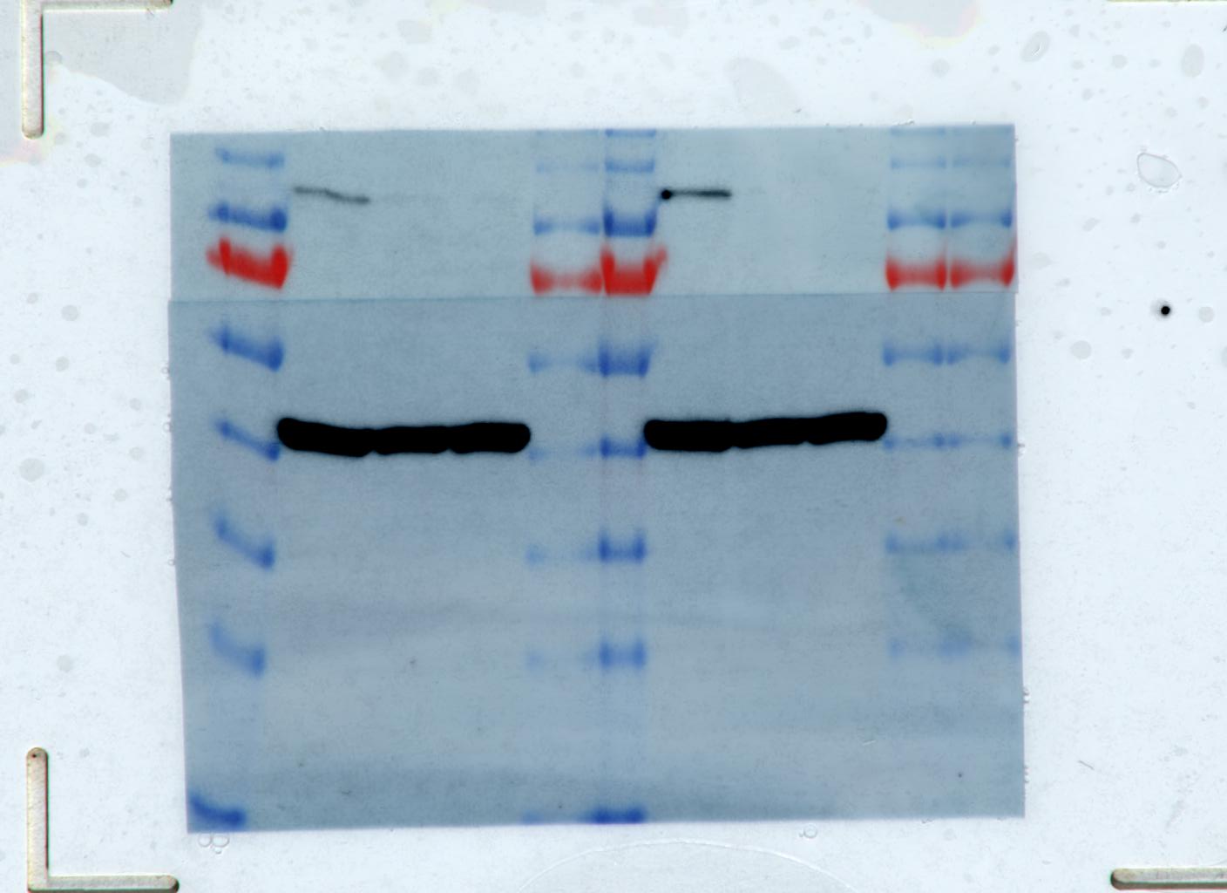
Figure 2A
OCI-AML2 expressing
Cas9 (Figure 2A)
sg1 LONP1
sgControl
sg2 LONP1
kDa
170
130
95
72
55
43
34
26
17
Not used in
manuscript
LONP1
Beta-Actin

Slide 4
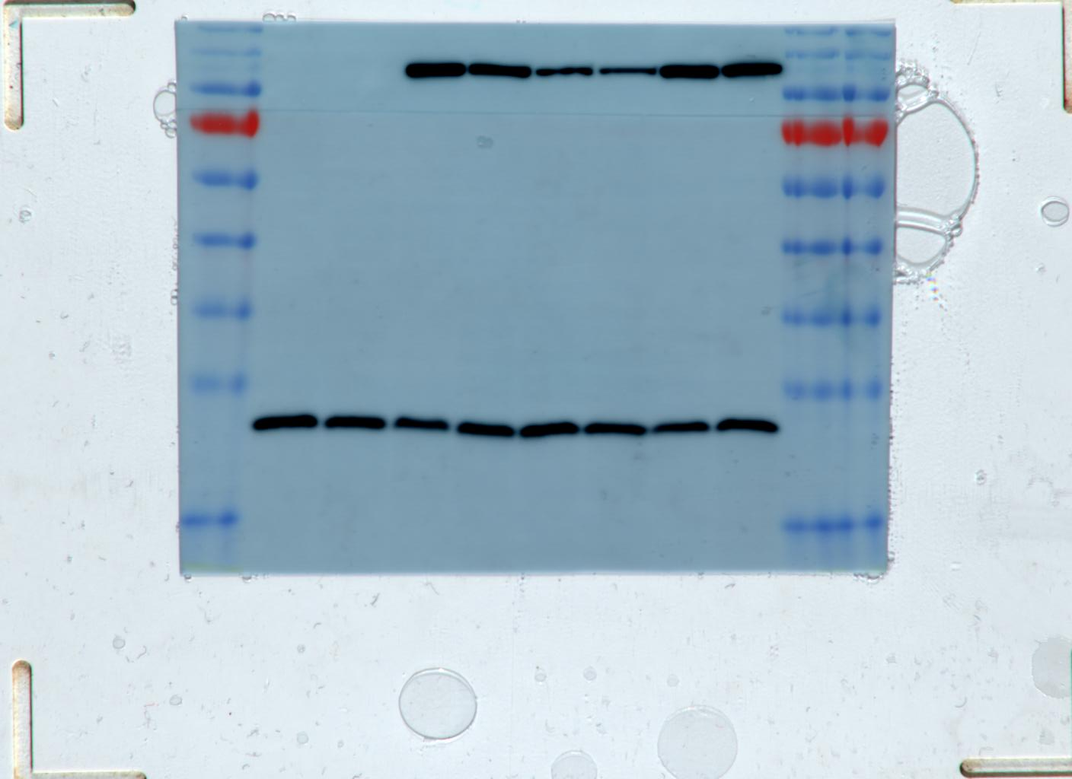
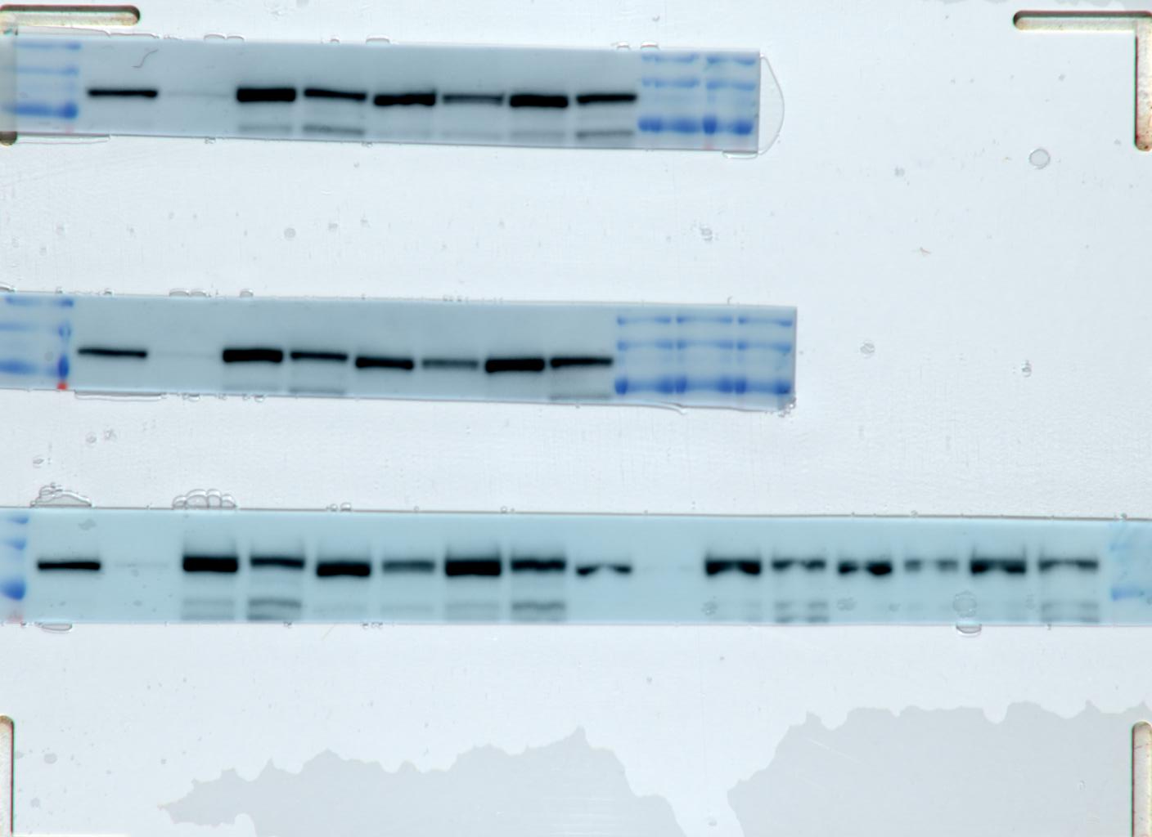
Empty vector
+ | +
 |  | + | +
 |  |  |  | + | +
 |  |  |  |  |  | + | +
+ |  | + |  | + |  | +
 | + |  | + |  | + |  | +
LONP1^{wt}
Empty vector
+ | +
 |  | + | +
 |  |  |  | + | +
 |  |  |  |  |  | + | +
+ |  | + |  | + |  | +
 | + |  | + |  | + |  | +
LONP1^{E591A}
LONP1^{wt}
LONP1^{S855A}
LONP1^{E591A}
shControl
FLAG fragment stripped and re-blotted with new aliquot of LONP1 antibody
LONP1^{S855A}
shLONP1 3’UTR
shControl
170
130
95
72
55
43
34
26
17
shLONP1 3’UTR
FLAG
kDa
170
130
95
Figure 5A
LONP1
Not used in manuscript
MnSOD
Figure S9C
Not used in manuscript

Slide 5
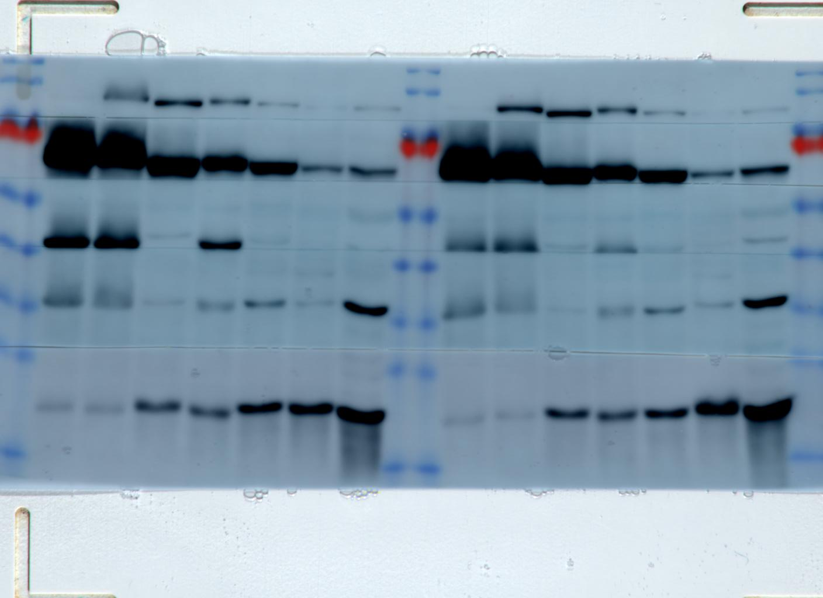
Figure 6A
mouse
Not used in
manuscript
OCI-AML2
Not used in
manuscript
Heart
kDa
170
130
95
72
55
43
34
26
17
A20
Liver
Brain
LONP1
Not used in manuscript
MnSOD

Slide 6
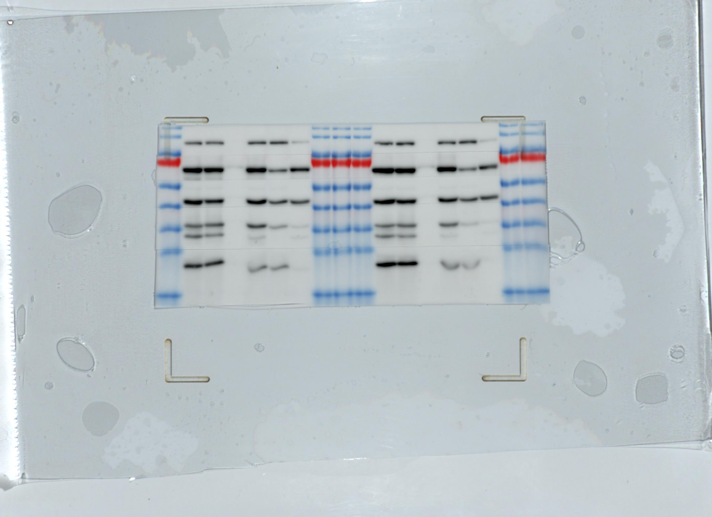
Figure 6B
Vehicle
Bardoxolone
methyl
Vehicle
Omaveloxolone
kDa
170
130
95
72
55
43
34
26
17
MT
S
P
MT
S
P
MT
S
P
MT
S
P
LONP1
CLPX
TUFM
NDUFA9
MnSOD

Slide 7
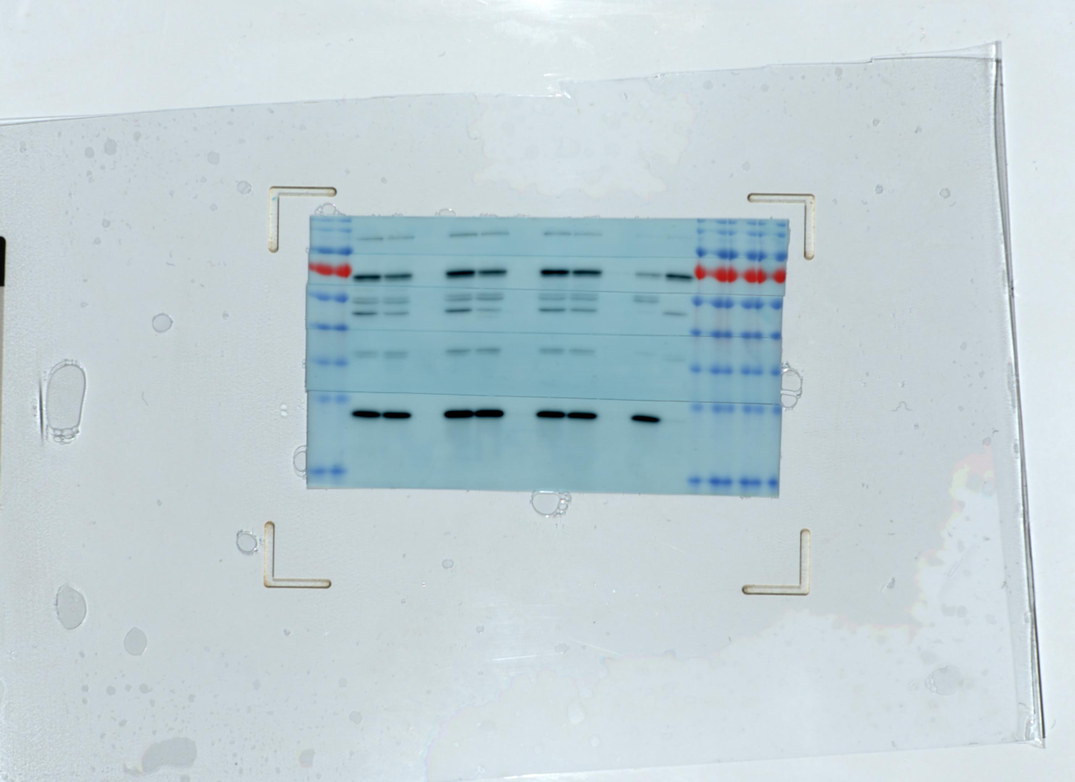
Figure 6C
Bardoxolone
methyl
Omaveloxolone
kDa
170
130
95
72
55
43
34
26
17
Vehicle
45ºC
MT
S
P
MT
S
P
MT
S
P
S
P
LONP1
CLPX
TUFM
NDUFA9
MnSOD

Slide 8
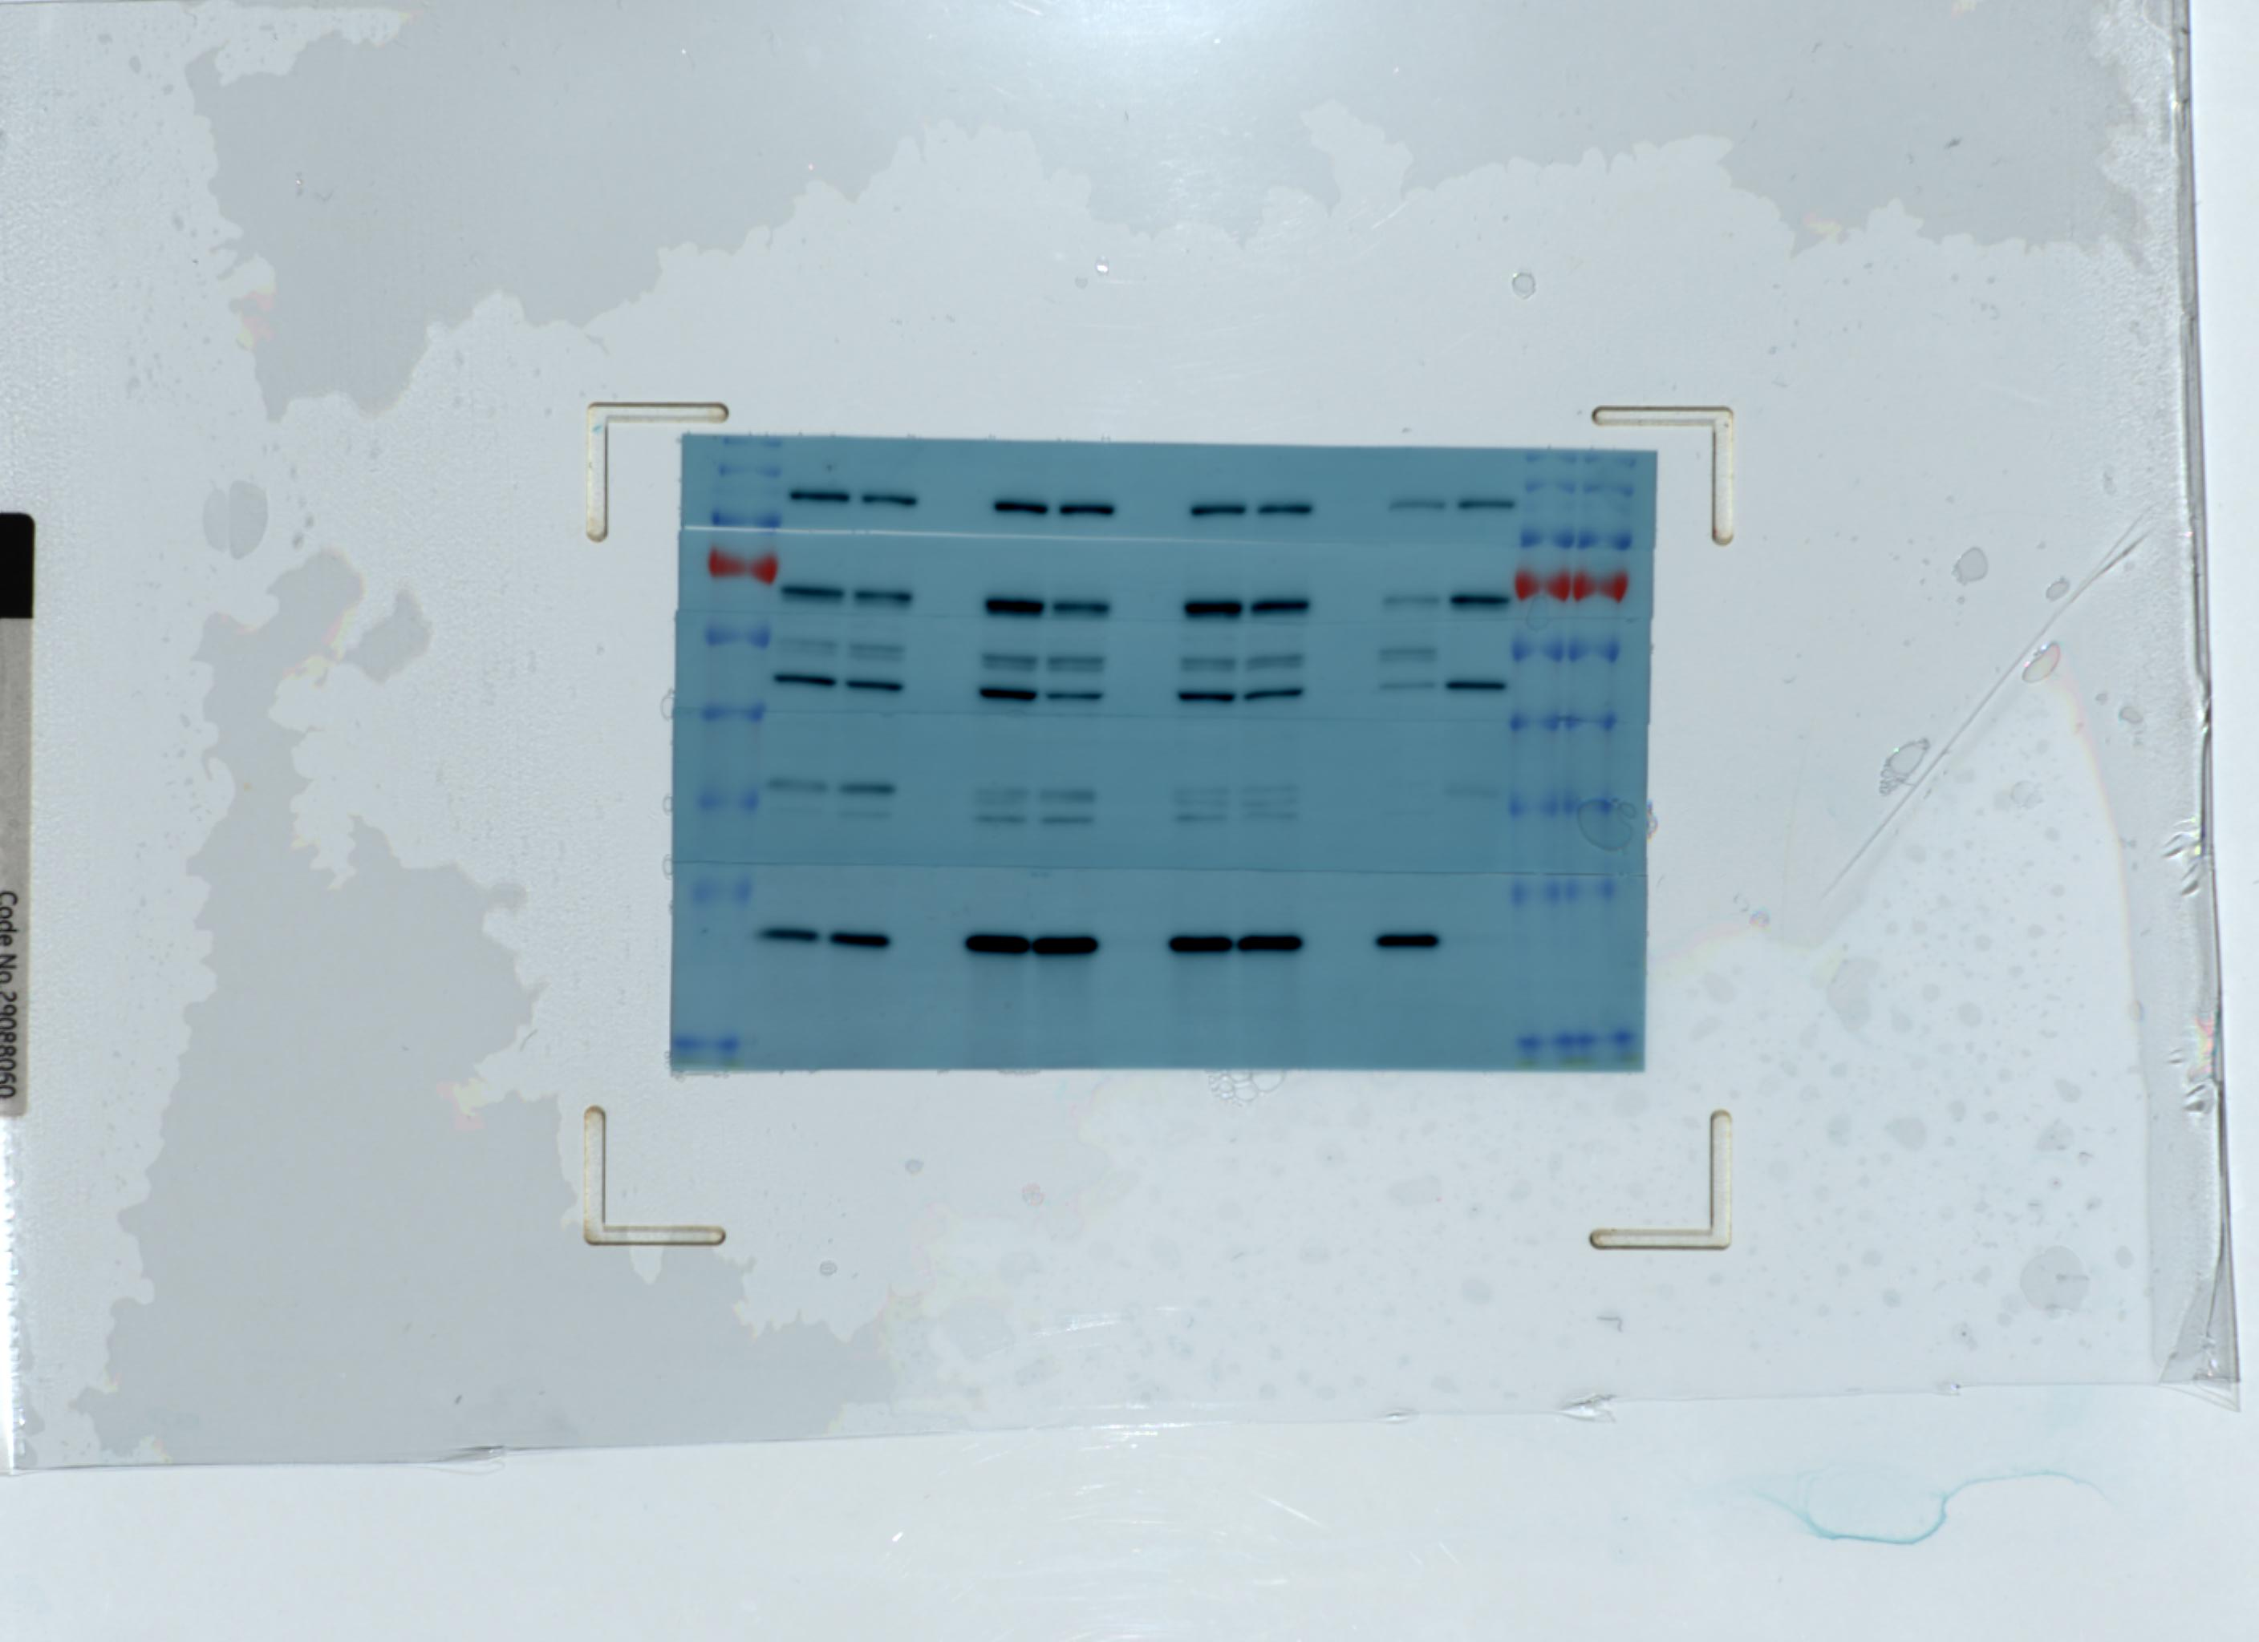
Figure 6D
Bardoxolone
methyl
45ºC
kDa
170
130
95
72
55
43
34
26
17
Vehicle
Omaveloxolone
MT
S
P
MT
S
P
MT
S
P
S
P
LONP1
CLPX
TUFM
NDUFA9
MnSOD

Slide 9
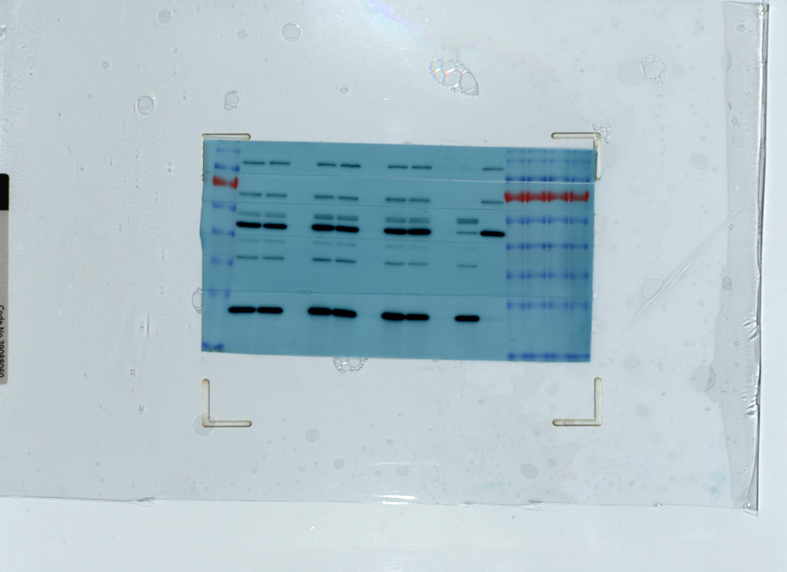
Figure 6E
Bardoxolone
methyl
45ºC
kDa
170
130
95
72
55
43
34
26
17
Vehicle
Omaveloxolone
MT
S
P
MT
S
P
MT
S
P
S
P
LONP1
CLPX
TUFM
NDUFA9
MnSOD

Slide 10
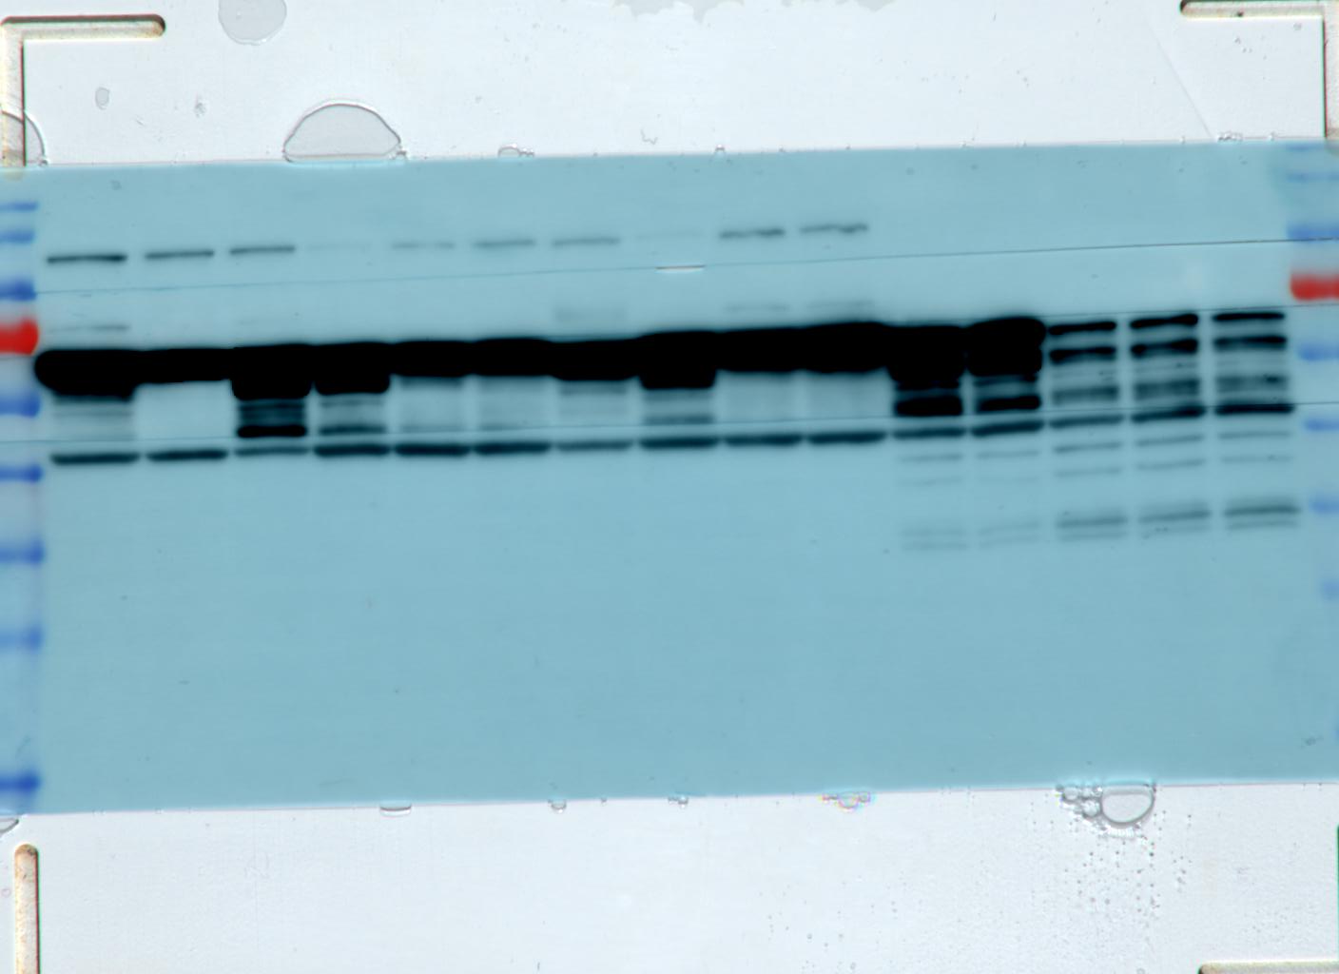
Figure S5B
Primary AML
Normal
OCI-AML2
199810
kDa
170
130
95
72
55
43
34
26
17
162111
844355
6164
100356
140301
245174
100857
110633
#1
#2
#3
#4
#5
LONP1
Not used in manuscript
Beta-actin

Slide 11
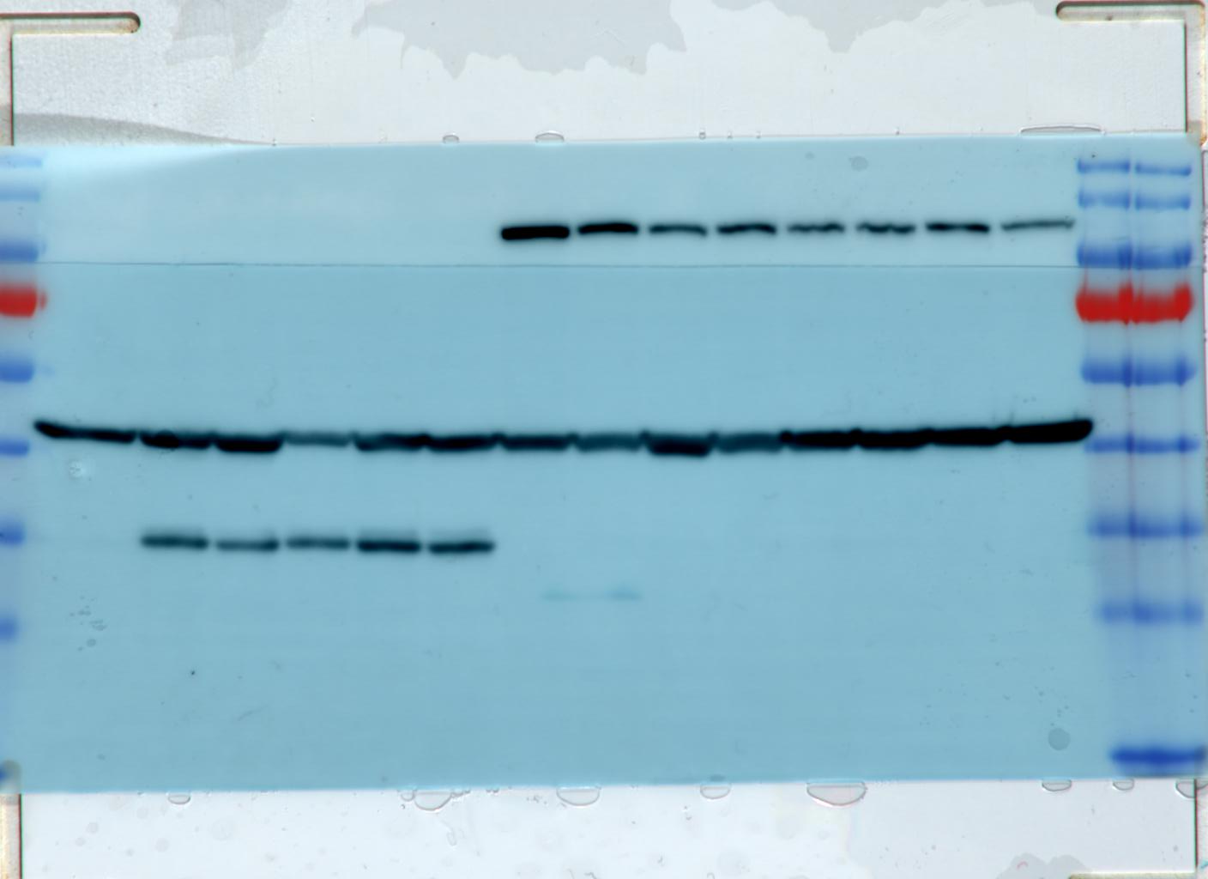
Figure S5B
CD34+
Normal
Primary AML
OCI-AML2
160853
161965
100388
120697
161153
151656
kDa
170
130
95
72
55
43
34
26
17
130853
#6
#7
#8
#6
#7
#8
LONP1
Beta-actin

Slide 12
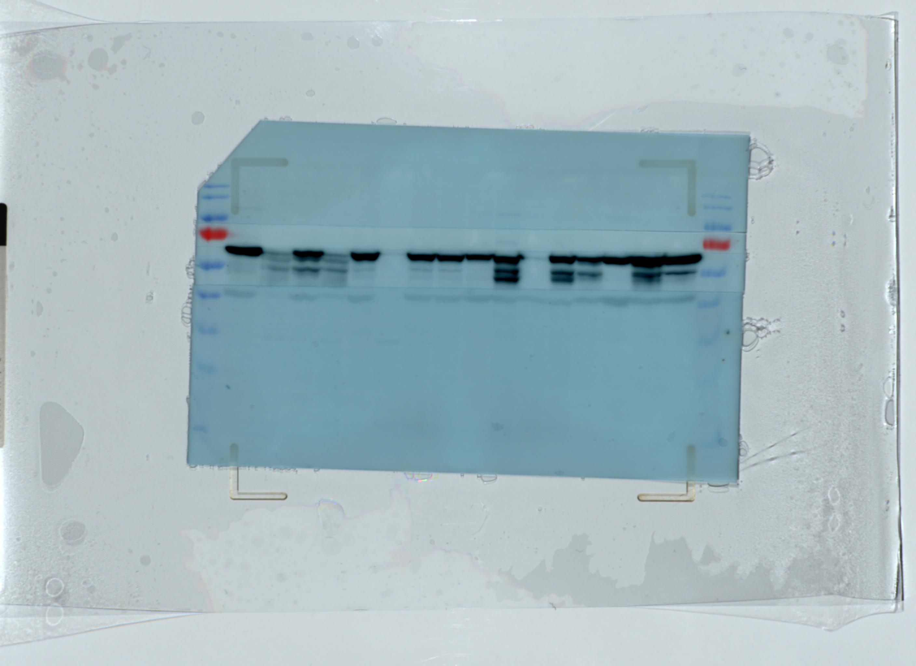
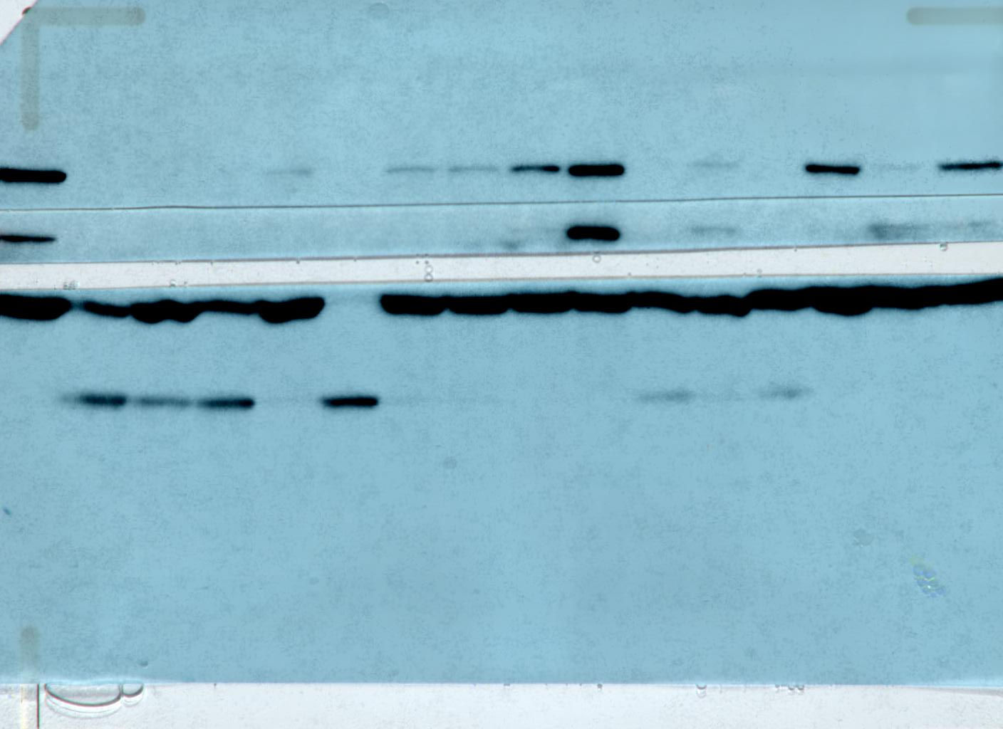
Figure S5B
Unused fragment on original blot with extremely high signal was removed
and blot without this fragment was re-imaged to the left.
Not used in manuscript
Re-imaged blot used in manuscript
Unused fragment
removed
Primary AML
kDa
170
130
95
72
55
43
34
26
17
Primary AML
OCI-AML2
90381
172036
80551
80250
90558
90147
192030
185484
130433
223566
160556
186253
207202
161476
161868
OCI-AML2
90381
172036
80551
80250
90558
90147
192030
185484
130433
223566
160556
186253
207202
161476
LONP1
161868
Not used in
manuscript
LONP1
Not used in
manuscript
Beta-actin
Beta-actin

Slide 13
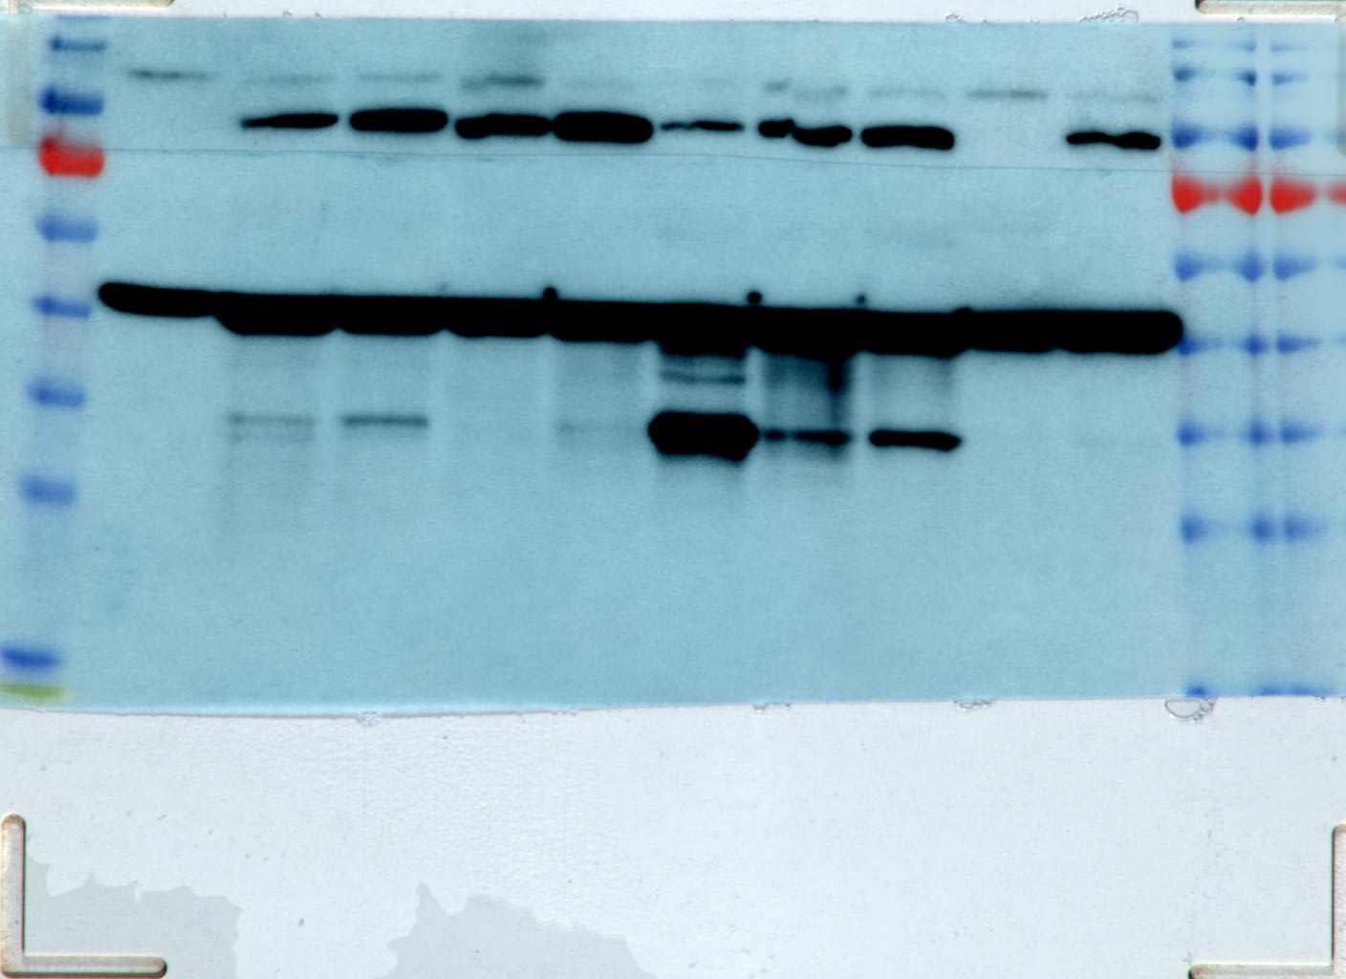
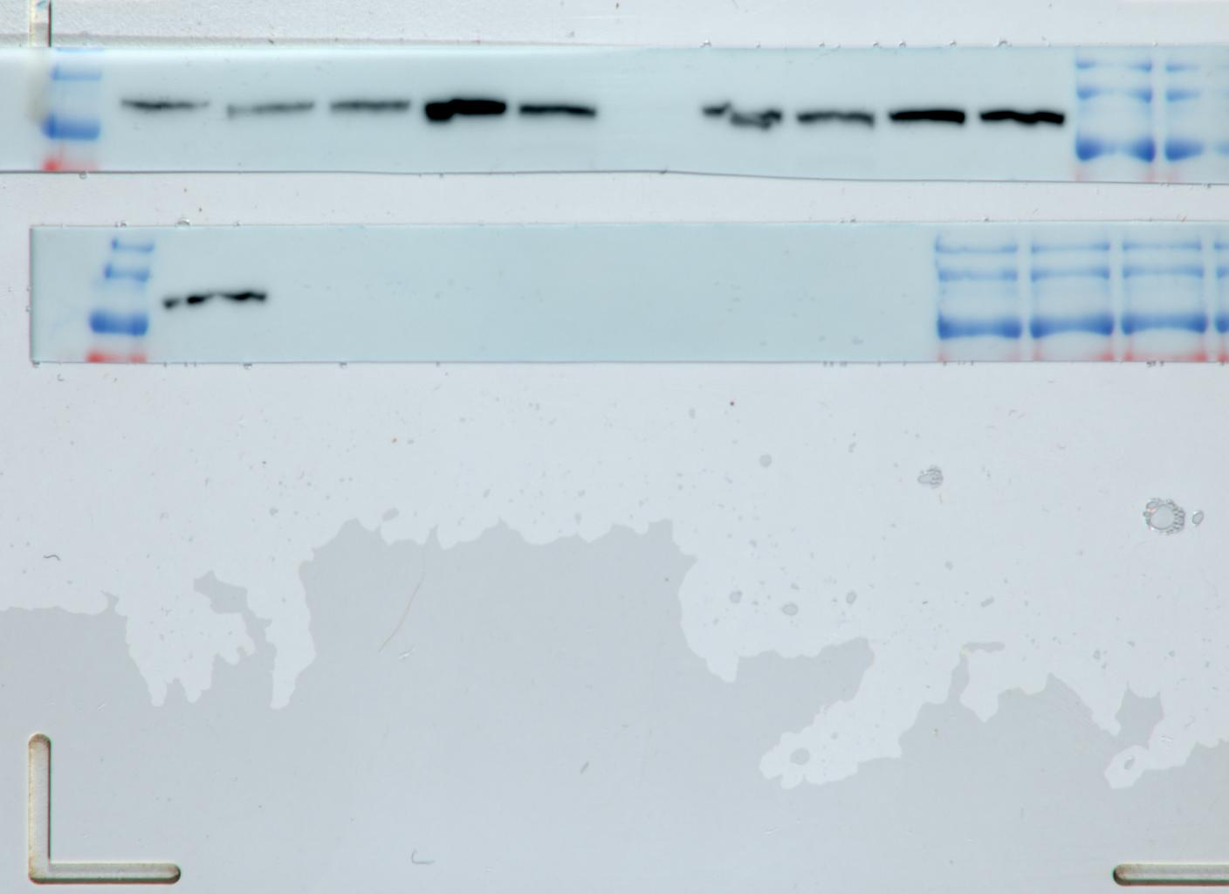
Figure S5B
Not used in manuscript due to
unexpected double band; LONP1 should produce a band above 95 kDa
Primary AML
Top fragment stripped and
reblotted with new LONP1 antibody
Primary AML
1022957
OCI-AML2
OCI-AML2
130579
1021535
90784
1038828
827875
220776
1022957
90784
884575
130579
1021535
120805
1038828
827875
220776
884575
kDa
170
130
95
72
55
43
34
26
17
120805
kDa
170
130
95
LONP1
Used later in Figure S5B; see next slide for loading
Beta-actin

Slide 14
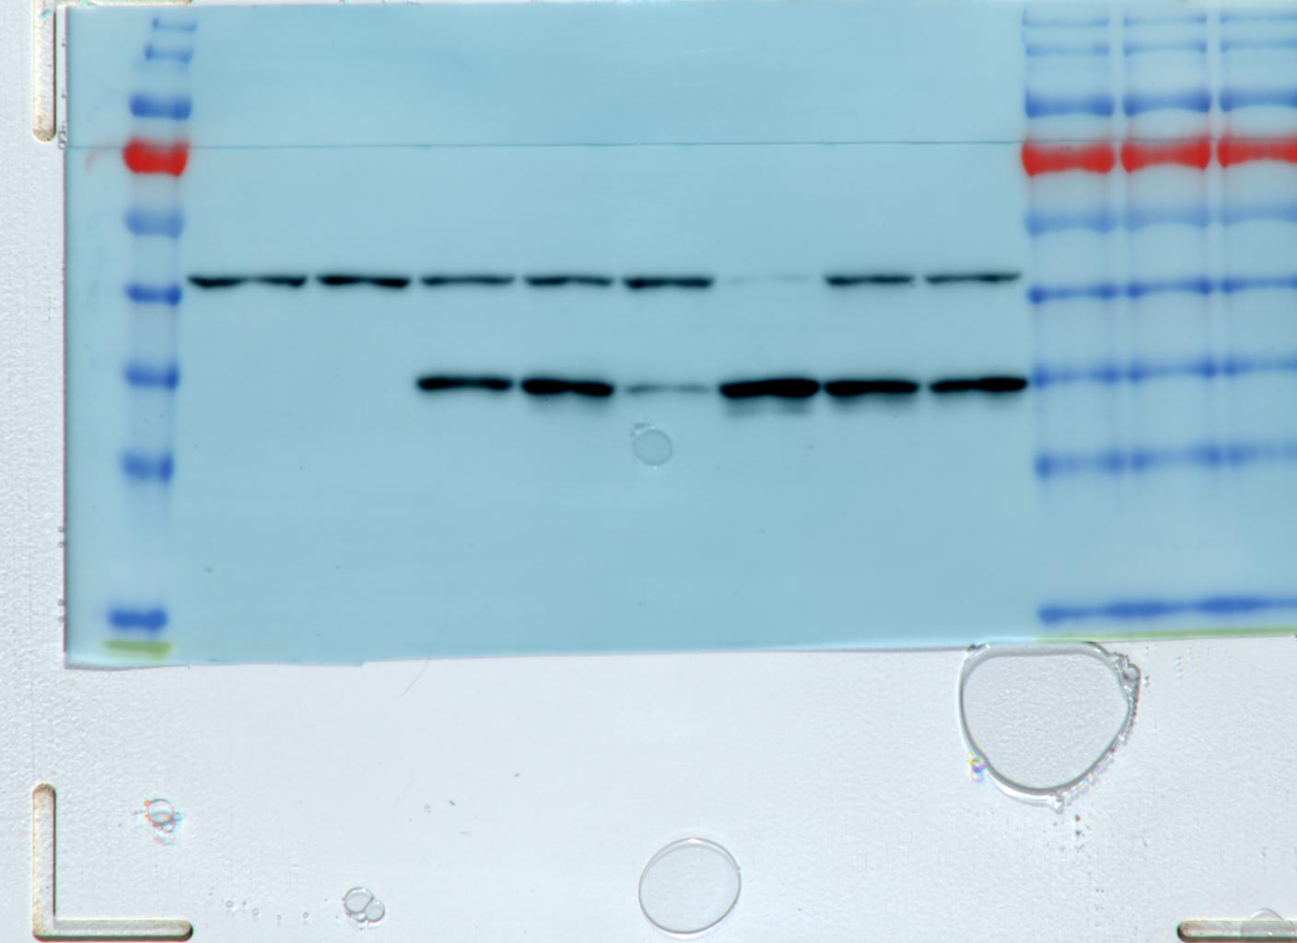
Figure S5B
Fragment re-imaged alone
without beta-actin fragment
Used in Figure S5B (see previous slide)
OCI-AML2
Normal
No LONP1 signal due to strong loading signal
kDa
170
130
95
72
55
43
34
26
17
#9
#10
#11
#12
#13
#14
#15
kDa
170
130
95
LONP1
Beta-actin
#9
#10
#11
#12
#13
#14
#15
OCI-AML2
Normal

Slide 15
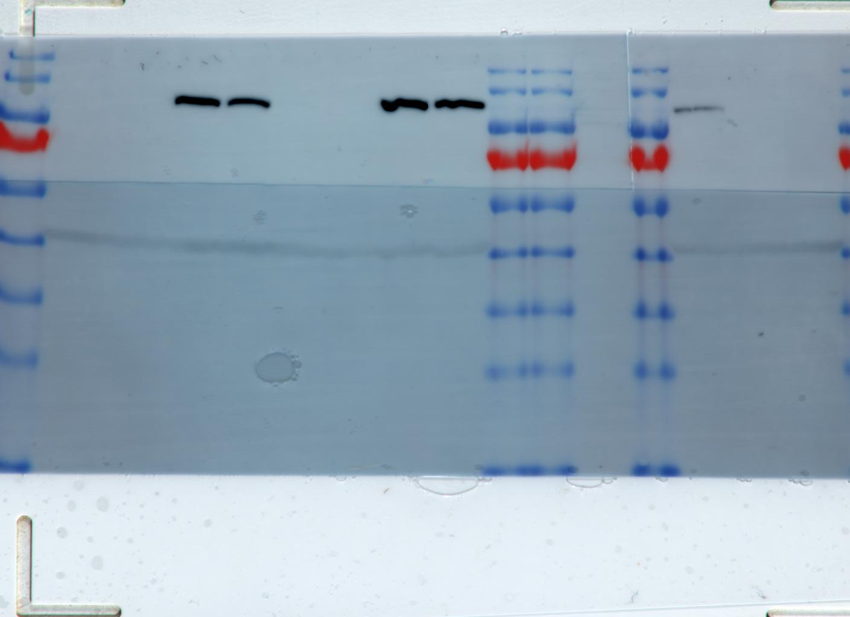
Figure S9A
TEX
shLONP1 3’UTR
shLONP1 1755
Not used in manuscript
shControl
kDa
170
130
95
72
55
43
34
26
17
LONP1
Beta-actin

Slide 16
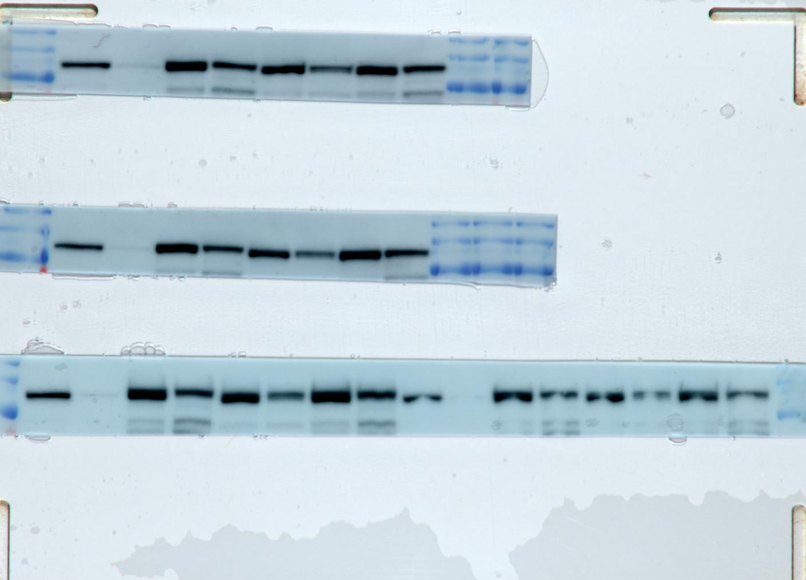
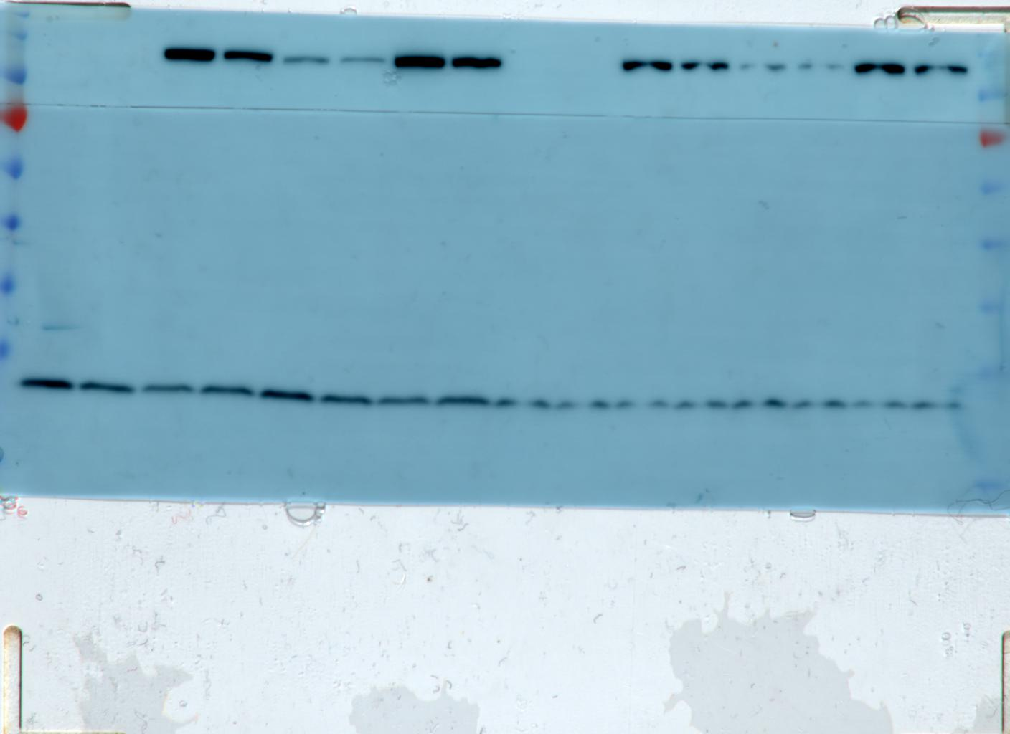
Figure S9C
Used in Figure 5A
Empty vector
FLAG fragment stripped and
re-blotted with LONP1 antibody
+ | +
 |  | + | +
+ |  | +
 | + |  | +
Not used in manuscript
shControl
LONP1^{wt}
shLONP1 3’UTR
Not used in manuscript
170
130
95
72
55
43
34
26
17
Not used in manuscript
FLAG
170
130
95
LONP1
Empty vector
+ | +
 |  | + | +
+ |  | +
 | + |  | +
shControl
Beta-actin
LONP1^{wt}
shLONP1 3’UTR

Slide 17
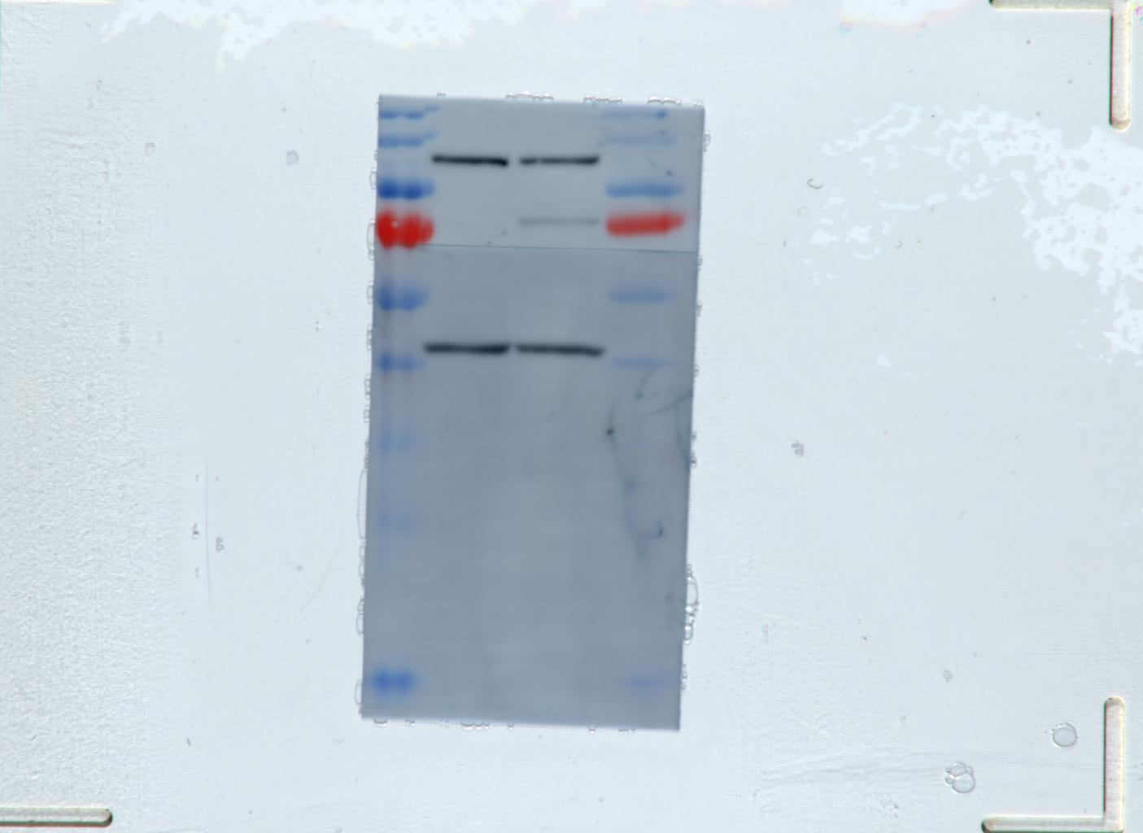
Figure S16
AML 1009107
OCI-AML2
kDa
170
130
95
72
55
43
34
26
17
LONP1
Beta-actin

Slide 18
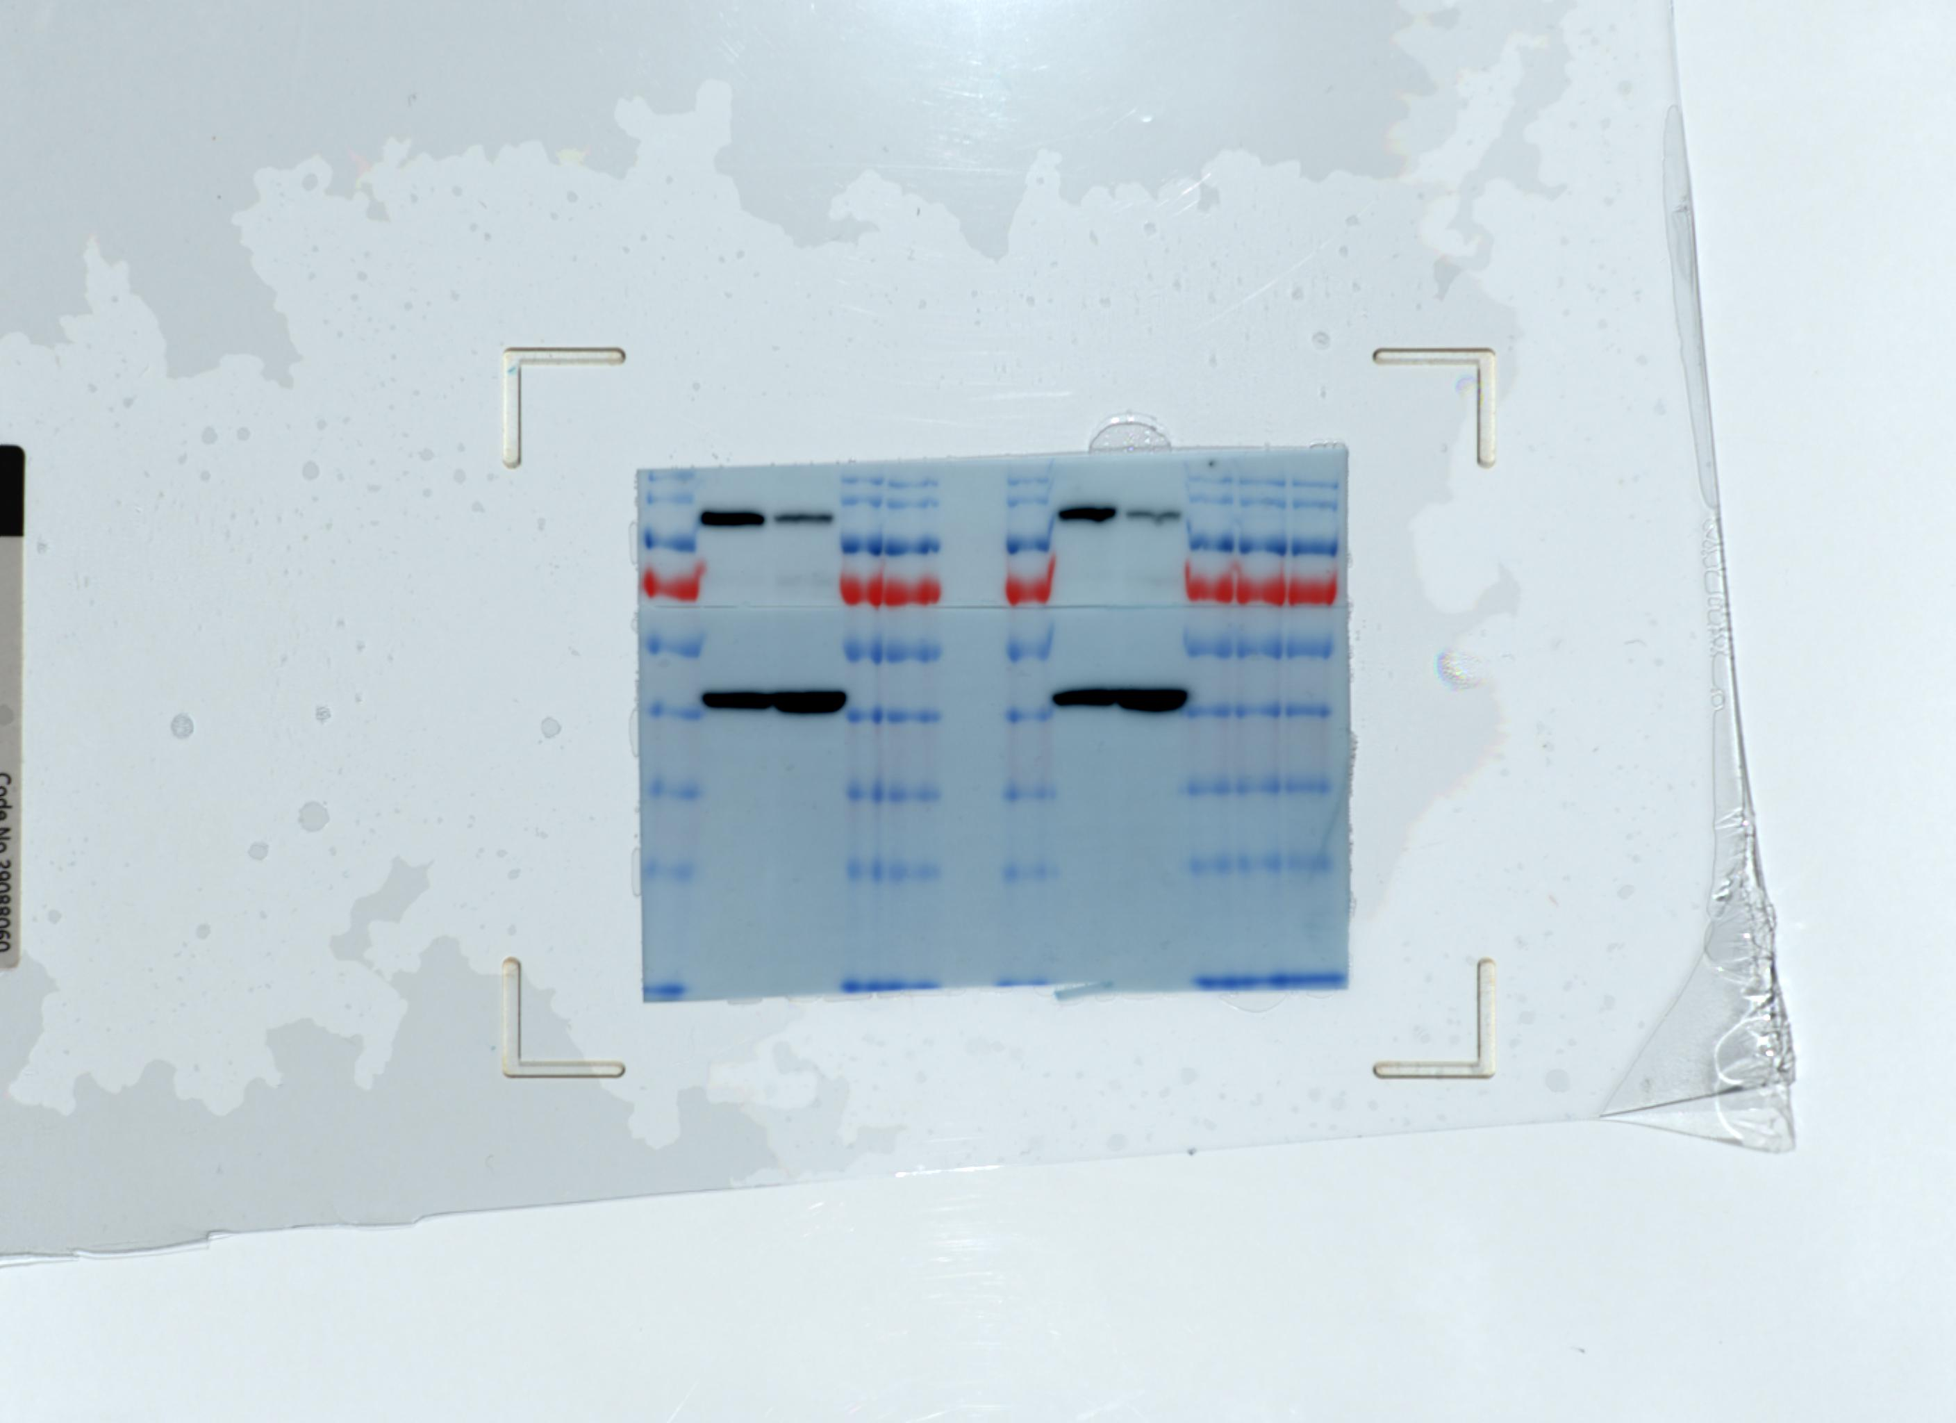
Figure S16
Not used
in manuscript
OCI-AML2
AML 1004783
kDa
170
130
95
72
55
43
34
26
17
LONP1
Beta-actin

Slide 19
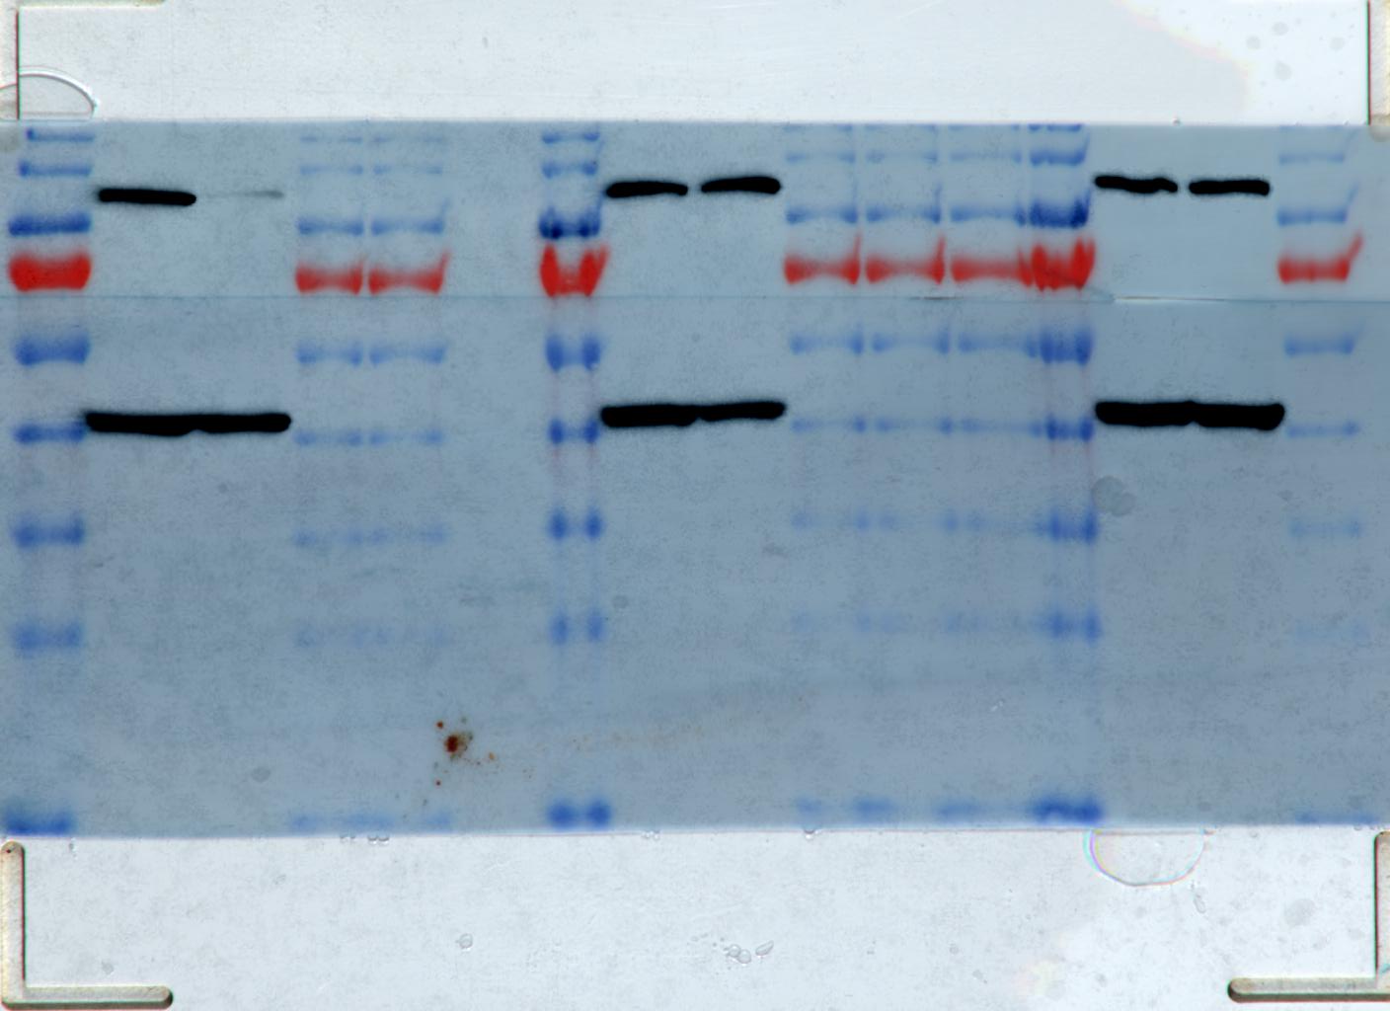
Figure S16
AML 1021537
AML 1039024
AML 1022957
OCI-AML2
OCI-AML2
OCI-AML2
kDa
170
130
95
72
55
43
34
26
17
LONP1
Beta-actin

Slide 20
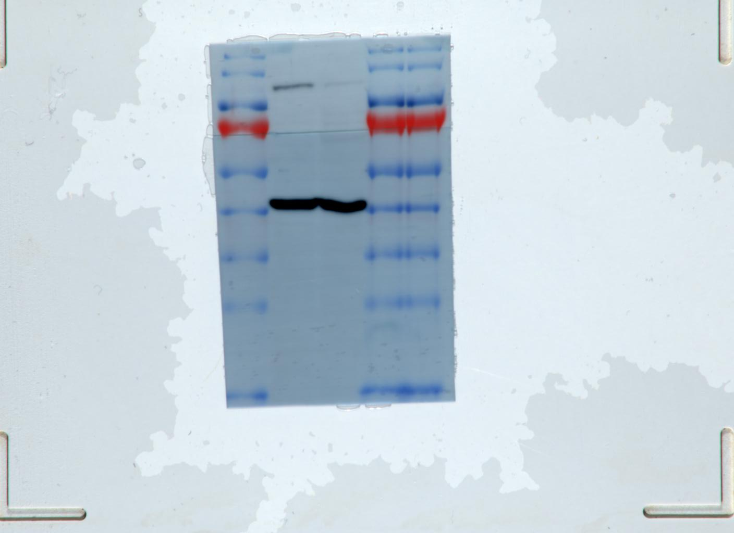
Figure S16
AML 1021966
OCI-AML2
kDa
170
130
95
72
55
43
34
26
17
LONP1
Beta-actin

Slide 21
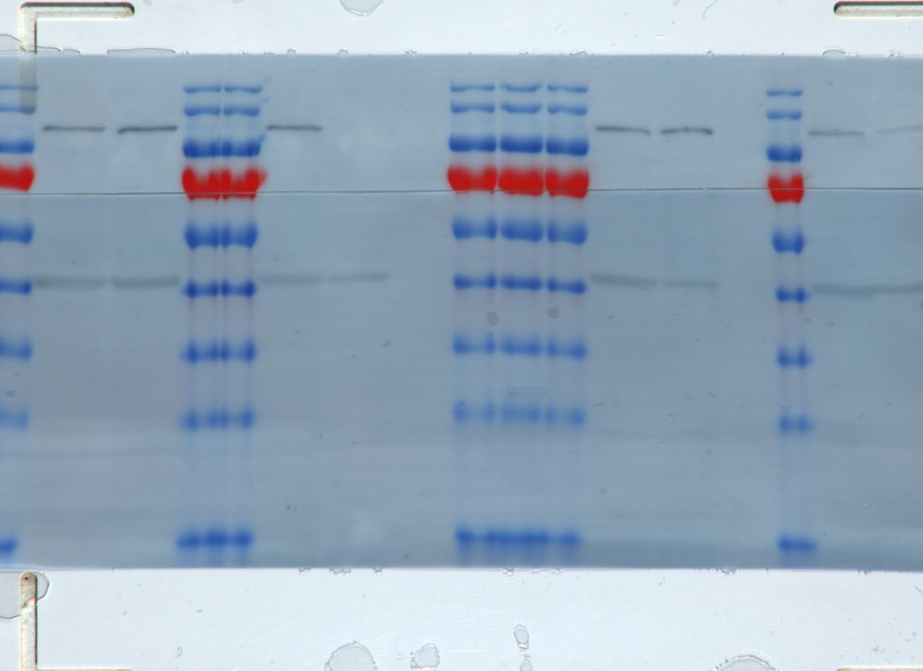
Figure S16
Not used in
manuscript
AML 1039034
Not used in
manuscript
OCI-AML2
kDa
170
130
95
72
55
43
34
26
17
LONP1
Beta-actin

Slide 22
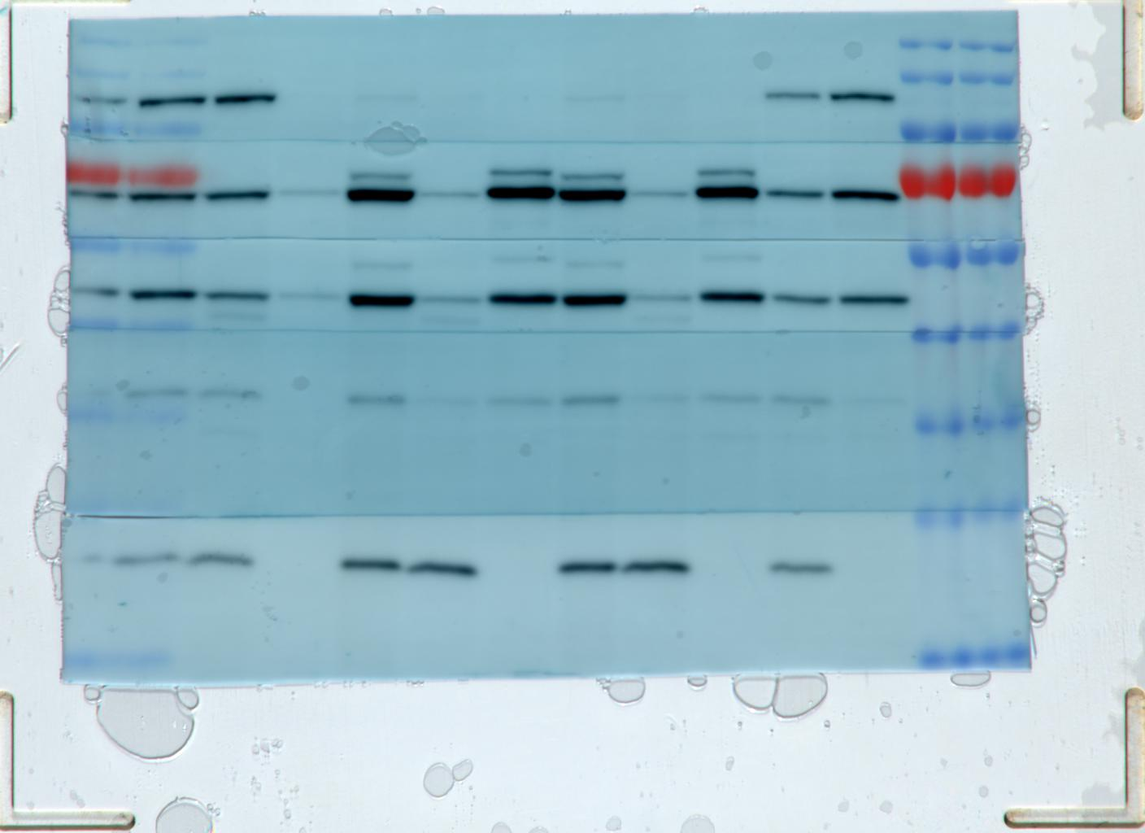
Figure S18
OCI-AML2
shControl
shLONP1
1755
shLONP1
3’UTR
45ºC
MT
S
P
MT
S
P
MT
S
P
S
P
kDa
170
130
95
72
55
43
34
26
17
LONP1
CLPX
TUFM
NDUFA9
MnSOD

Slide 23
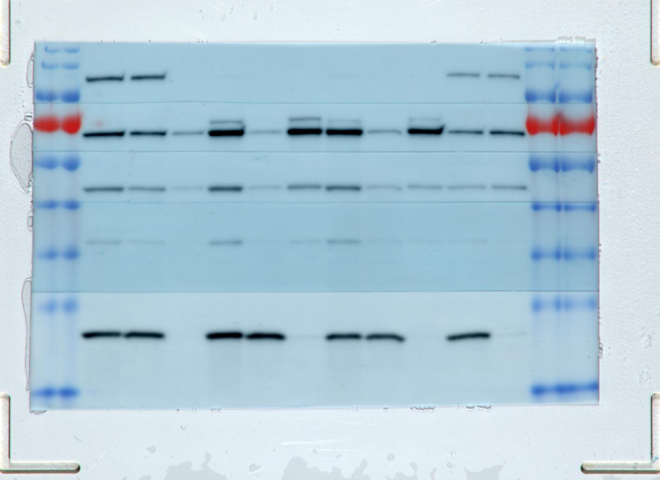
Figure S19A
OCI-AML2 expressing Cas9
sgControl
sg1 LONP1
sg2 LONP1
45ºC
kDa
170
130
95
72
55
43
34
26
17
MT
S
P
MT
S
P
MT
S
P
S
P
LONP1
CLPX
TUFM
NDUFA9
MnSOD

Slide 24
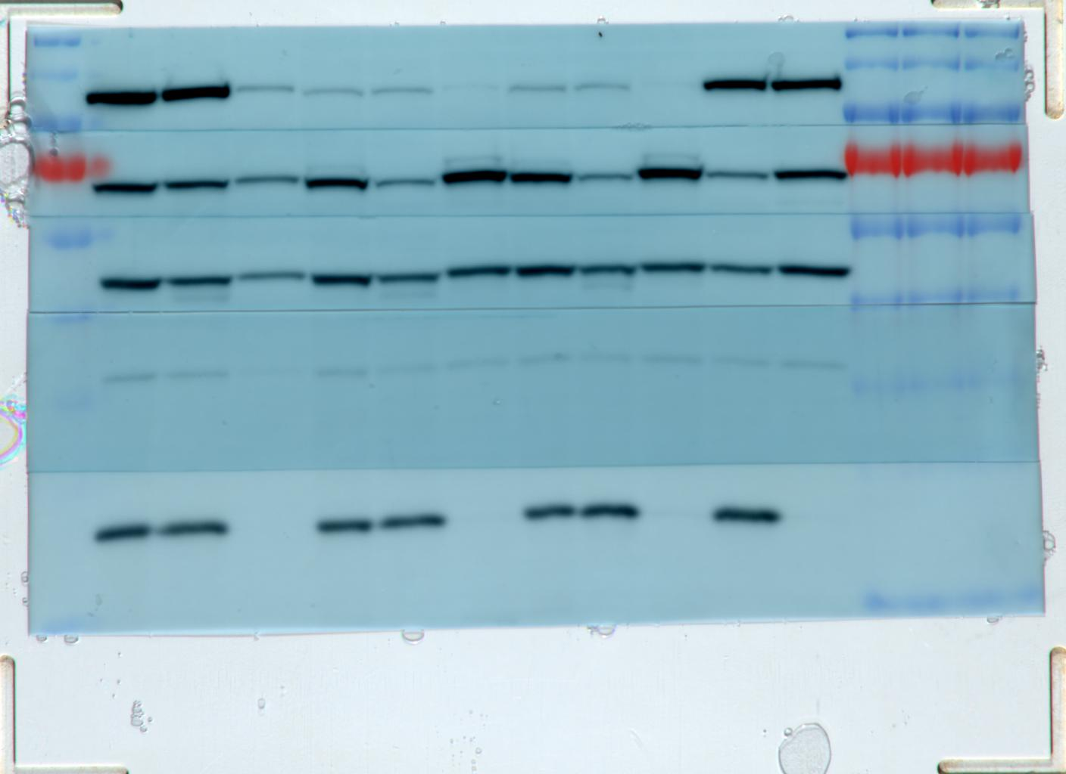
Figure S19A
OCI-M2
shLONP1
1755
shLONP1
3’UTR
shControl
45ºC
MT
S
P
MT
S
P
MT
S
P
S
P
kDa
170
130
95
72
55
43
34
26
17
LONP1
CLPX
TUFM
NDUFA9
MnSOD

Slide 25
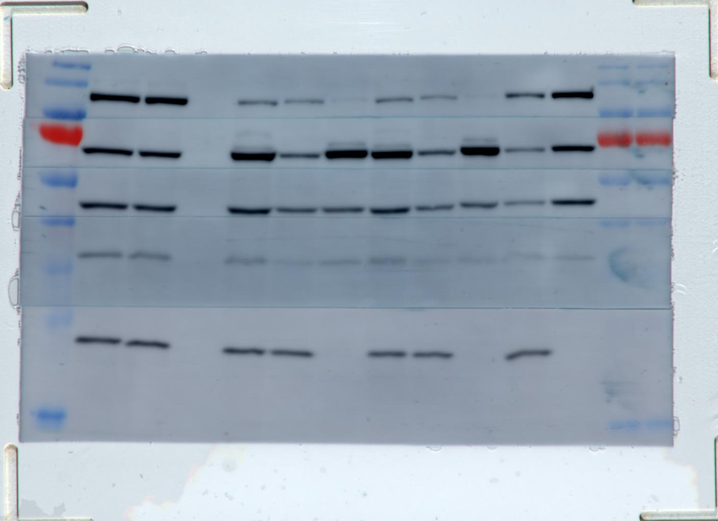
Figure S19A
TEX
shControl
shLONP1
1755
shLONP1
3’UTR
45ºC
kDa
170
130
95
72
55
43
34
26
17
MT
S
P
MT
S
P
MT
S
P
S
P
LONP1
CLPX
TUFM
NDUFA9
MnSOD

Slide 26
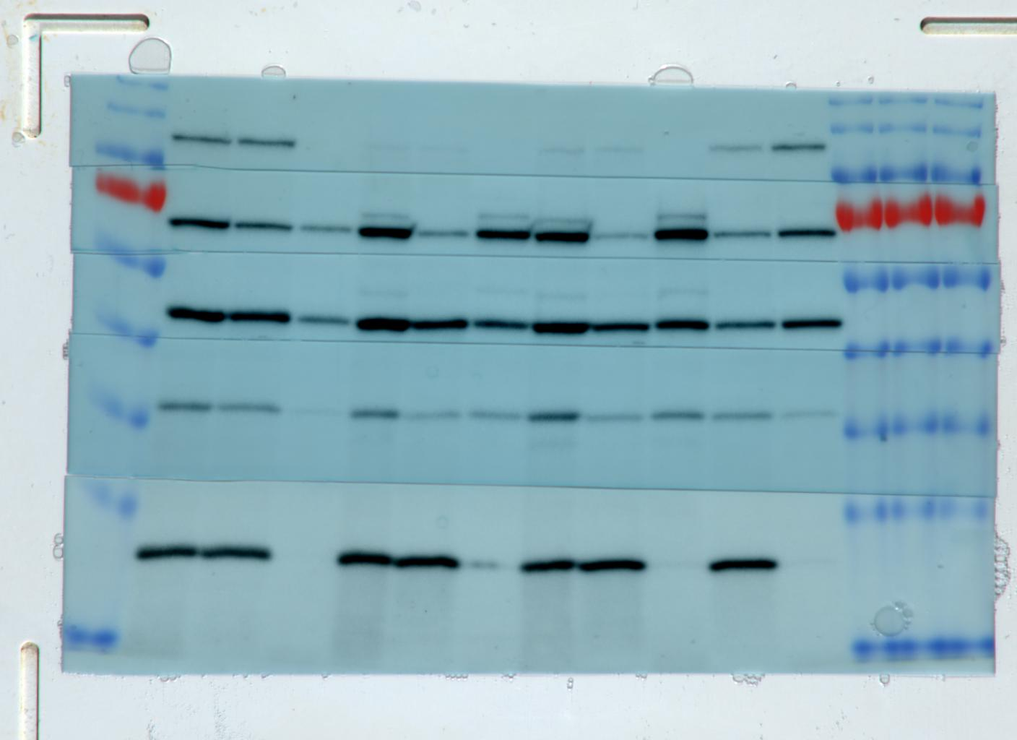
Figure S19A
NB4
shLONP1
1755
shLONP1
3’UTR
shControl
45ºC
kDa
170
130
95
72
55
43
34
26
17
MT
S
P
MT
S
P
MT
S
P
S
P
LONP1
CLPX
TUFM
NDUFA9
MnSOD

Slide 27
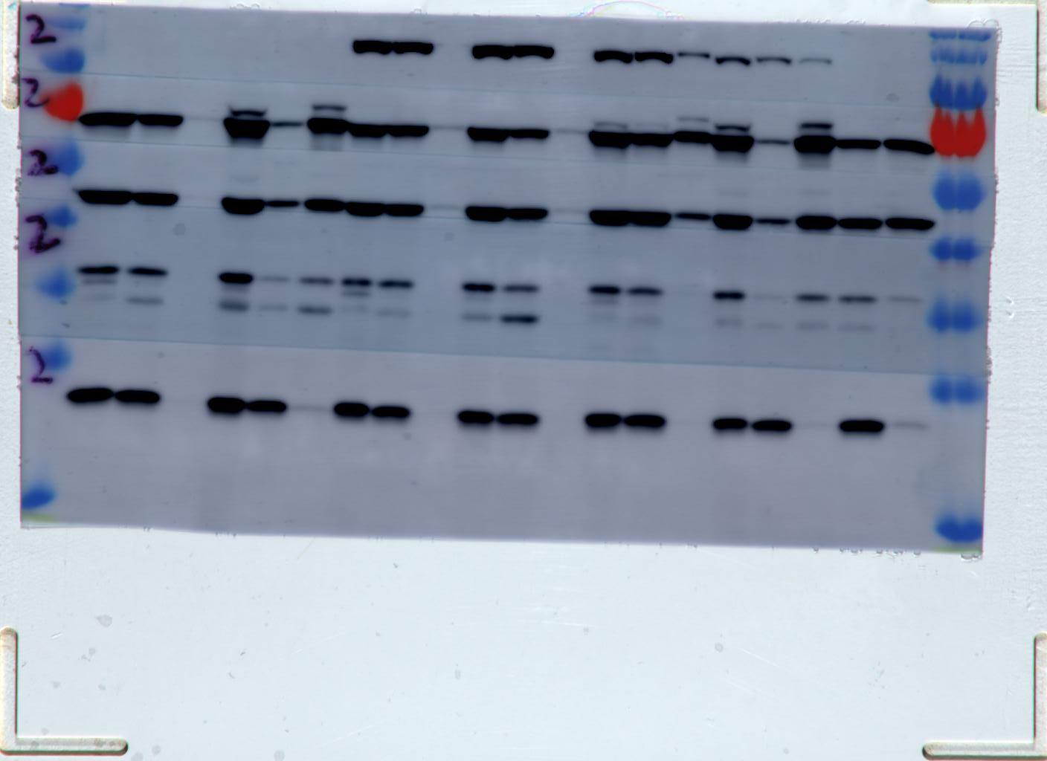
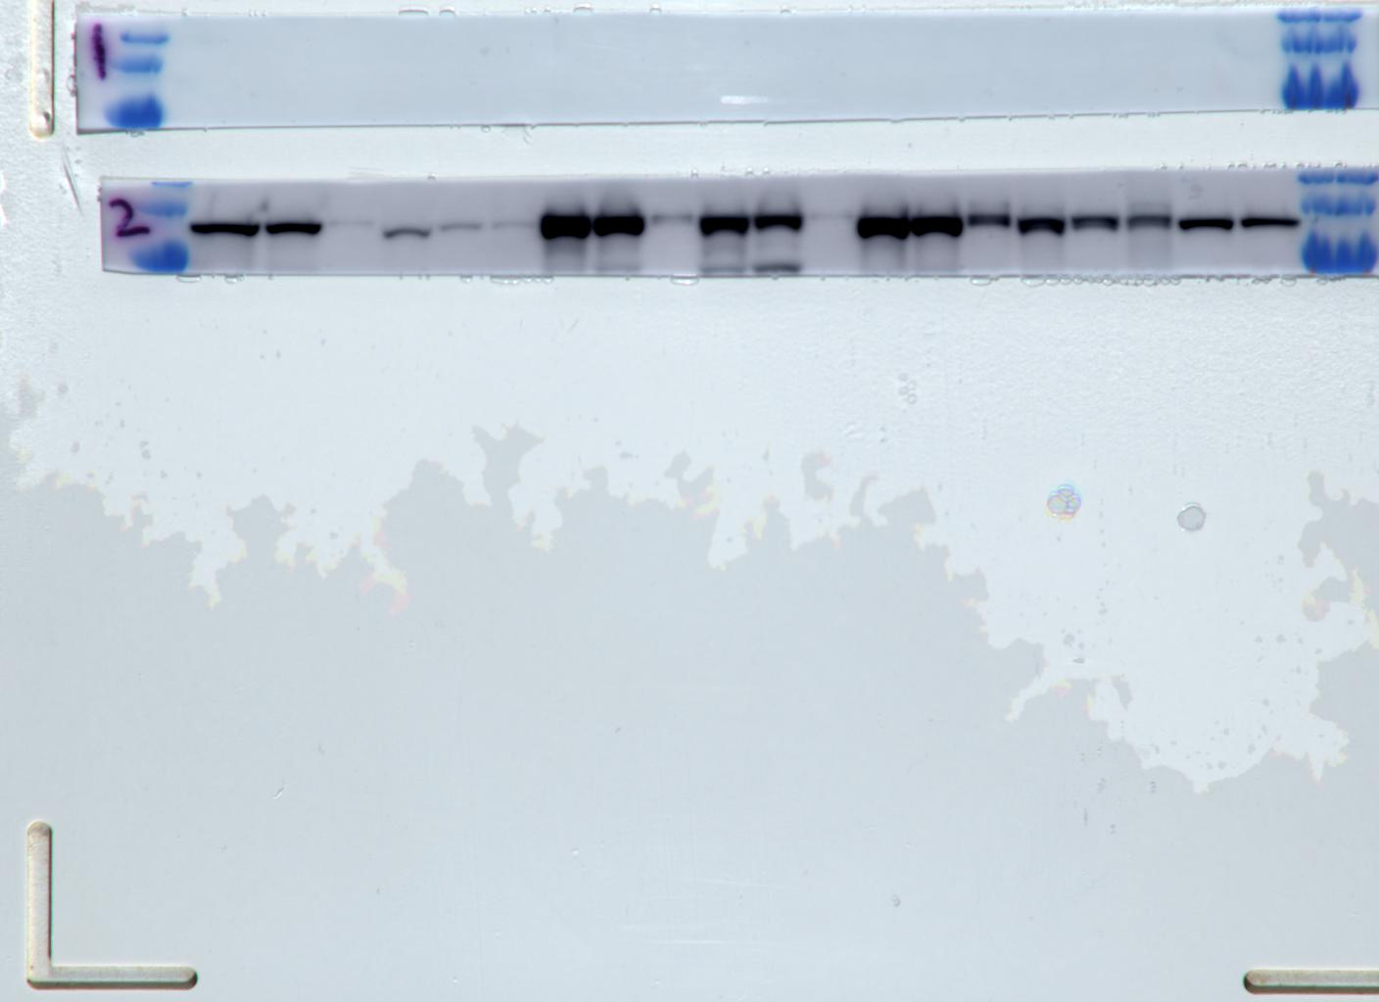
Figure S21
Empty vector
+ | + |  |  |  |  | +
 |  | + | +
 |  |  |  | + | +
+ |  | + |  | + |  | +
 | + |  | + |  | +
LONP1^{wt}
LONP1^{E591A}
LONP1^{S855A}
shControl
shLONP1 3’UTR
170
130
95
72
55
43
34
26
17
MT S P
MT S P
MT S P
MT S P
MT S P
MT S P
S P
FLAG
Not used in manuscript
kDa
170
130
95
CLPX
TUFM
LONP1
NDUFA9
MT S P
MT S P
MT S P
MT S P
MT S P
MT S P
S P
Empty vector
+ | + |  |  |  |  | +
 |  | + | +
 |  |  |  | + | +
+ |  | + |  | + |  | +
 | + |  | + |  | +
LONP1^{wt}
MnSOD
LONP1^{E591A}
LONP1^{S855A}
shControl
FLAG fragment stripped and
re-blotted with LONP1 antibody
shLONP1 3’UTR

Slide 28
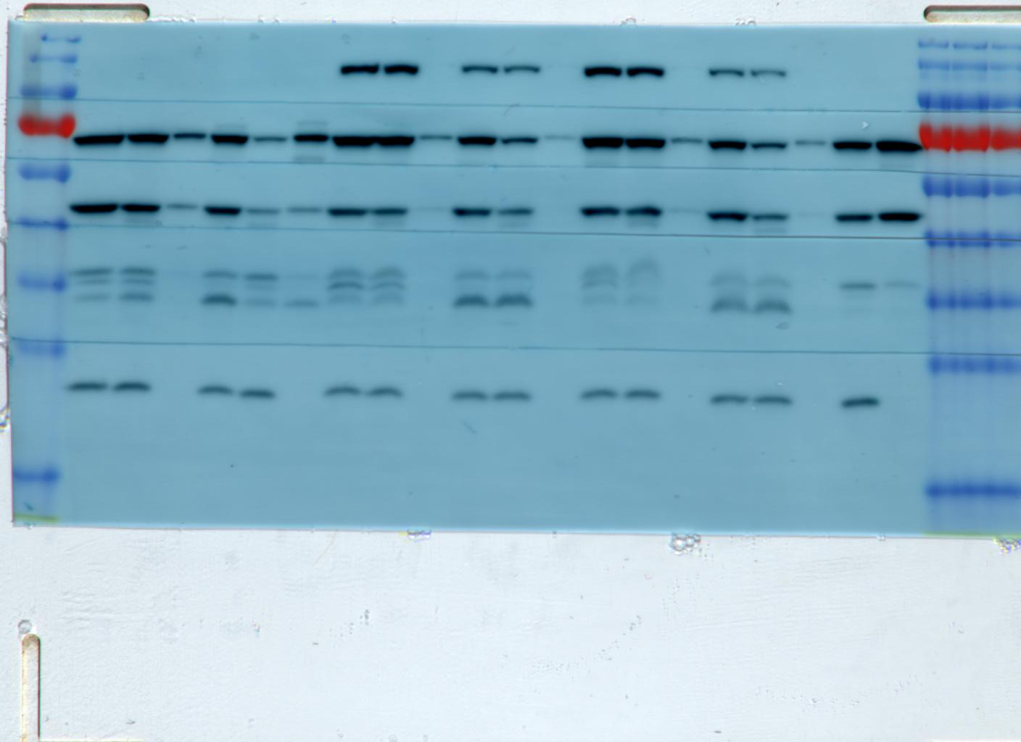
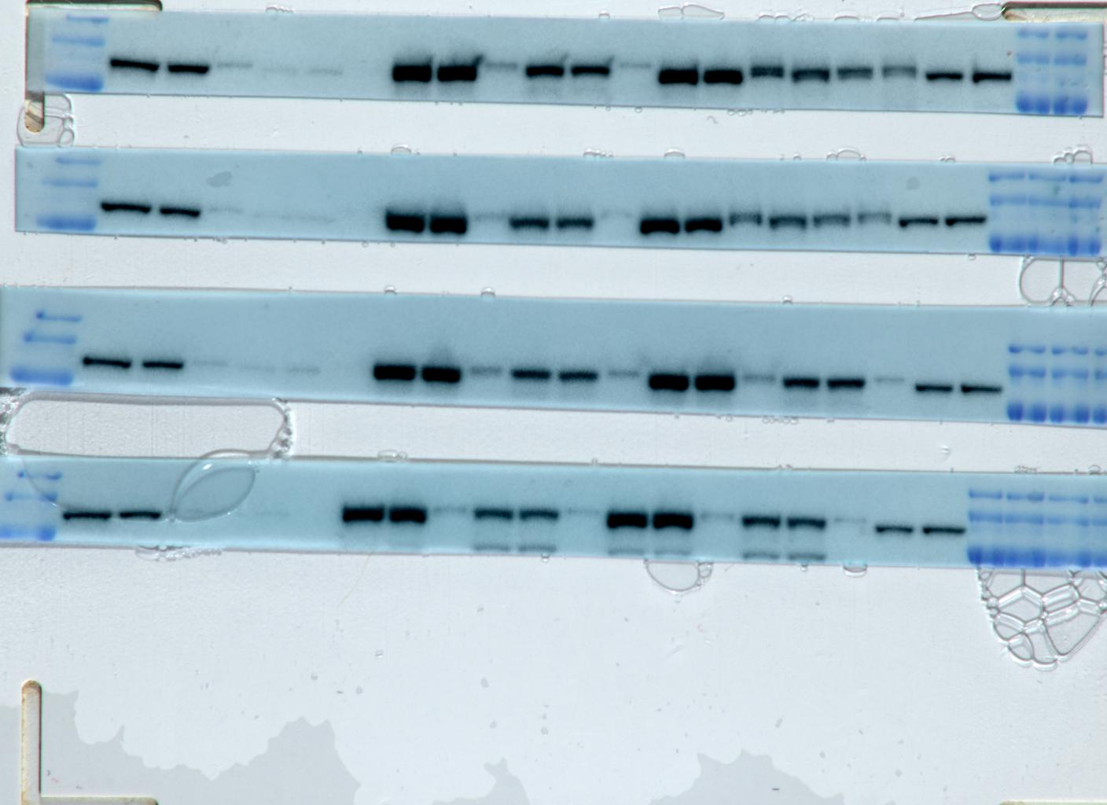
Fig S21
Empty vector
+ | + |  |  |  |  | +
 |  | + | +
 |  |  |  | + | +
+ |  | + |  | + |  | +
 | + |  | + |  | +
LONP1^{wt}
LONP1^{E591A}
LONP1^{S855A}
shControl
shLONP1 3’UTR
170
130
95
72
55
43
34
26
17
MT S P
MT S P
MT S P
MT S P
MT S P
MT S P
S P
FLAG
CLPX
Not used in manuscript
TUFM
FLAG fragment stripped and
re-blotted with LONP1 antibody
NDUFA9
MnSOD
170
130
95
MT S P
MT S P
MT S P
MT S P
MT S P
MT S P
S P
Empty vector
+ | + |  |  |  |  | +
 |  | + | +
 |  |  |  | + | +
+ |  | + |  | + |  | +
 | + |  | + |  | +
LONP1^{wt}
LONP1^{E591A}
LONP1^{S855A}
shControl
shLONP1 3’UTR

