Slide 1
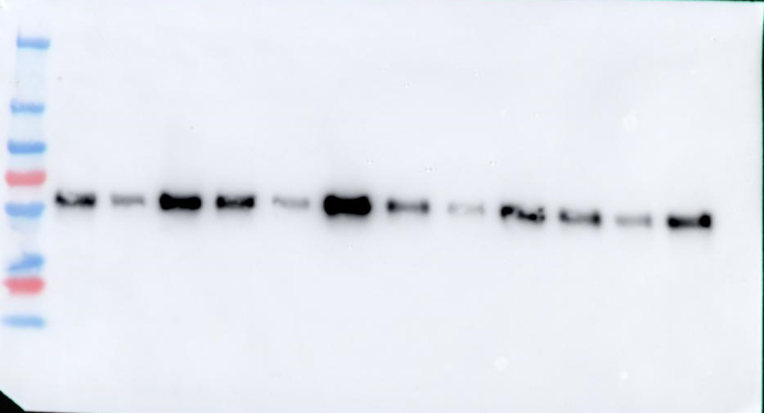
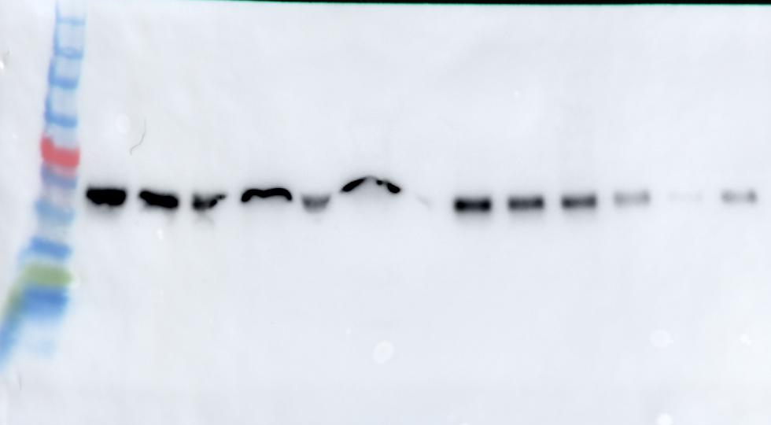
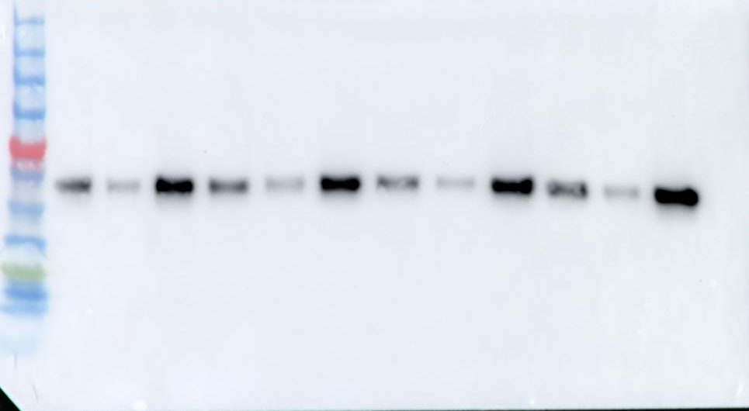
Full unedited blot for Figure 2C
T
C
N
T
C
N
T
C
N
Ctrl
R493H
Iso.Ctrl

Slide 2
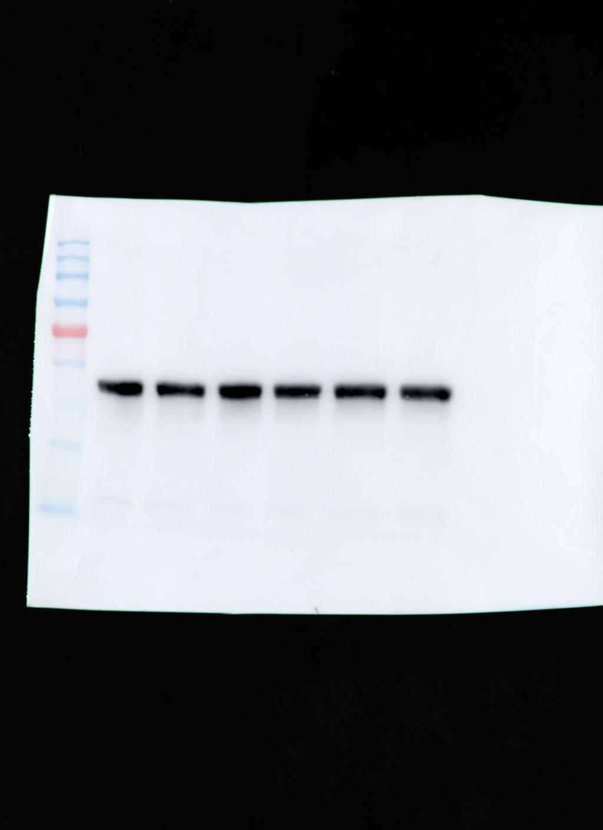
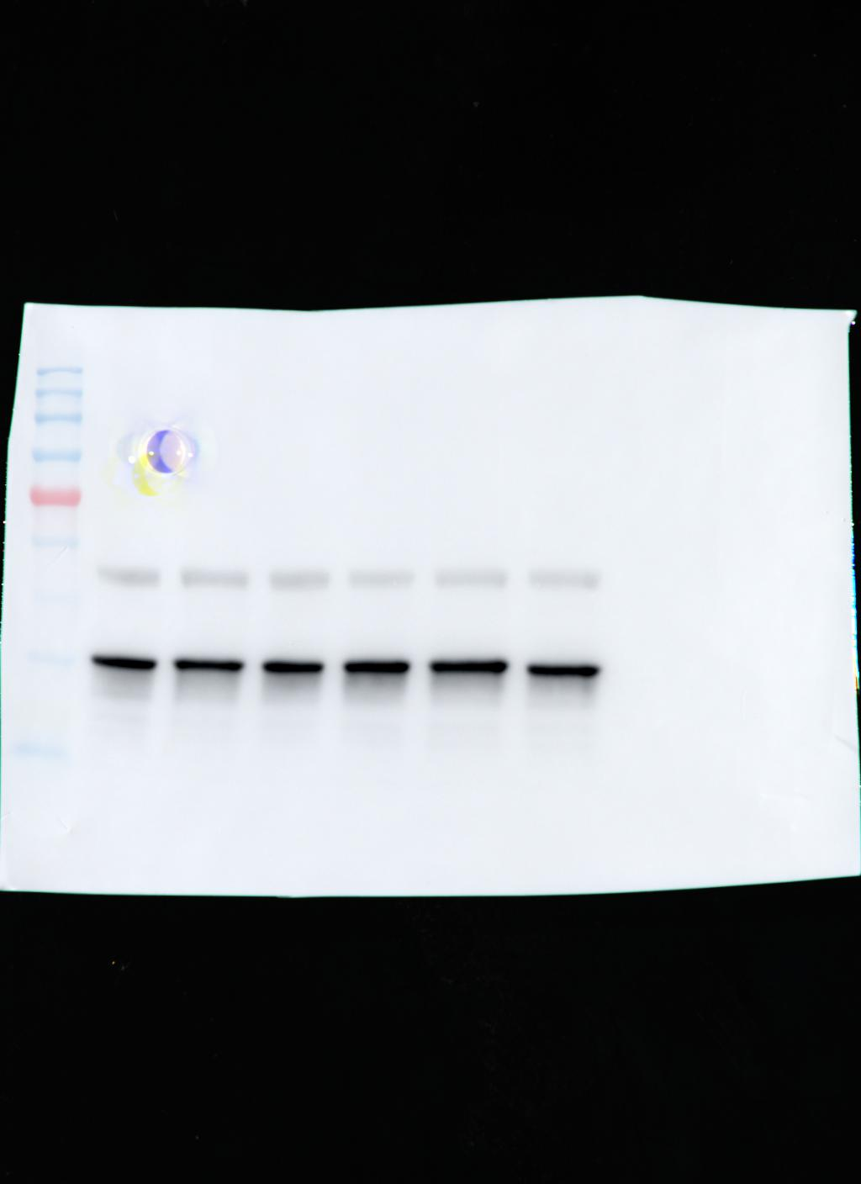
Full unedited blot for Figure 2N
WT
KI
WT
KI
CELF2
GAPDH

Slide 3
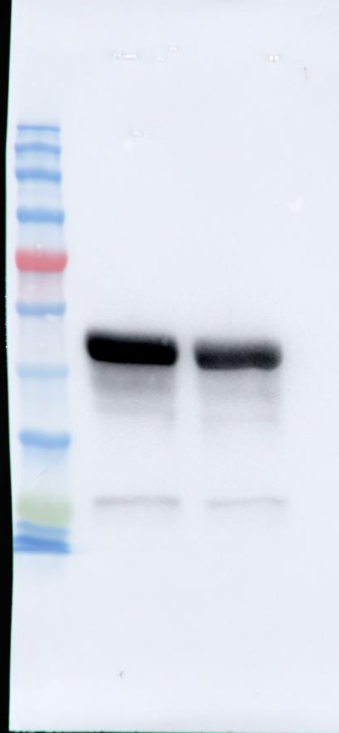
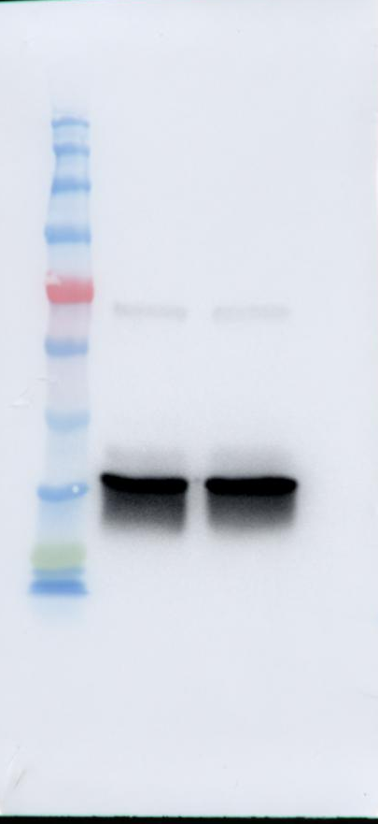
Full unedited blot for Figure 3I
WT
KO
WT
KO
CELF2
GAPDH

Slide 4
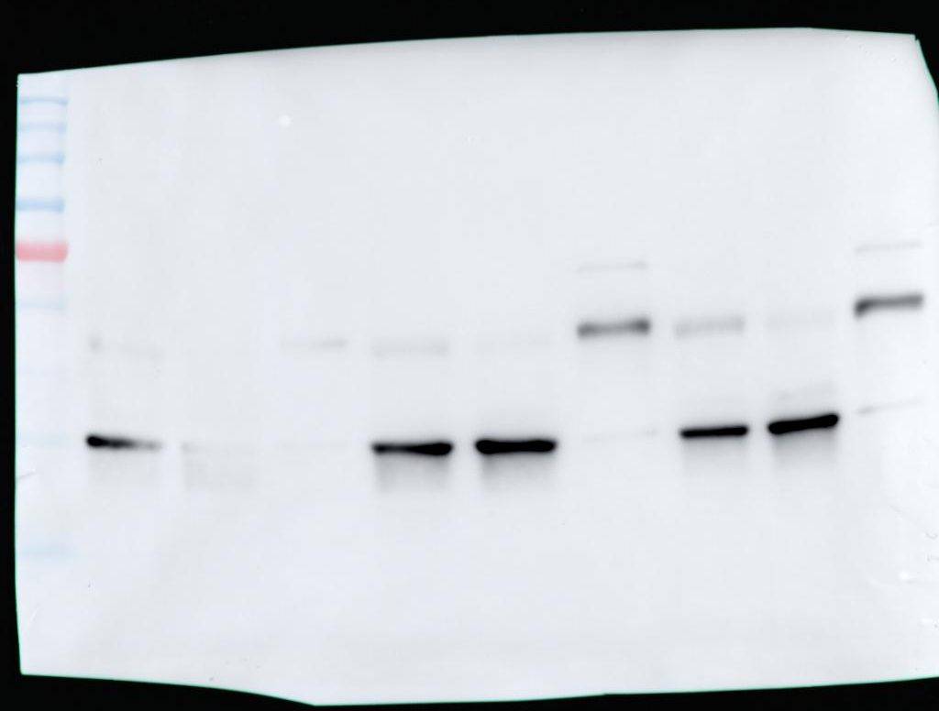
Full unedited blot for Figure 4D
T
C
N
LMNB1
GAPDH

Slide 5
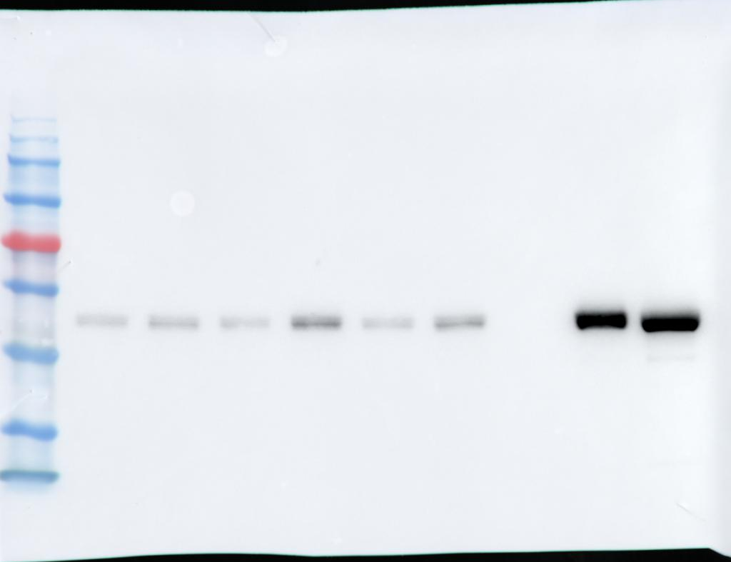
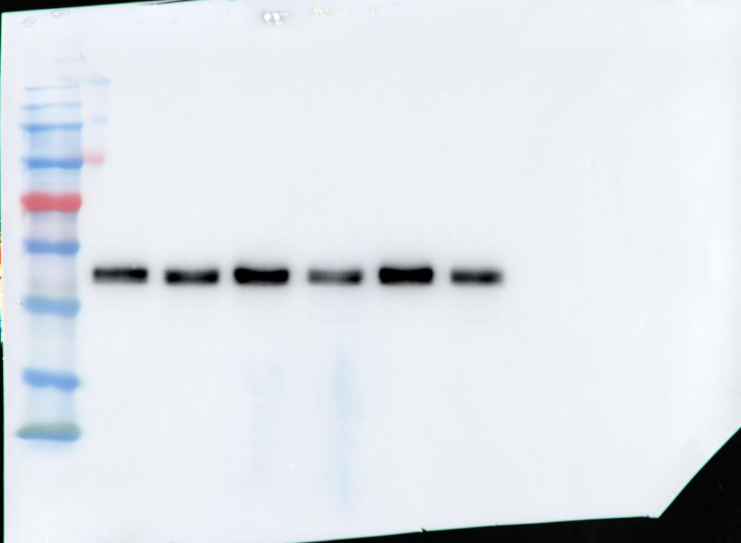
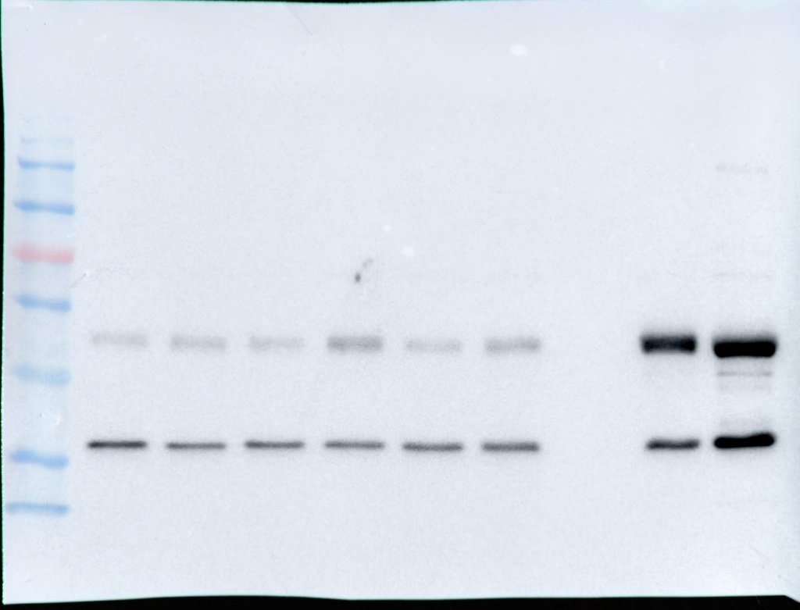
Full unedited blot for Figure 4E
Cytoplasmic
Nuclear
Cytoplasmic
P0
P7
P0
P7
P0
P7
P0
P7
P0
P7
P0
P7
P0
P7
P0
P7
P0
P7
CELF2
CELF2
GAPDH

Slide 6
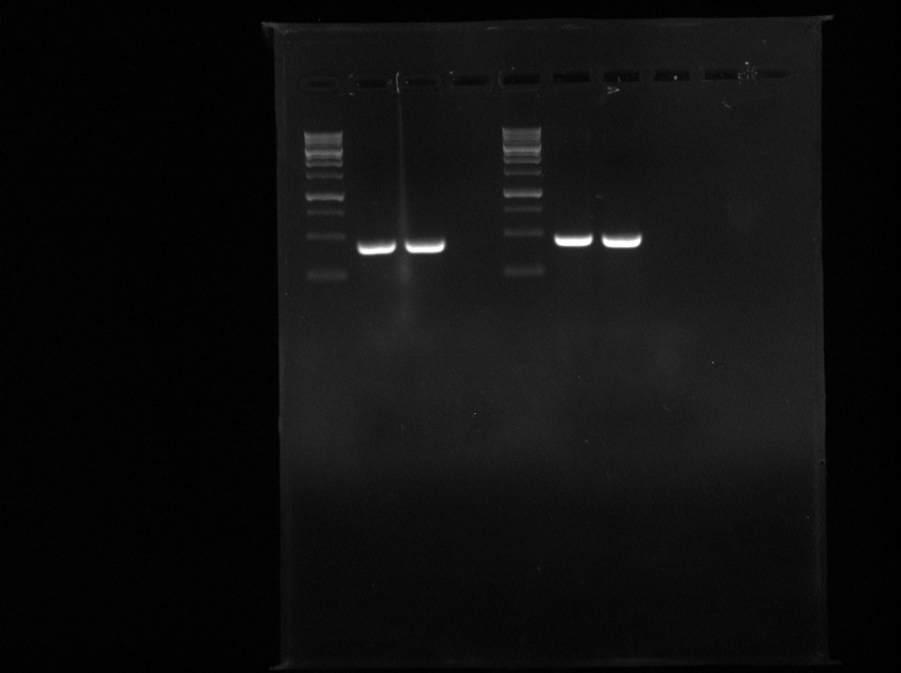
Full unedited blot for Supplemental Figure 1E
Reporter
Intronless

Slide 7
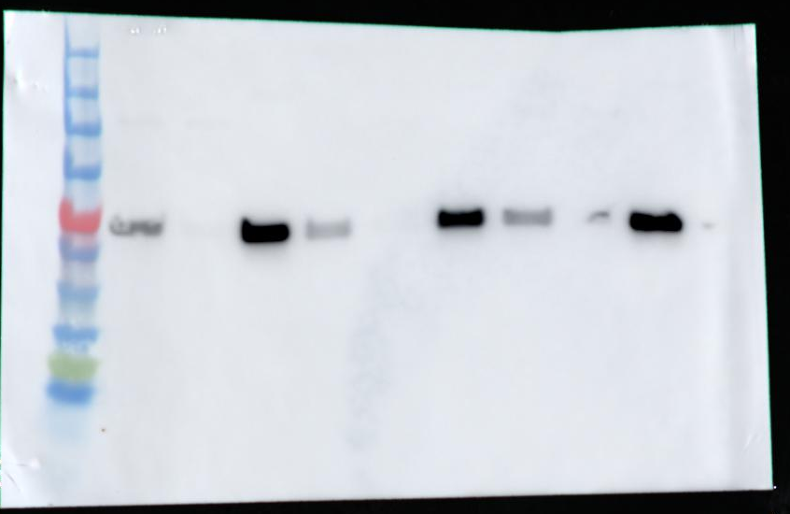
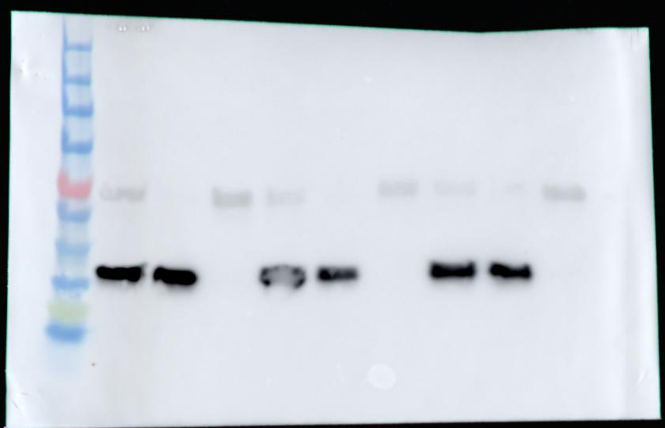
Full unedited blot for Supplemental Figure 2B
Ctrl
R493H
Iso.Ctrl
Ctrl
R493H
Iso.Ctrl
T
C
N
T
C
N
T
C
N
T
C
N
T
C
N
T
C
N
LMNB1
GAPDH

Slide 8
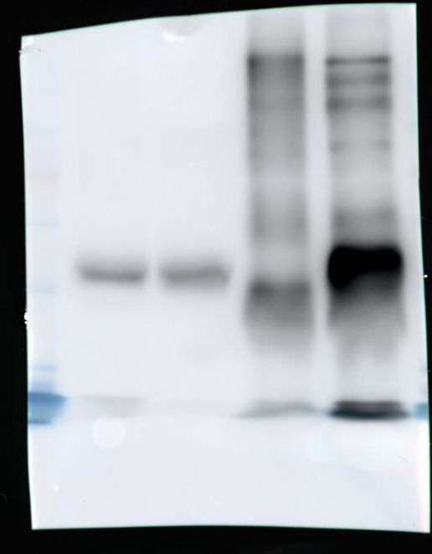
Full unedited blot for Supplemental Figure 5A
Lysate
IP
IgG
CELF2
IgG
CELF2
CELF2

Slide 9
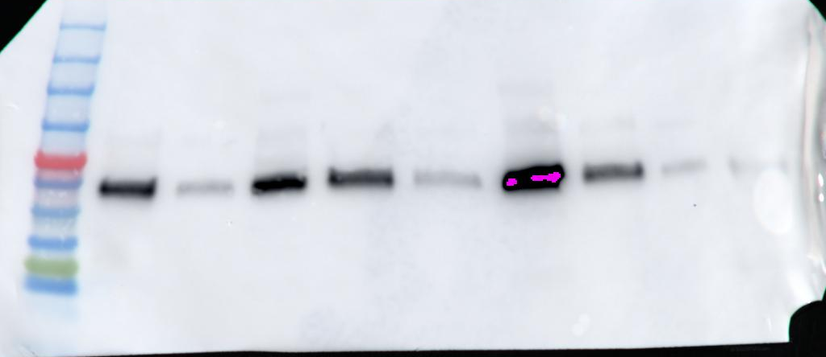
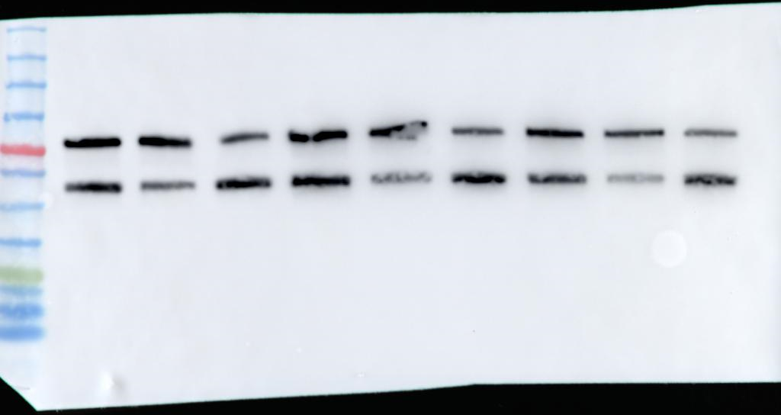
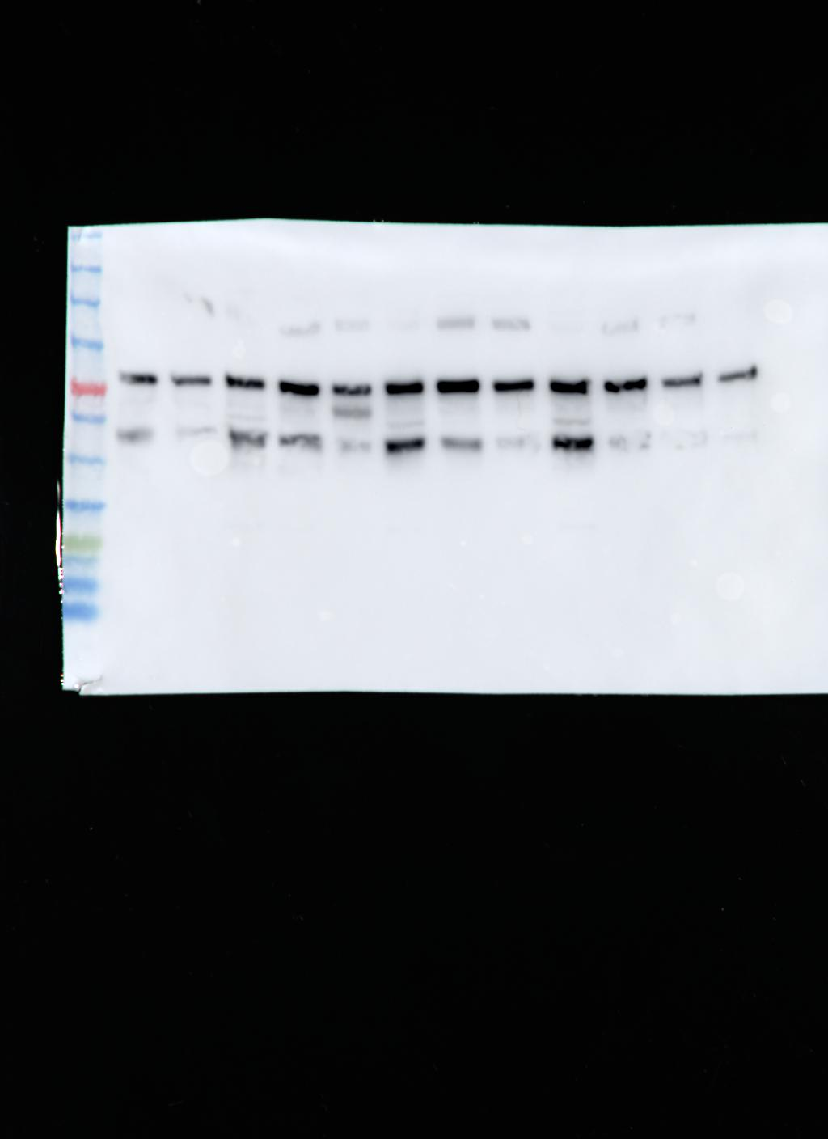
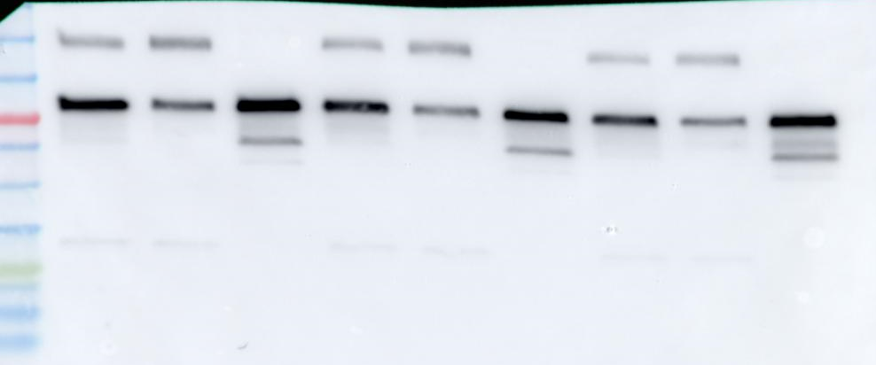
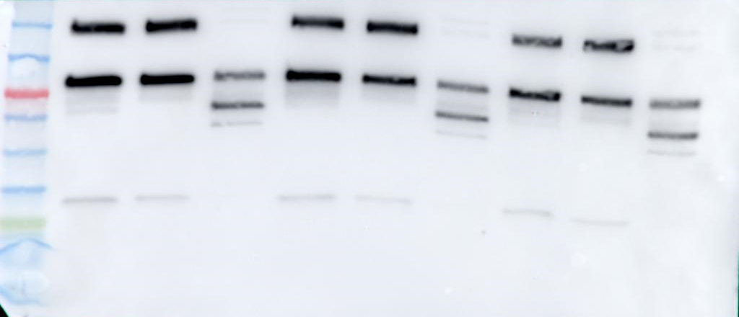
Full unedited blot for Supplemental Figure 7B
Empty Ctrl
R493H stable
WT stable
T C N
T C N
T C N
CELF2
CELF2
CELF2
WT stable
R493H stable
T C N
T C N
EGFP
EGFP

