Slide 1
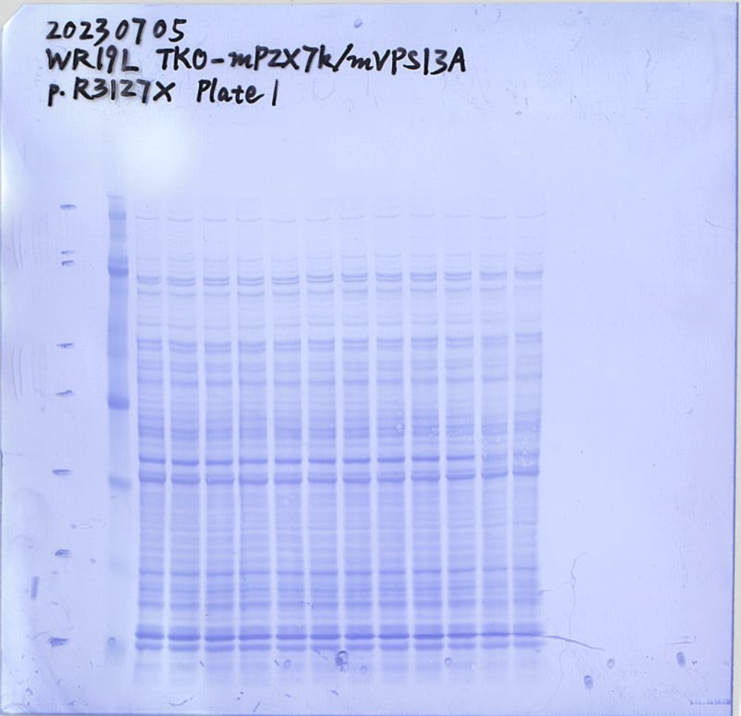
Full unedited blot for Figure 1B (none, WT, R3127Δ/CBB stain)

Slide 2
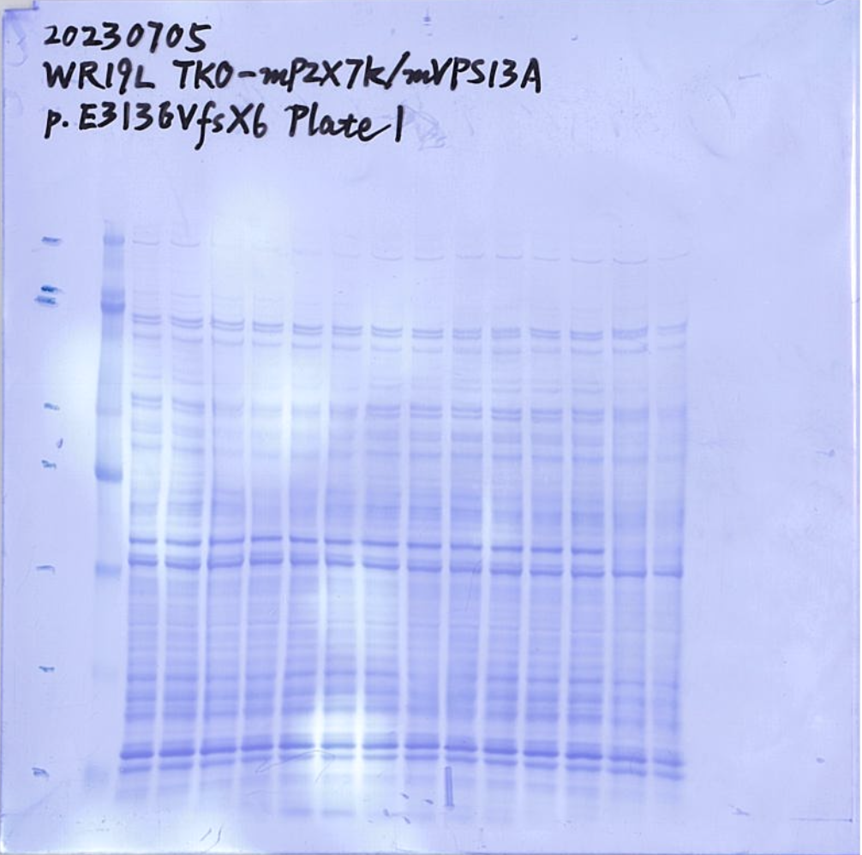
Full unedited blot for Figure 1B (E3136Δ/CBB stain)

Slide 3
Full unedited blot for Figure 1C (VPS13A)

Slide 4
Full unedited blot for Figure 1C (XK)

Slide 5
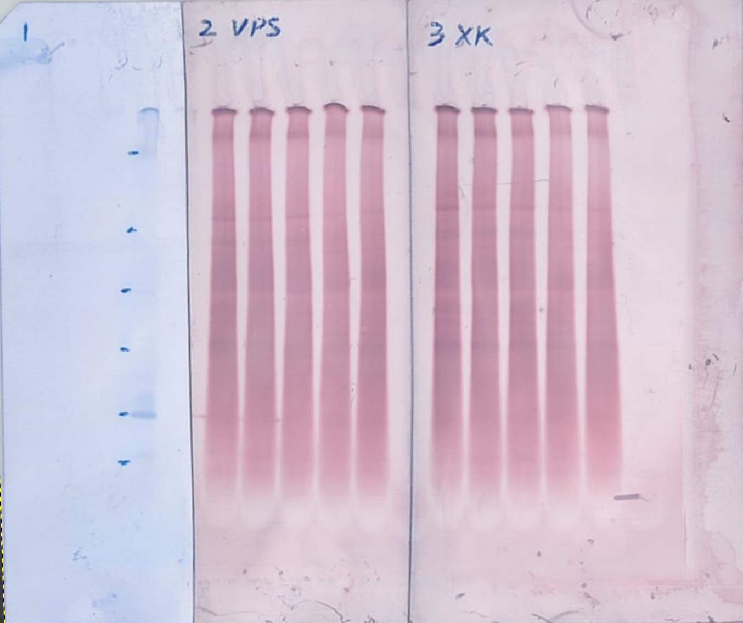
Full unedited blot for Figure 1C (Gold stain)

Slide 6
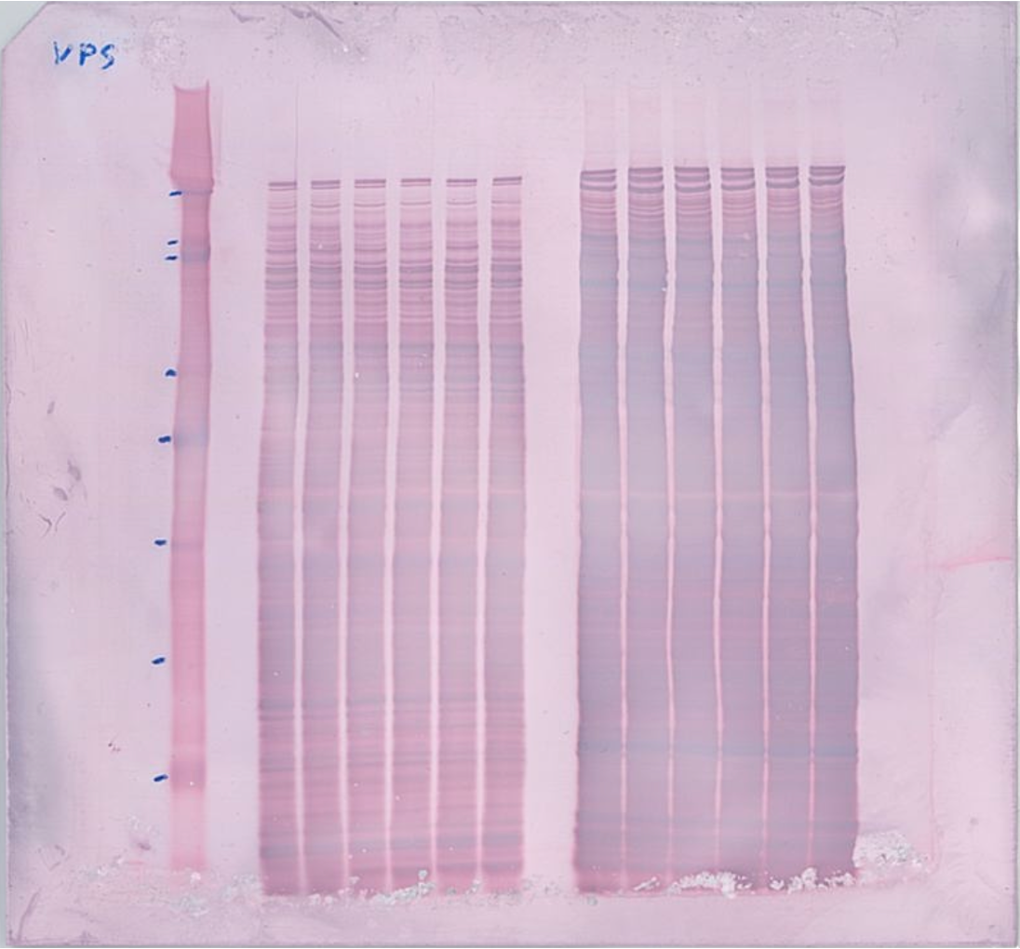
Full unedited blot for Figure 2B

Slide 7
Full unedited blot for Figure 2C (VPS13A)

Slide 8
Full unedited blot for Figure 2C (XK)

Slide 9
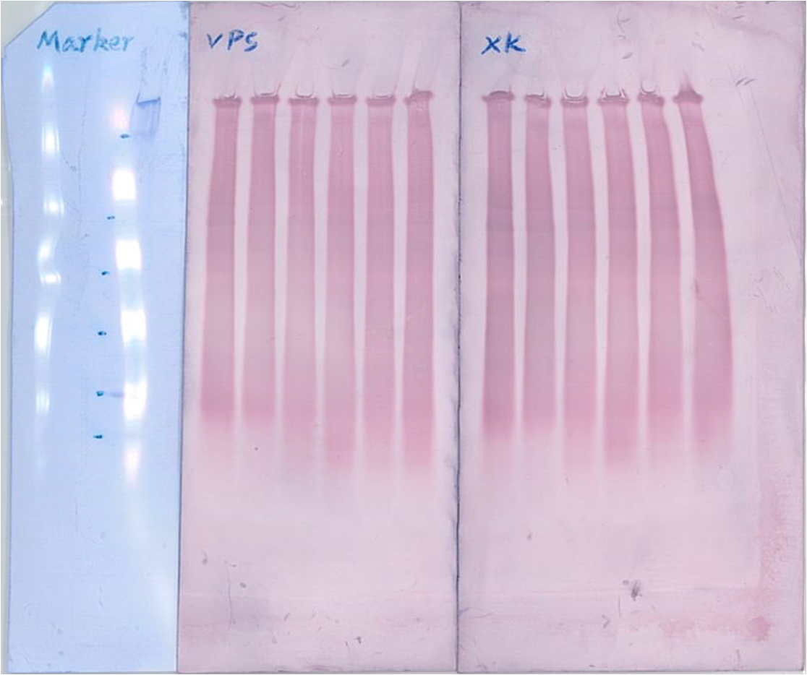
Full unedited blot for Figure 2C (Gold stain)

Slide 10
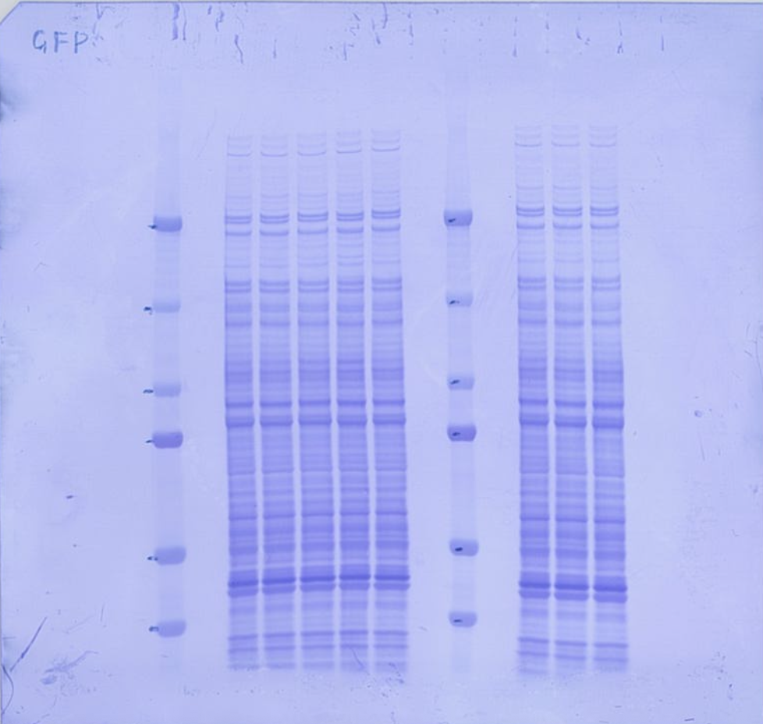
Full unedited blot for Figure 2E (GFP/CBB stain)

Slide 11
Full unedited blot for Figure 2F (BN-PAGE)

Slide 12
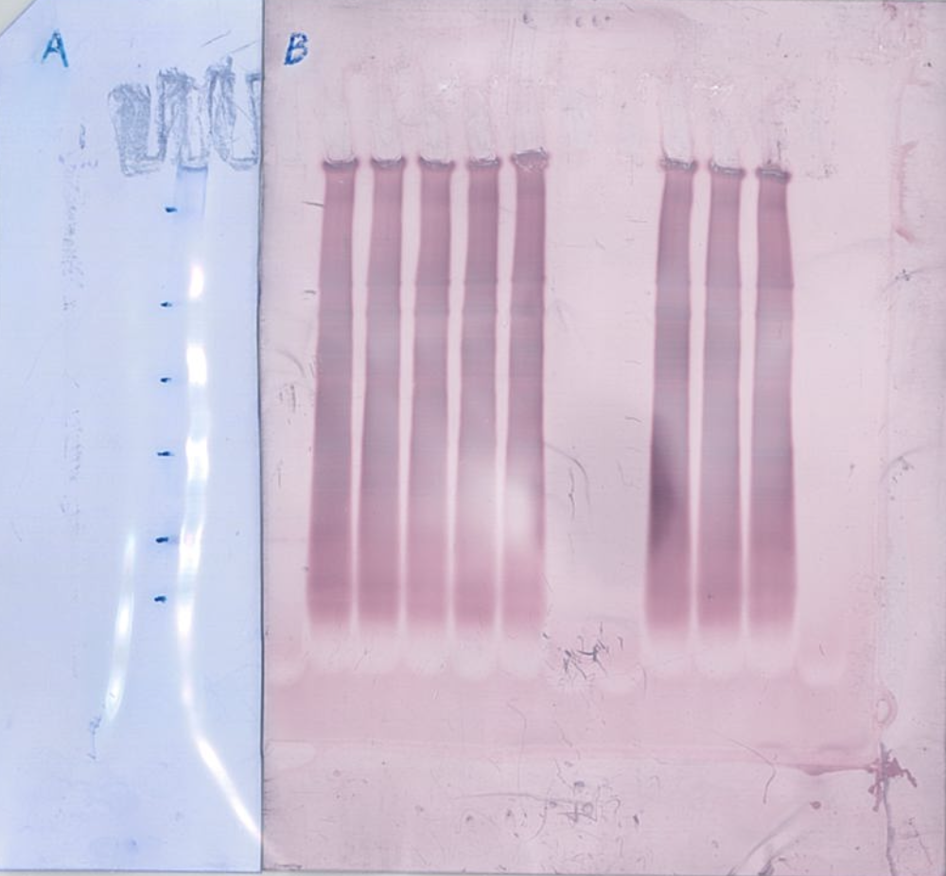
Full unedited blot for Figure 2F (BN-PAGE/Gold stain)

Slide 13
Full unedited blot for Figure 2F (SDS-PAGE)

Slide 14
Full unedited blot for Figure 3B (SDS-PAGE/CBB Stain)

Slide 15
Full unedited blot for Figure 3D (VPS13A)

Slide 16
Full unedited blot for Figure 3D (VPS13A/Gold stain)

Slide 17
Full unedited blot for Figure 3D (GFP)

Slide 18
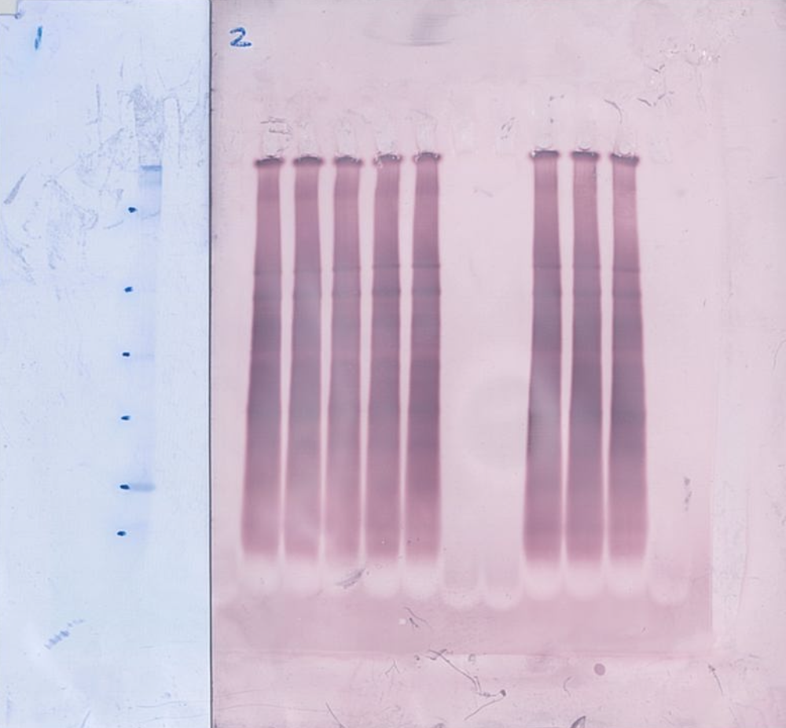
Full unedited blot for Figure 3D (GFP/Gold stain)

Slide 19
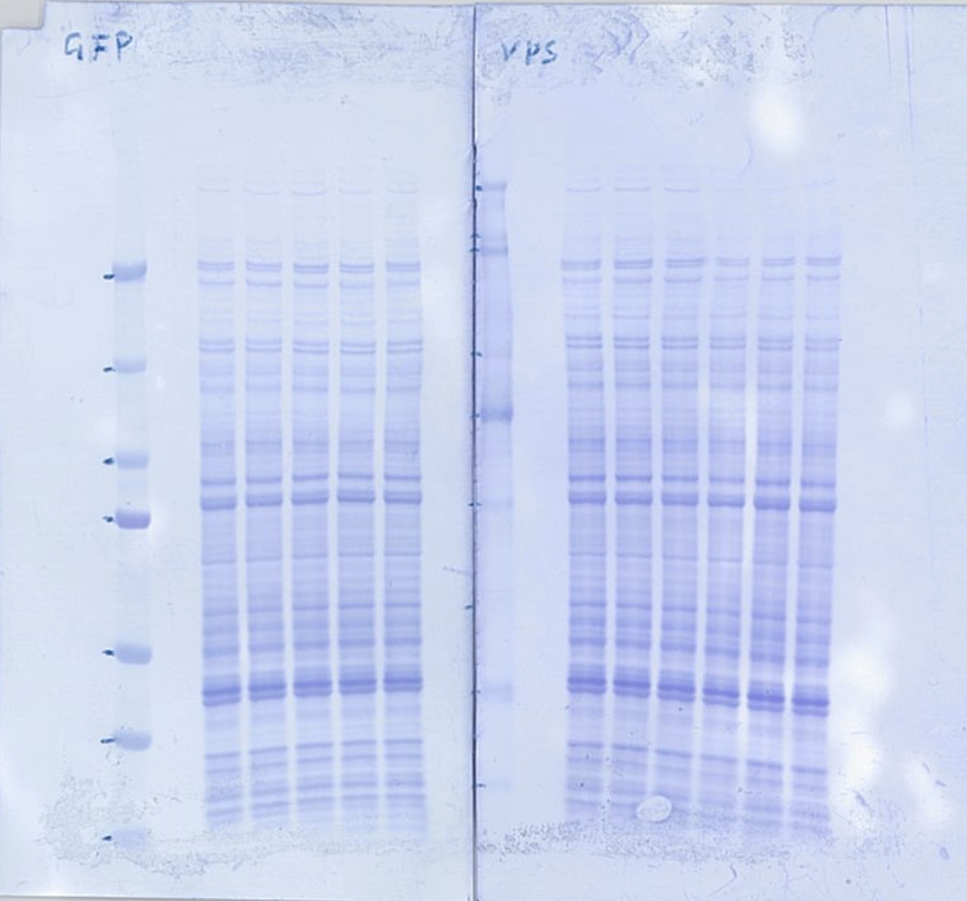
Full unedited blot for Figure 3F (GFP/CBB stain)

Slide 20
Full unedited blot for Figure 3G (BN-PAGE)

Slide 21
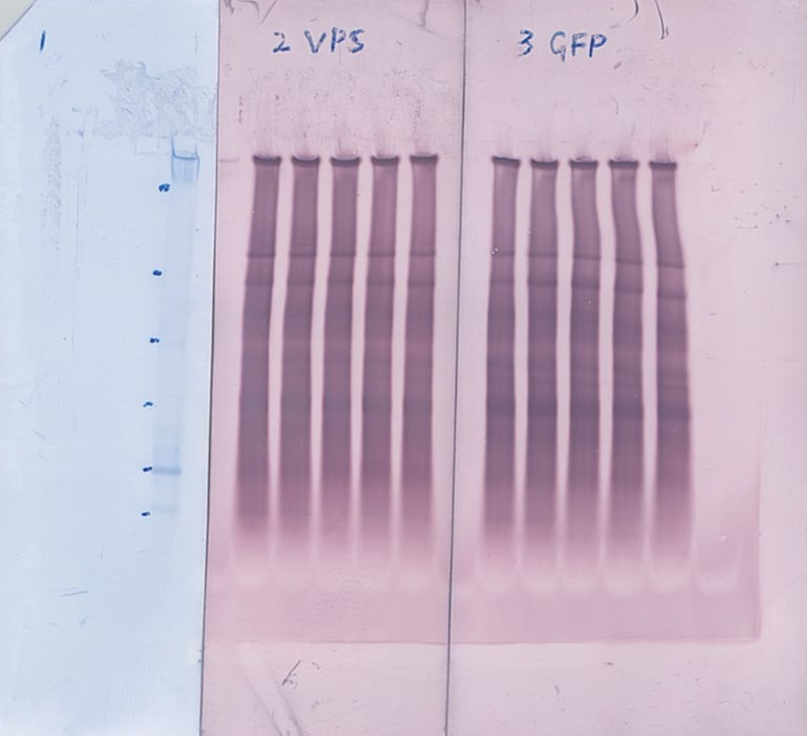
Full unedited blot for Figure 3G (BN-PAGE/Gold)

Slide 22
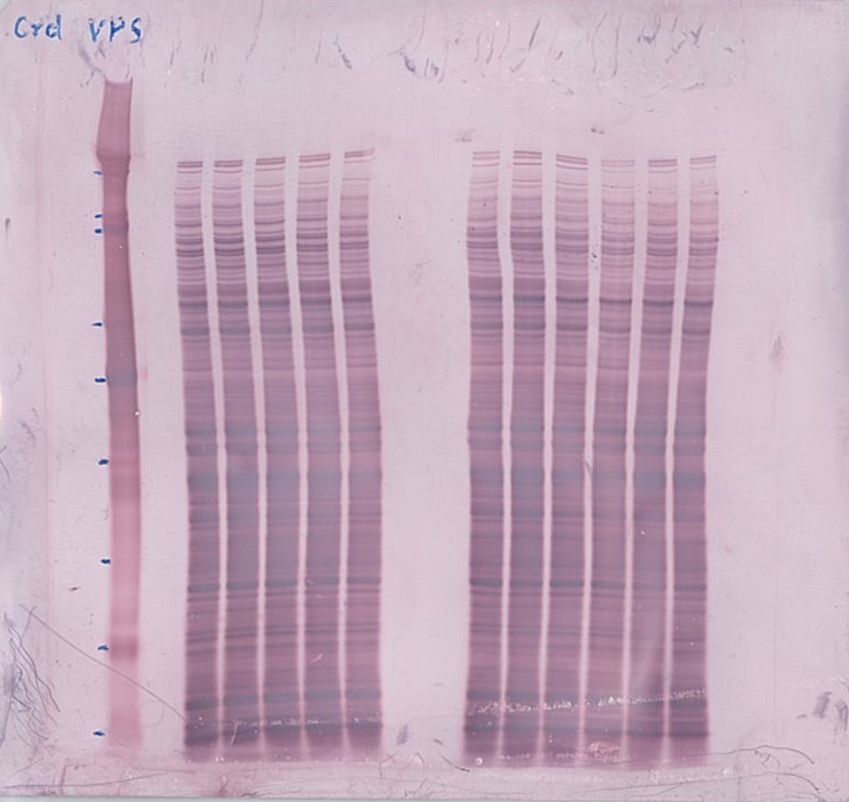
Full unedited blot for Figure 3H (BN-PAGE/Gold stain)

Slide 23
Full unedited blot for Figure 3I (BN-PAGE)

Slide 24
Full unedited blot for Figure 4A (SDS-PAGE)

Slide 25
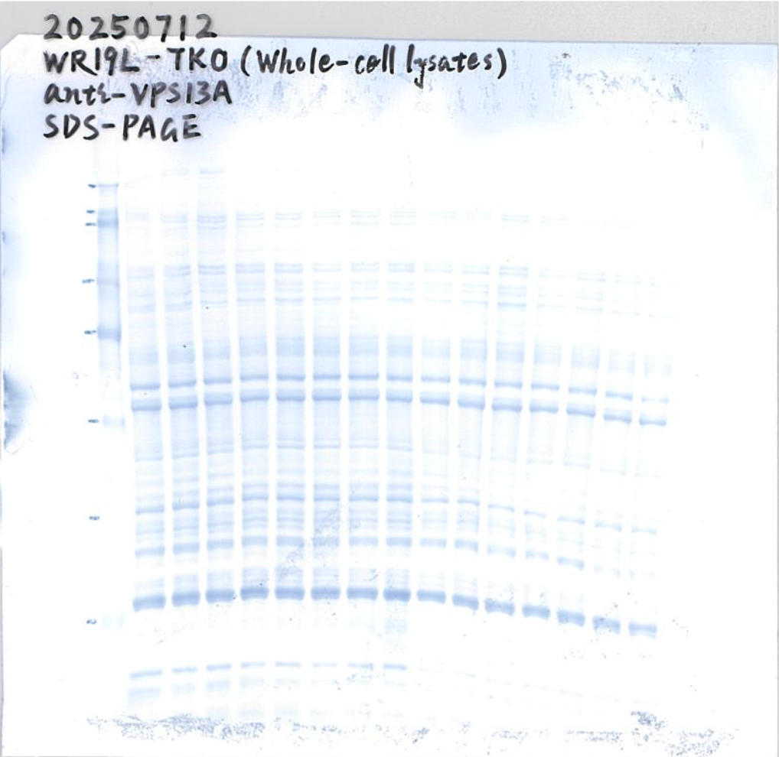
Full unedited blot for Figure 4A (SDS-PAGE/CBB stain)

Slide 26
Full unedited blot for Figure 4D (VPS13A)

Slide 27
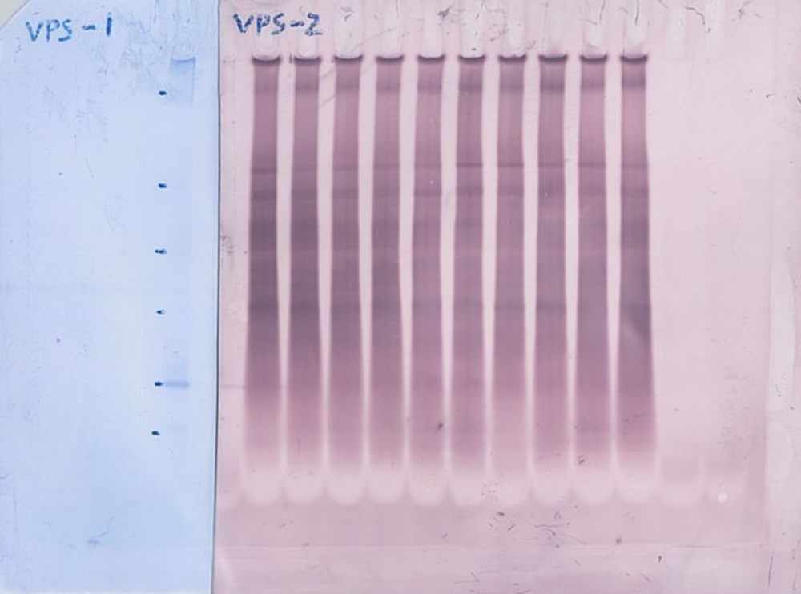
Full unedited blot for Figure 4D (VPS13A/Gold stain)

Slide 28
Full unedited blot for Figure 4D (XK)

Slide 29
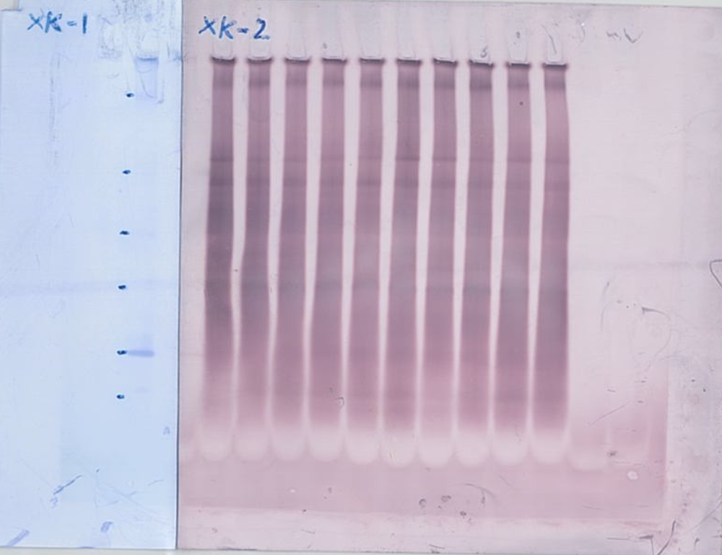
Full unedited blot for Figure 4D (XK/Gold stain)

