Slide 1
Manganese availability determines insulin sensitivity by enhancing Akt activity
Uncropped Western Blots
Red boxes denotes blot used in paper

Slide 2
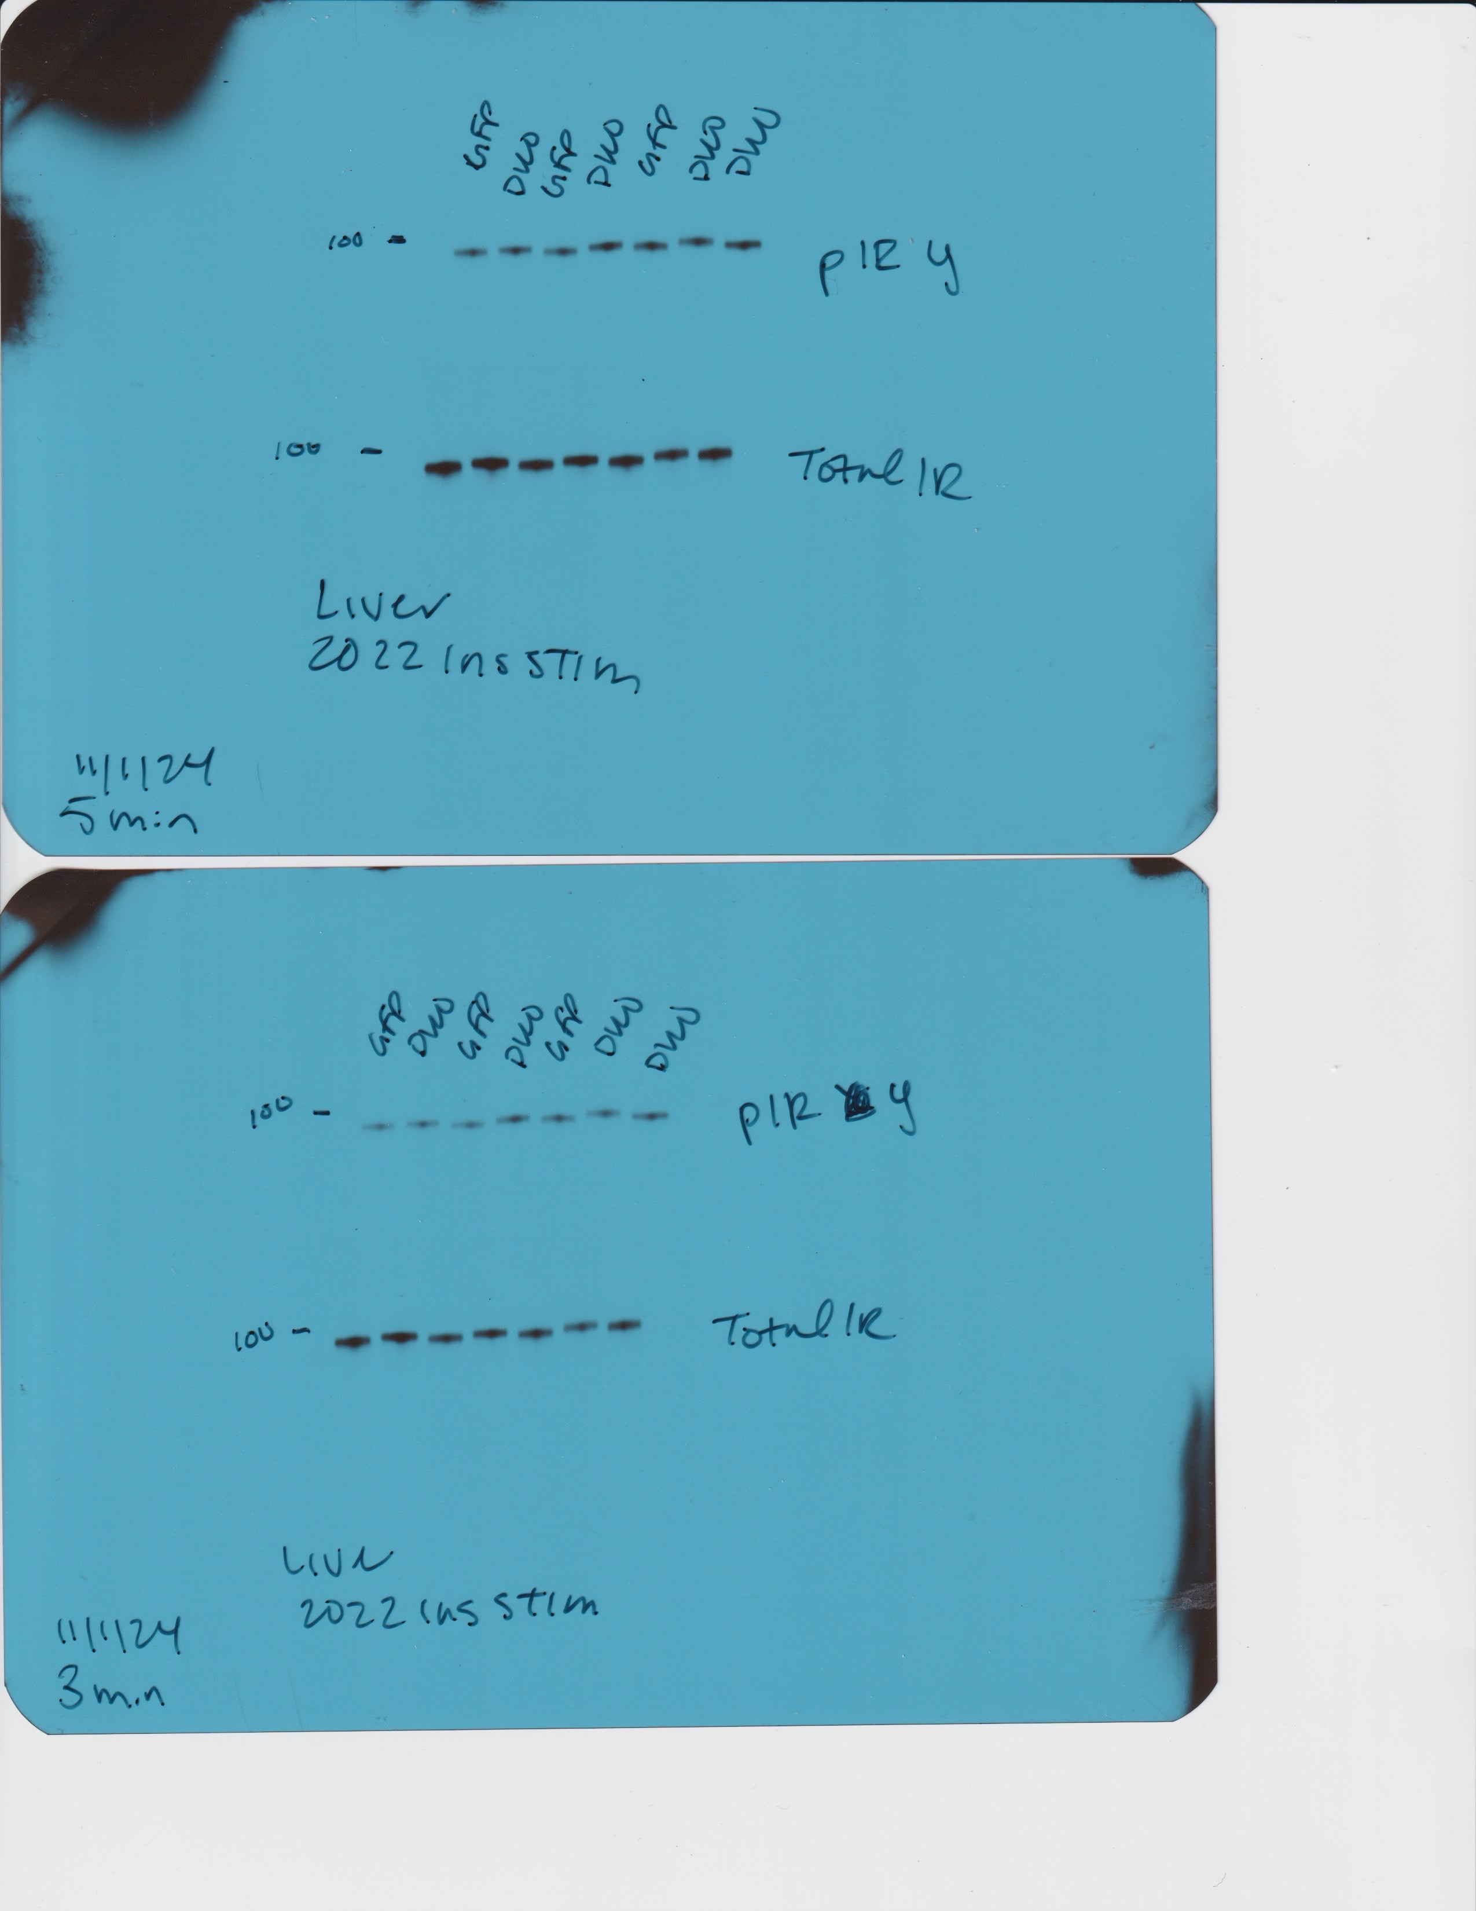
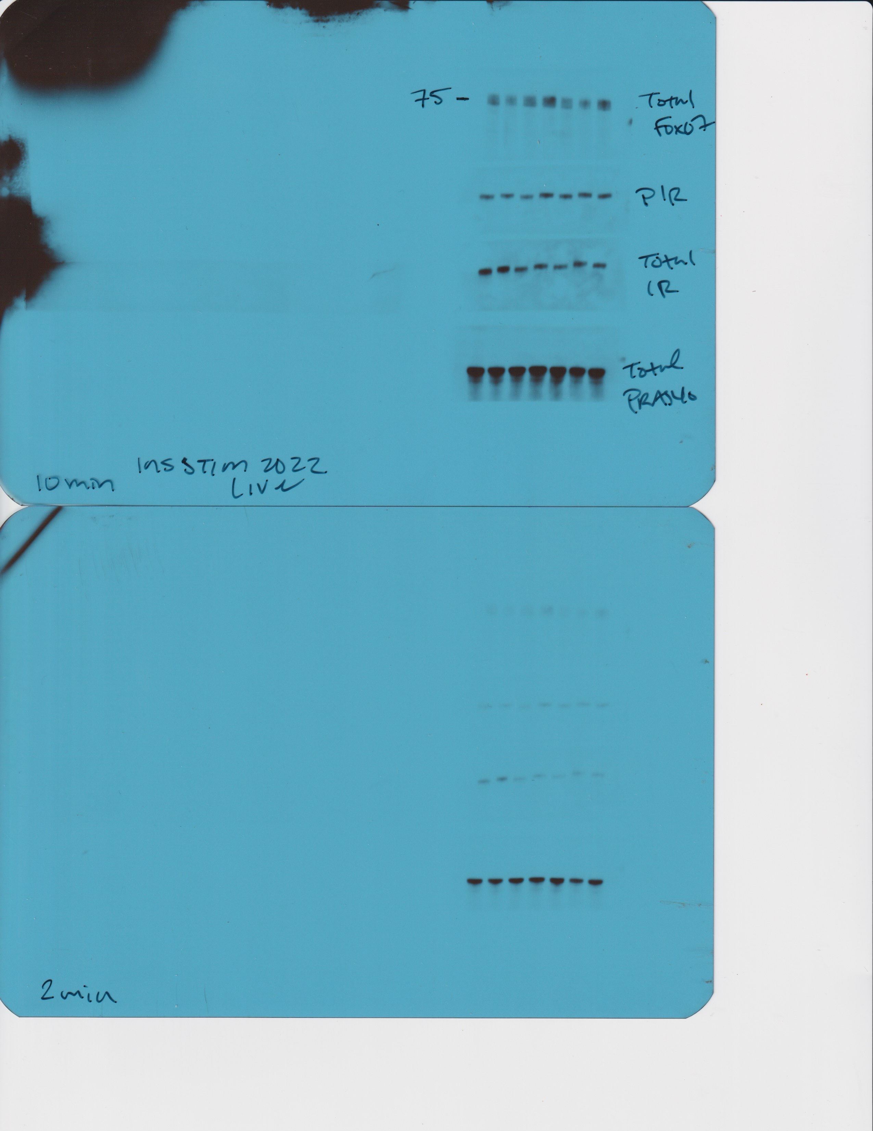
Figure 3A
Total FoxO1
p-IRβ Y1150
Total IRβ
Total PRAS40

Slide 3
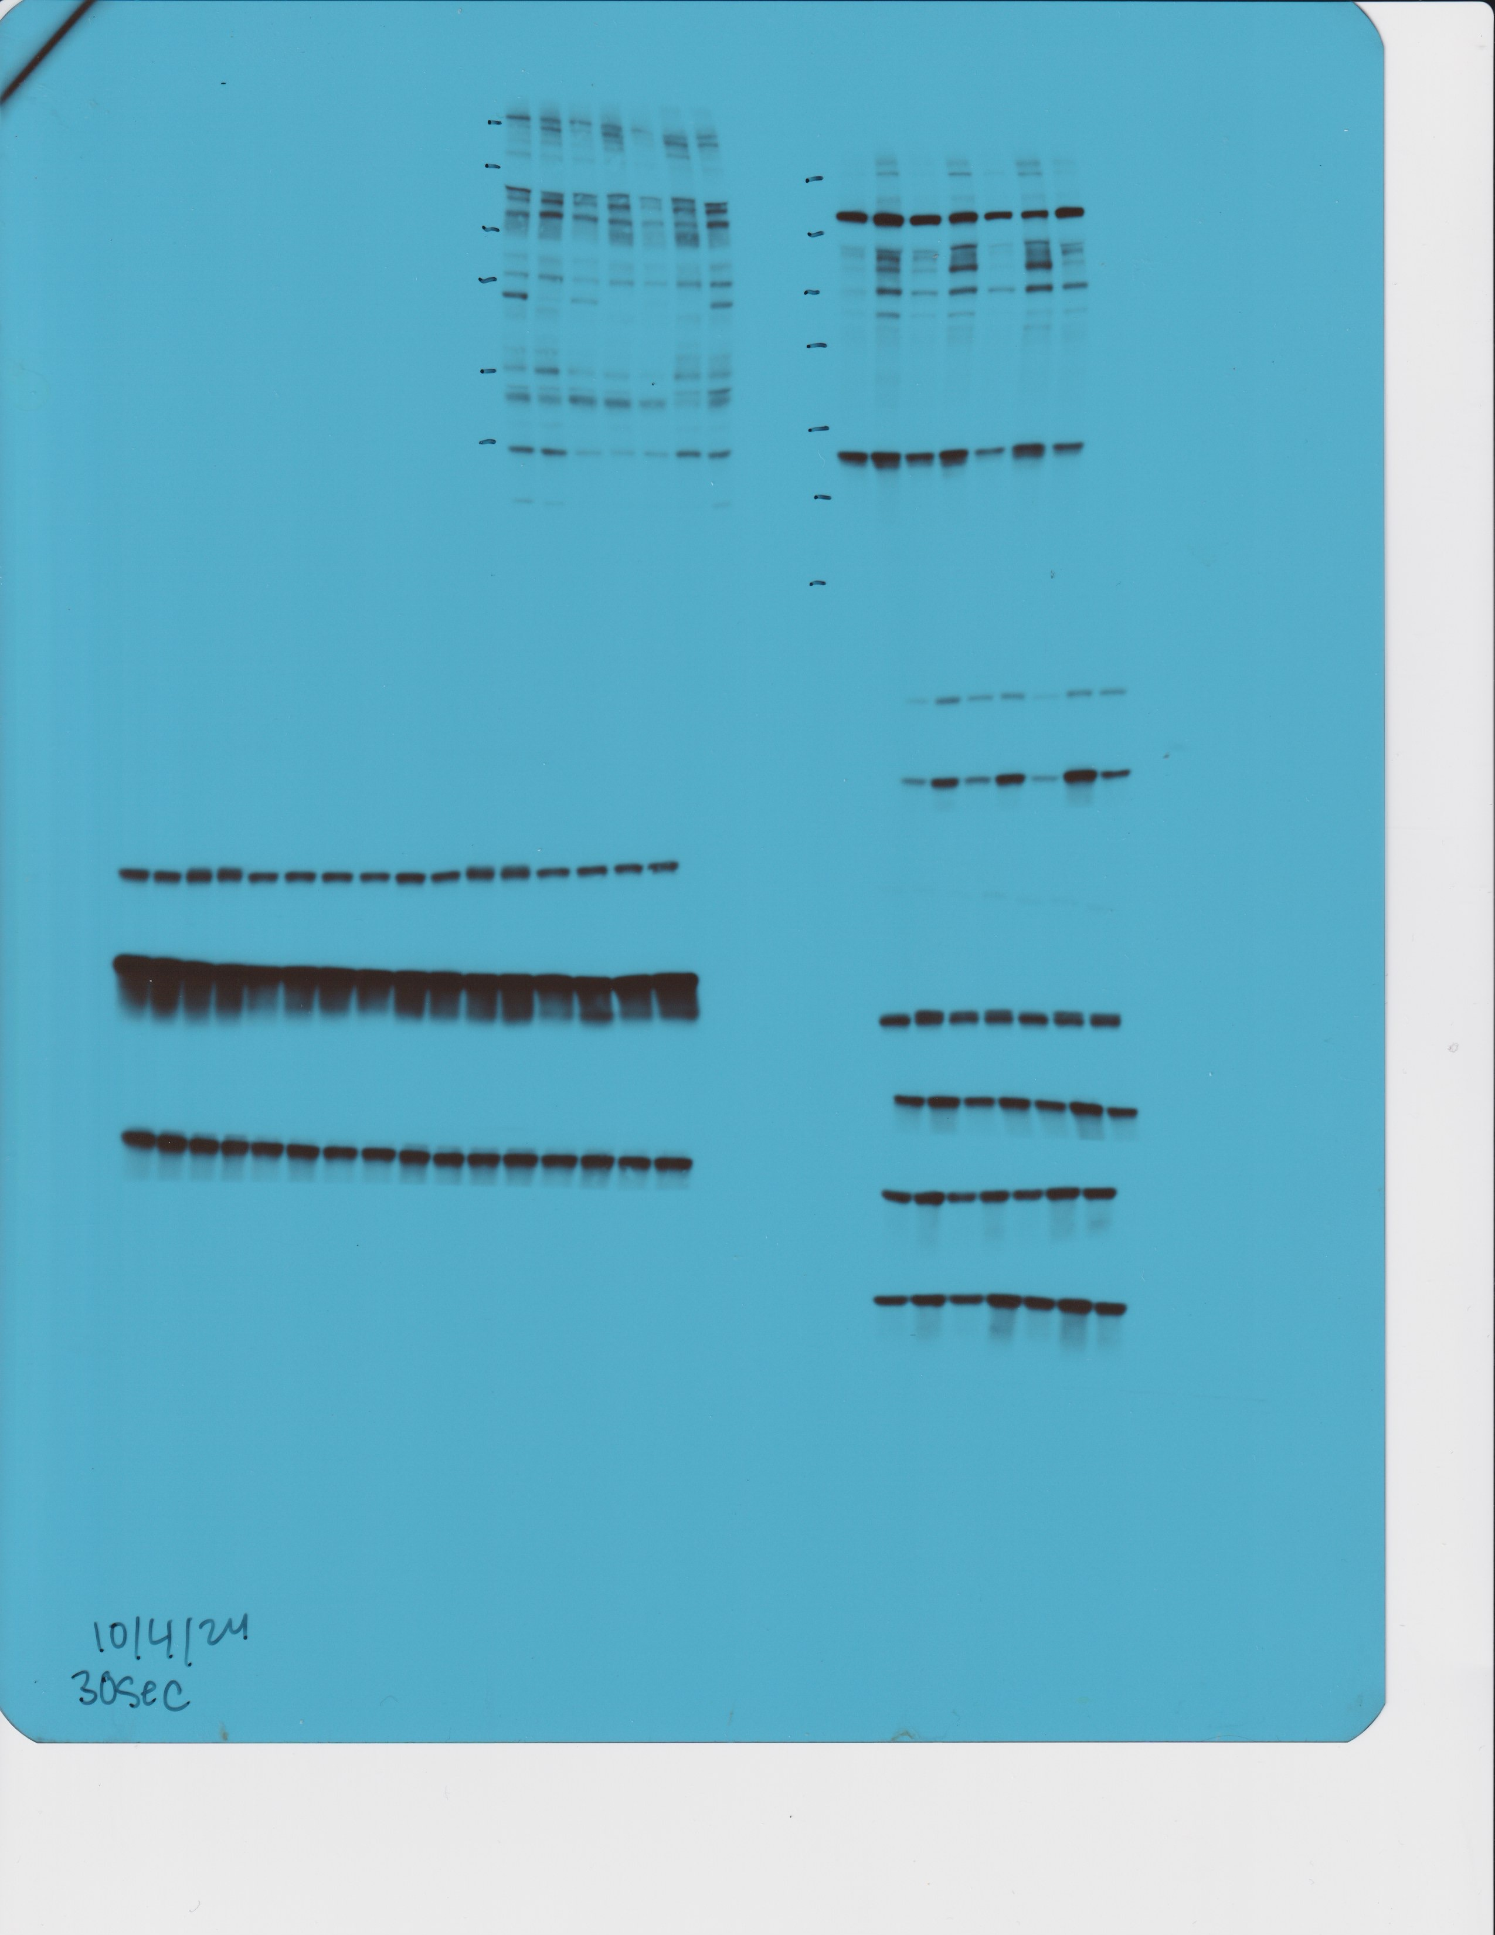
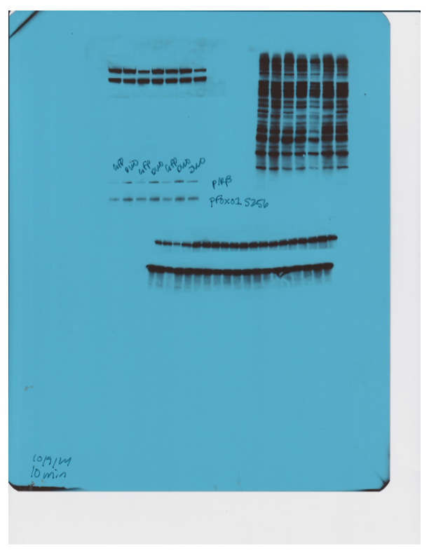
Figure 3A
p-FoxO1 S256
p-GSK3β Ser9
pan AKT
Total GSK3β
Gapdh

Slide 4
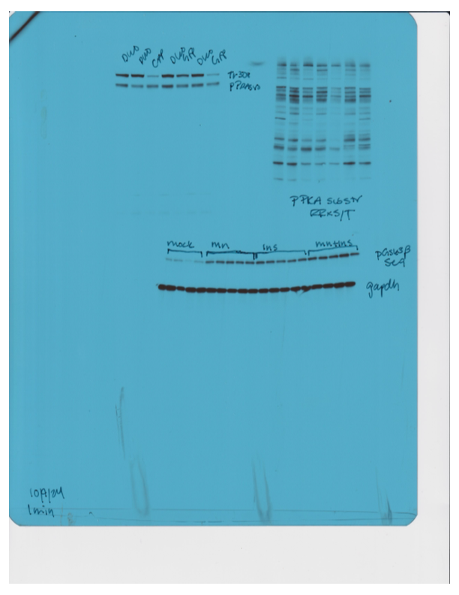
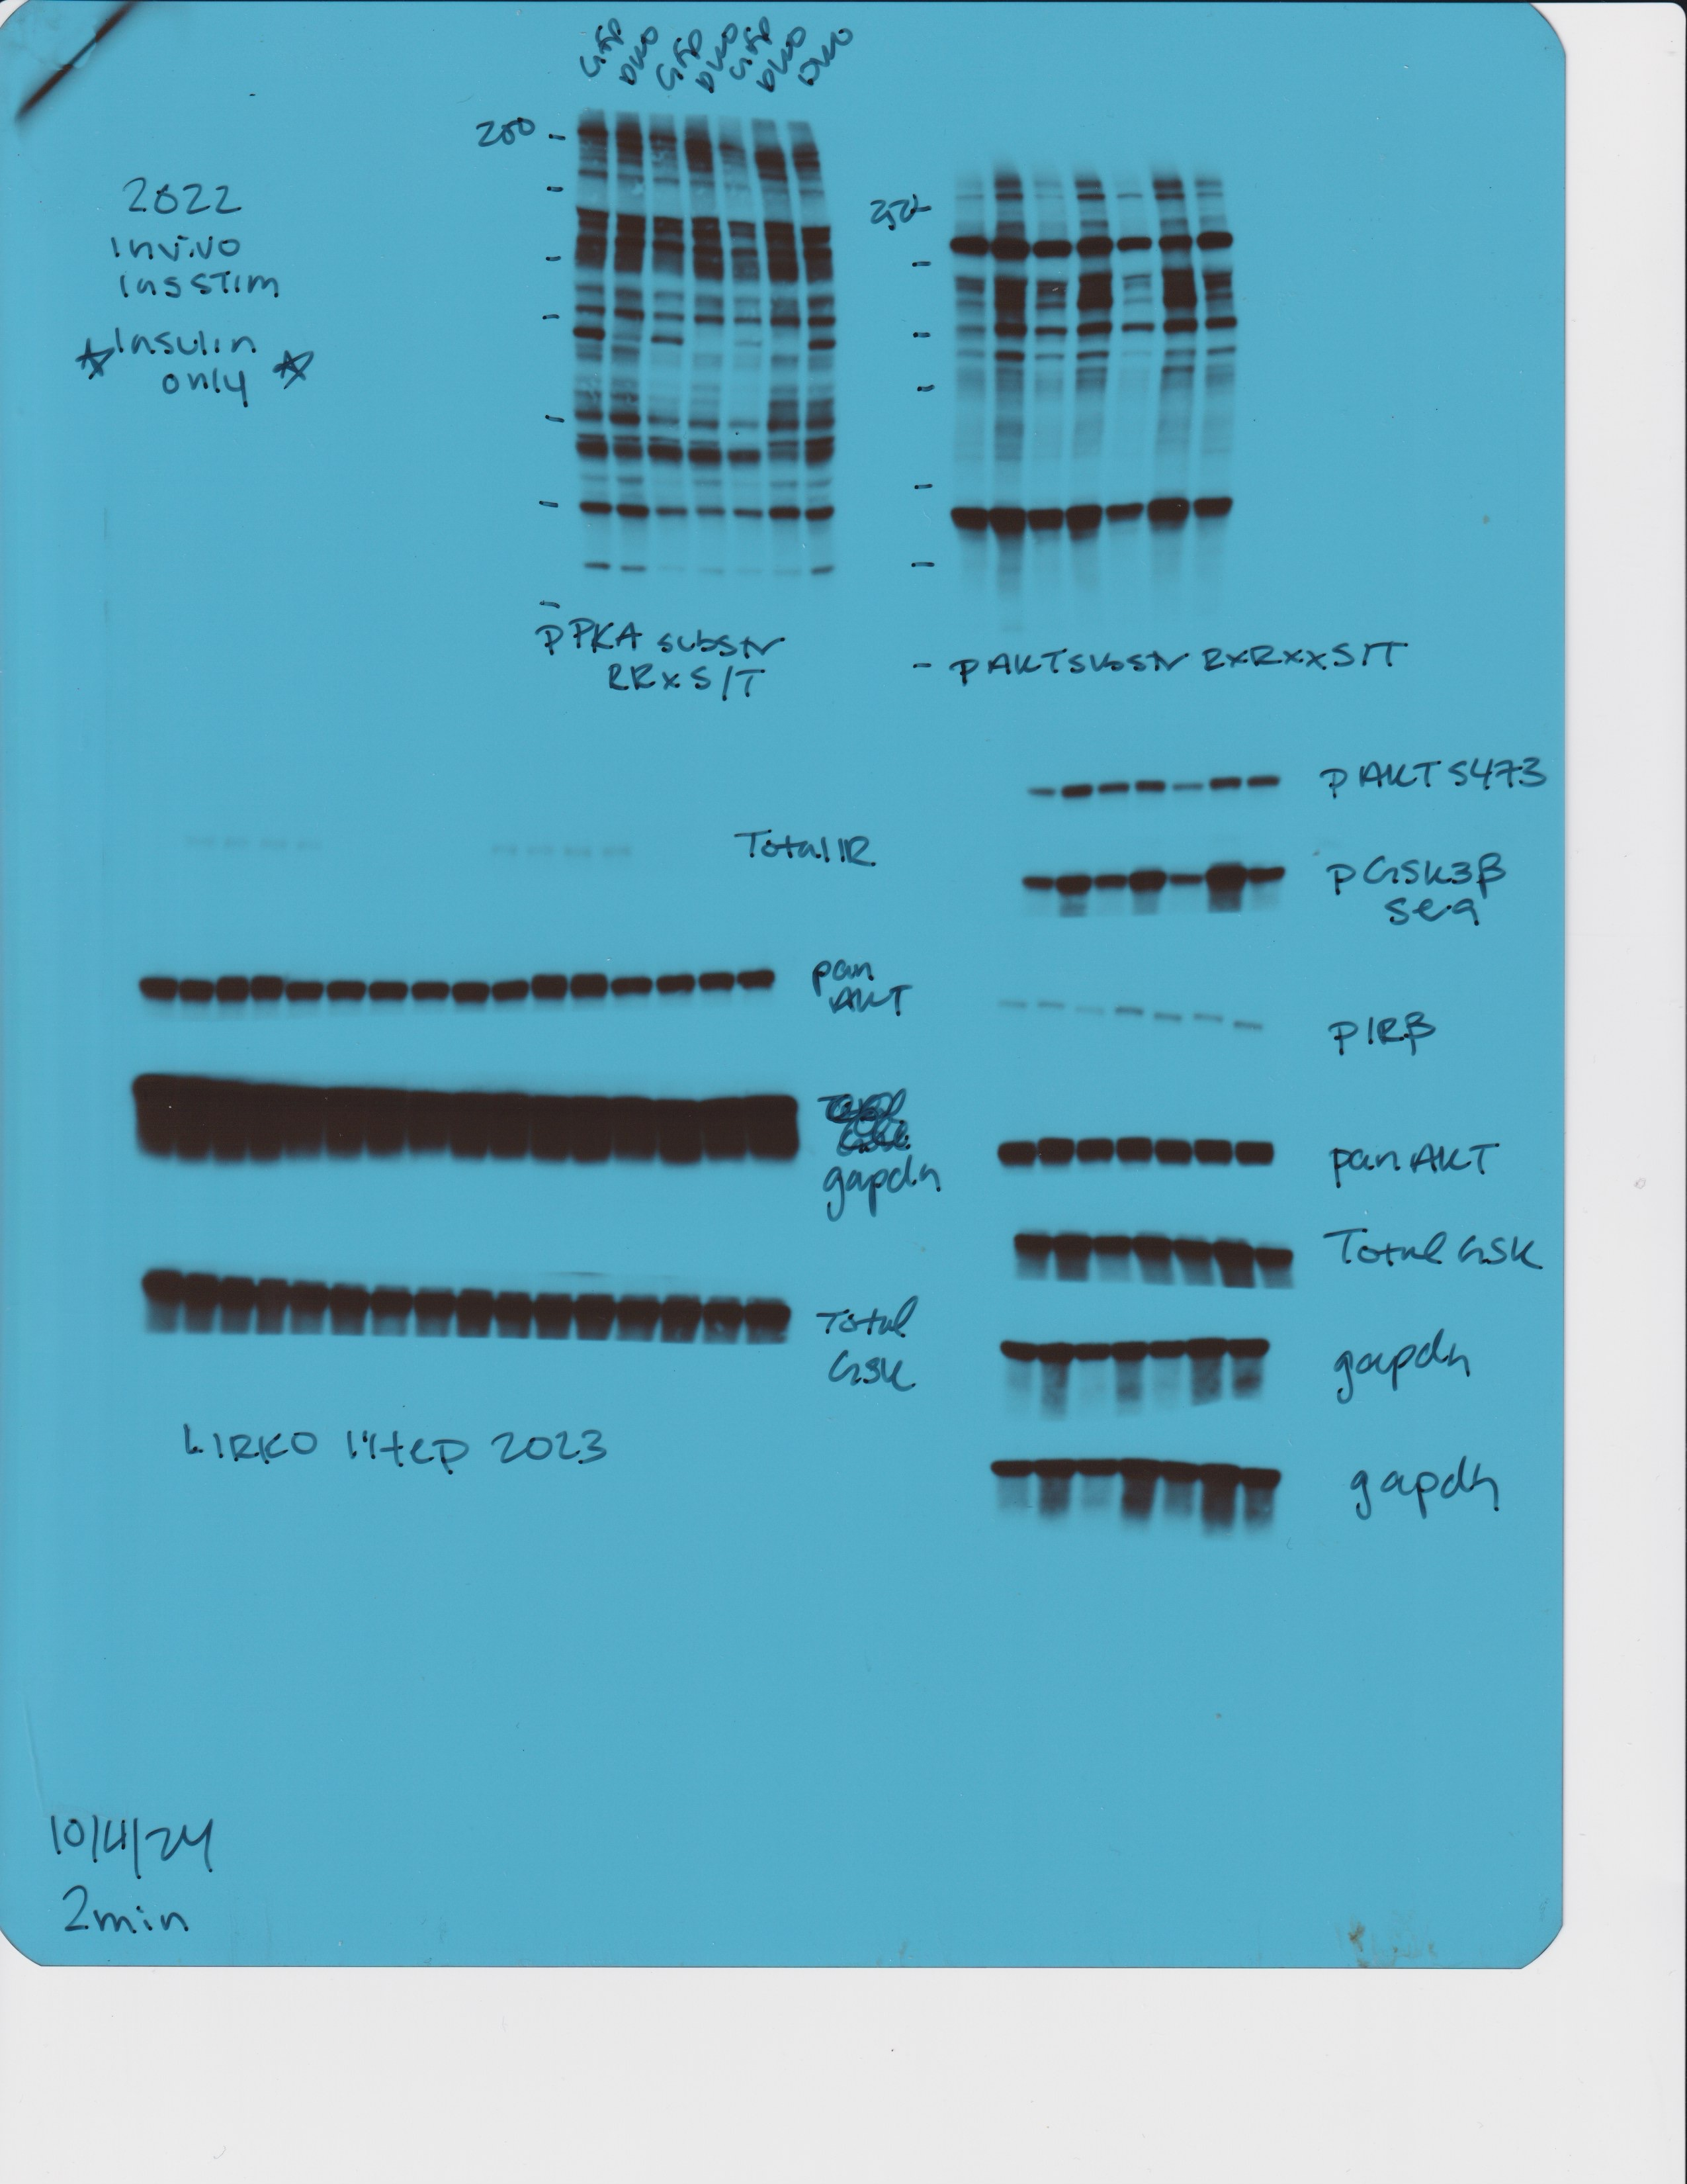
Figure 3A
p-AKT Thr308
p-PRAS40 Thr246
*These are inverted as denoted
p-AKT Ser473

Slide 5
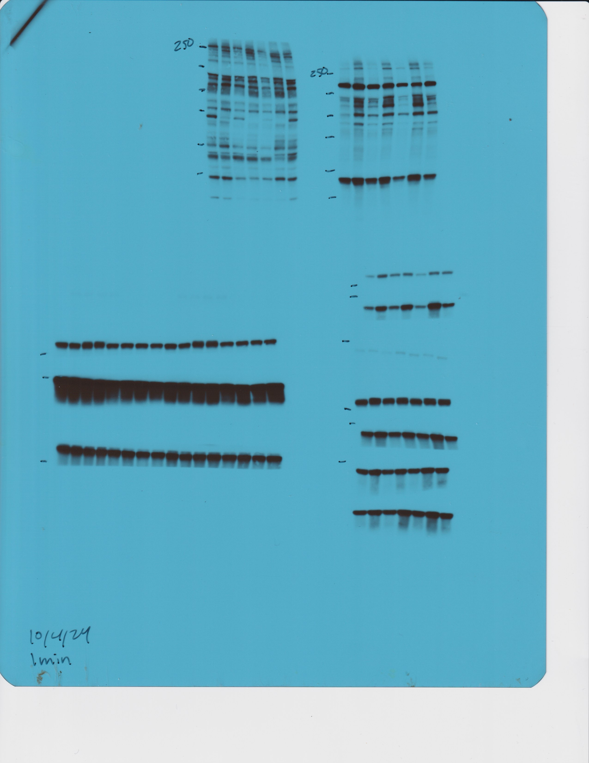
Figure 3C
p-AKT Substrates (RxRxxS/T*)

Slide 6
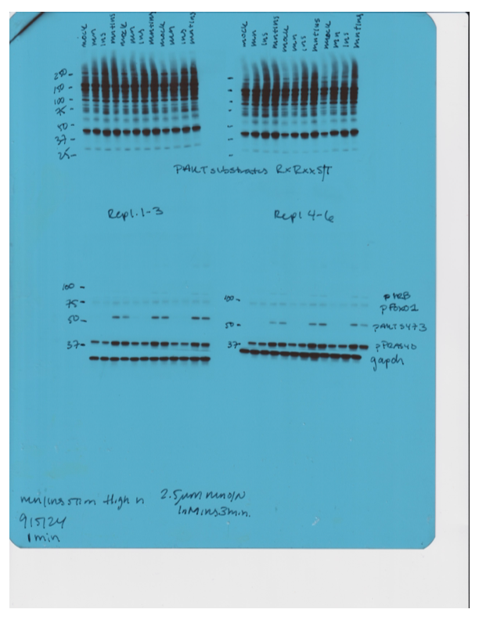
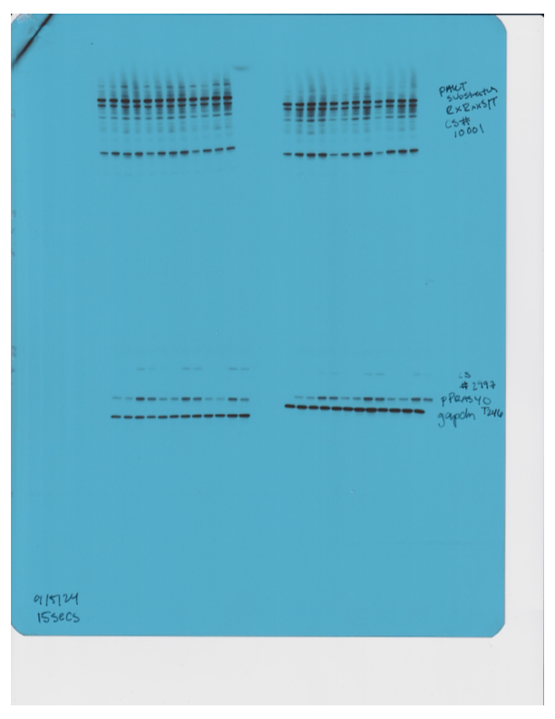
Figure 3E
p-AKT substrates (RxRxxS/T*)
p-AKT Ser473
Gapdh

Slide 7
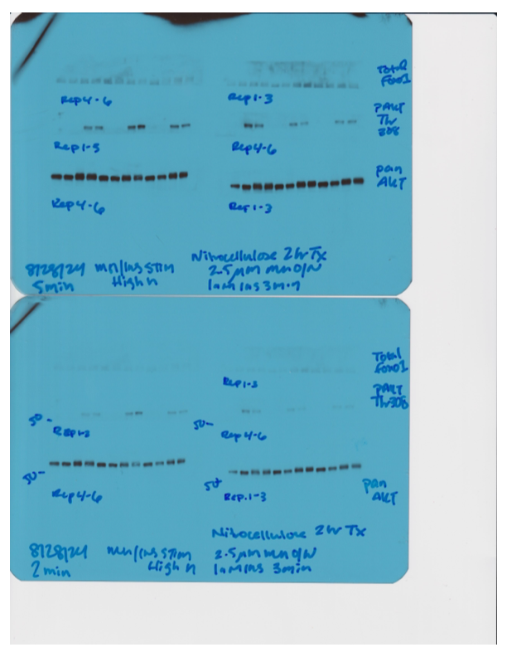
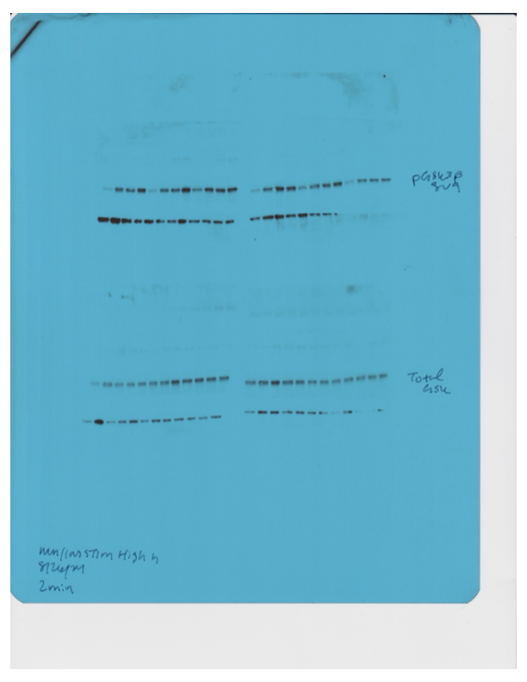
Figure 3E
p-AKT Thr308
p-GSK3β Ser9
Total GSK3β
Pan AKT

Slide 8
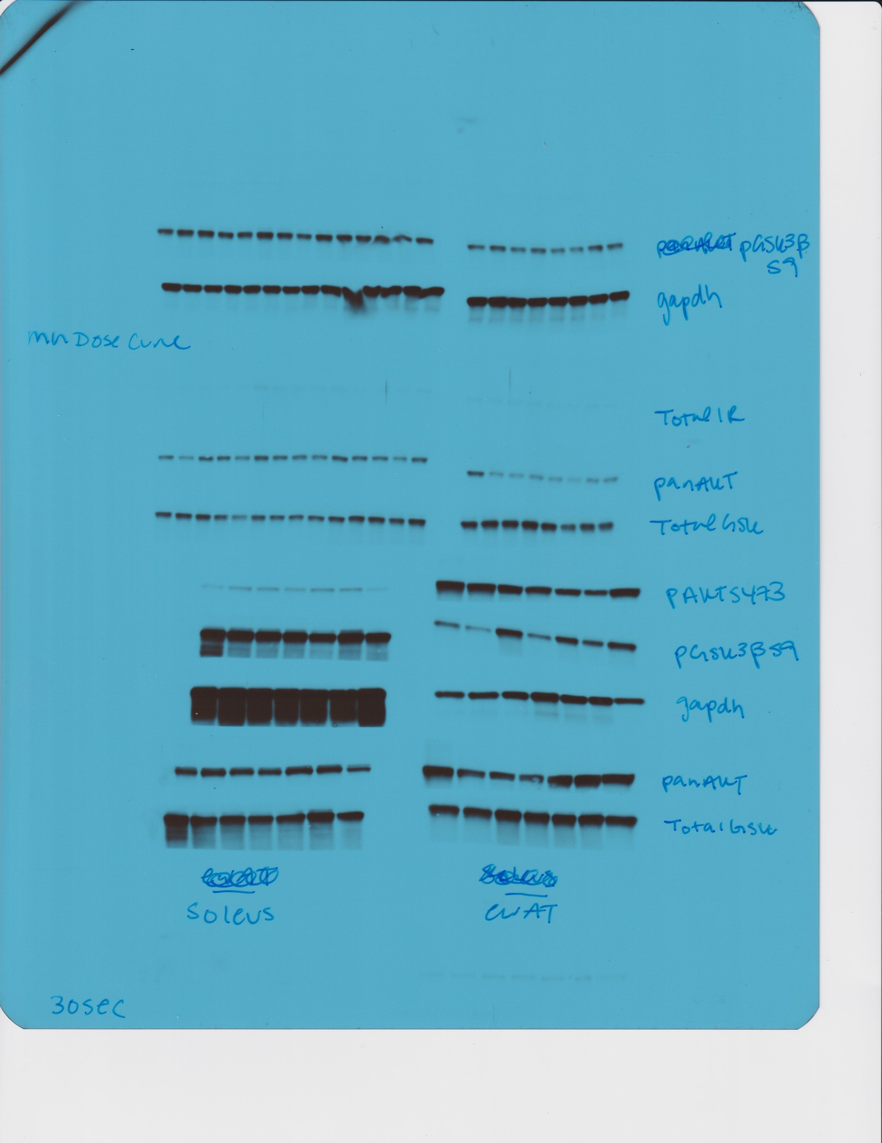
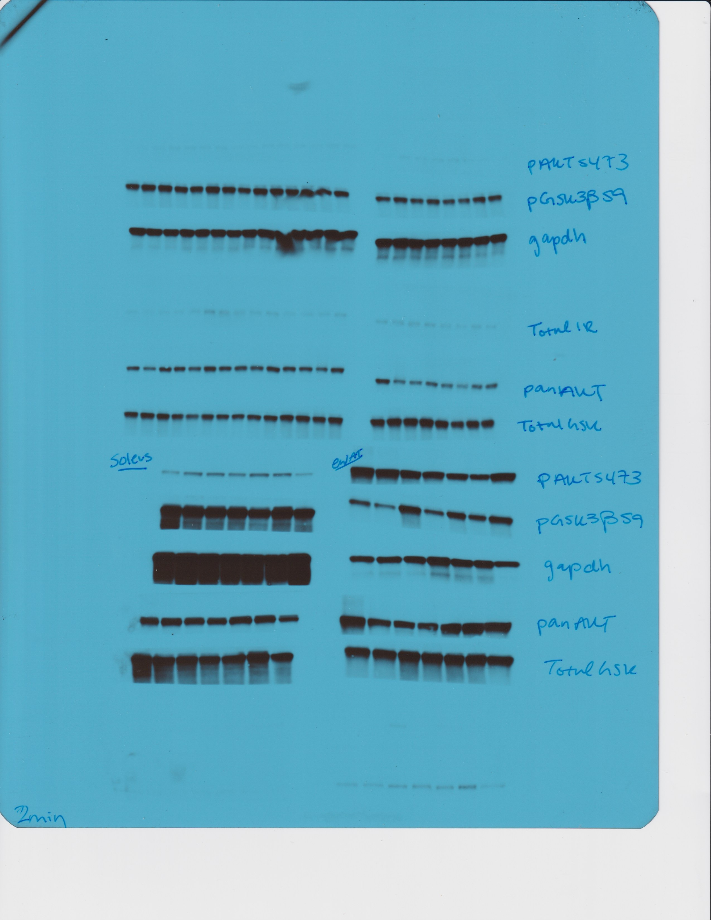
Suppl Figure 4A
p-Akt Ser473(soleus)
p-Akt Ser473 (eWAT)
p-GSK3β Ser9 (eWAT)
Gapdh (eWAT)
Pan AKT (soleus)
Pan AKT (eWAT)
Total GSK3β (soleus)
Total GSK3β (eWAT)

Slide 9
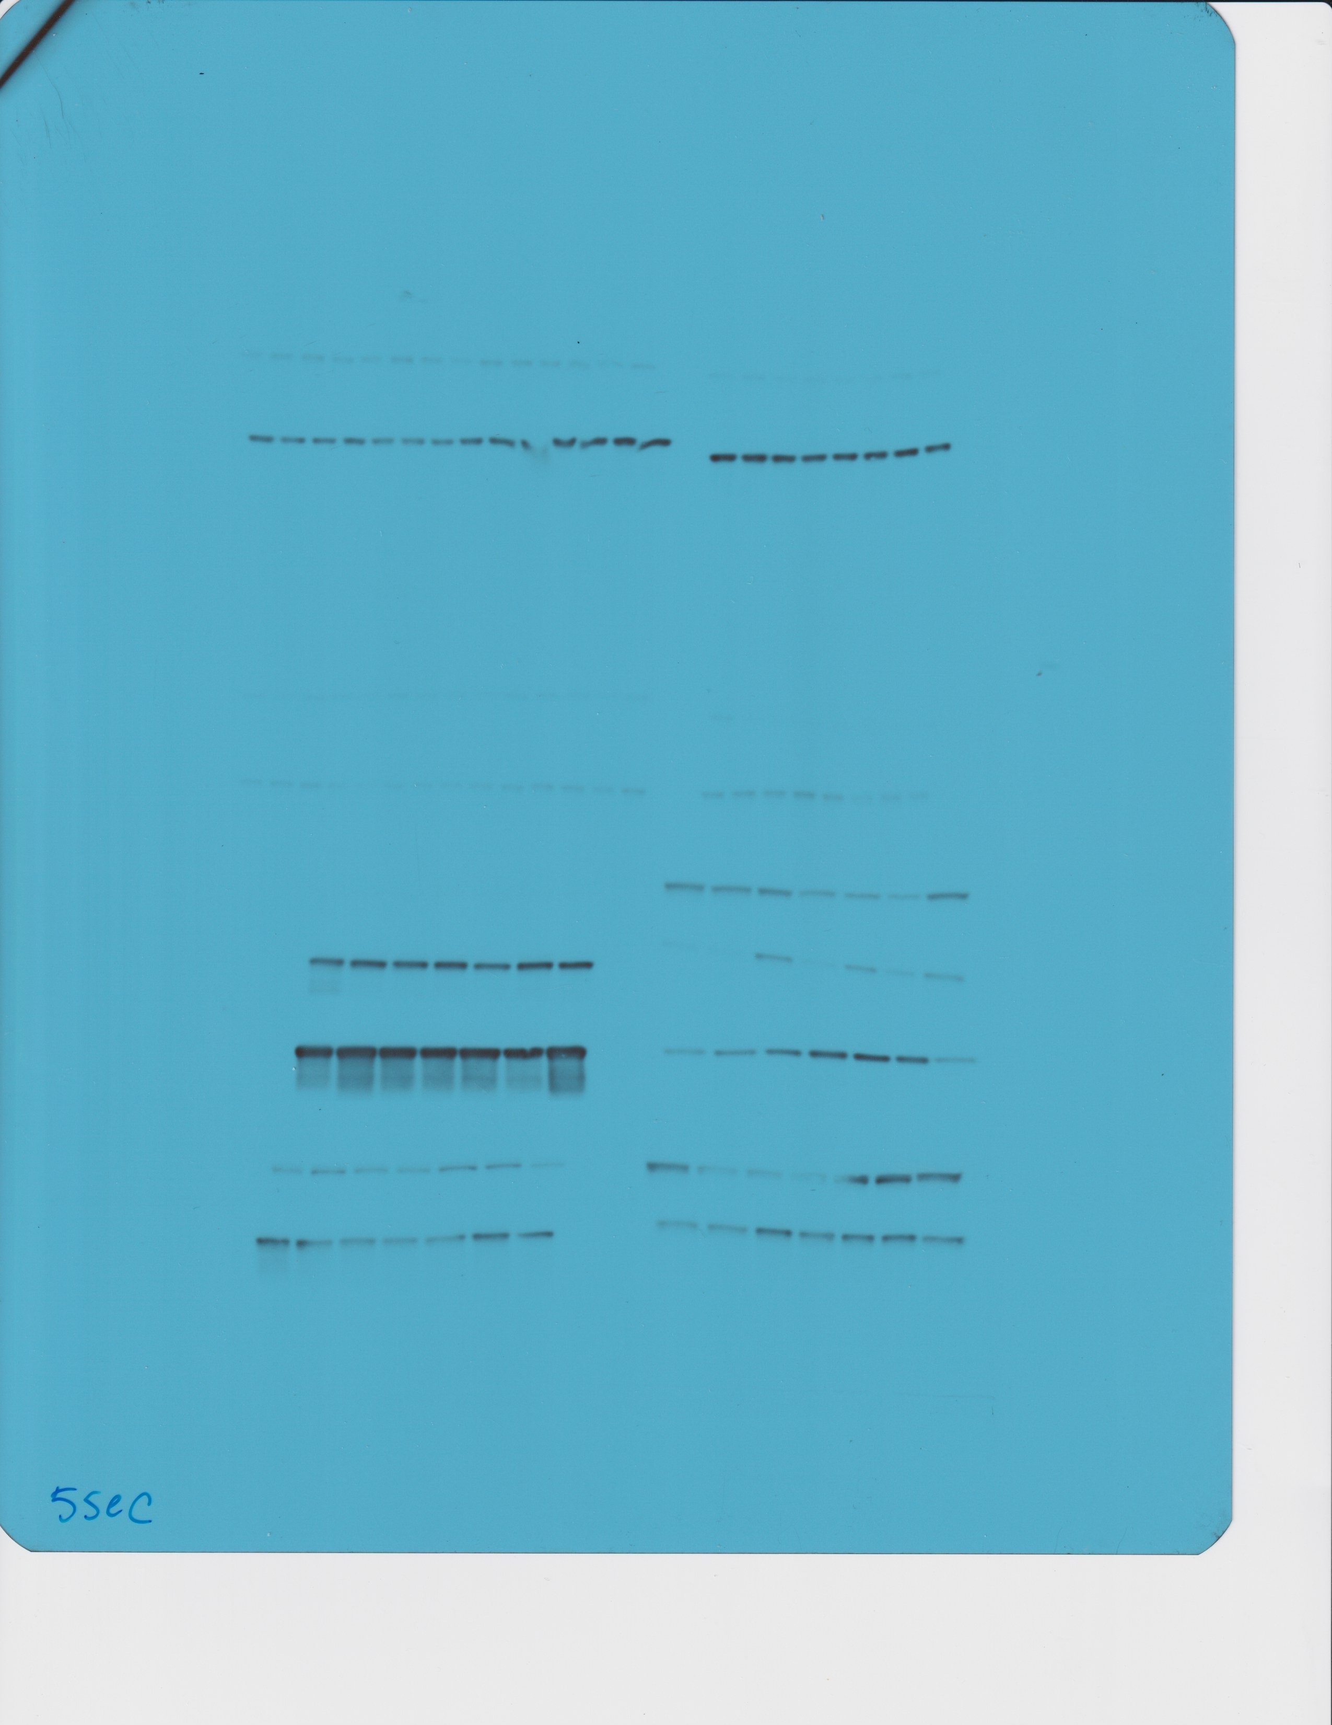
Suppl Figure 4A
p-GSK3β Ser9 (soleus)
Gapdh (soleus)

Slide 10
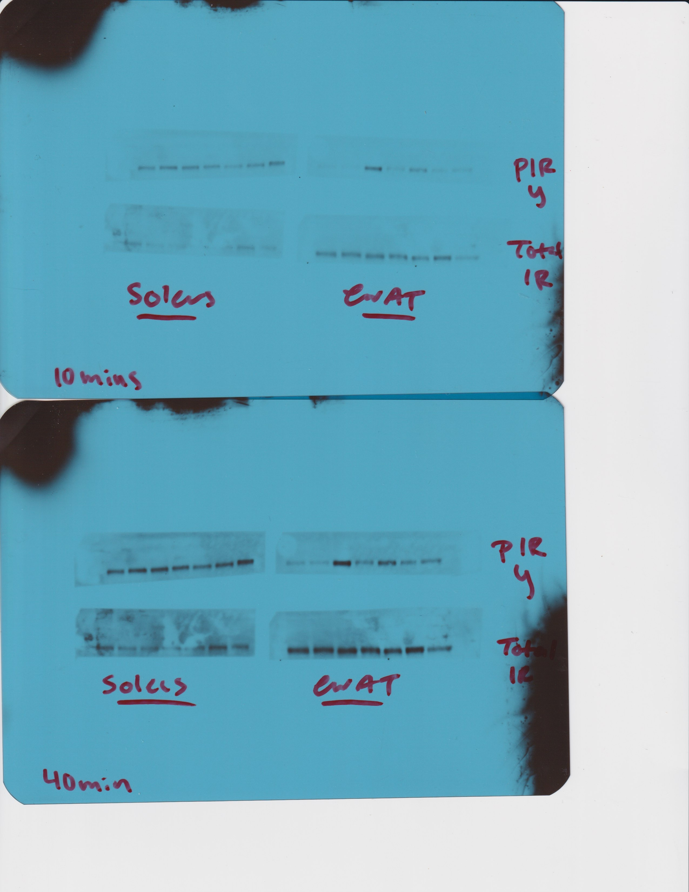
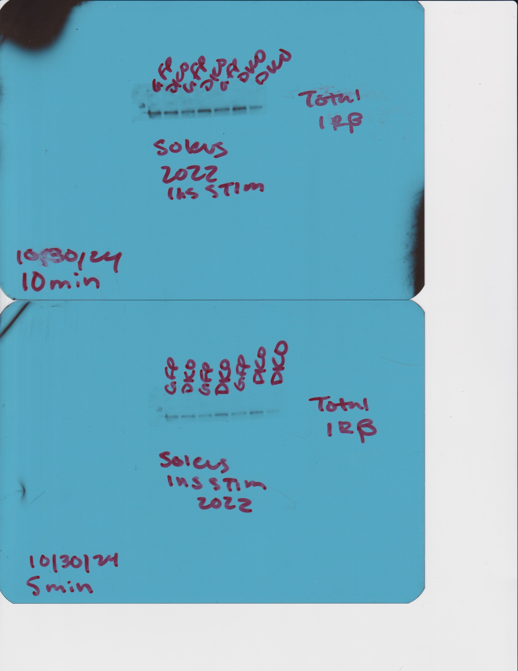
Suppl Figure 4A
Total IRβ (Soleus)
p-IRβ Y1150 (soleus)
p-IRβ Y1150 (eWAT)
Total IRβ (eWAT)

Slide 11
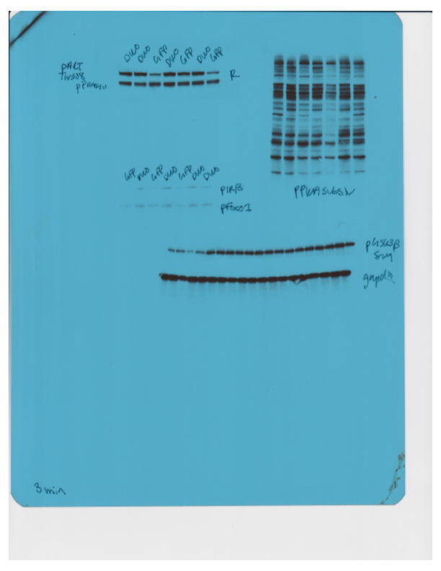
Suppl Figure 4C
p-PKA Substrates (RRxxS/T*)

Slide 12
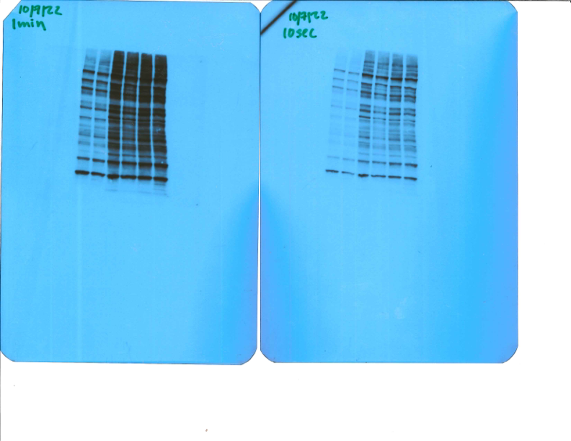
Suppl Figure 4G
p-PKA Substrates (RRxxS/T*)

Slide 13
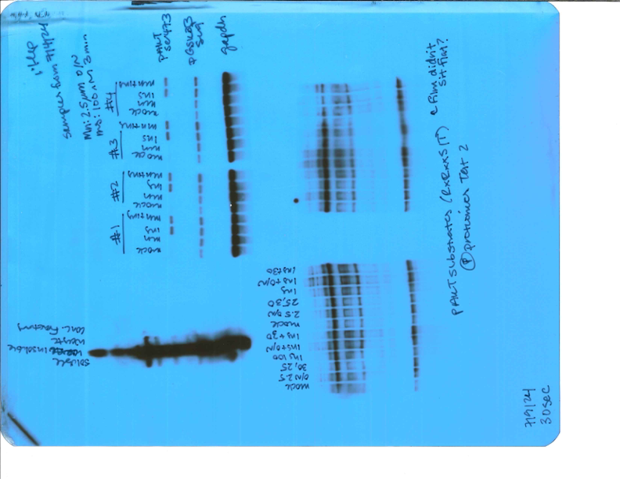
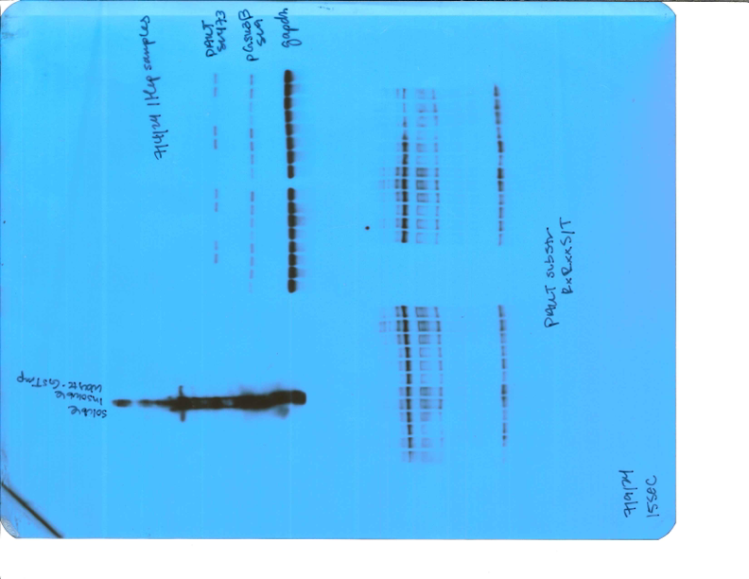
Suppl Figure 5A
p-AKT Ser473
Gapdh

Slide 14
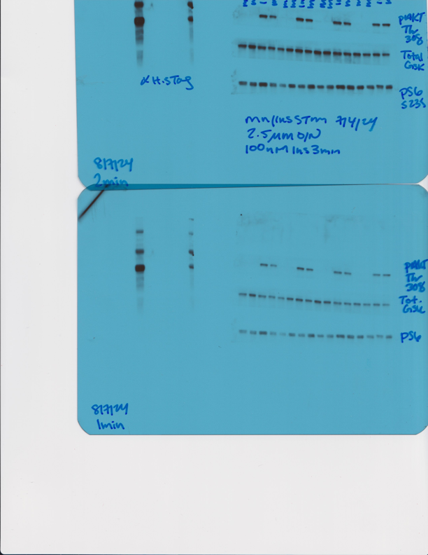
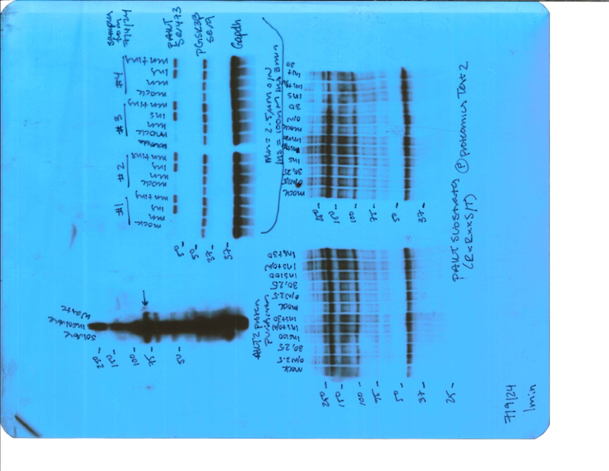
Suppl Figure 5A
Total GSK3β
p-GSK3β Ser9
p-AKT Thr308

Slide 15
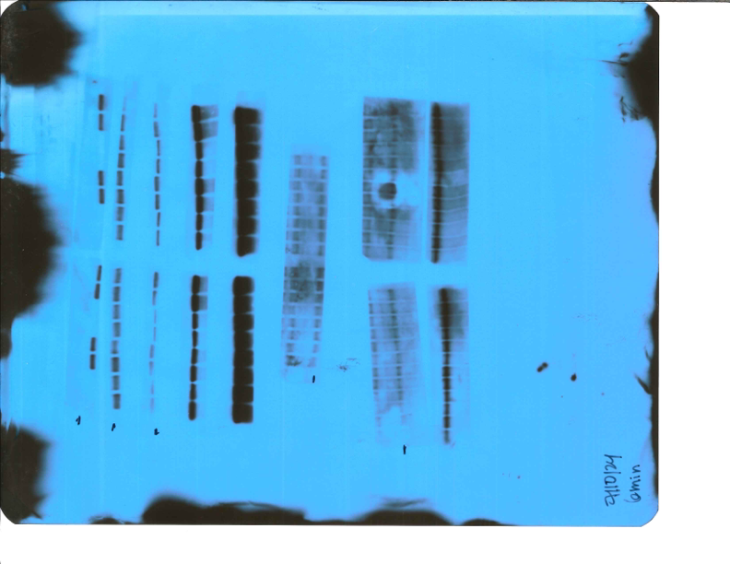
Suppl Figure 5A
Pan AKT

Slide 16
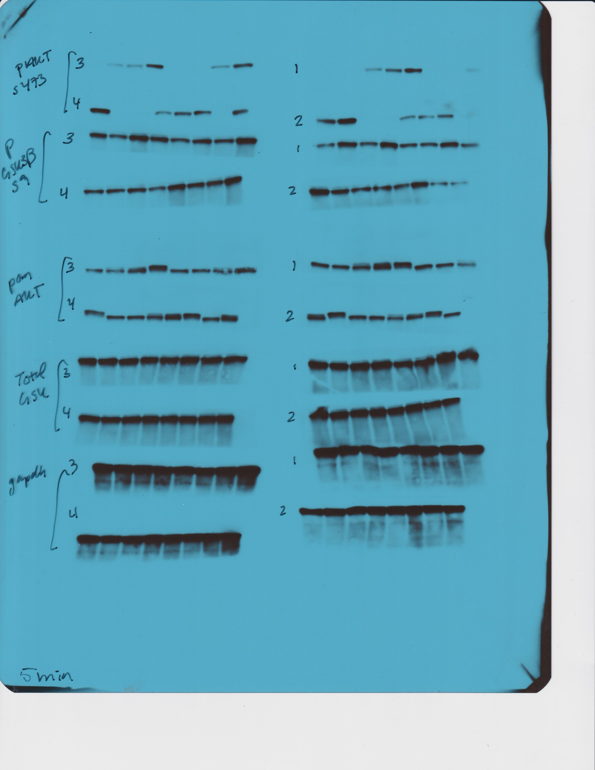
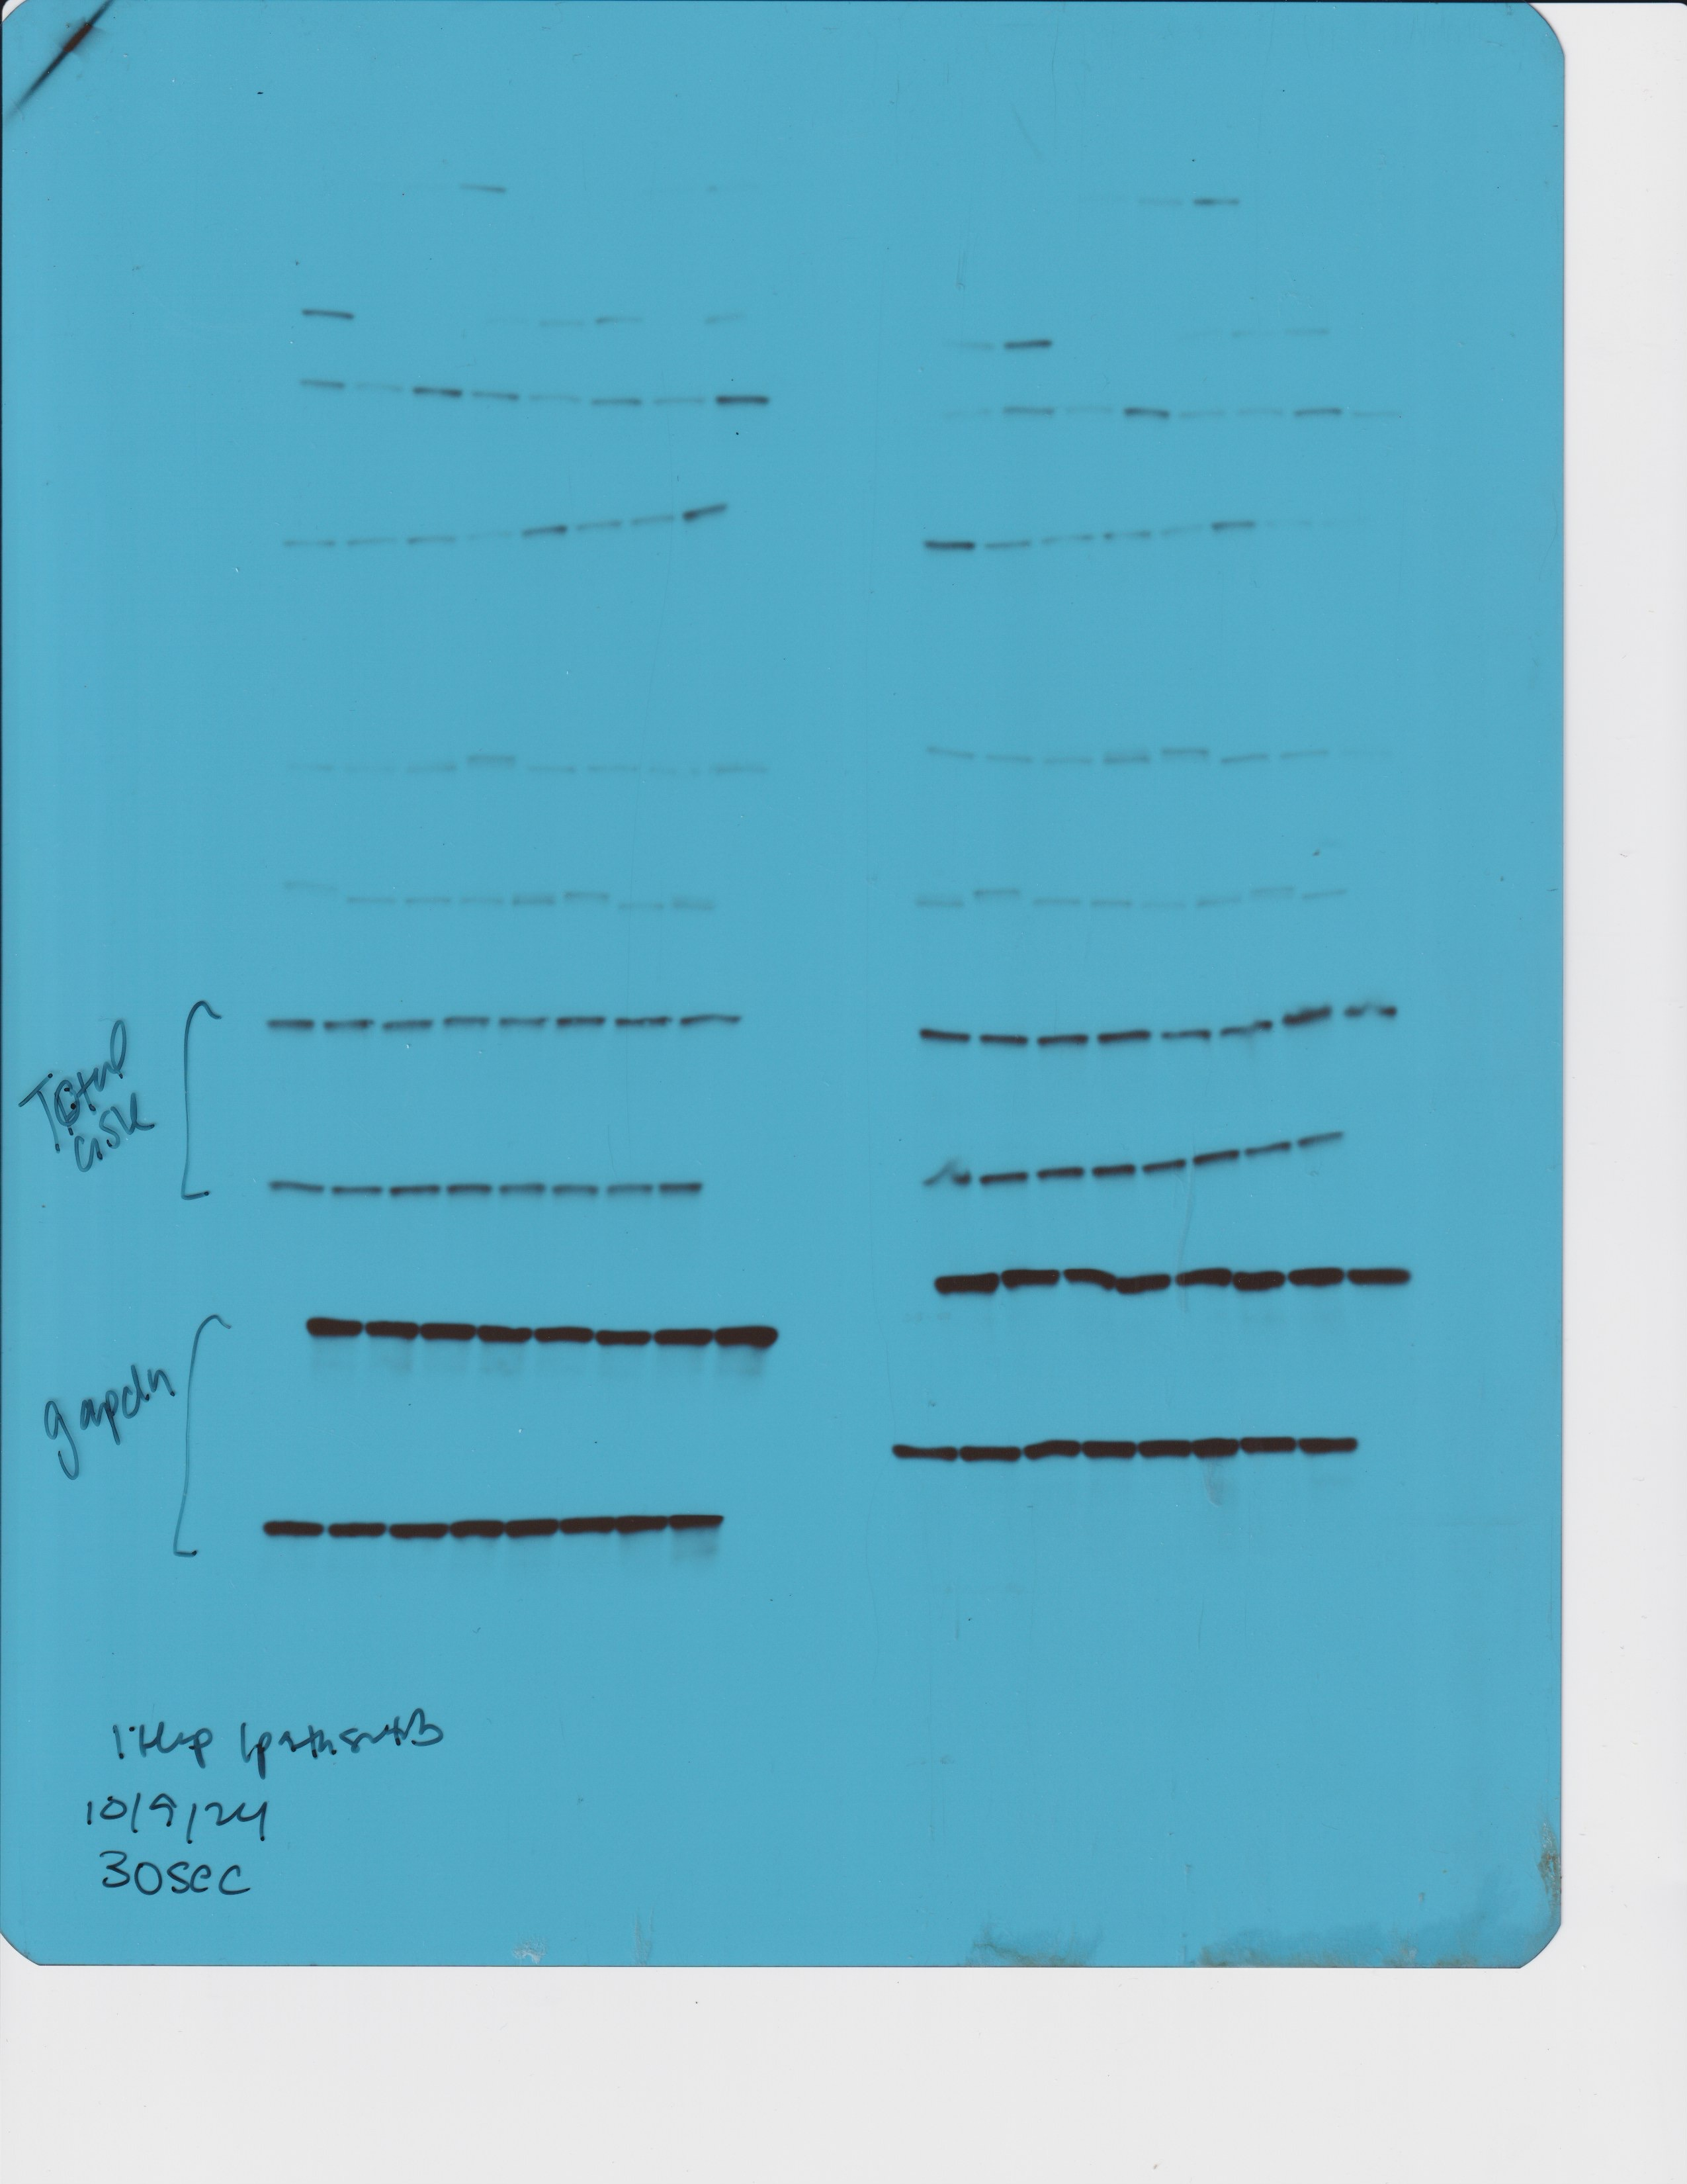
p-AKT Ser473
p-GSK3β Ser9
Figure 6A
Pan AKT
Total GSK
Gapdh

Slide 17
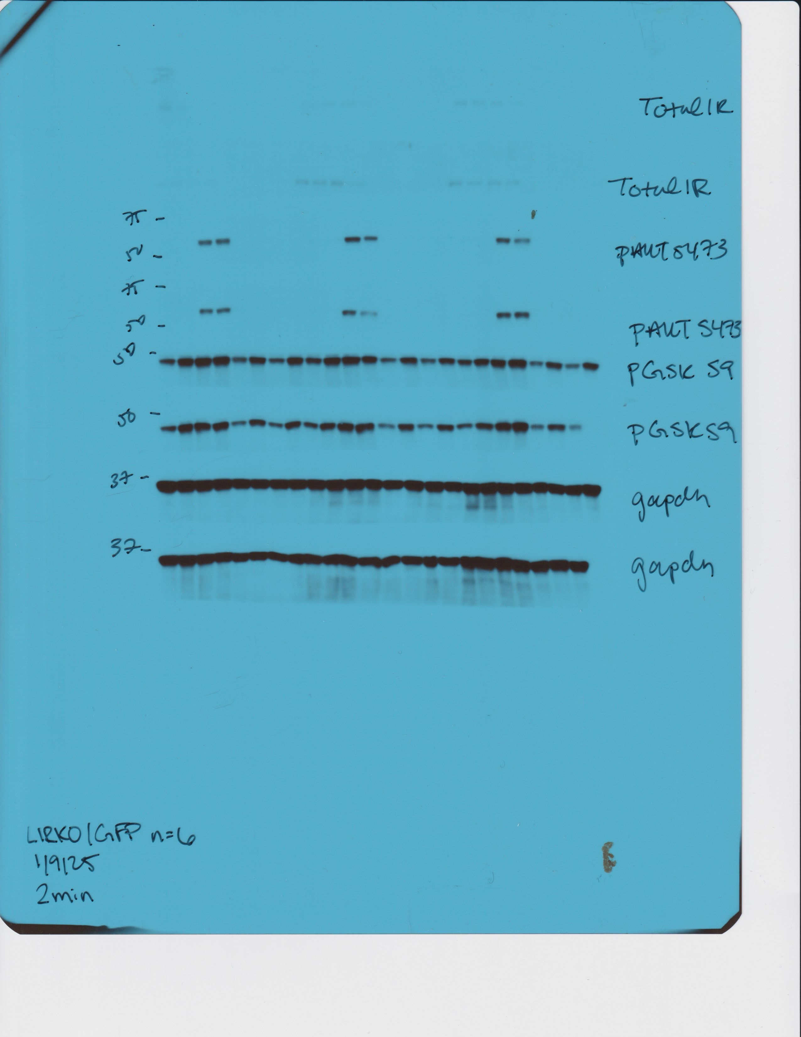
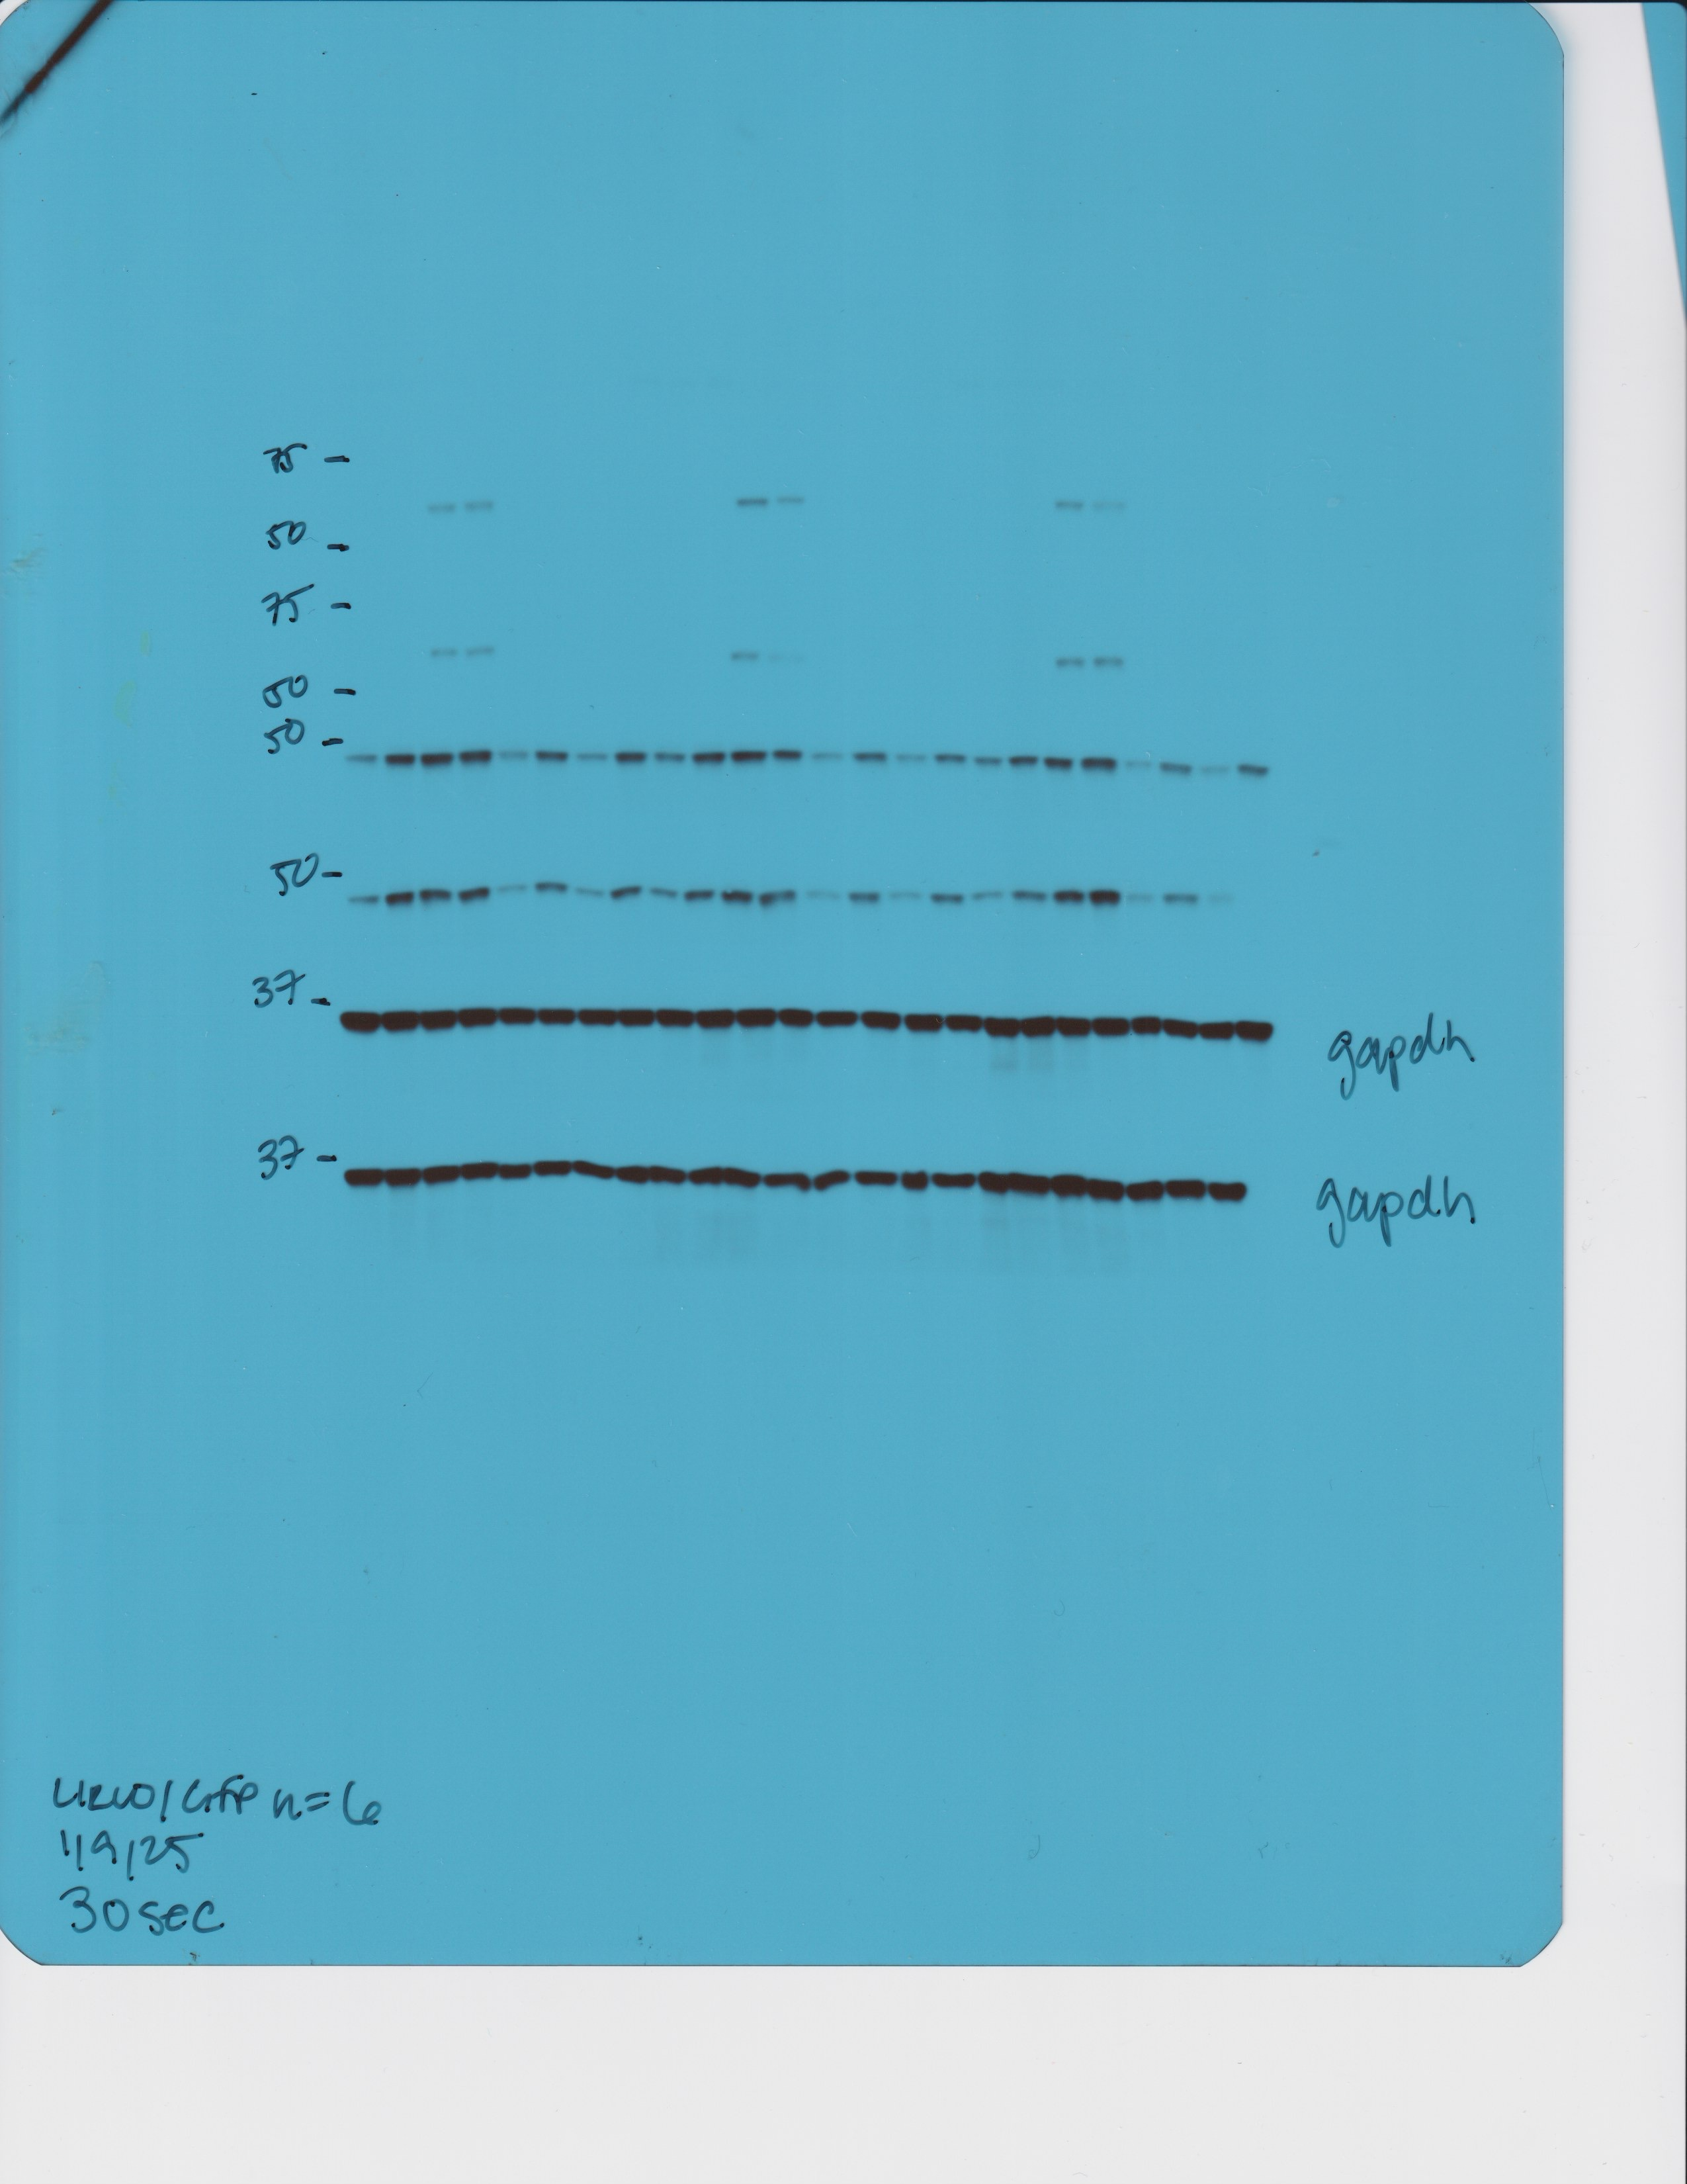
Figure 6C
p-AKT Ser473
p-GSK3β Ser9
Gapdh

Slide 18


Total IRβ
Pan AKT
Figure 6C
Total GSK3β

Slide 19
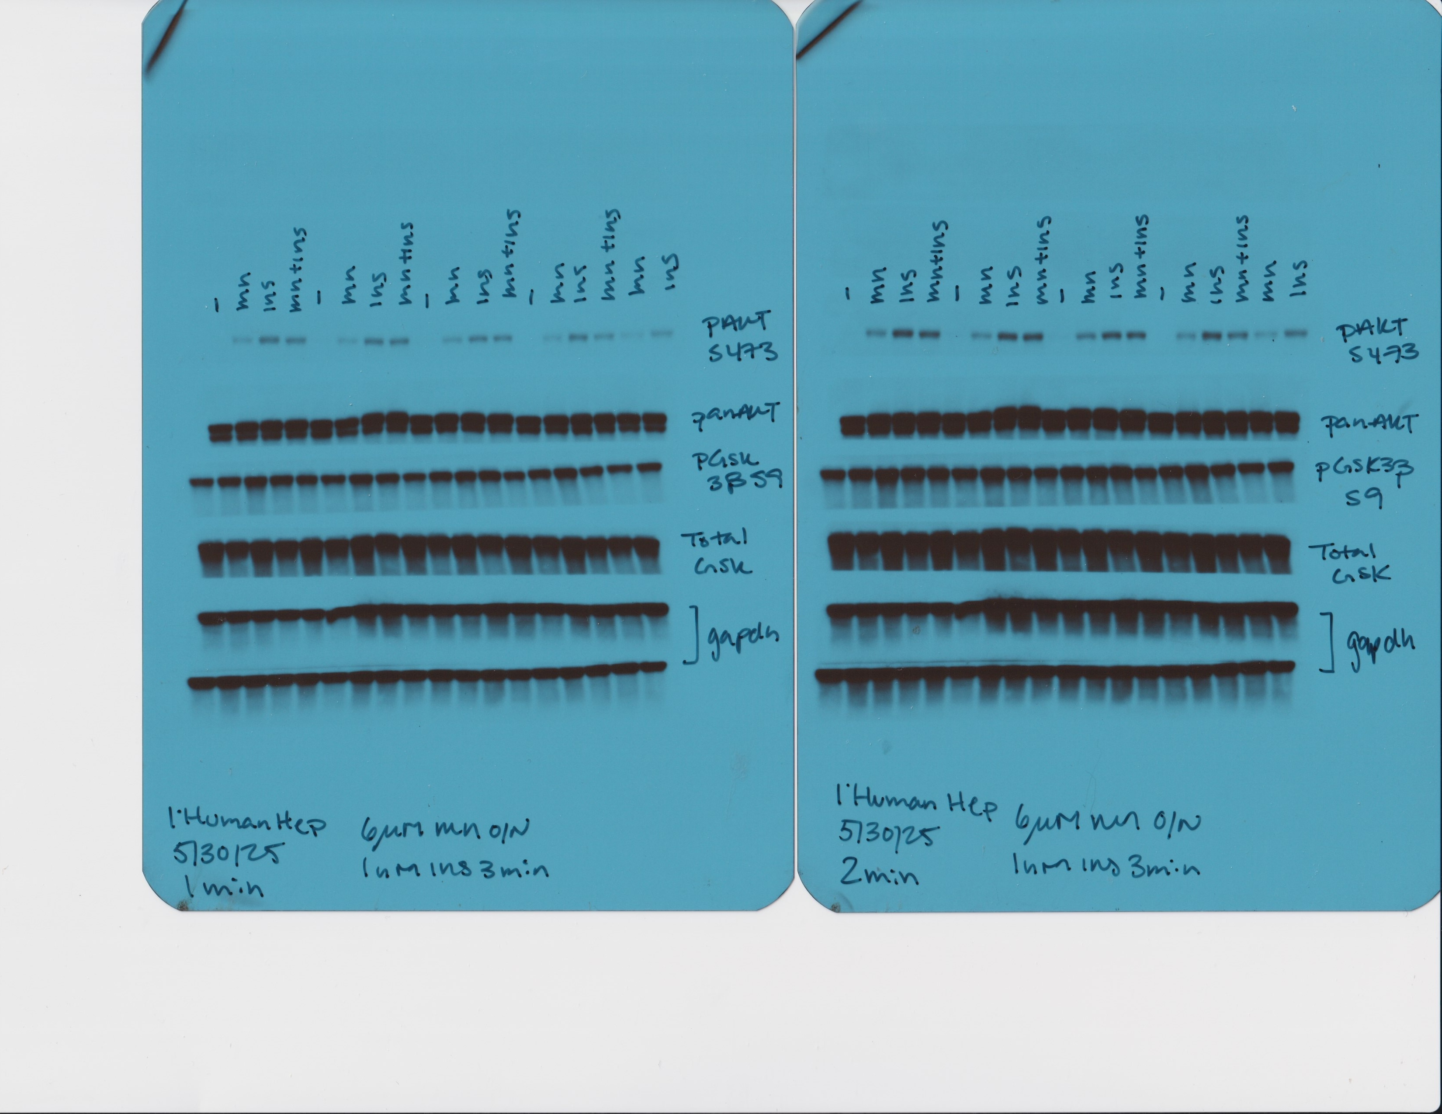
p-Akt Ser473
Figure 5A

Slide 20
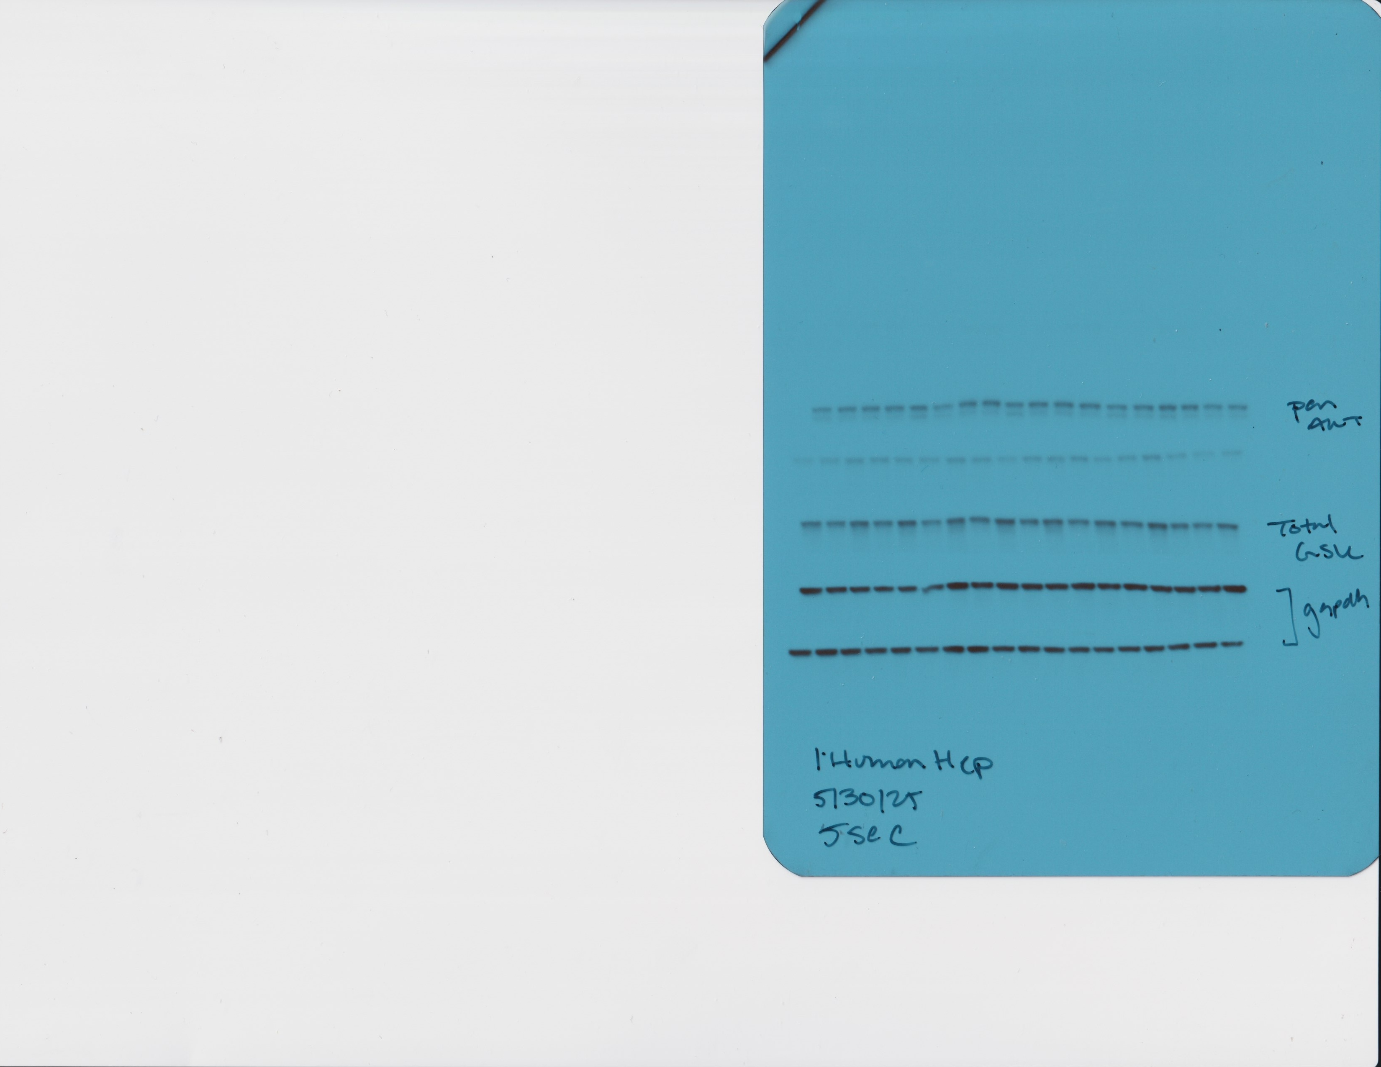
Figure 5A
Total GSK3β
Gapdh

Slide 21
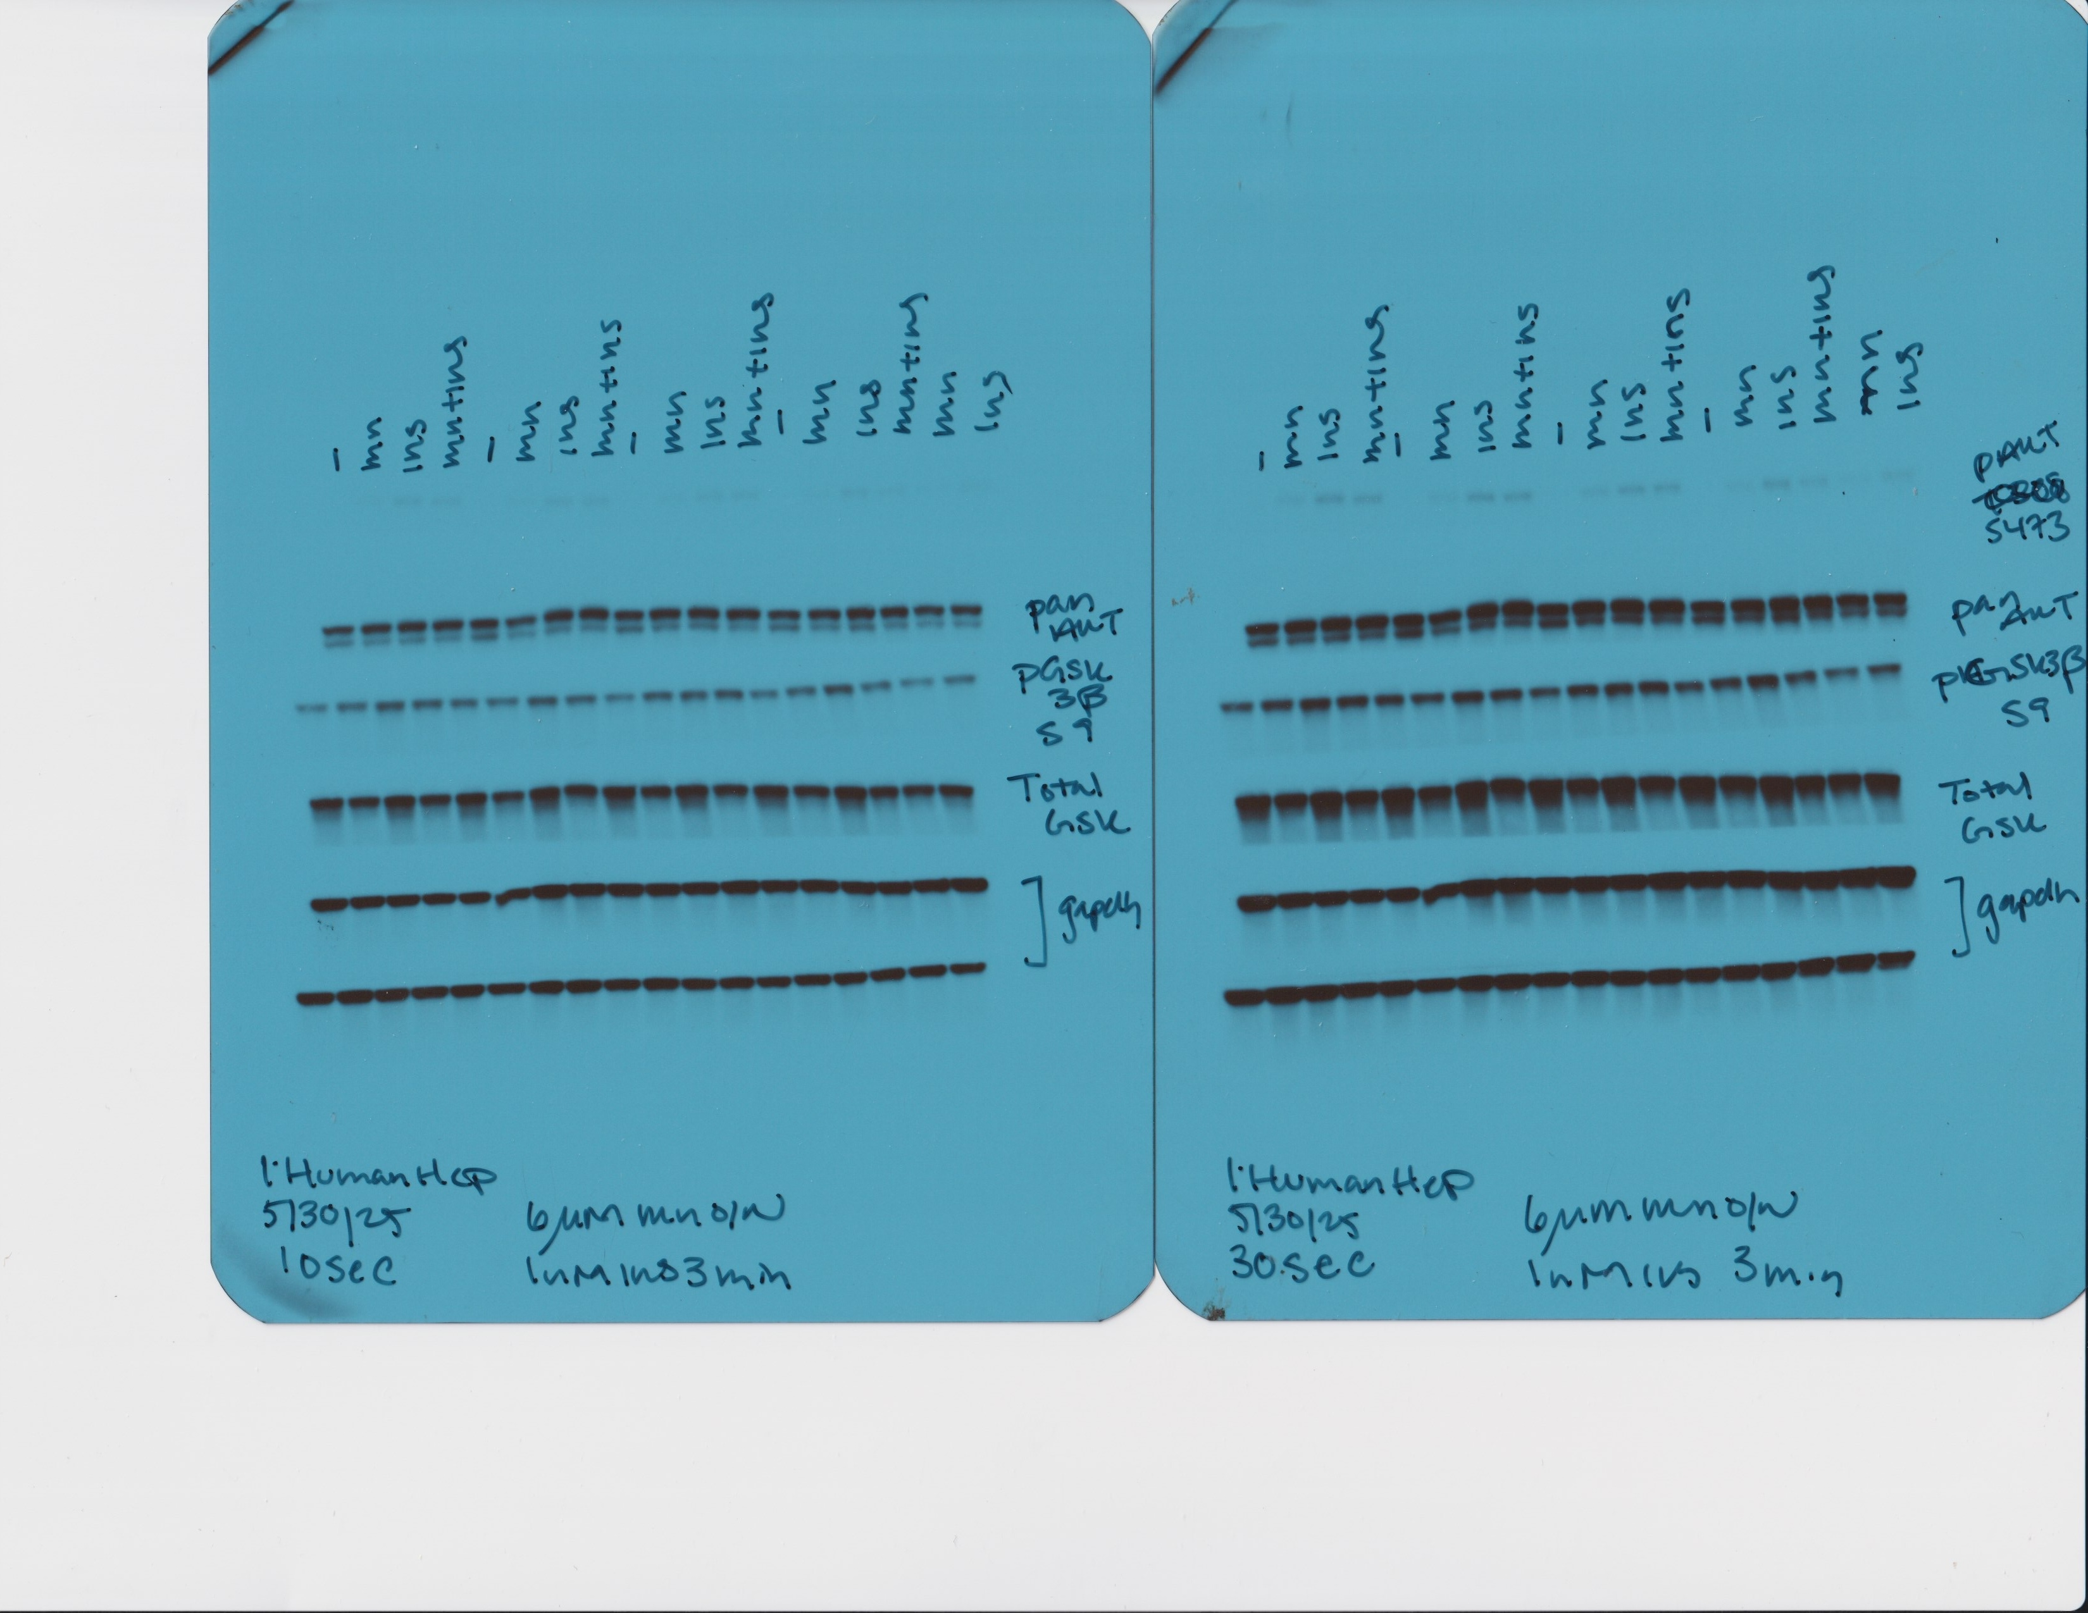
Figure 5A
Pan AKT

Slide 22
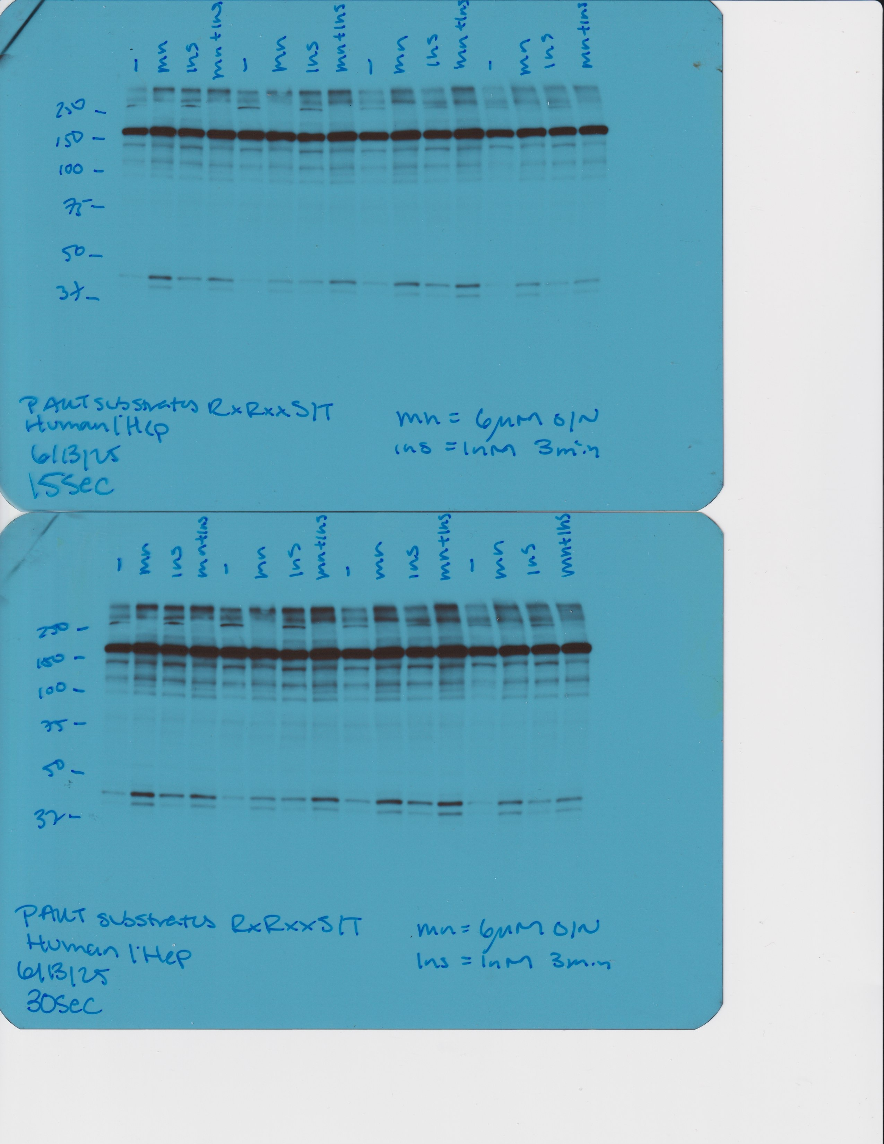
Figure 5C
p-Akt substrates (RxRxxS/T*)

