Slide 1
Primary antibodies including rabbit anti Phospho-FAK (Tyr397) (#3283), FAK (#3285), Phospho-p44/42 MAPK (Erk1/2) (Thr202/Tyr204) (#4370), p44/42 MAPK (Erk1/2) (#4695), Phospho-Stat3 (Tyr705) (D3A7) (#9145), STAT3 (#4904), Phospho-Akt (Ser473) (#4060), Akt(pan)(#4691), p-ERK1/2 T202/Y204 (#9101), ERK1/2 (#9107), p-MEK1/2 S217/221 (#9121), p-S6 S235/236 (#4858), CyclinD1 (#2978), GAPDH (#2118), Caspase-3 (#9662), PARP (#9542), and β-Actin (#4967 and #4970) antibodies were purchased from Cell Signaling Technology. Primary rabbit anti-GAPDH (#TAB1001, Invitrogen) antibody was purchased from Thermo Fisher Scientific Inc. Anti-Rabbit Detection Module(#DM-001, Bio-Techne, Minnesota, USA) was used to detect the targeted primary antibodies.

Slide 2
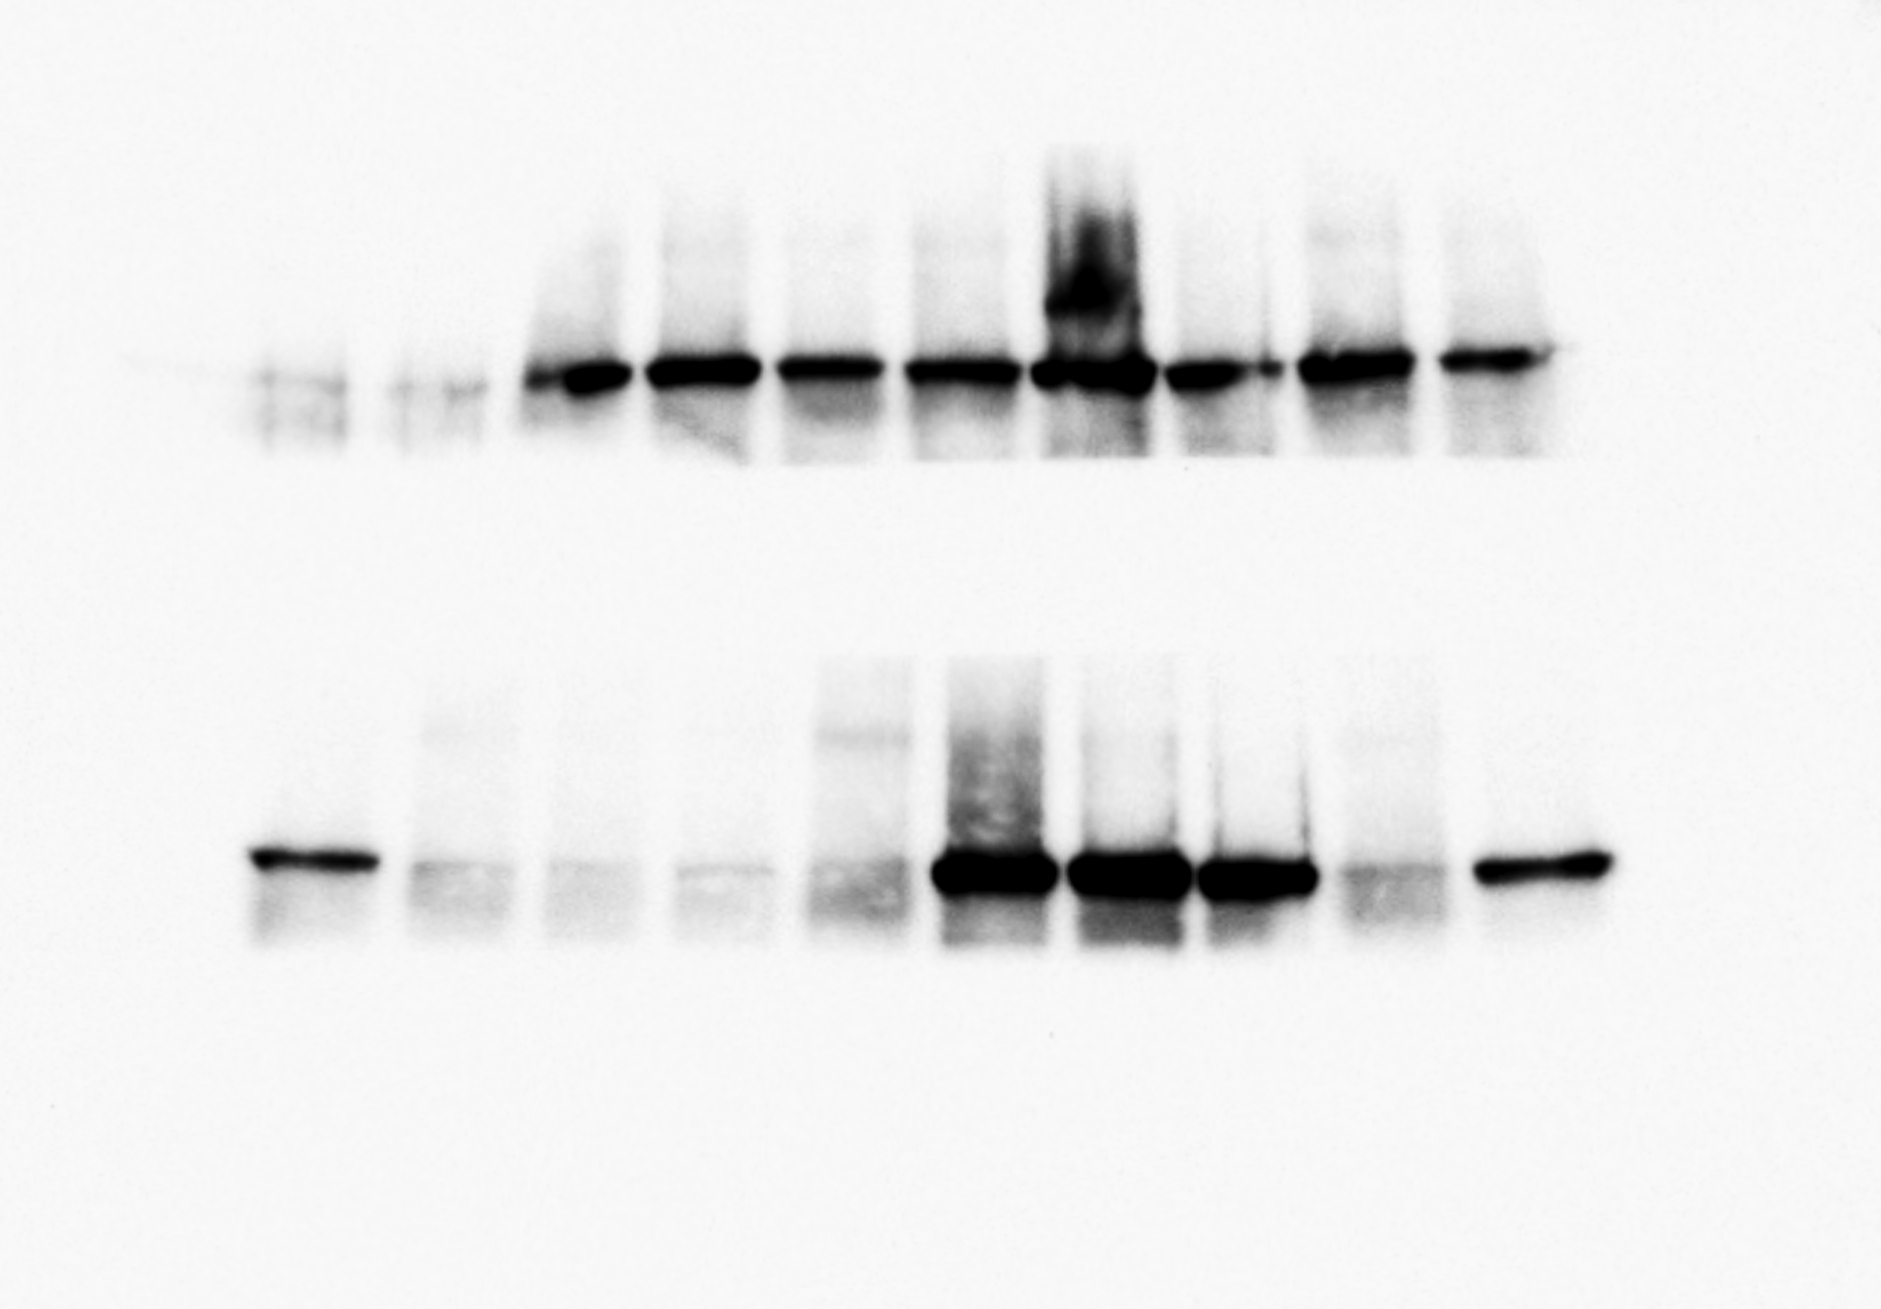
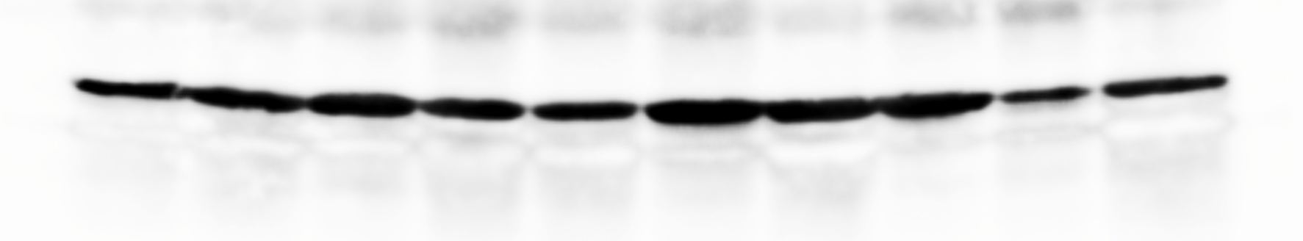
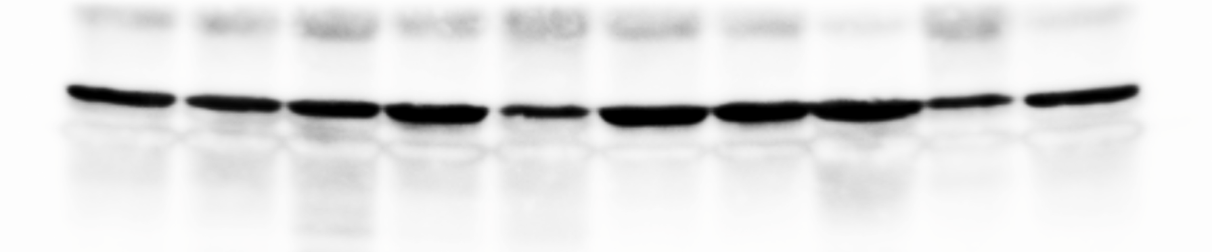
Figure 1E
Raw blots
FAK
beta-Actin
Panel 1
Panel 2

Slide 3
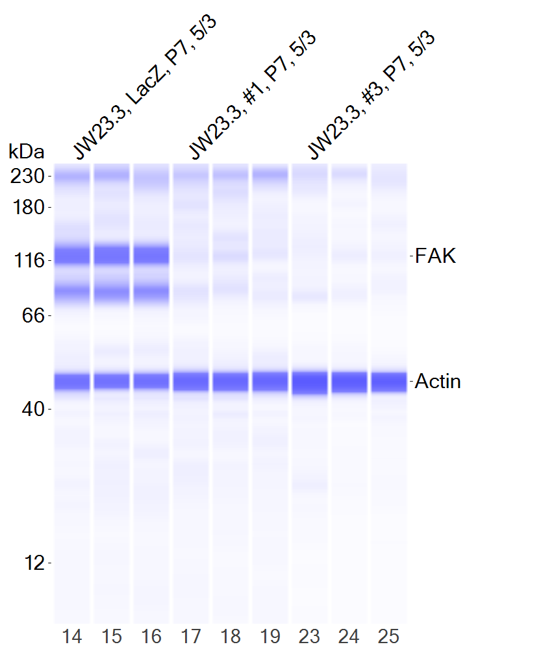
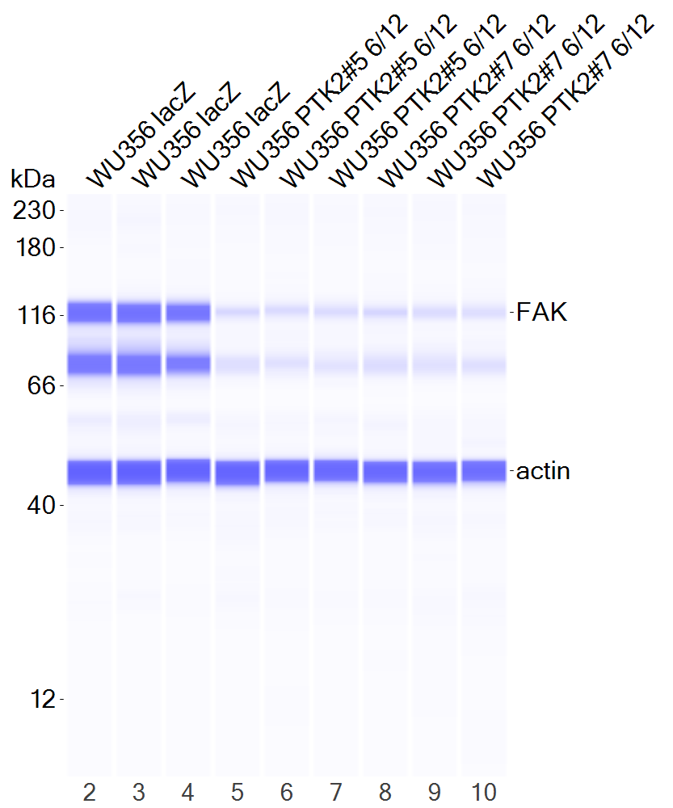
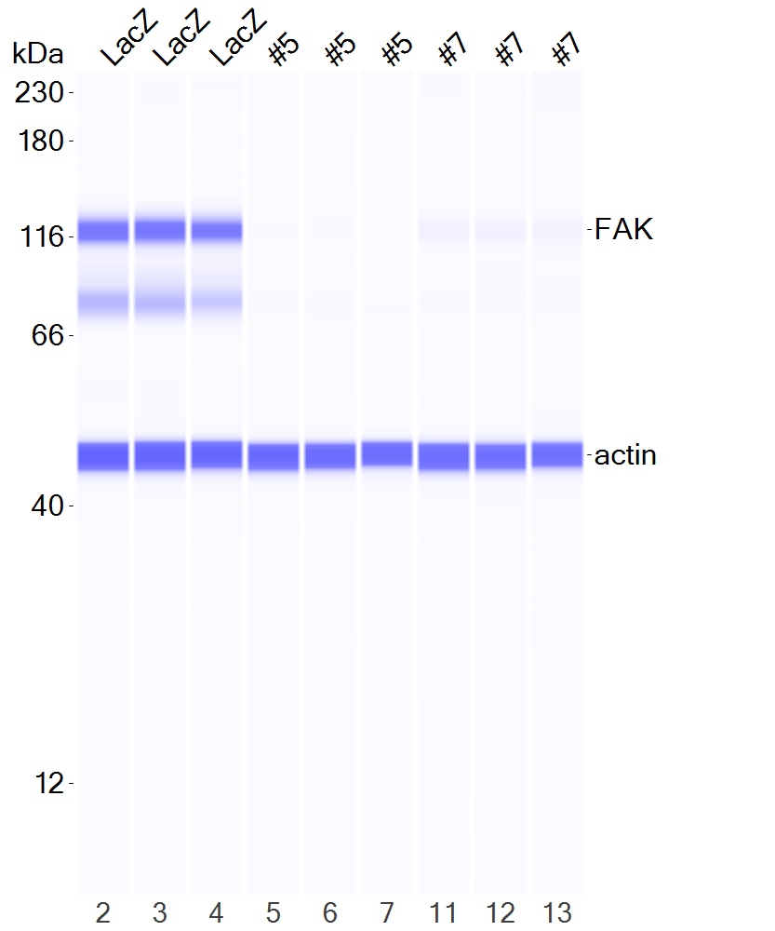
Figure 2B
JW23.3 JH-2-002 WU-356

Slide 4
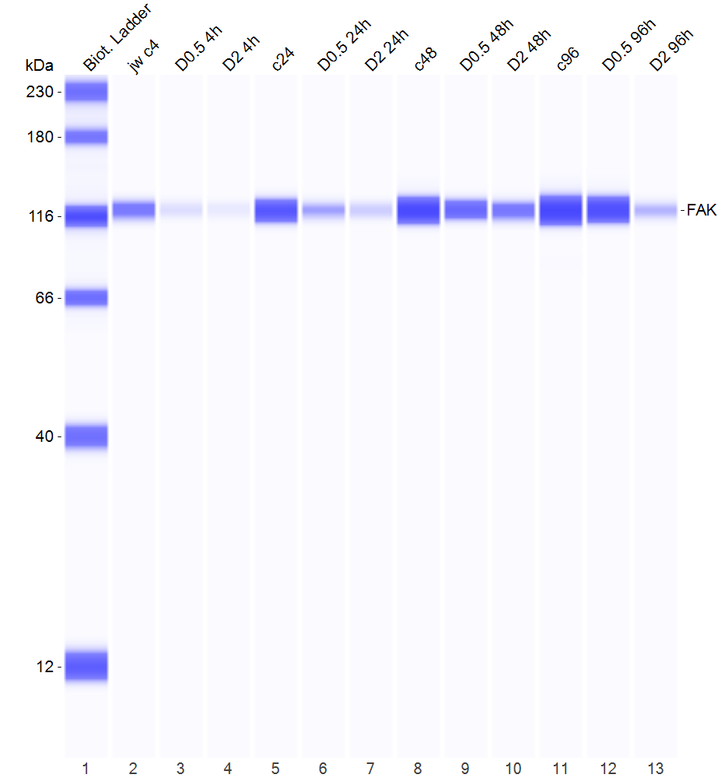
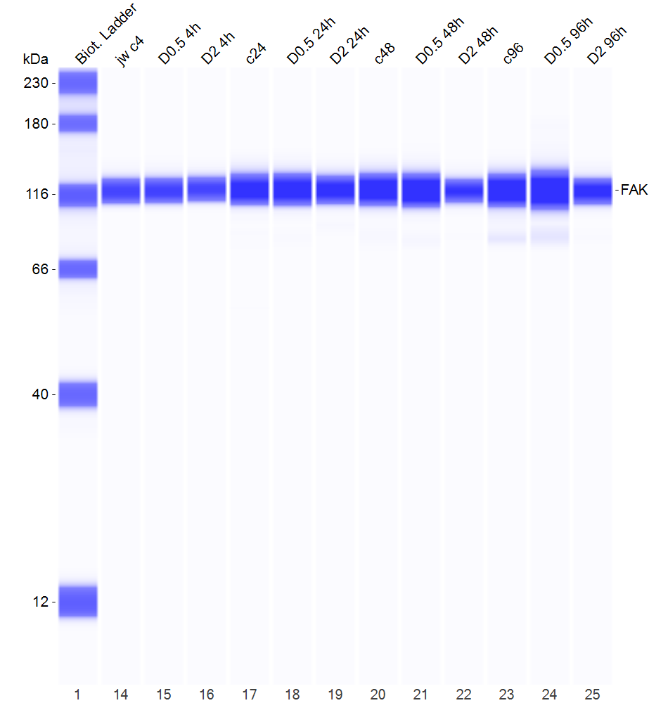
Figure 3C
JW23.3

Slide 5
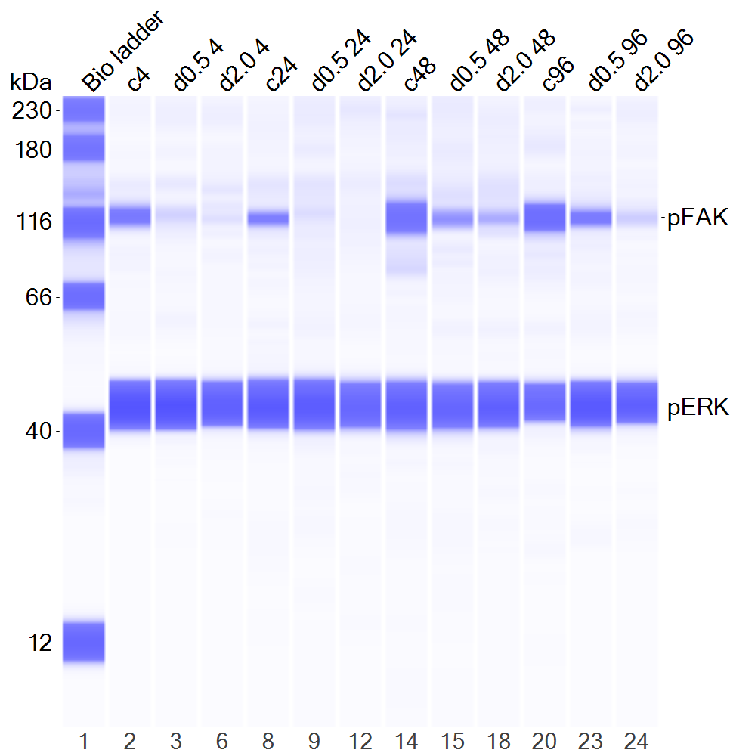
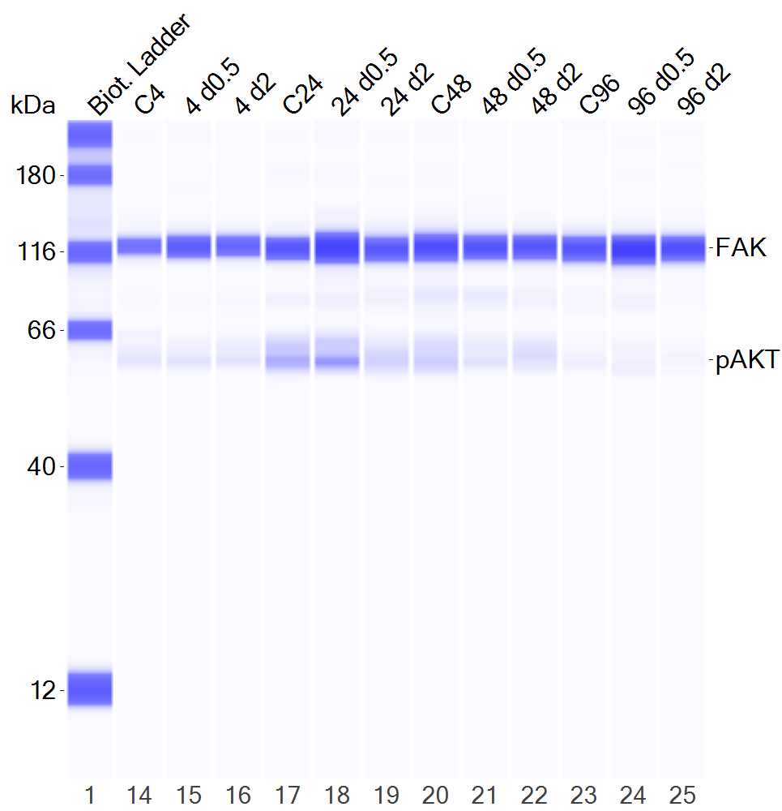
Figure 3C
JH-2-002

Slide 6
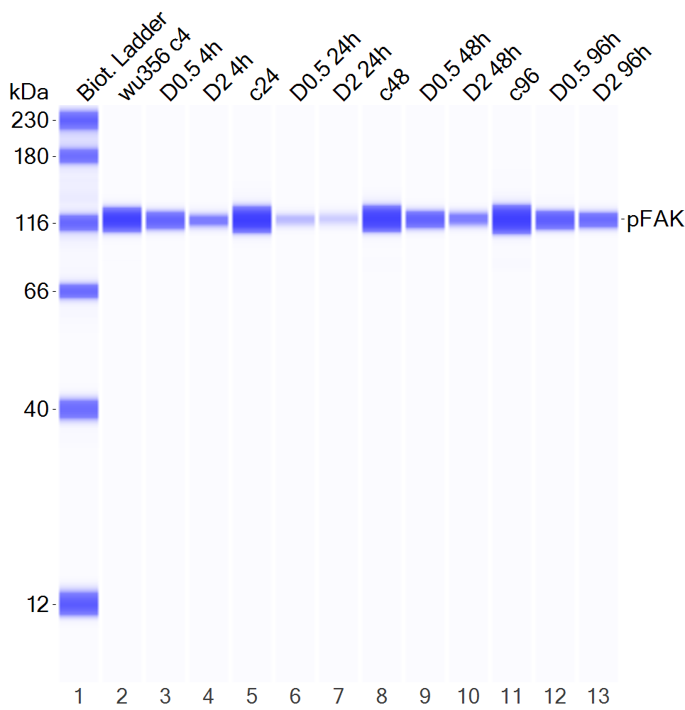
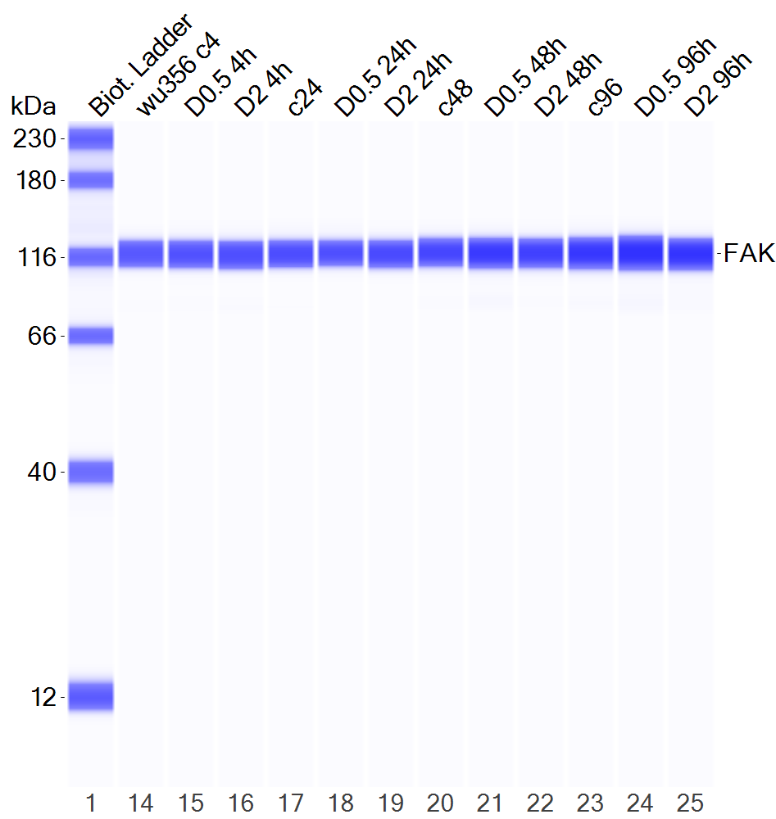
Figure 3C
WU356

Slide 7
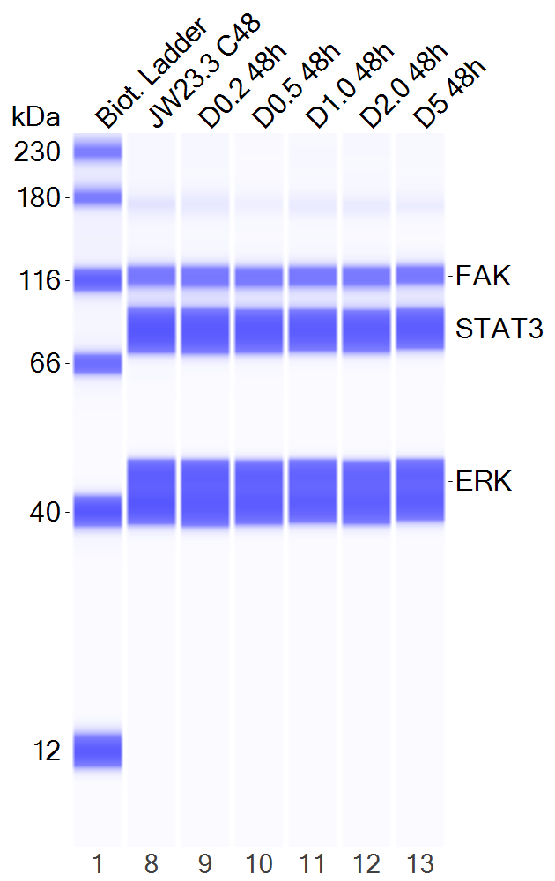
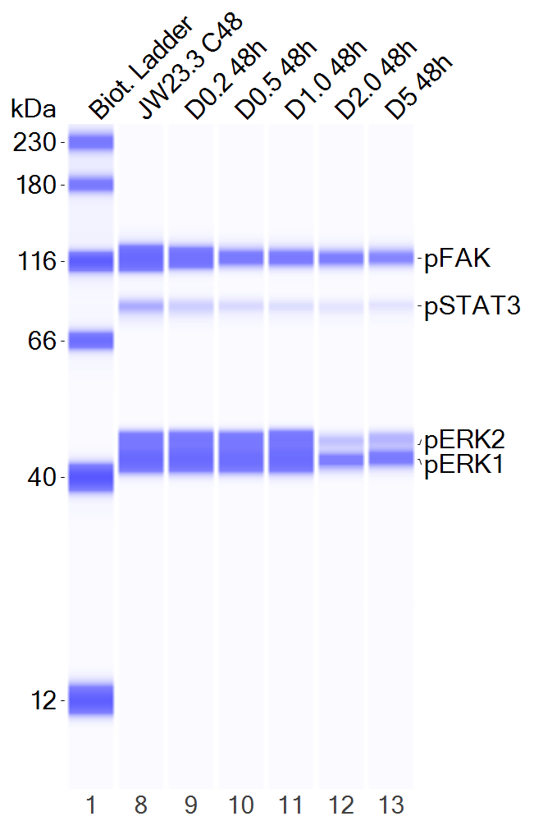
Figure 3D
JW23.3

Slide 8
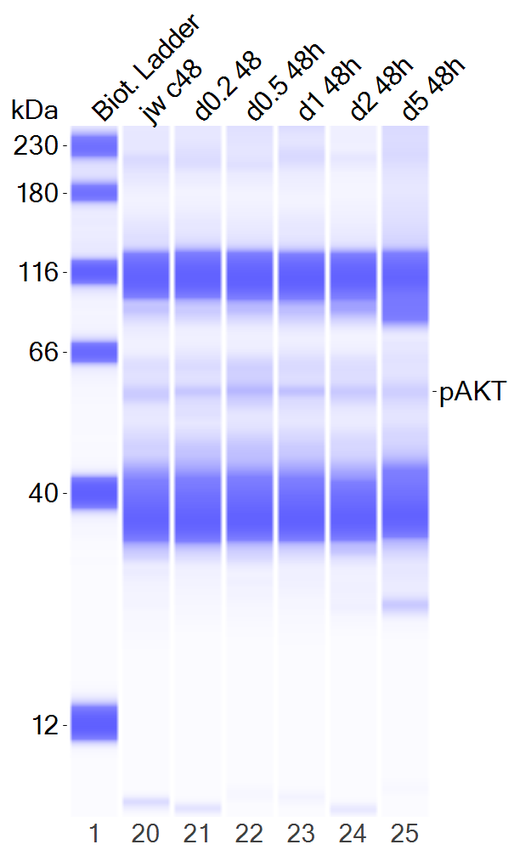
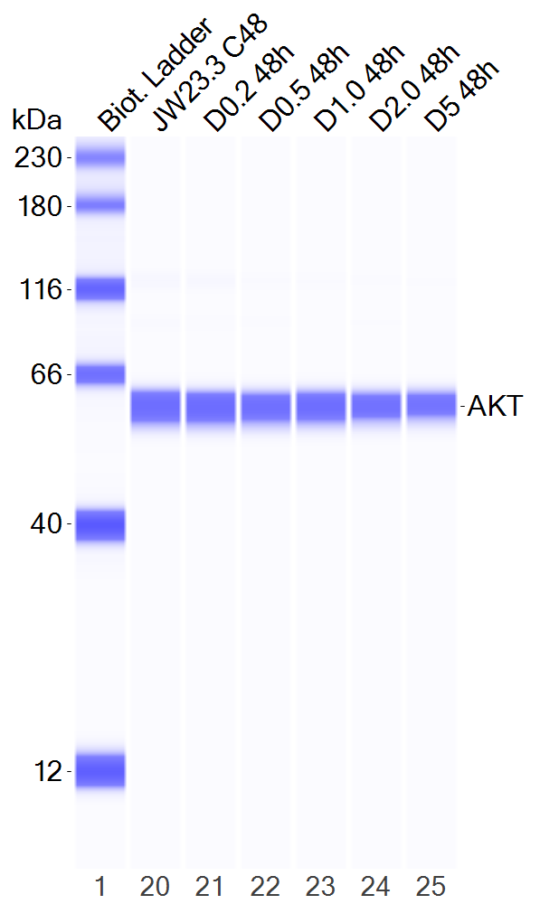
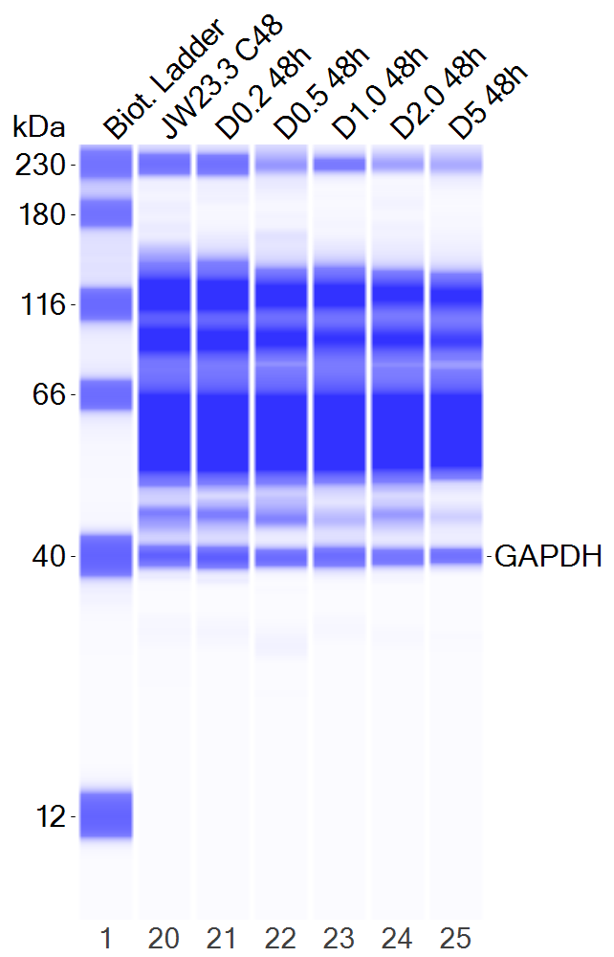
Figure 3D
JW23.3

Slide 9
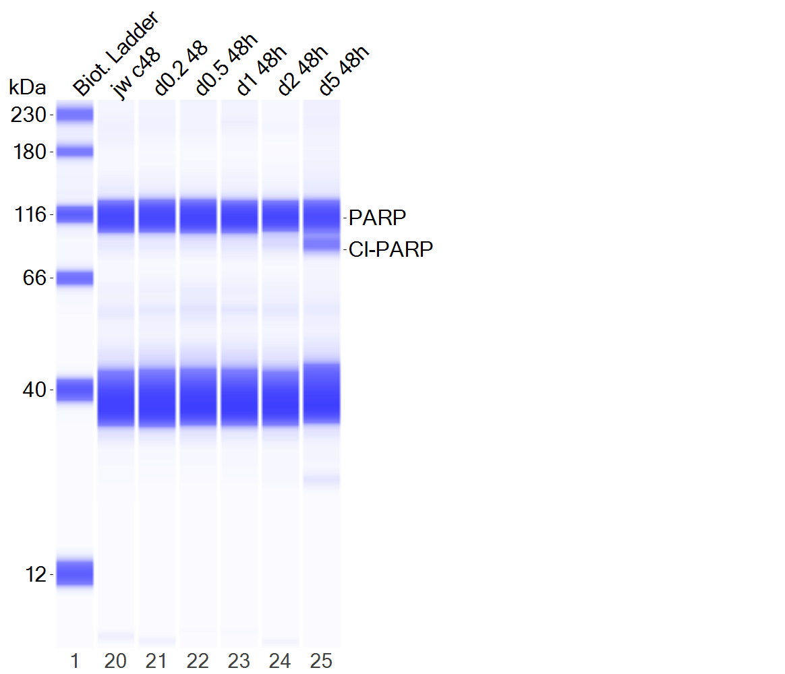
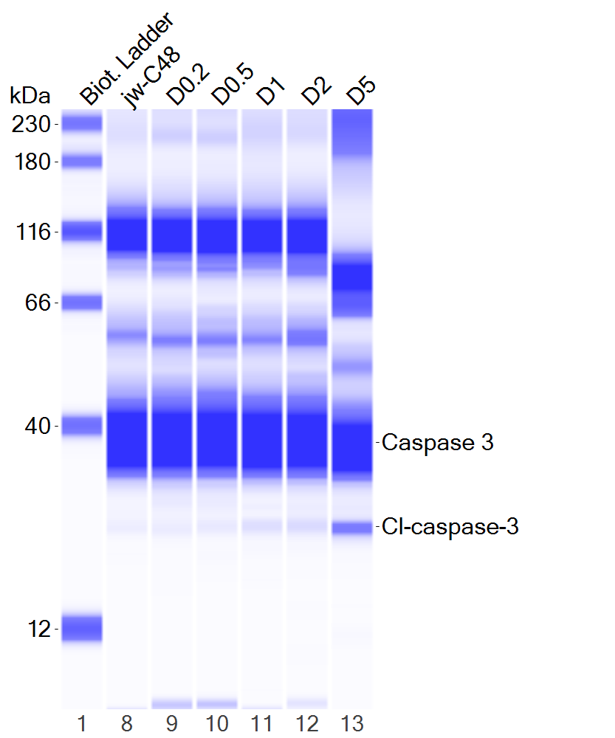
Figure 3D
JW23.3

Slide 10
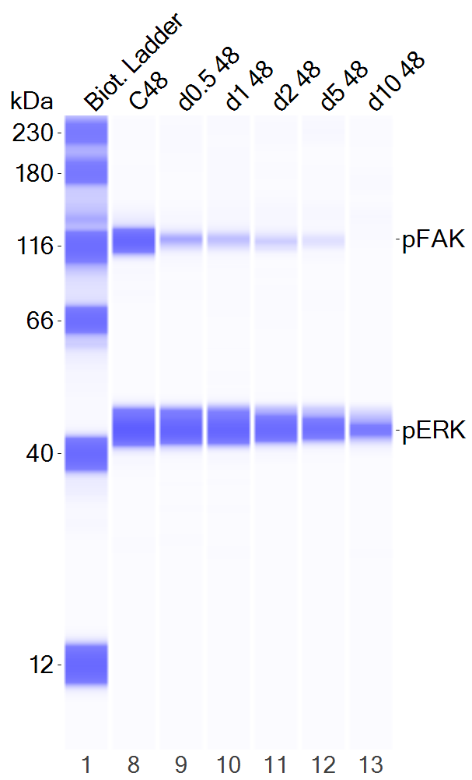
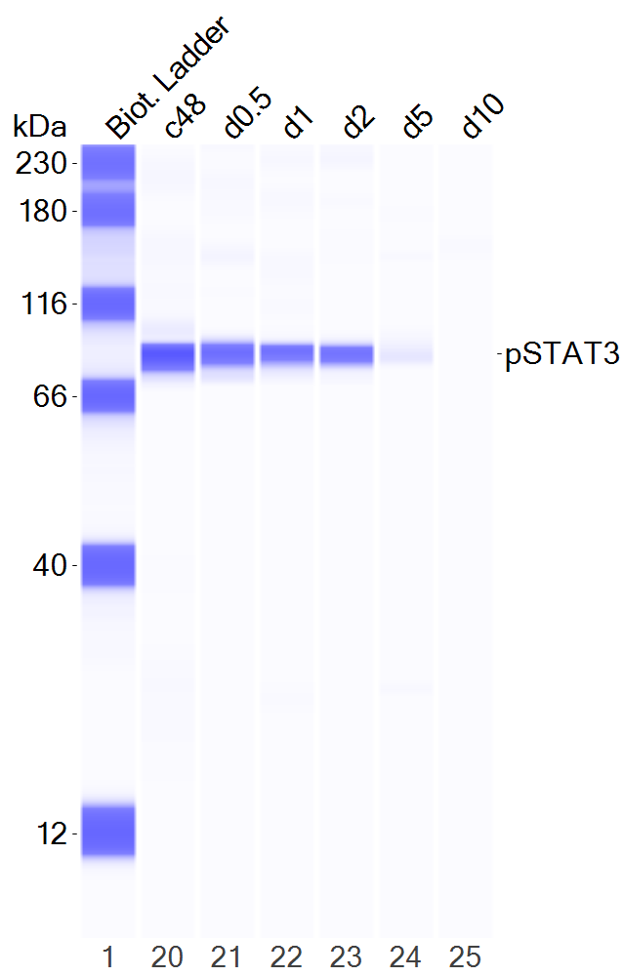
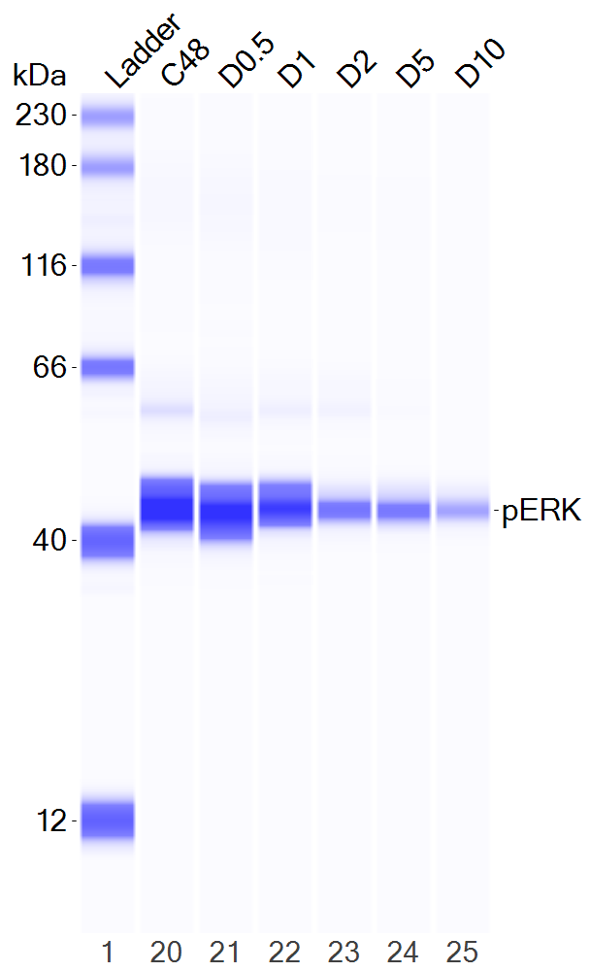
Figure 3D
JH-2-002

Slide 11
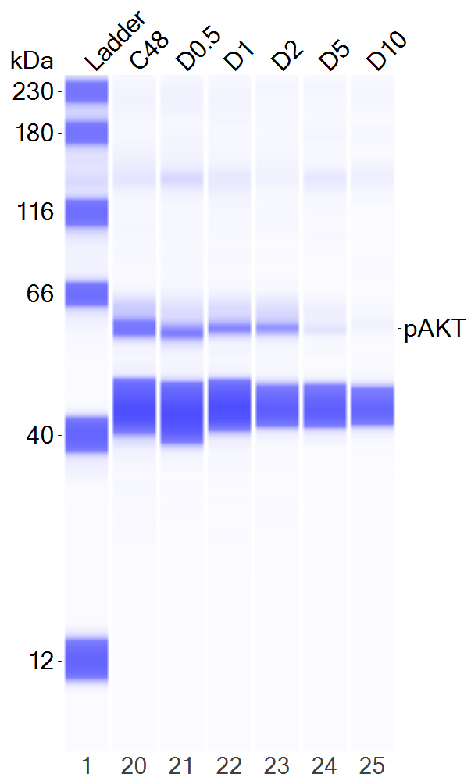
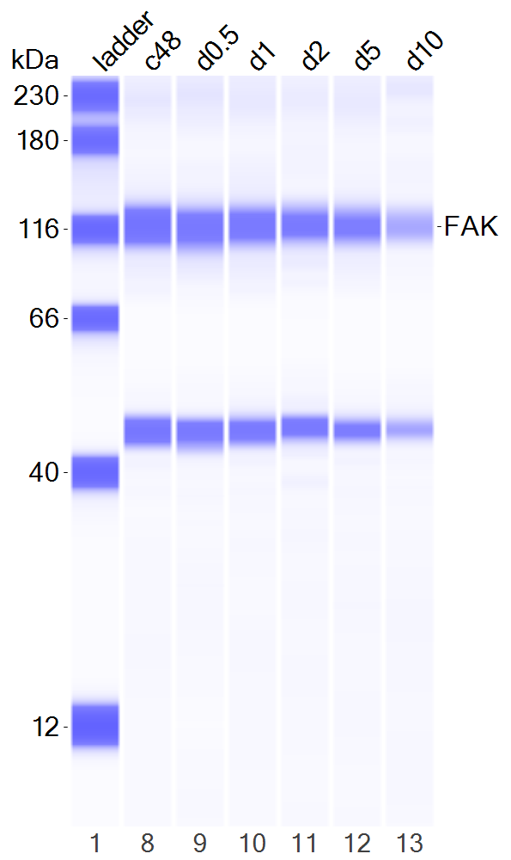
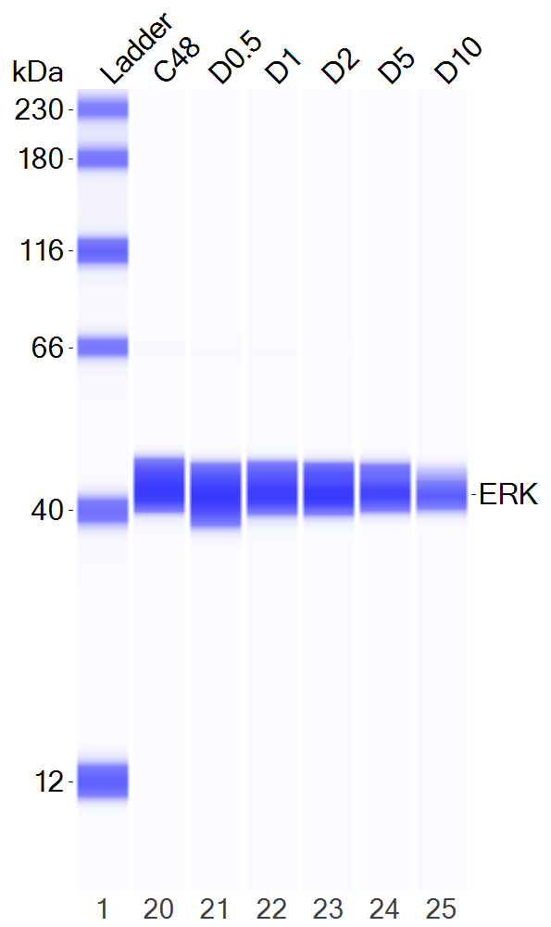
Figure 3D
JH-2-002

Slide 12
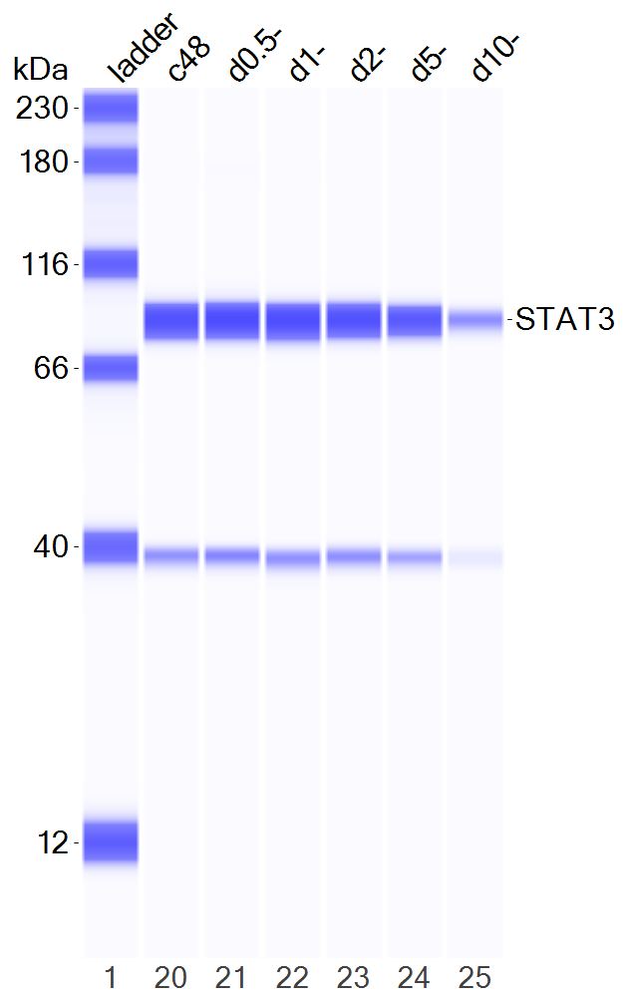
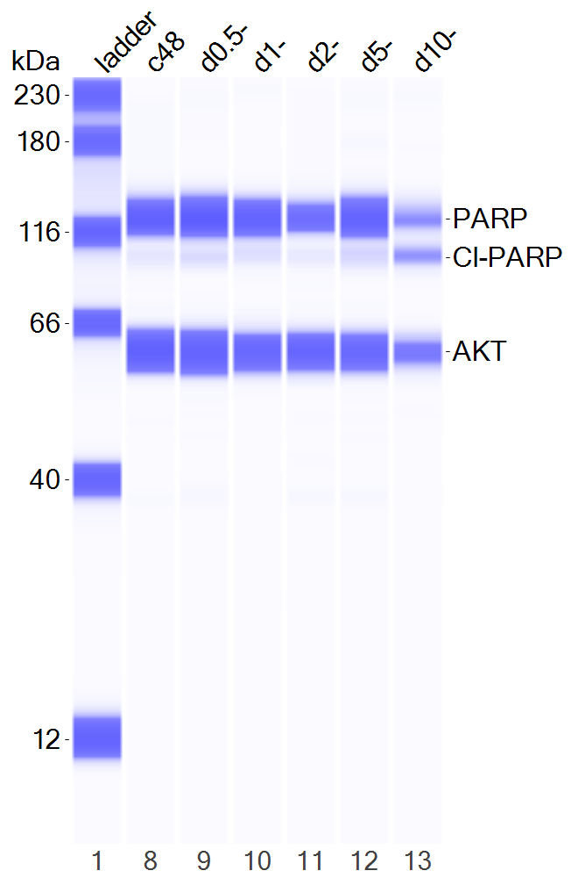
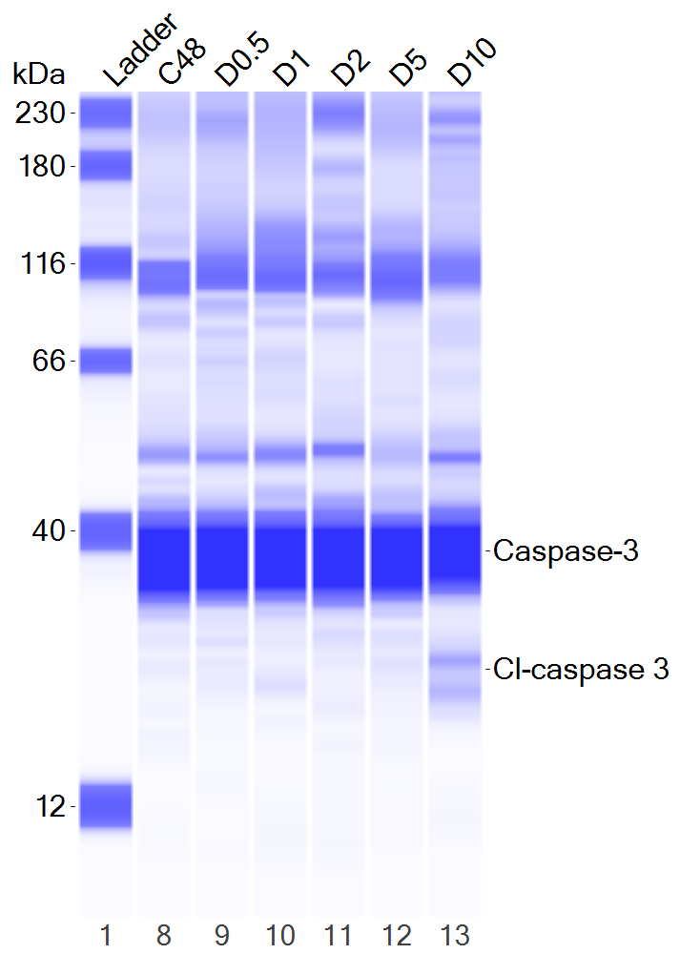
Figure 3D
JH-2-002

Slide 13
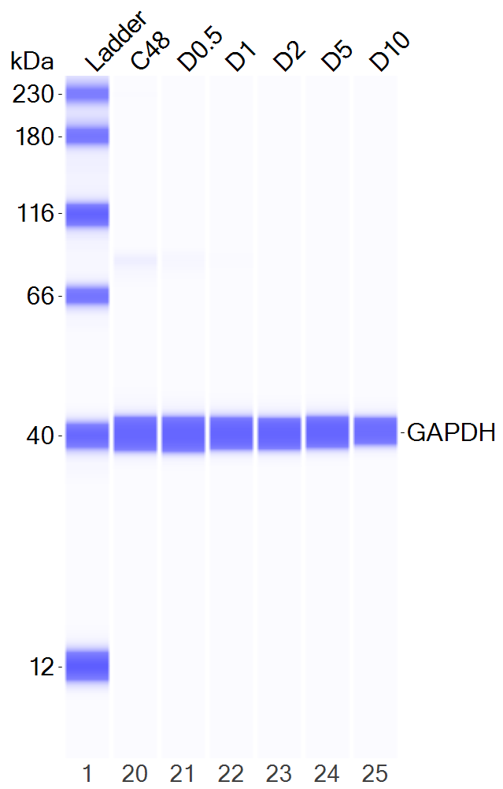
Figure 3D
JH-2-002

Slide 14
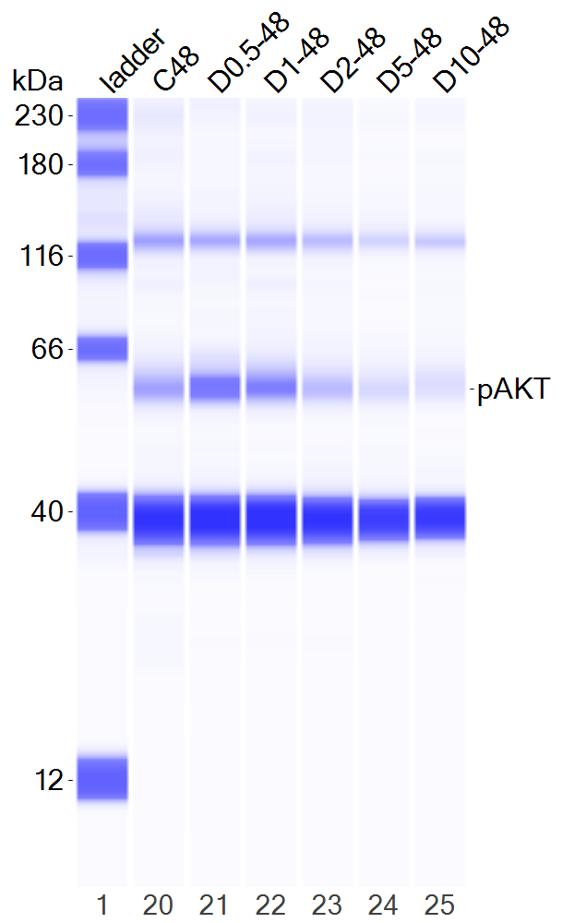
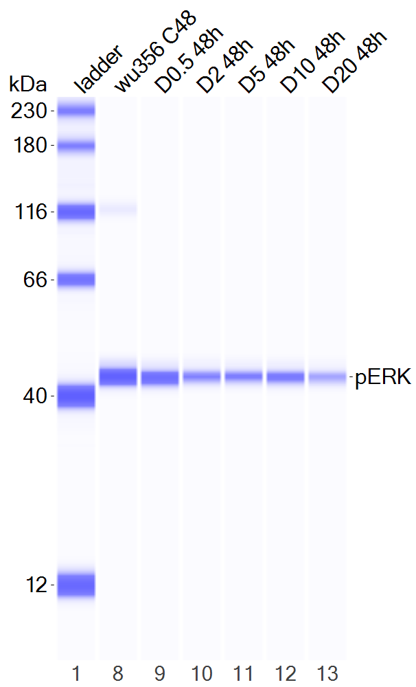
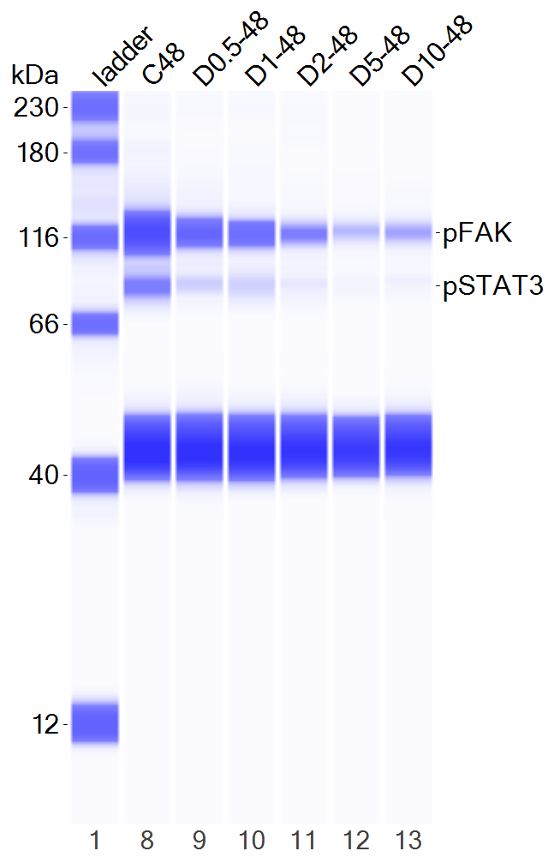
Figure 3D
WU356

Slide 15
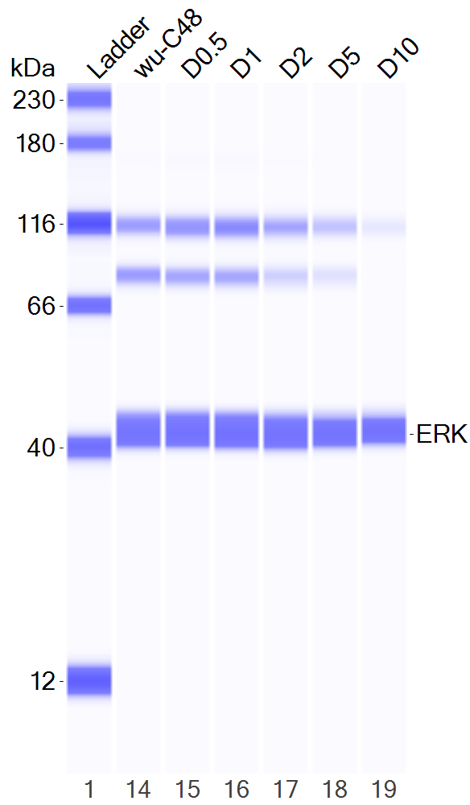
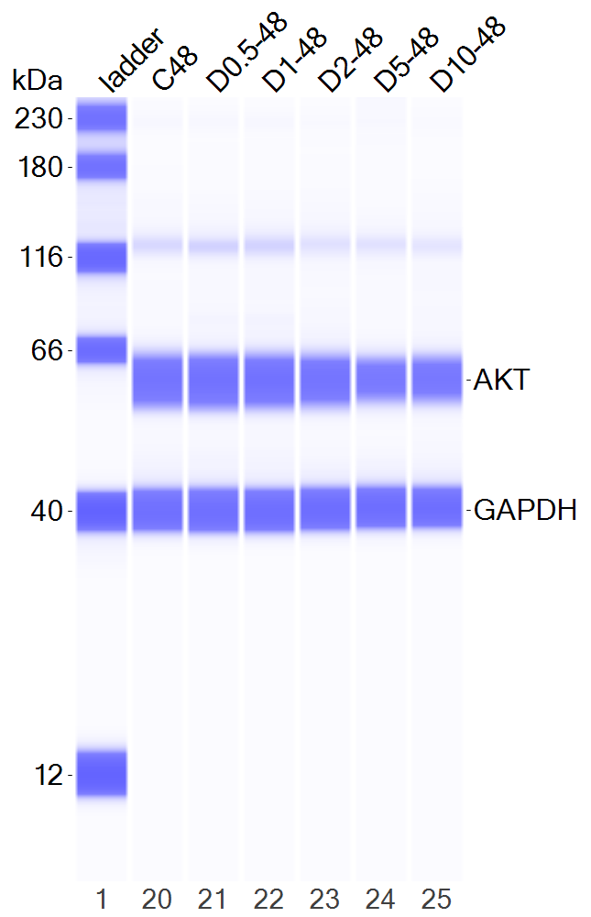
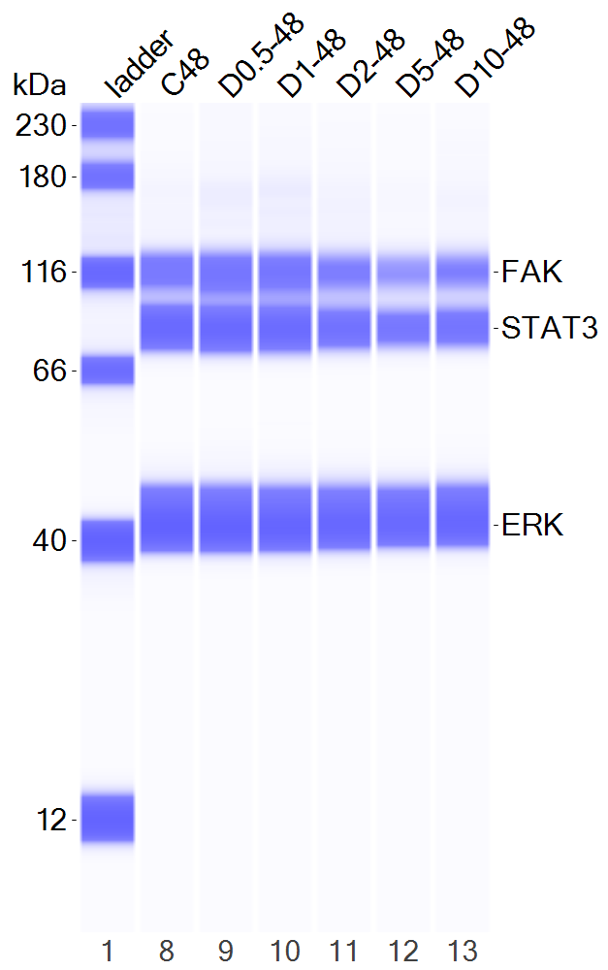
Figure 3D
WU356

Slide 16
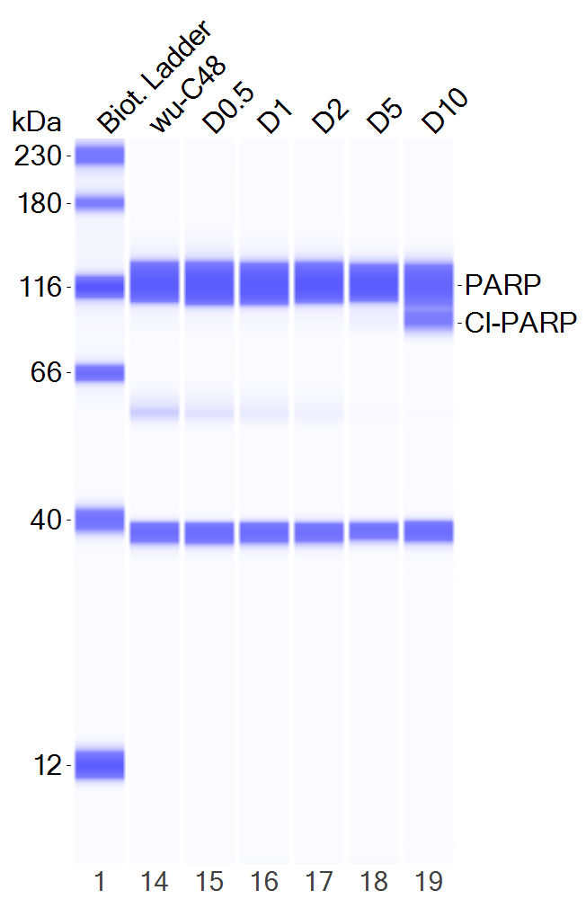
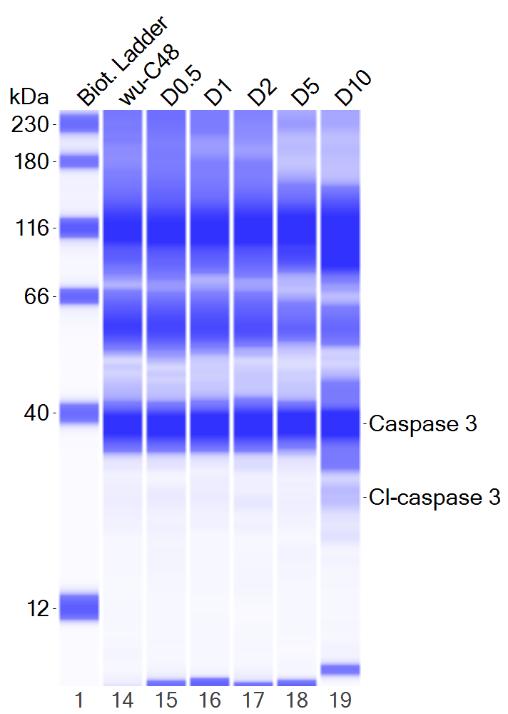
Figure 3D
WU356

Slide 17
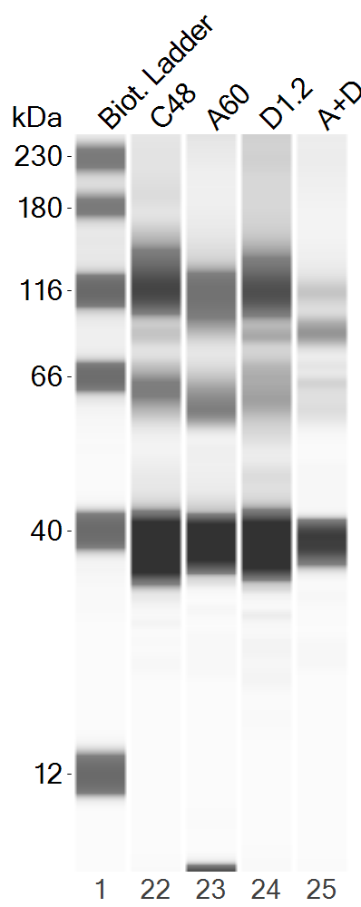
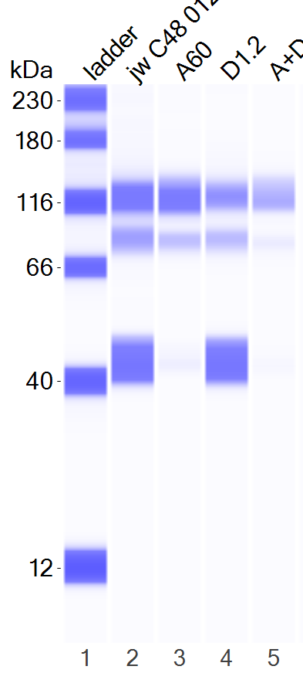
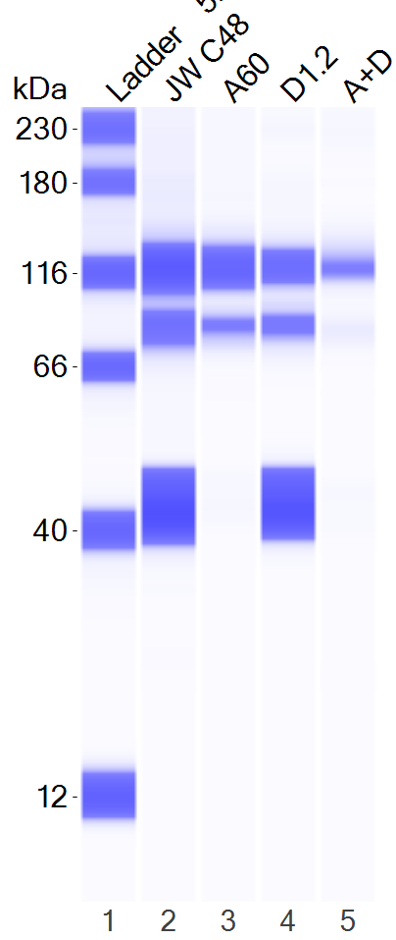
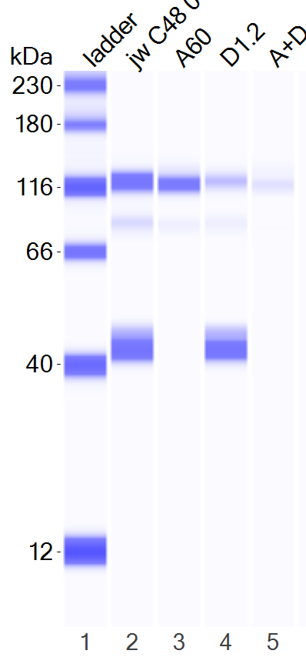
Figure 5C
JW23.3
pFAK
pSTAT3
pAKT
pERK

Slide 18
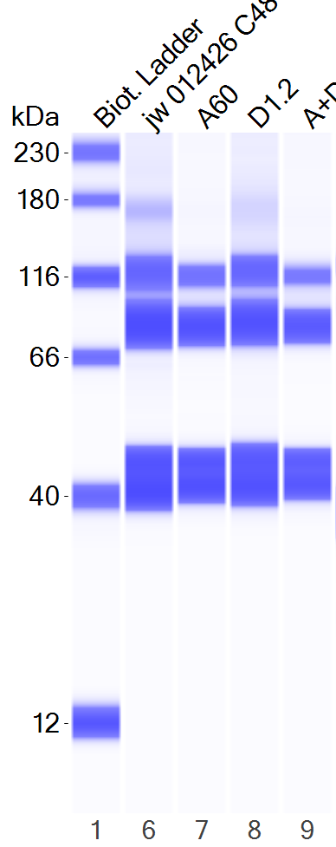
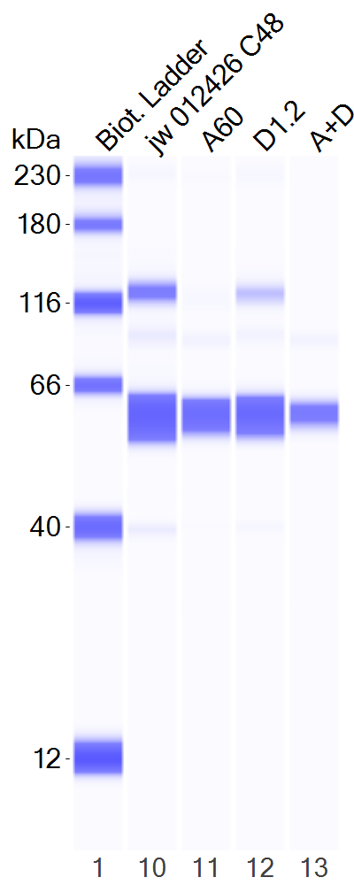
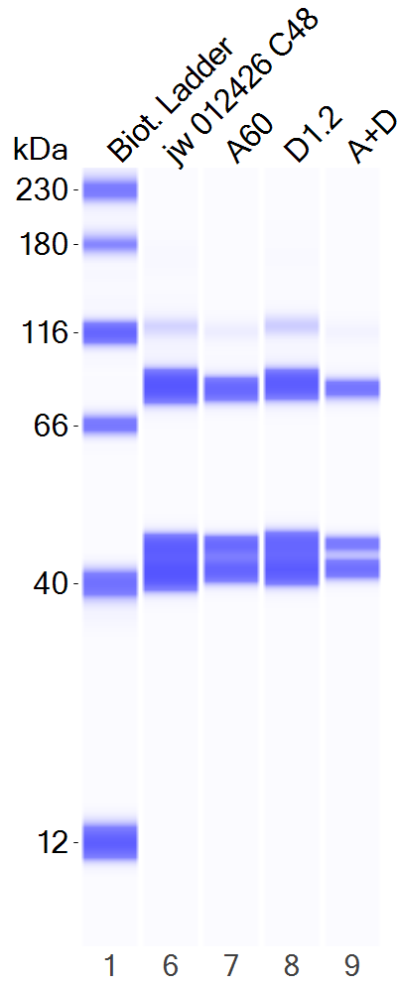
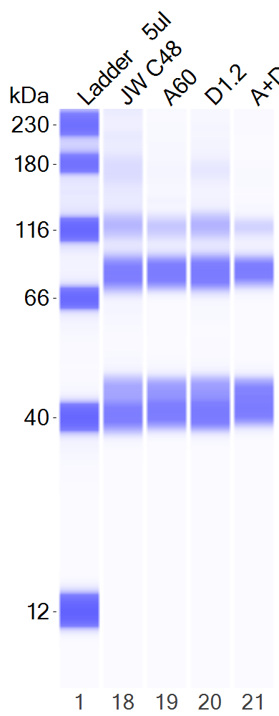
Figure 5C
JW23.3
FAK
STAT3
AKT
ERK

Slide 19
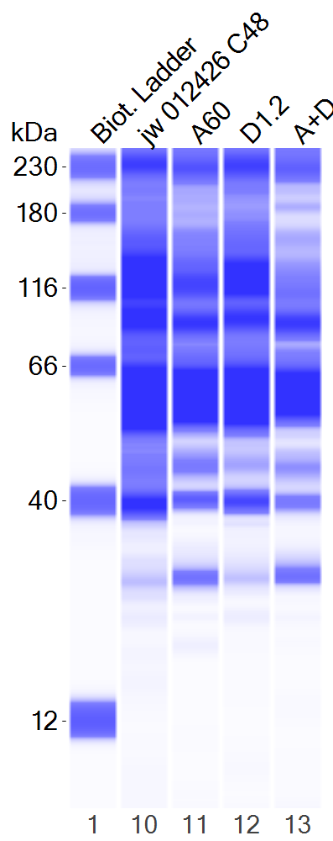
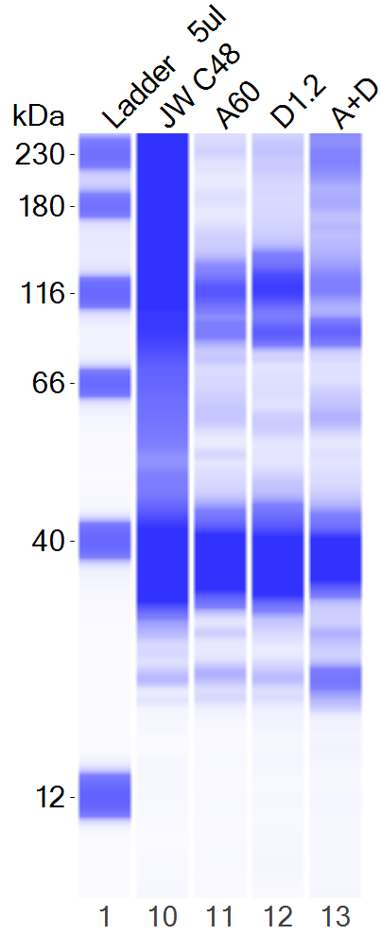

Figure 5C
JW23.3
PARP-1
Cl-PARP-1
Caspase-3
Cl-Caspase-3
GAPDH

Slide 20
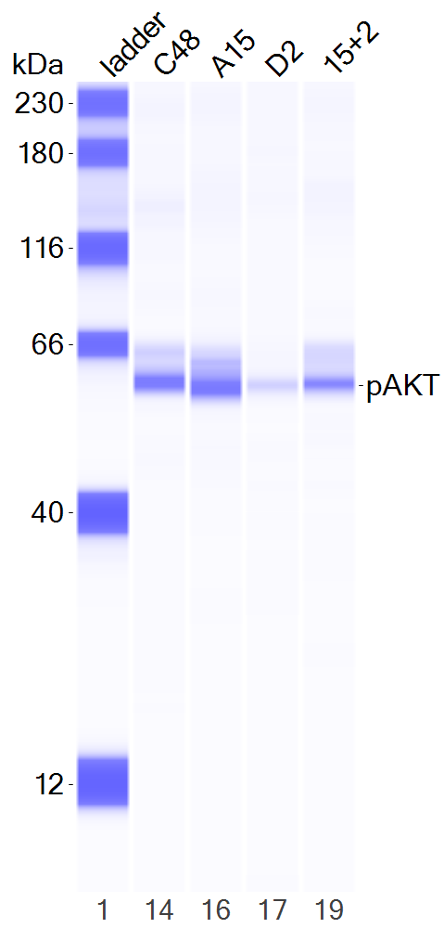
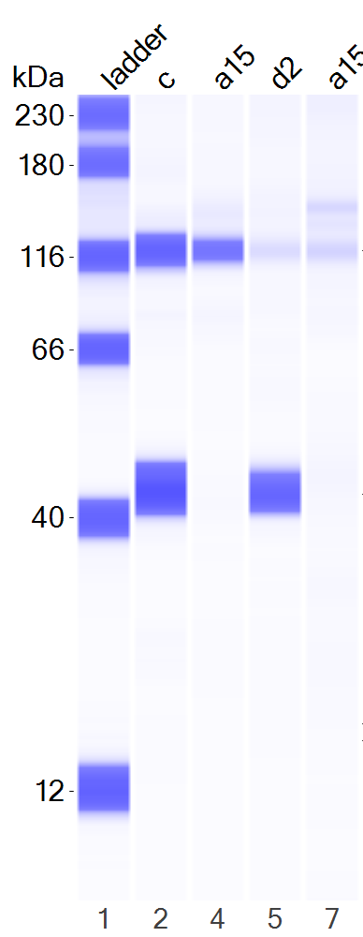
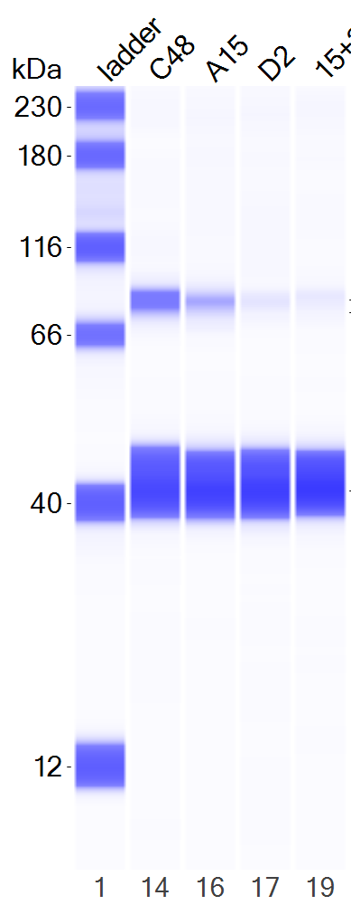

Figure 5C
JH-2-002
pFAK
pSTAT3
pAKT
pERK

Slide 21



Figure 5C
JH-2-002
FAK
STAT3
AKT
ERK

Slide 22



Figure 5C
JH-2-002
PARP-1
Cl-PARP-1
GAPDH
Caspase-3
Cl-Caspase-3

Slide 23




Figure 5C
WU356
pFAK
pSTAT3
pAKT
pERK

Slide 24




Figure 5C
WU356
FAK
STAT3
AKT
ERK

Slide 25



Figure 5C
WU356
PARP-1
Cl-PARP-1
GAPDH
Caspase-3
Cl-Caspase-3

Slide 26


Supplementary Figure 7A
JH-2-002
48h 120h
48h 120h
pFAK

Slide 27


Supplementary Figure 7A
JH-2-002
48h 120h
48h 120h
pSTAT3

Slide 28


Supplementary Figure 7A
JH-2-002
48h 120h
48h 120h

Slide 29


Supplementary Figure 7A
JH-2-002
48h 120h
48h 120h
PARP-1
Cl-PARP-1
ERK

Slide 30


Supplementary Figure 7A
JH-2-002
48h 120h
48h 120h
GAPDH
Caspase-3
Cl-Caspase-3

Slide 31




Supplementary Figure 7C
JW23.3

Slide 32




Supplementary Figure 7C
Supplementary Figure 7
JW23.3

Slide 33



Supplementary Figure 7C
Supplementary Figure 7
JW23.3

Slide 34




Supplementary Figure 7
Supplementary Figure 7C
JH-2-002

Slide 35




Supplementary Figure 7C
JH-2-002

Slide 36



Supplementary Figure 7C
JH-2-002

Slide 37




Supplementary Figure 7C
WU356

Slide 38




Supplementary Figure 7C
WU356

Slide 39



Supplementary Figure 7C
WU356

Slide 40


Supplementary Figure 8B
JH-2-002

Slide 41

Supplementary Figure 8B
JH-2-002

Slide 42


Supplementary Figure 12
MN2
pFAK
FAK

Slide 43



Supplementary Figure 12
MN2
pAKT
AKT
GAPDH

Slide 44


Supplementary Figure 12
MN2
pERK
ERK

Slide 45


Supplementary Figure 12
MN2
pSTAT3
STAT3

Slide 46


Supplementary Figure 12
MN2
Caspase-3
Caspase-3
Cl-Caspase-3

Slide 47


Supplementary Figure 12
MN2
PARP-1
PARP-1
Cl-PARP-1

Slide 48
Supplementary Figure 12
MN2
GAPDH

Slide 49










Supplementary Figure 13D
Raw blots
ST8814
24h
48h
Par
tram Res
Par
tram Res
+
-
-
-
-
+
-
-
-
-
DMSO
+
-
-
-
-
+
-
-
-
-
DMSO
-
+
-
-
-
-
+
-
-
-
trametinib_20nM
-
+
-
-
-
-
+
-
-
-
trametinib
-
-
+
-
+
-
-
+
-
+
avutometinib_200nM
-
-
+
-
+
-
-
+
-
+
avutometinib
defactinib_3µM
-
-
-
+
+
-
-
-
+
+
defactinib
-
-
-
+
+
-
-
-
+
+
p-FAK Y397
p-FAK Y397
FAK
FAK
p-MEK1/2 S217/221
p-MEK1/2 S217/221
p-ERK1/2 T202/Y204
p-ERK1/2 T202/Y204
ERK1/2
ERK1/2

Slide 50






Supplementary Figure 13D
Raw blots
ST8814
24h
48h
Par
tram Res
Par
tram Res
+
-
-
-
-
+
-
-
-
-
DMSO
+
-
-
-
-
+
-
-
-
-
DMSO
-
+
-
-
-
-
+
-
-
-
trametinib_20nM
-
+
-
-
-
-
+
-
-
-
trametinib
-
-
+
-
+
-
-
+
-
+
avutometinib_200nM
-
-
+
-
+
-
-
+
-
+
avutometinib
defactinib_3µM
-
-
-
+
+
-
-
-
+
+
defactinib
-
-
-
+
+
-
-
-
+
+
p-S6 S235/236
p-S6 S235/236
CyclinD1
CyclinD1
GAPDH
GAPDH

Slide 51










Supplementary Figure 13D
Raw blots
NF90.8
24h
48h
Par
tram Res
Par
tram Res
+
-
-
-
-
+
-
-
-
-
DMSO
-
+
-
-
-
-
+
-
-
-
+
-
-
-
-
+
-
-
-
-
DMSO
trametinib_20nM
-
+
-
-
-
-
+
-
-
-
avutometinib_200nM
trametinib
-
-
+
-
+
-
-
+
-
+
-
-
+
-
+
-
-
+
-
+
avutometinib
defactinib_3µM
-
-
-
+
+
-
-
-
+
+
-
-
-
+
+
-
-
-
+
+
defactinib
p-FAK Y397
p-FAK Y397
FAK
FAK
p-MEK1/2 S217/221
p-MEK1/2 S217/221
p-ERK1/2 T202/Y204
p-ERK1/2 T202/Y204
ERK1/2
ERK1/2

Slide 52






Supplementary Figure 13D
Raw blots
NF90.8
24h
48h
Par
tram Res
Par
tram Res
+
-
-
-
-
+
-
-
-
-
DMSO
+
-
-
-
-
+
-
-
-
-
DMSO
-
+
-
-
-
-
+
-
-
-
trametinib_20nM
-
+
-
-
-
-
+
-
-
-
trametinib
-
-
+
-
+
-
-
+
-
+
avutometinib_200nM
-
-
+
-
+
-
-
+
-
+
avutometinib
defactinib_3µM
-
-
-
+
+
-
-
-
+
+
defactinib
-
-
-
+
+
-
-
-
+
+
p-S6 S235/236
p-S6 S235/236
CyclinD1
CyclinD1
GAPDH
GAPDH

