Slide 1
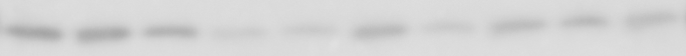
Gel 1
CD31
LINE1
Caspase-3
TOM 20
GAPDH

Slide 2
CD31
Gel 1
Gel 2
CD31
CD31

Slide 3
Cleaved Caspase 3
Gel 1
Gel 2
Cleaved Caspase 3
Cleaved Caspase 3

Slide 4
LINE1
Gel 1
Gel 2
LINE1
LINE1

Slide 5
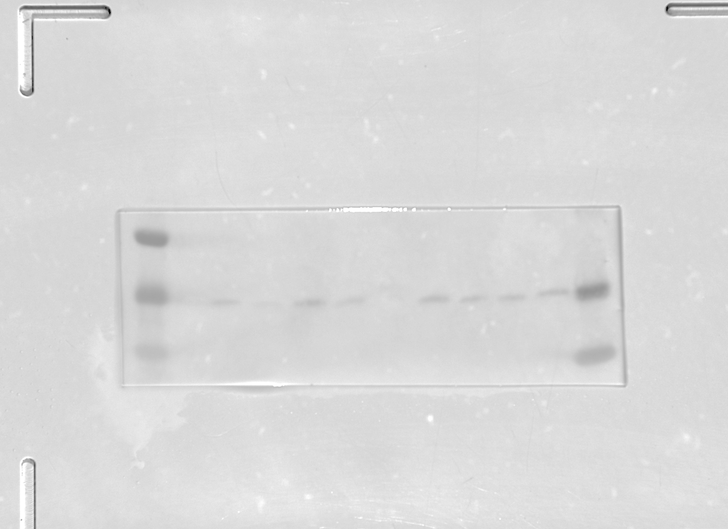
TOMM20
Gel 1
Gel 2
TOMM20
TOMM20
Gel 3
Not used for quantification since GAPDH band was damaged
TOMM20

Slide 6
GAPDH
Gel 1
Gel 2
GAPDH
GAPDH
Gel 3
Not used for quantification
GAPDH

