Slide 1
Fig. 2A Day 3
DRG SC (total) Syn (Syn)
Sal Mor
Sal Mor
Sal Mor
150
100
150
75
BRAF
BRAF
100
BRAF
75
100
50
75
PSD95
GAPDH
37
GAPDH
25

Slide 2
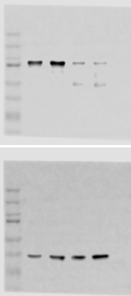
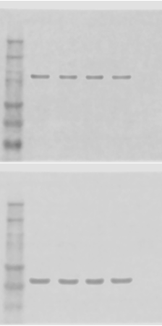
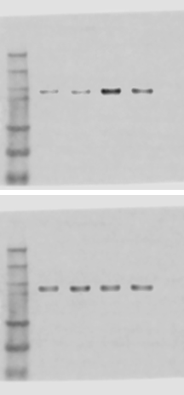
Fig. 2B Day 7
DRG SC (total) Syn (Syn)
Sal Mor
Sal Mor
Sal Mor
150
100
75
50
BRAF
150
BRAF
100
BRAF
75
50
37
150
100
PSD95
25
75
GAPDH
GAPDH

Slide 3
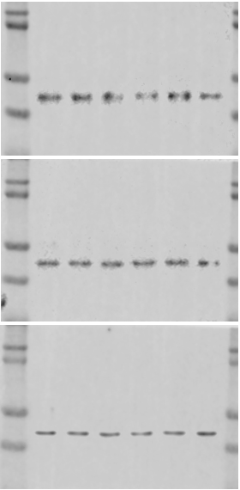
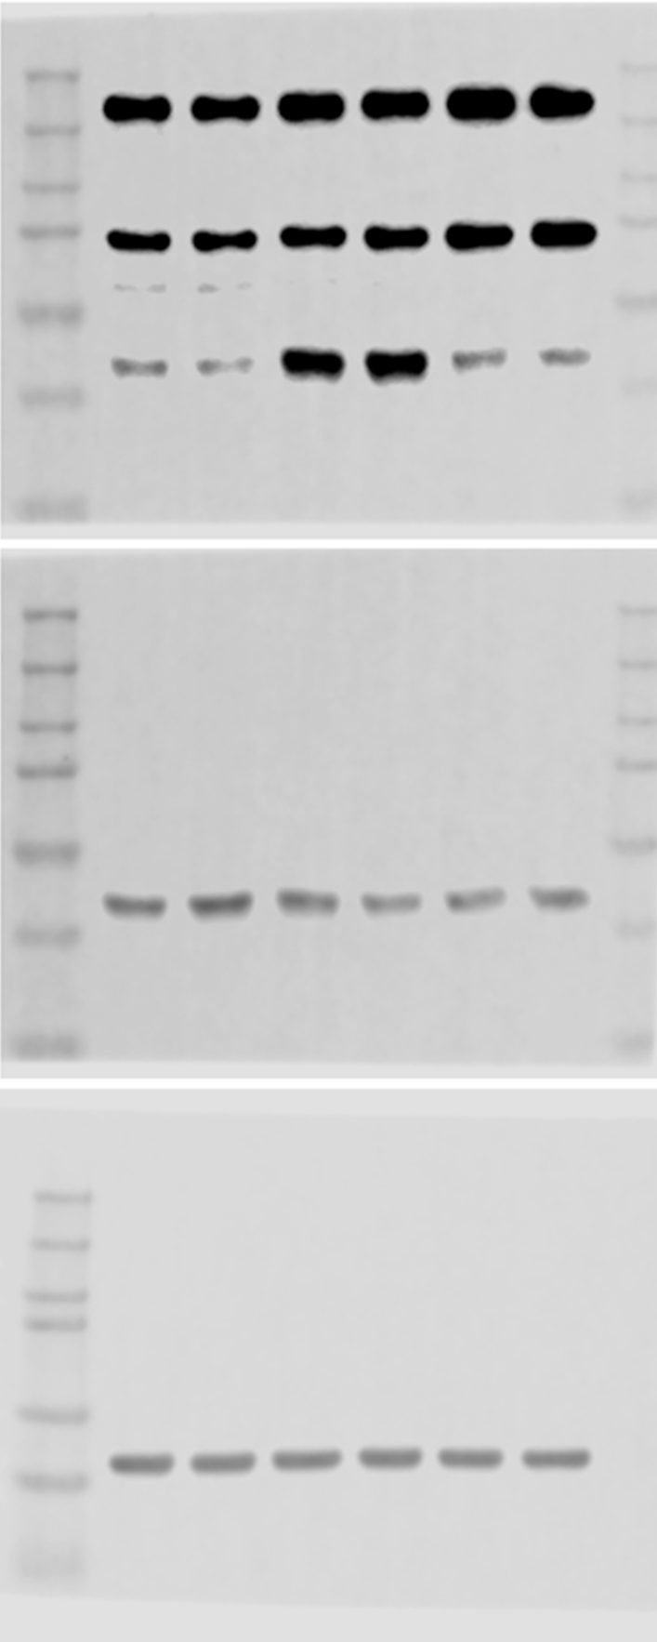
Fig. 3A pMEK
DRG spinal cord
M+Veh
Saline
Saline
M+VEM
M+Veh
M+VEM
pMEK
pMEK
MEK
MEK
β-actin
β-actin

Slide 4
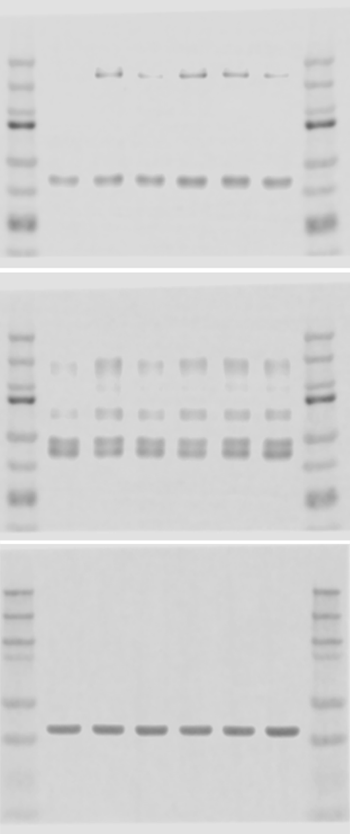
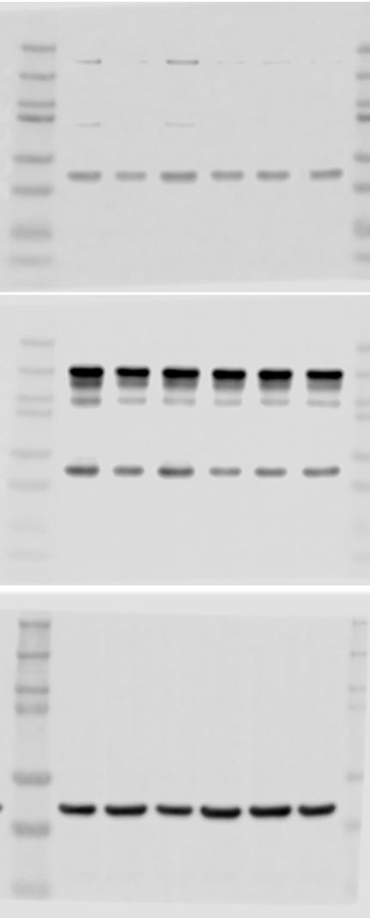
Fig. 3B pMEK by VEM alone
DRG spinal cord
M+Veh
Saline
Saline
M+VEM
M+Veh
M+VEM
pMEK
pMEK
MEK
MEK
β-actin
β-actin

Slide 5
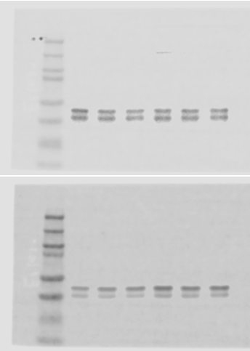
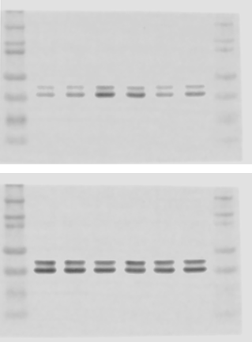
Fig. 3C pERK
DRG spinal cord
Saline
M+VEM
M+Veh
M+Veh
Saline
M+VEM
pERK
pERK
ERK
ERK

Slide 6
Fig. 3D pMEK by BRAF-IP

Slide 8
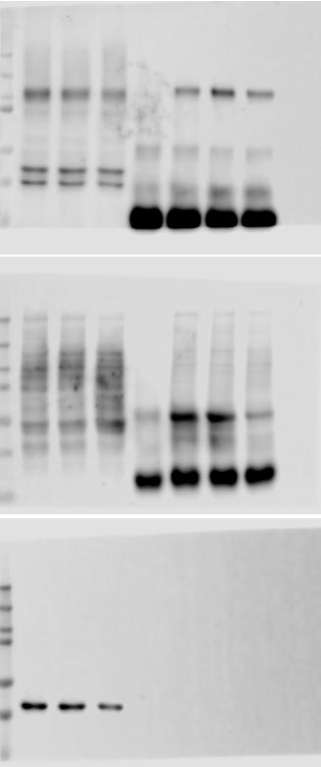
Fig. 4A pSer phosphorylation
Input IP: pSer
M+Veh
M+VEM
M+Veh
Saline
IgG
M+VEM
Saline
GluN1
pSer
β-actin

Slide 9
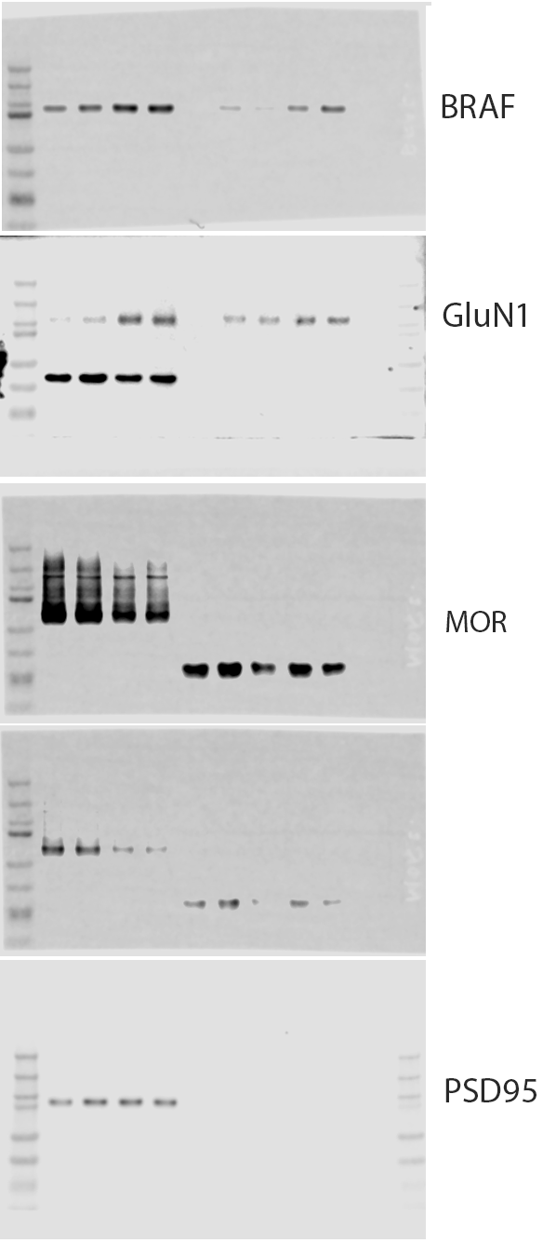
Fig. 4B BRAF-IP
Input IP: BRAF
Sal Mor IgG Sal Mor
(long exposure)
MOR
(short exposure)

Slide 10
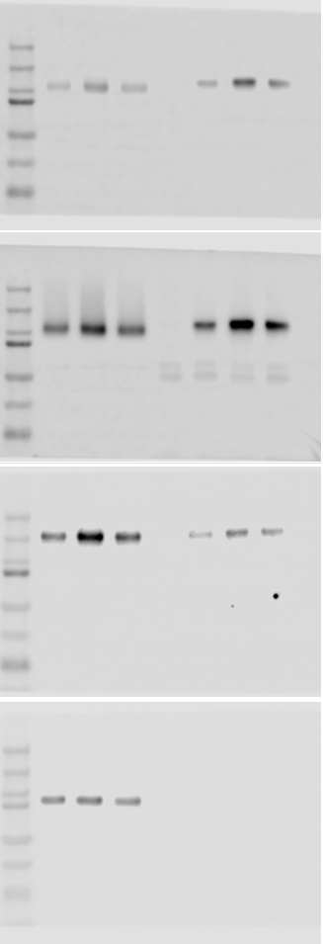
Fig. 4C GluN1-IP
Input IP: GluN1
Saline
M+Veh
M+VEM
IgG
Saline
M+Veh
M+VEM
GluN1
(short exposure)
GluN1
(long exposure)
α2δ−1
PSD95

Slide 12
Fig. 8A
DRG SC (total) SC (Syn)
WT-Sal
WT-Mor
cKO-Sal
cKO-Mor
WT-Sal
WT-Mor
cKO-Sal
cKO-Mor
WT-Sal
WT-Mor
cKO-Sal
cKO-Mor
BRAF
BRAF
BRAF
PSD95
GAPDH
GAPDH

Slide 13
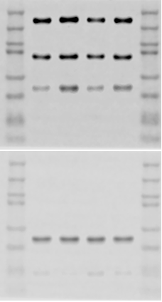
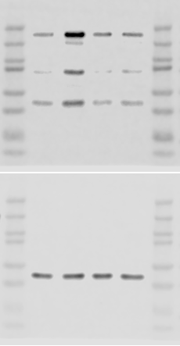
Fig. 8B
SC (total) SC (Syn)
WT cKO
WT cKO
Sal Mor Sal Mor
Sal Mor Sal Mor
pMEK
pMEK
MEK
MEK

Slide 15
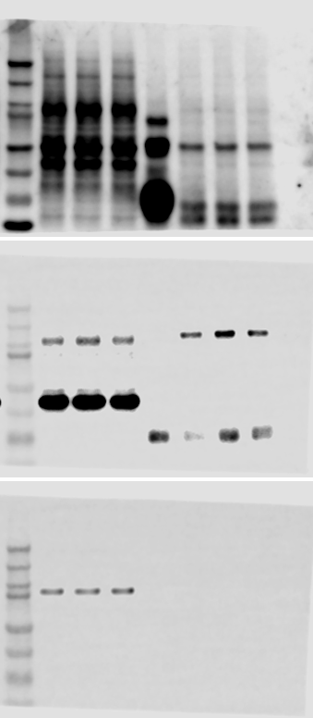
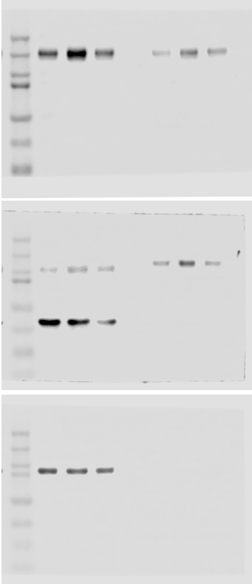
Fig. 9A
Fig. 9B
Input IP: pSer
Input IP: GluN1
WT-Sal
WT-Mor
cKO-Mor
IgG
WT-Sal
WT-Mor
cKO-Mor
WT-Sal
WT-Mor
cKO-Mor
IgG
WT-Sal
WT-Mor
cKO-Mor
α2δ-1
pSer
GluN1
GluN1
PSD95
PSD95

Slide 18
Fig. S1C DRG
DRG SC (total) Syn (Syn)
FNA+Mor
FNA+Mor
FNA+Mor
saline
Veh+Mor
saline
Veh+Mor
saline
Veh+Mor
BRAF
BRAF
BRAF
GAPDH
PSD95
GAPDH

Slide 19

Fig. S2
BRAF
(short exposure)
GluN1
(short exposure)
MOR
(long exposure)
BRAF
(long exposure)
MOR
(short exposure)
GluN1
(long exposure)
GAPDH

Slide 20
Fig. S3
Input IP: GluN1
S1 S2 IgG S1 S2
BRAF
ERK
GluN1

Slide 21
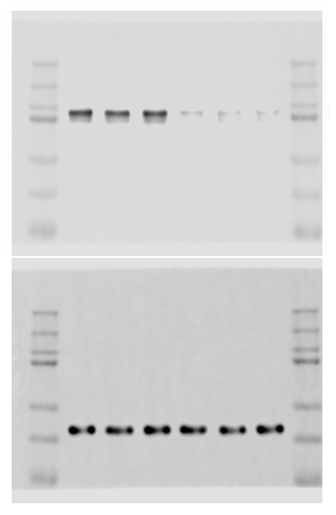
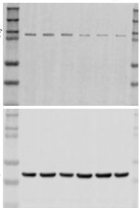
Fig. S4. Braf siRNA
DRG
Spinal cord
Cont siRNA
Cont siRNA
BRaf
BRaf
β-actin
β-actin

