Slide 1
Full unedited blot for Figure 1A- SGLT1
Ladder
Platelet
Sample 1
Platelet
Sample 2
Platelet
Sample 3
Platelet
Sample 4
Kidney
250 kDa
150 kDa
SGLT1
(74 kD)
100 kDa
75 kDa
50 kDa
37 kDa
25 kDa
20 kDa
15 kDa
10 kDa

Slide 2
Full unedited blot for Figure 1A- β-actin
Ladder
Platelet
Sample 1
Platelet
Sample 2
Platelet
Sample 3
Platelet
Sample 4
Kidney
250 kDa
150 kDa
100 kDa
75 kDa
50 kDa
β-actin
(45 kDa)
37 kDa
25 kDa
20 kDa
15 kDa
10 kDa

Slide 3
Full unedited blot for Figure 1A- CD41
Platelet
Sample
1
Platelet
Sample
2
Platelet
Sample
3
Platelet
Sample
4
Kidney
Ladder
250 kDa
150 kDa
CD41 (125 kD)
100 kDa
75 kDa
50 kDa
37 kDa
25 kDa
20 kDa
15 kDa

Slide 4
Full unedited blot for Figure 1A- CD45
Platelet
Sample
1
Platelet
Sample
2
Platelet
Sample
3
Platelet
Sample
4
Kidney
Ladder
250 kDa
CD45 (220 kD)
150 kDa
100 kDa
75 kDa
50 kDa
37 kDa
25 kDa
20 kDa
15 kDa

Slide 5
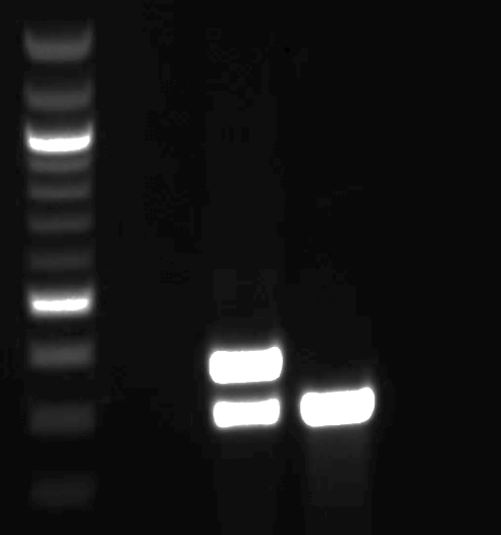
Full unedited PCR for Figure 5B
Wild-type
GpIbα-Cre⁺
Scl5a1^{fl/wt}
Wild-type
Scl5a1^{fl/fl}
1000 bp
500 bp
←614 bp
←540 bp
←372 bp
←297 bp

Slide 6
Full unedited blot for Figure 5C
Only lanes to the left of the red line were included in the figure.
Mouse Intestine Sample 2
Mouse Heart Sample 2
Mouse Intestine Sample 1
Slc5a1 ^{fl/fl} GpIbα-Cre-
Mouse Heart Sample 1
Mouse Heart Sample 3
Slc5a1 ^{fl/fl} GpIbα-Cre+
Mouse Kidney
Ladder
Ladder
250 kDa
150 kDa
100 kDa
75 kDa
SGLT1 (75 kDa)
50 kDa
37 kDa
β-actin (45 kDa)
25 kDa
20 kDa
15 kDa
10 kDa

Slide 7
For reviewers only- example blots for SGLT2
Human
Platelet
Sample
1
Human
Platelet
Sample
2
Brain
Ladder
Ladder
HUVEC
250 kDa
150 kDa
250 kDa
SGLT2 expected at 74kDa with bands at ~55 kDa and ~45kDa can also be detected representing cleavage fragments.
100 kDa
SGLT2
(74 kDa)
150 kDa
75 kDa
100 kDa
SGLT2
(74 kDa)
75 kDa
50 kDa
β-actin
(45 kDa)
50 kDa
β-actin
(45 kDa)
37 kDa
37 kDa
25 kDa
25 kDa
20 kDa
20 kDa
15 kDa
15 kDa
10 kDa
10 kDa

