Slide 1
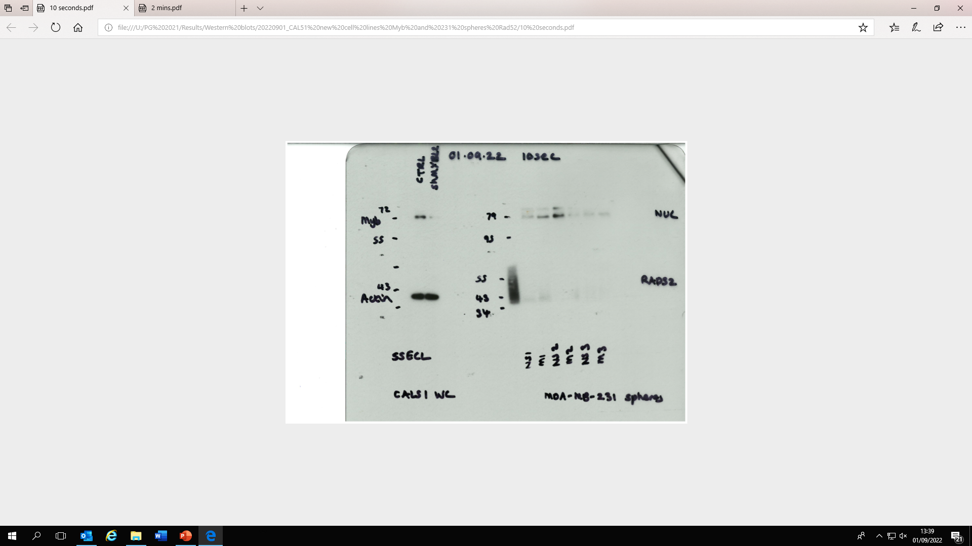


Full blot for Figure 1B
shMYBL2
shCTRL
shMYBL2
shCTRL
MDA-MB-231 BMyb
CAL51 BMyb
shMYBL2
shCTRL
MDA-MB-231 Actin
shMYBL2
shCTRL
CAL51 Actin

Slide 2
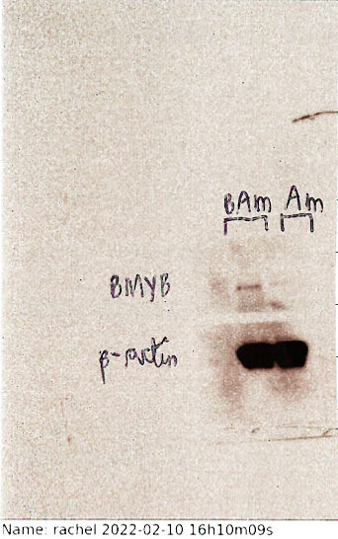
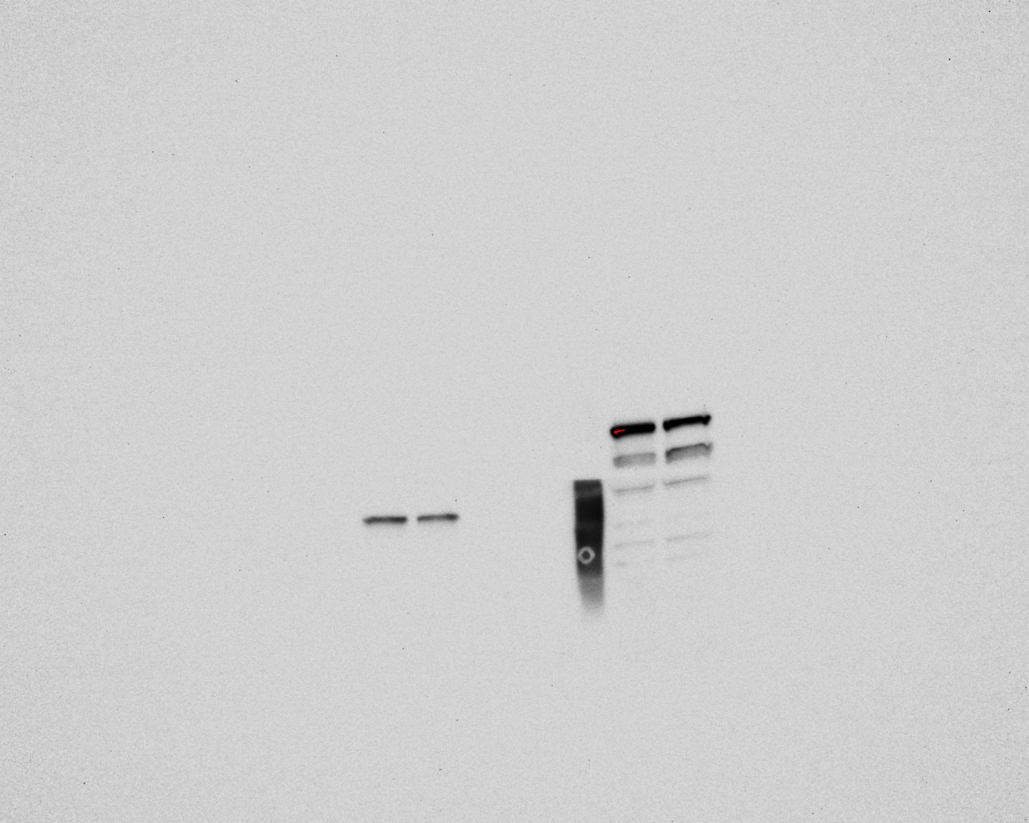
Full blot for Figure 1K
BMyb
Actin
Bmyb AmCyan
Bmyb AmCyan
AmCyan
AmCyan

Slide 3
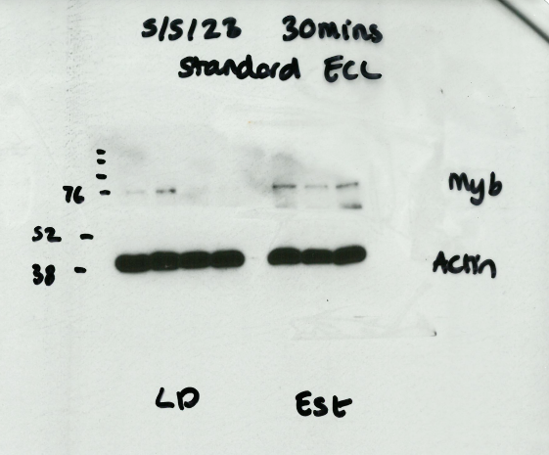
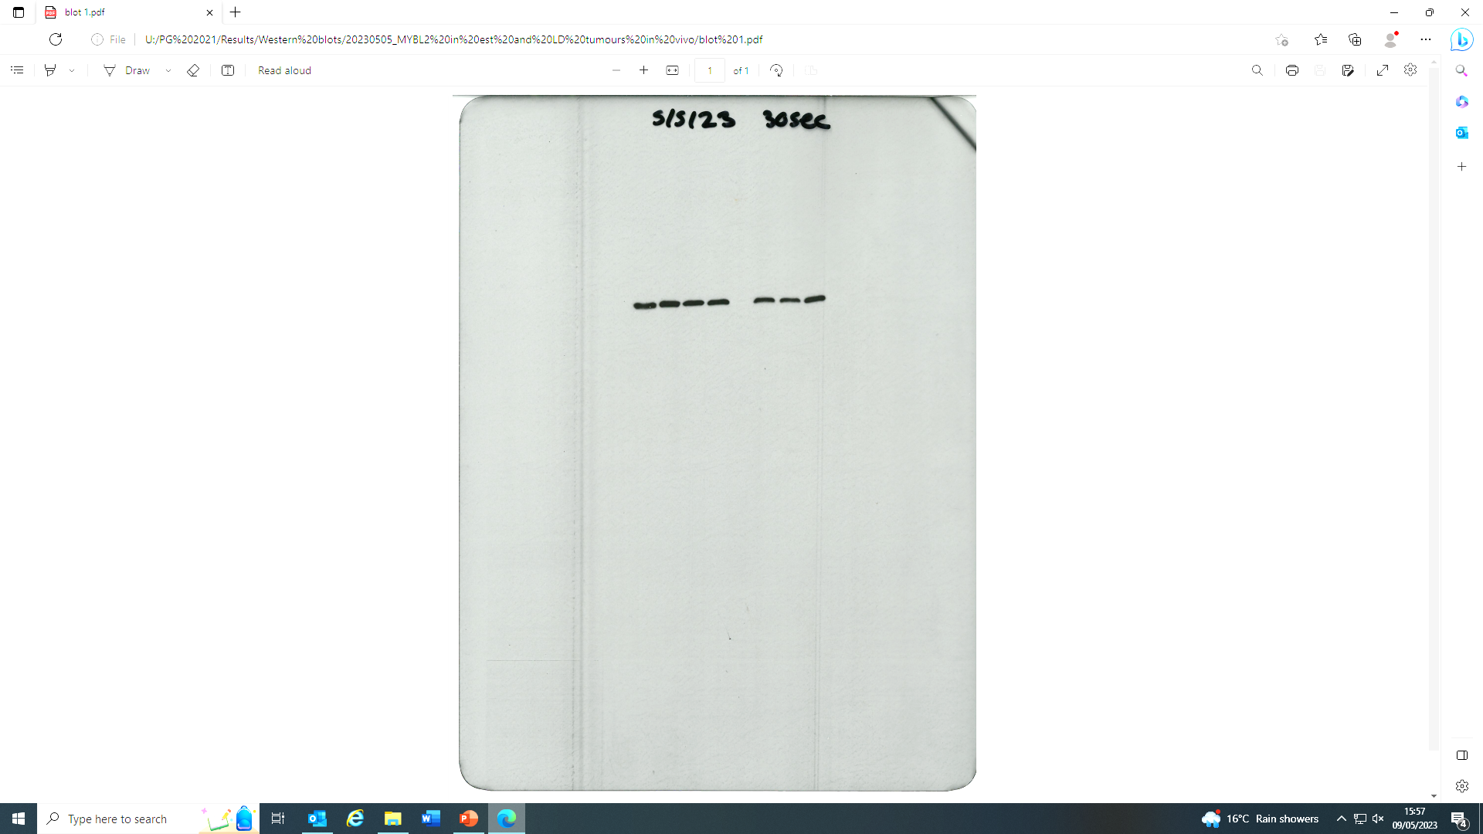
Full blot for Figure 2E
BMyb
Actin
shMYBL2
shCTRL
shMYBL2
shCTRL

Slide 4
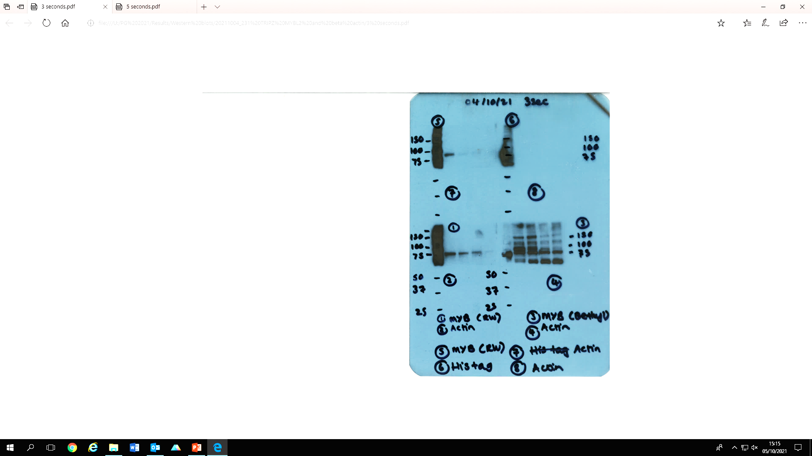
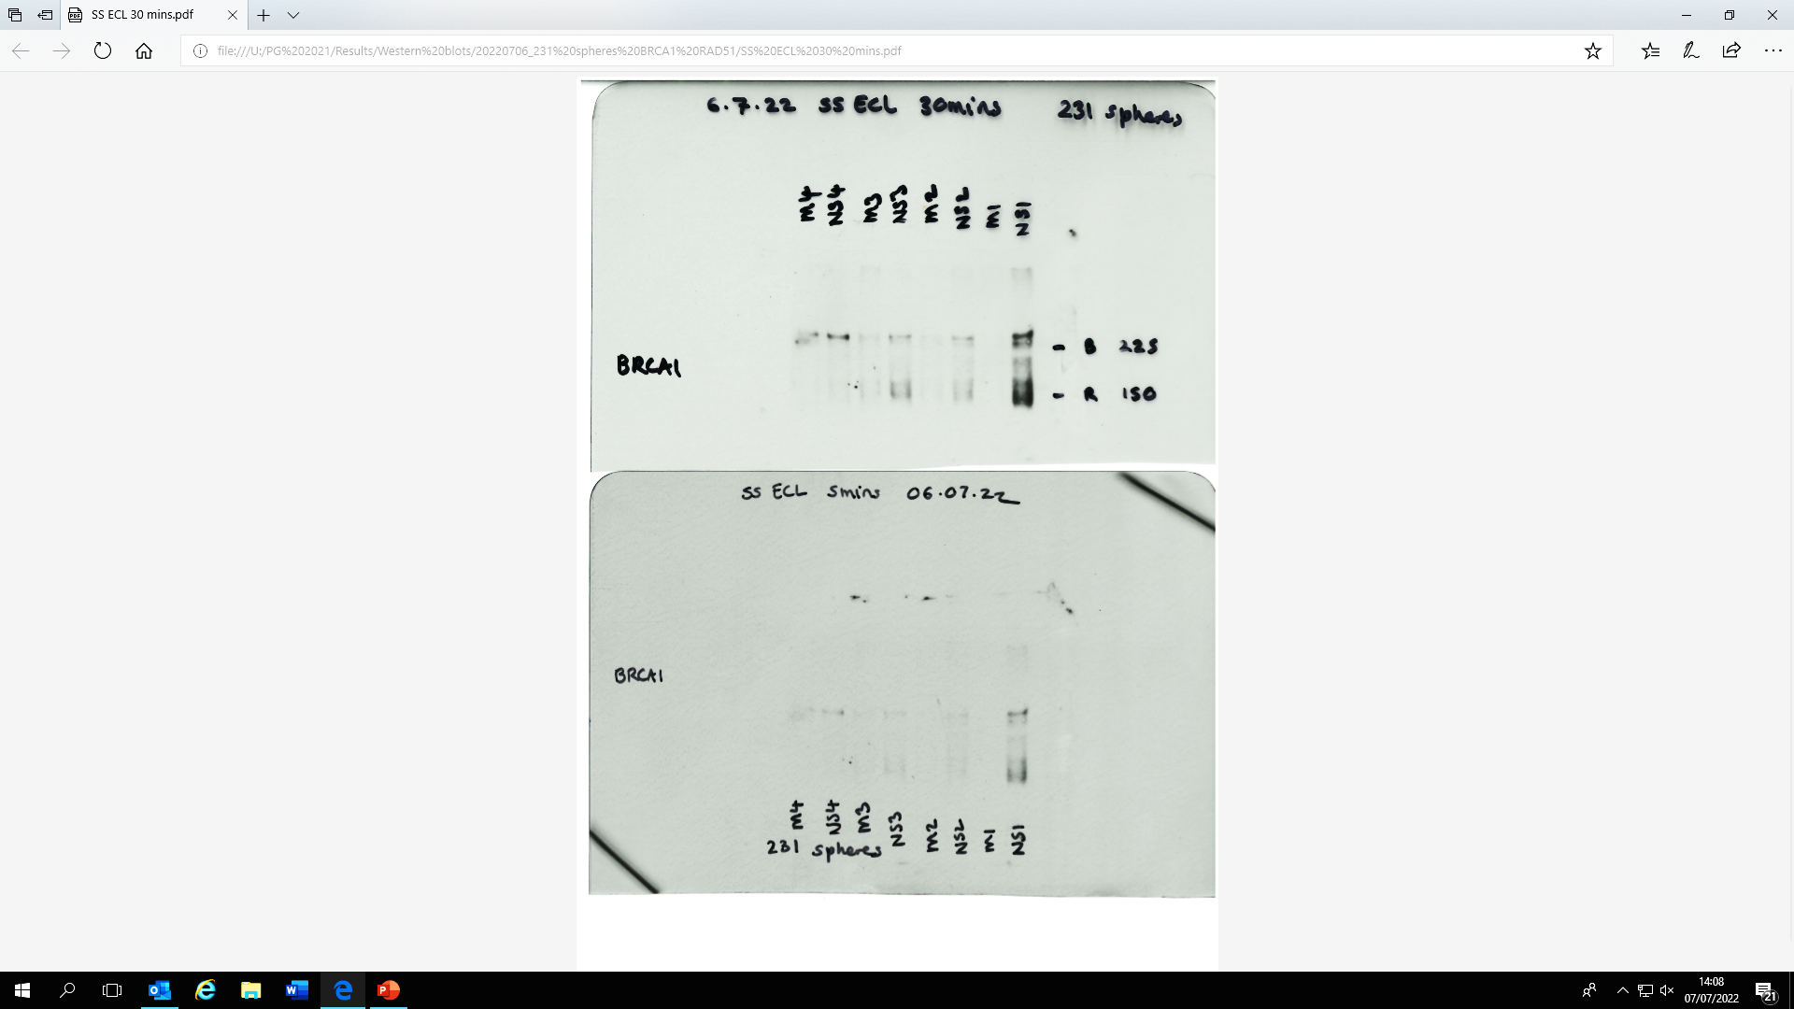
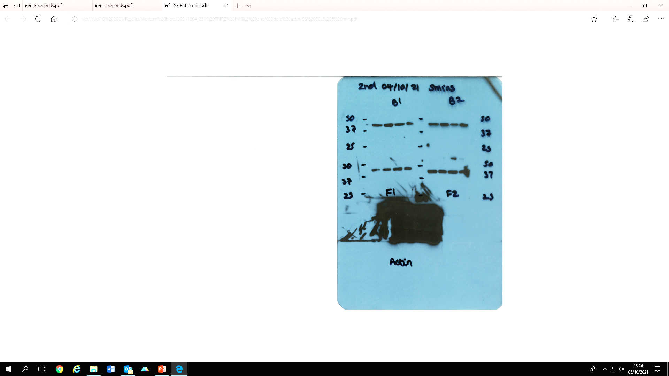
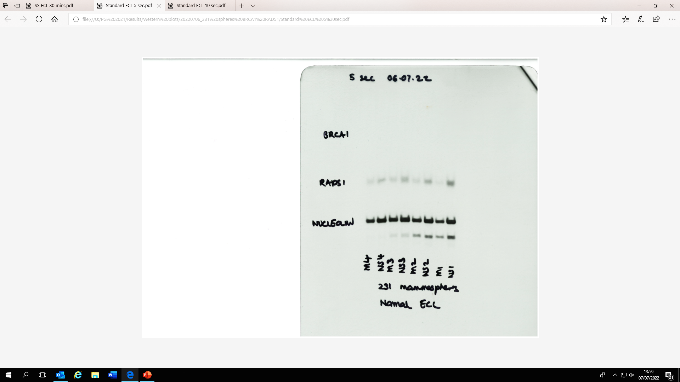
Full blot for Figure 3J
BMyb
BRCA1
shMYBL2
shCTRL
shMYBL2
shCTRL
Actin
shMYBL2
Nucleolin
shCTRL
shMYBL2
shCTRL

Slide 5
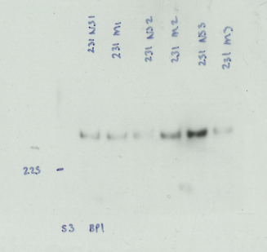
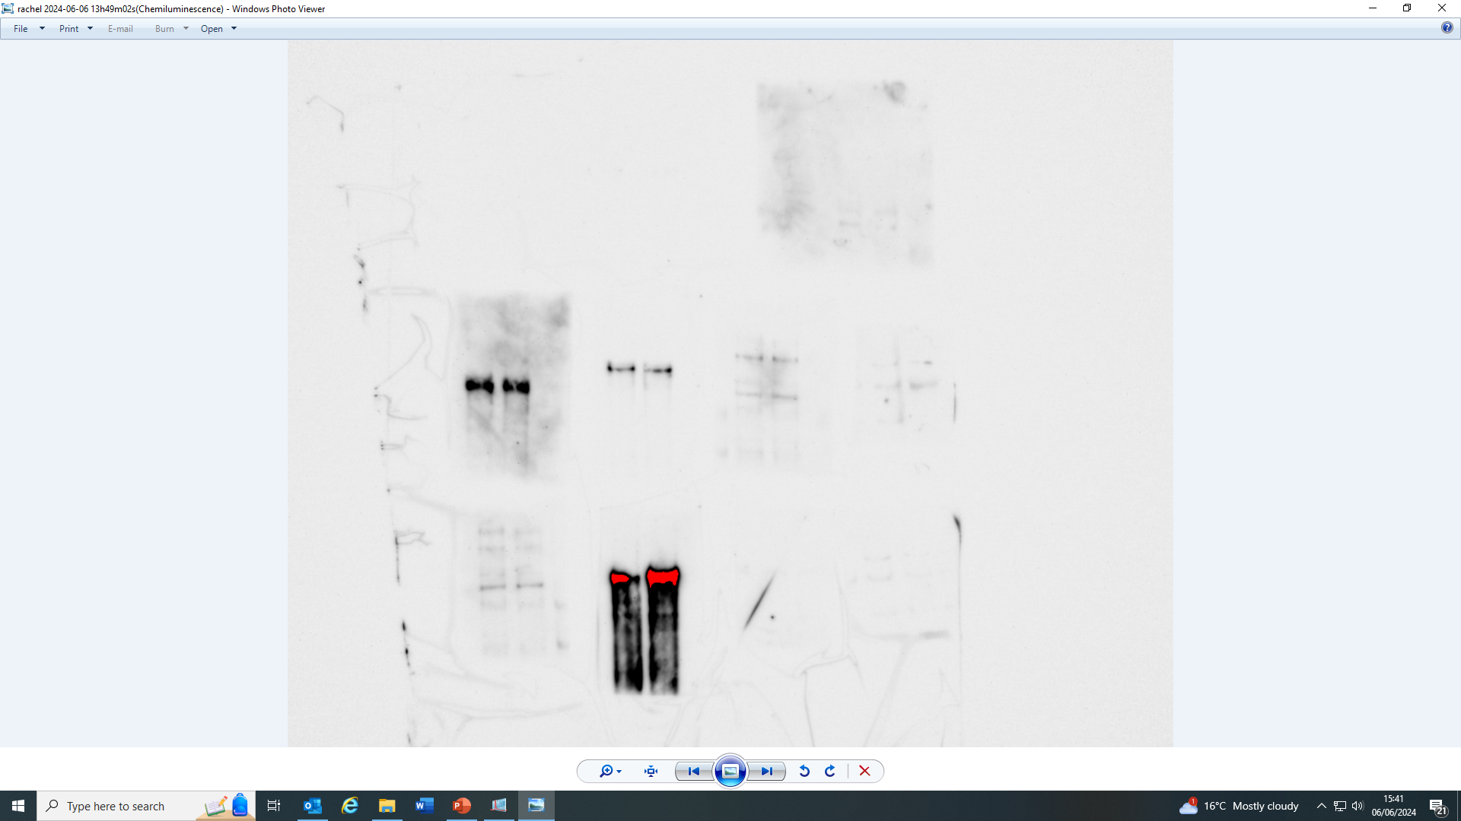
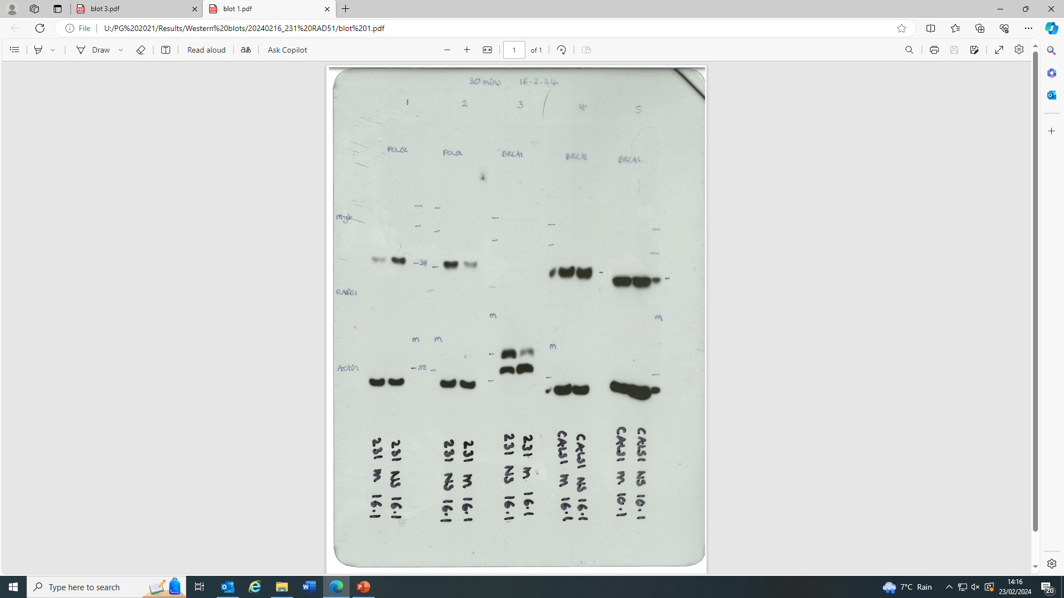
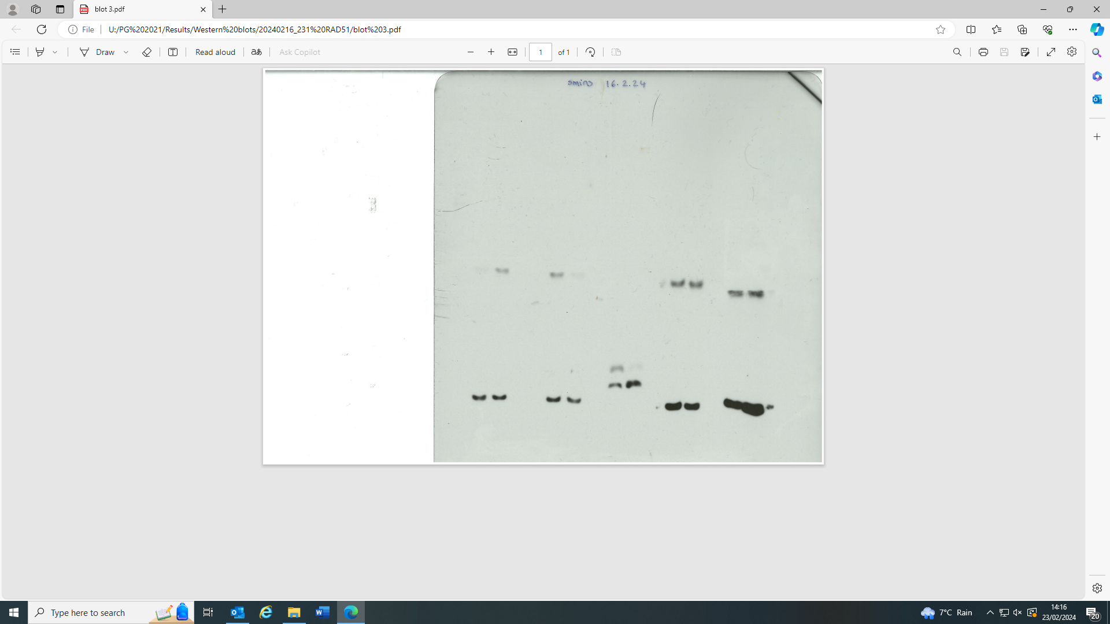
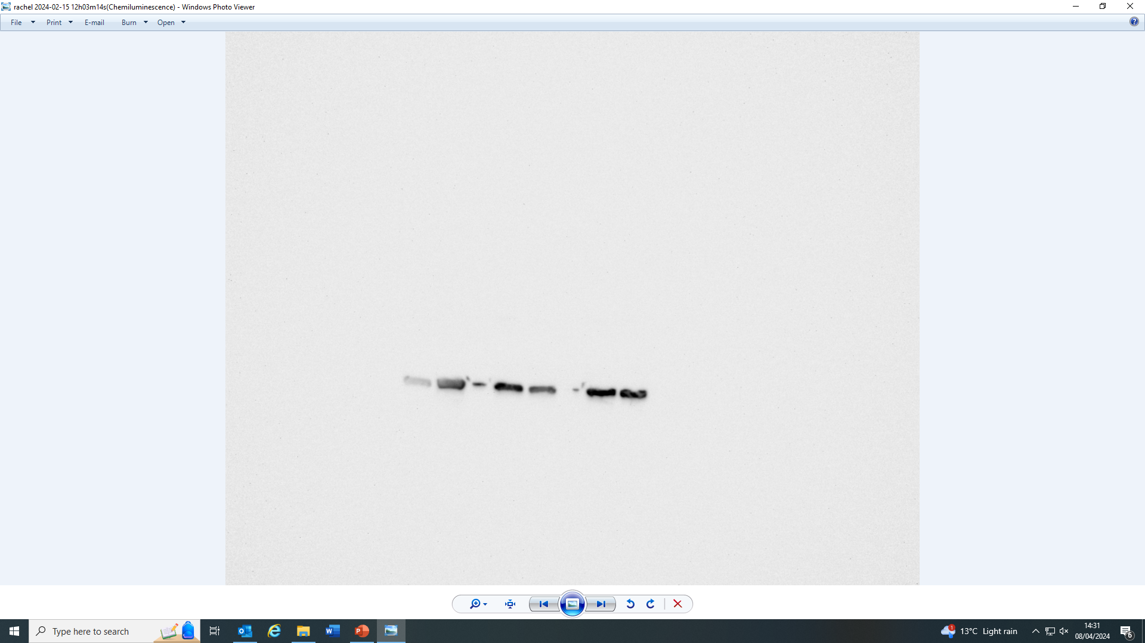
Full blot for Figure 3J
53BP1
RIF1
shMYBL2
shCTRL
shMYBL2
RAD51
shCTRL
shMYBL2
shCTRL
Actin
Actin
shMYBL2
shCTRL
shMYBL2
shCTRL

Slide 6
Full blot for Supp Figure 9
MDA-MB-231
MDA-MB-468
CAL-51
CAL-120
BT-549
MYBL2
Actin

