Slide 1








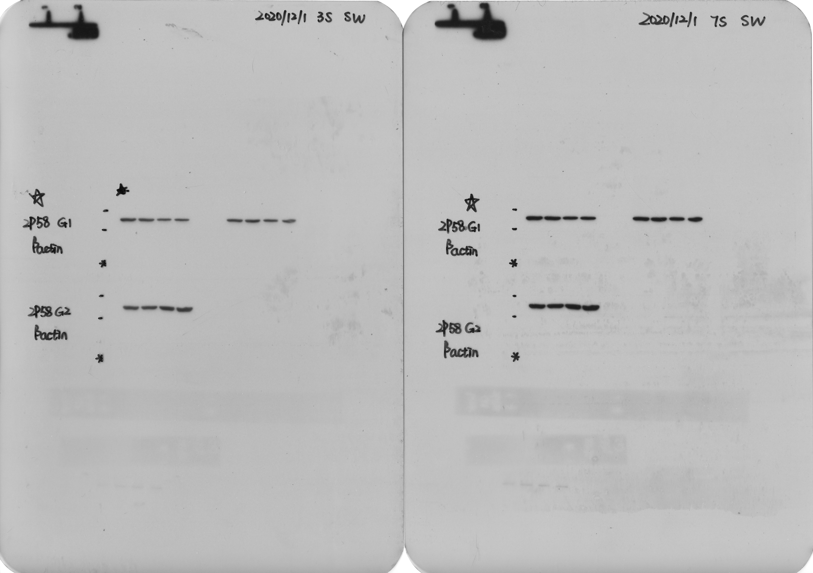
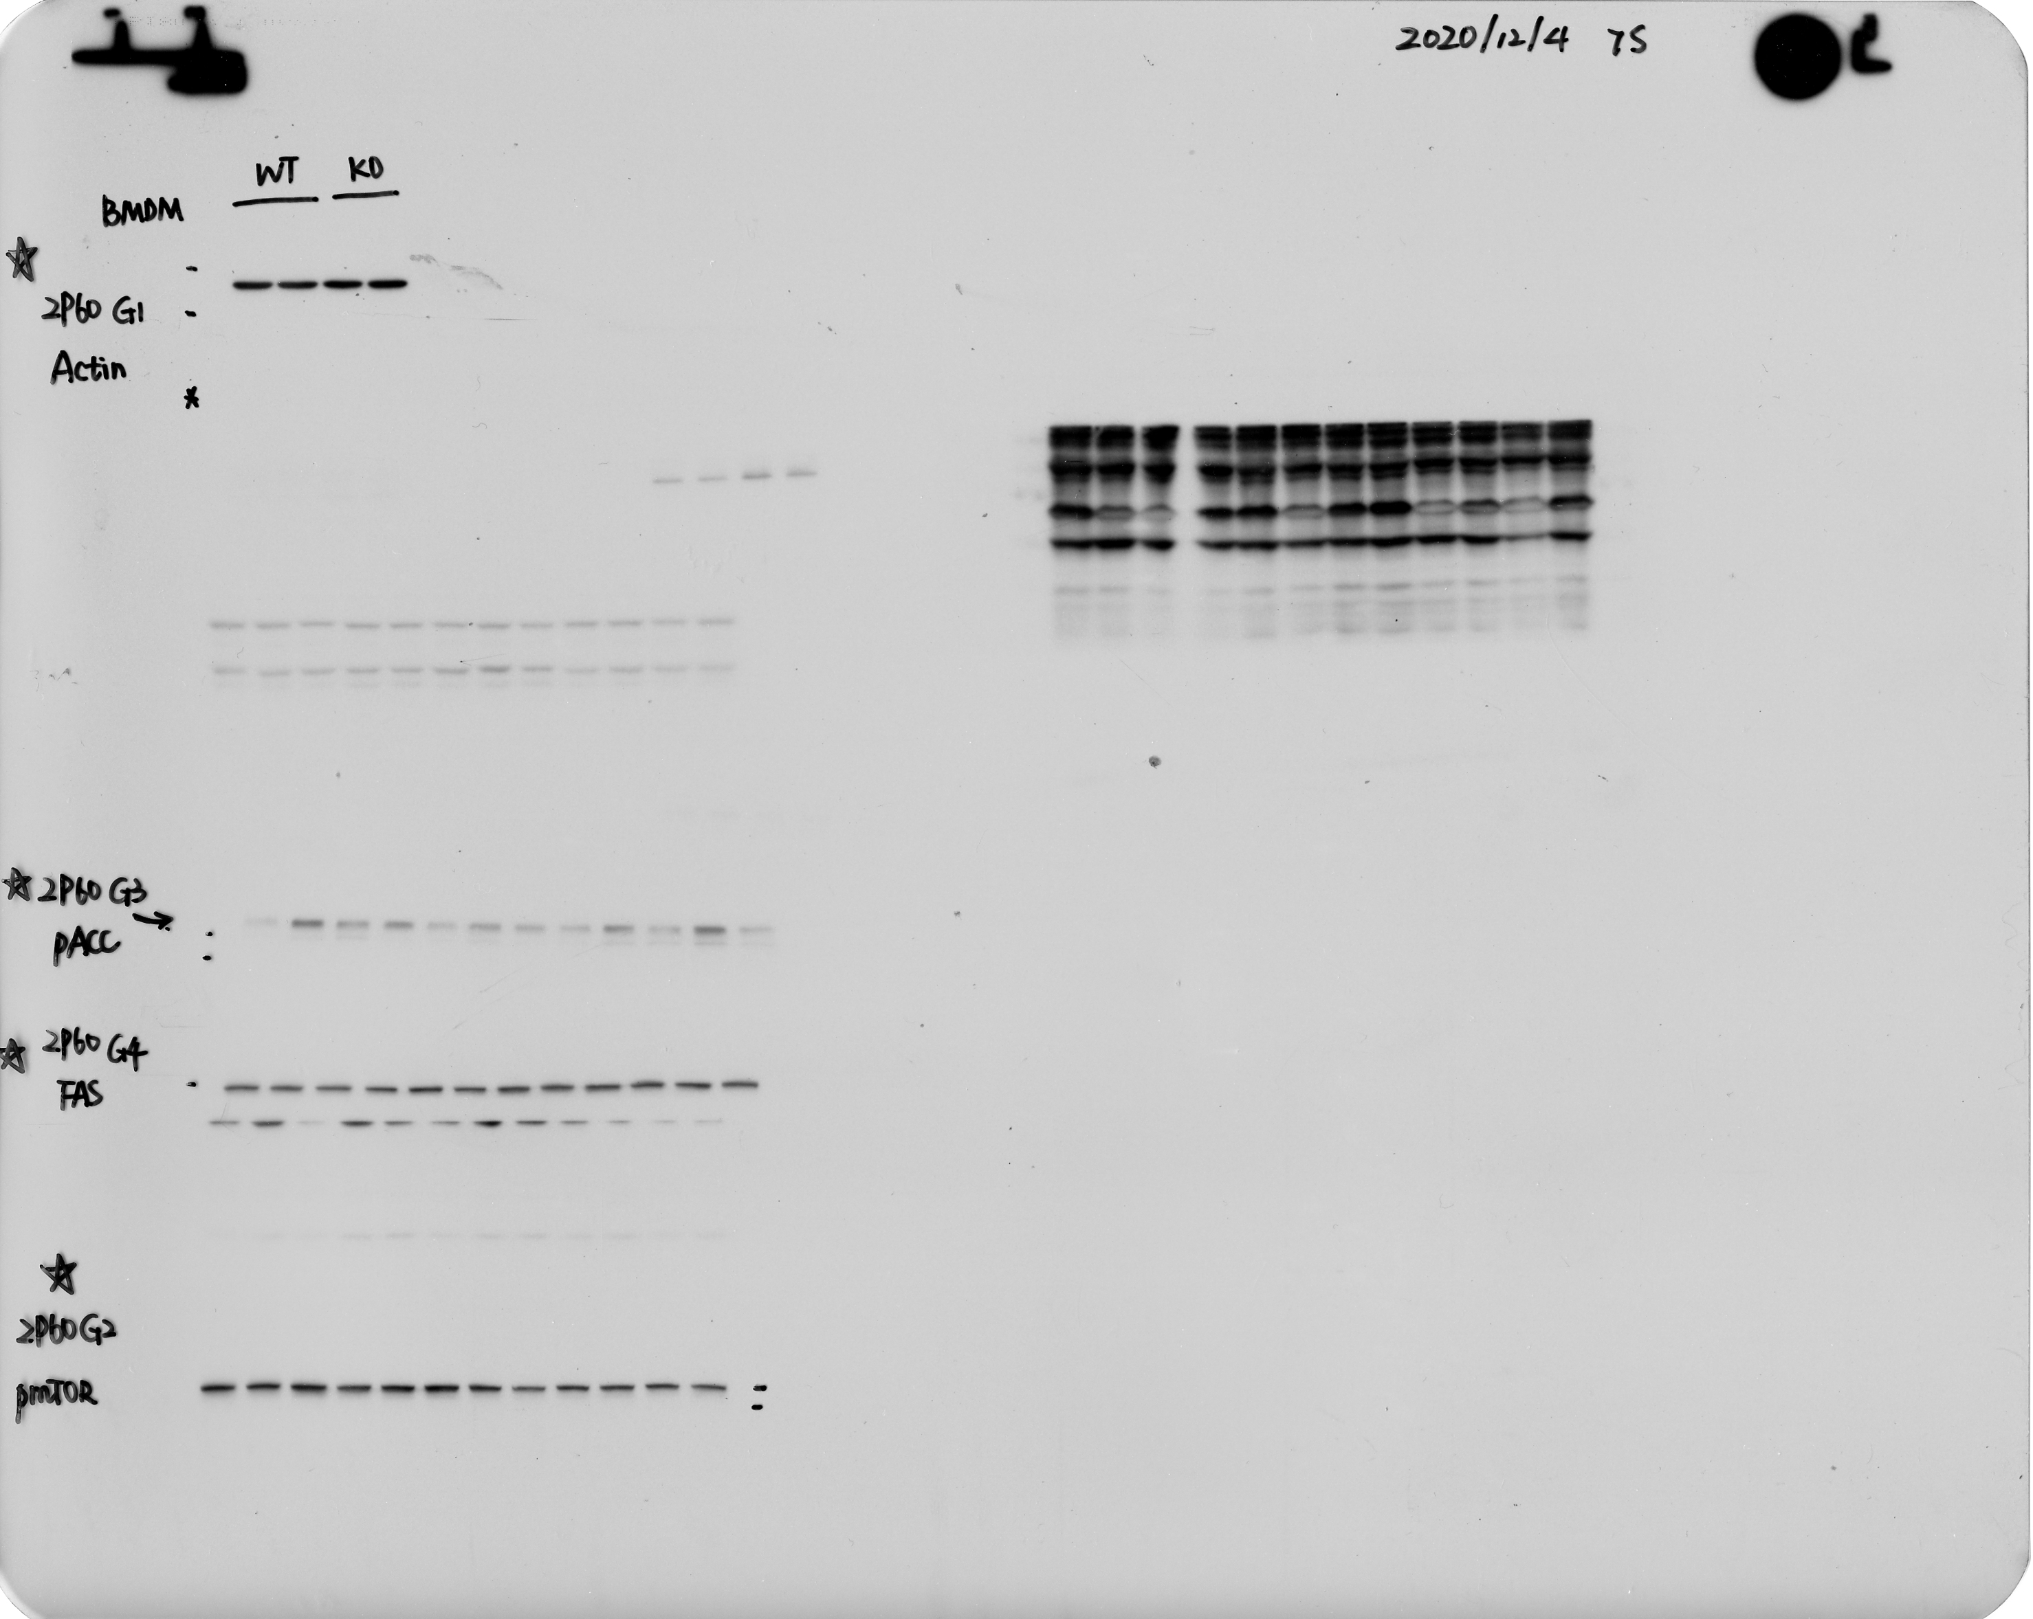
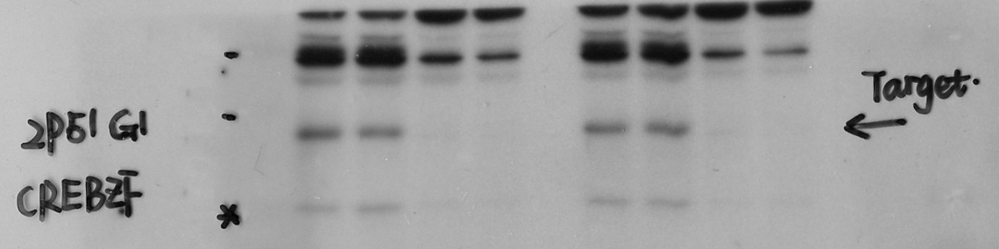
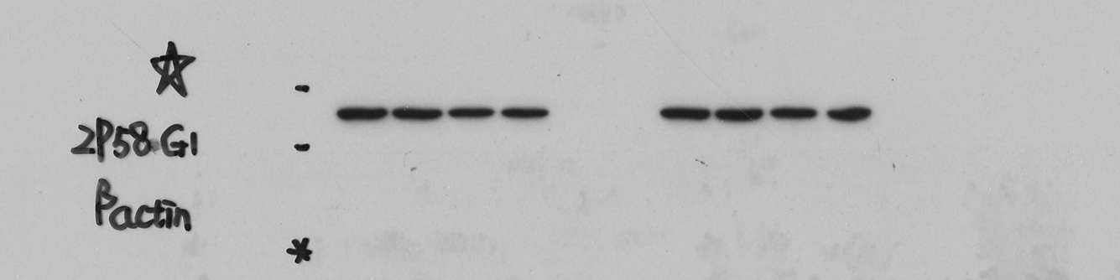
Full unedited blot/gel for Figure S2C
C
WT
KO
WT
KO
CREBZF
T cells
CREBZF
CD4+
T cells
β-actin
WT
KO
β-actin
WT
KO
CREBZF
B cells
CREBZF
CD8+
T cells
β-actin
β-actin
S2C. T cell CREBZF
T cell Actin
50 kD
37 kD
B cell CREBZF
B cell Actin
50 kD
37 kD
CD4+ T cell CREBZF
CD8+ T cell CREBZF
37 kD
37 kD
CD4+ T cell Actin
CD8+ T cell Actin
50 kD

Slide 2









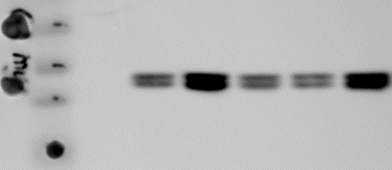
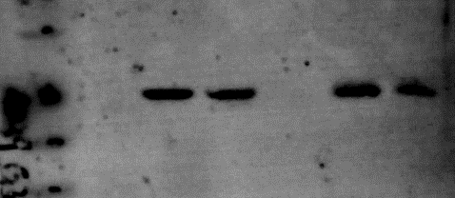
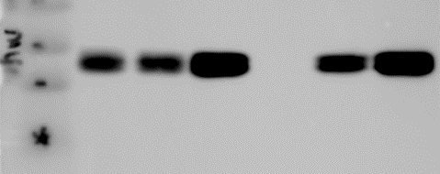
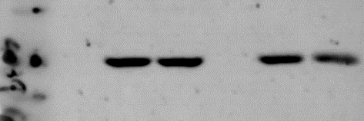
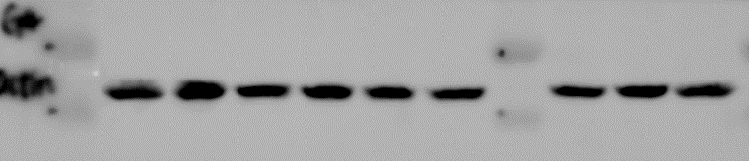
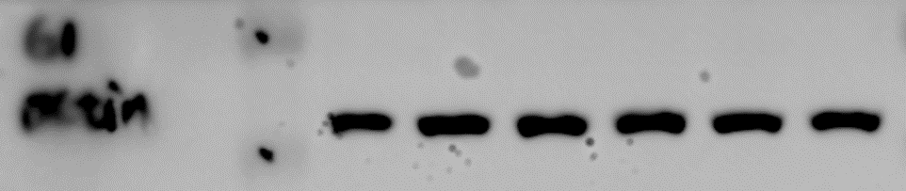
Full unedited blot for Figure S9B, 9C, and 9E
B
C
E
pcDNA + - -
FLAG-c-Jun - + +
myc-CREBZF +
pcDNA
+
-
-
-
-
+
-
-
-
+
-
-
+
-
-
+
+
-
+
+
pcDNA
myc-CREBZF
FLAG-c-Fos
myc-c-Jun
FLAG-tagged
- -
ETS1
ATF1
c-Jun
c-Fos
HIF1a
SMAD3
Foxp3
GST-CREBZF
IP: FLAG
IP: FLAG
IP: FLAG
IB: myc
IB: myc
IB: myc
IB: FLAG
IB: FLAG
IB: FLAG
Lysates
Lysates
Lysates
IB: myc
IB: myc
IB: myc
IB: FLAG
IB: FLAG
IB: FLAG
IB: β-actin
IB: GST
IB: β-actin
S9B.
IP myc
37 kD
50 kD
S9B.
IP FLAG
S9B.
Lysate myc
37 kD
S9B.
Lysate FLAG
50 kD
S9E.
IP myc
S9C.
IP myc
37 kD
37 kD
S9E.
IP FLAG
50 kD
S9C.
IP FLAG
50 kD
S9E.
Lysate myc
37 kD
S9C.
Lysate myc
37 kD
S9E.
Lysate FLAG
50 kD
50 kD
S9C.
Lysate FLAG
S9E.
Lysate GST
37 kD
S9C.
IB: β-actin
50 kD
S9E.
IB: β-actin
50 kD

